Slide 1
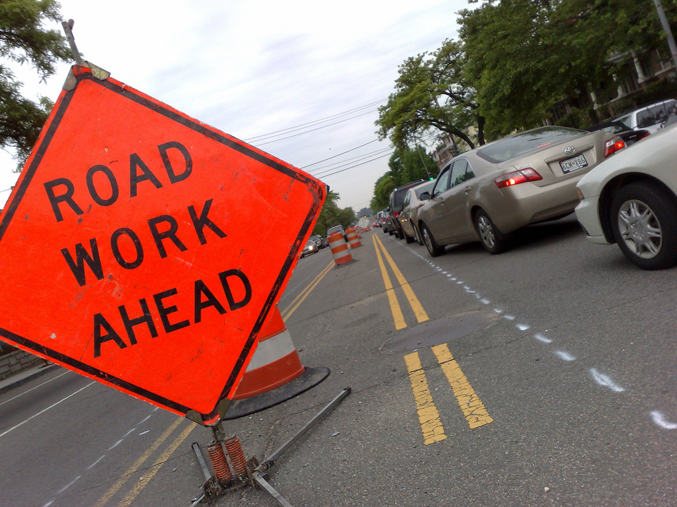
Work Zone Safety Data Collection and Analysis
American Traffic Safety Services Association
Image: ATSSA
Notes:
Key Message: Course opening
Est. Presentation Time: As needed
Explanation of Cues/Builds: None
Suggested Comments: Good morning. I would like to welcome you to the Work Zone Strategies Training Course. My name is (next slide) and I will be your instructor today.
Suggested Questions: Why are we here?
Possible Problems: None

Slide 2
About This Course
The course materials for this training are based upon work supported by the Federal Highway Administration (FHWA) under Grant Agreement DTFH611RA00018, “2016 Work Zone and Guardrail Safety Training Grants.”
Notes:
Key Message: FHWA disclaimer
Est. Presentation Time: Less than 1 minute(s)
Explanation of Cues/Builds: None
Suggested Comments: Self explanatory
Suggested Questions: None
Additional Information: Information about the grant can be found at www.atssa.com
Possible Problems: None

Slide 3
FHWA Work Zone Safety Grant
Develops and provides:
Products
Publications
Training resources (including this one)
National Work Zone Safety Information Clearinghouse
www.workzonesafety.org
Notes:
Key Message: This is a WZ Grant project, and the Grant has many products that could be helpful to your efforts.
Background Information:
Interaction:
Notes:

Slide 4

Developed and Presented by
Notes:
Key Message: Introduce ATSSA
Est. Presentation Time: Less than 1 minute(s)
Explanation of Cues/Builds: None
Suggested Comments: This course is presented to you by ATSSA, a national leader in work zone training.
Suggested Questions: How many of you have taken courses with ATSSA before? Which ones?
Additional Information: None
Possible Problems: Spell out the acronym. Do not assume everyone is familiar.

Slide 5
Work Zone Safety Data Collection and Analysis Course
1.5-day course
Begins promptly at 8:00 AM
Ends tomorrow no later than Noon
Notes:
Key Message: Discuss length of course
Est. Presentation Time: Less than 1 minute(s)
Explanation of Cues/Builds: None
Suggested Comments: Self explanatory
Suggested Questions: None
Additional Information: The class schedule is flexible! Depending on your experience, you may be able to cover the material in less time. Do not feel obligated to stretch the material through the ending time. Timing should be based on your audience’s experience.
Possible Problems: None

Slide 6
Course Objectives
To provide an introduction to work zone safety-related data collection and analysis, how it applies to the Final Rule on Work Zone Safety and Mobility
To introduce work zone data collection methods and discuss barriers to collecting data
To discuss data analysis techniques, tools, and best practices to identifying barriers and overcoming them
Notes:
Key Message: Discuss course objectives
Est. Presentation Time: 1-2 minute(s)
Explanation of Cues/Builds: None
Suggested Comments: Self explanatory
Suggested Questions: Are these the objectives you expect from this course?
Additional Information: None
Possible Problems: None

Slide 7
Workshop Agenda
1 | Overview of the Guide Overview Objectives
2 | Work Zone Safety Related Data Collection Data Collection Background Types of Data Elements to Collect Data Sampling and Collection Methods Barriers to Work Zone Data Collection Data Collection Practices
Notes:
Key Message: Discuss course format and modules
Est. Presentation Time: 3 minute(s)
Explanation of Cues/Builds: None
Suggested Comments: These are modules we will cover. The notebook follows the structure of the course, module by module.
Suggested Questions: None
Additional Information: Briefly discuss the content of each module and what will be covered. Try to “wet their appetite” with the information to come. Describe how each module builds unto the next.
Possible Problems: Avoid giving details. Do this in general terms and keep moving.

Slide 8
Workshop Agenda (cont.)
3 | Work Zone Safety Related Data Analysis Challenges to Work Zone Safety Related Data Analysis Data Analysis Tools and Techniques
4 | Applications Applications & Case Studies
5 | Your Turn Next Steps and Action Plan Knowledge Check
Notes:
Key Message: Discuss course format and modules
Est. Presentation Time: 3 minute(s)
Explanation of Cues/Builds: None
Suggested Comments: These are modules we will cover. The notebook follows the structure of the course, module by module.
Suggested Questions: None
Additional Information: Briefly discuss the content of each module and what will be covered. Try to “wet their appetite” with the information to come. Describe how each module builds unto the next.
Possible Problems: Avoid giving details. Do this in general terms and keep moving.

Slide 9
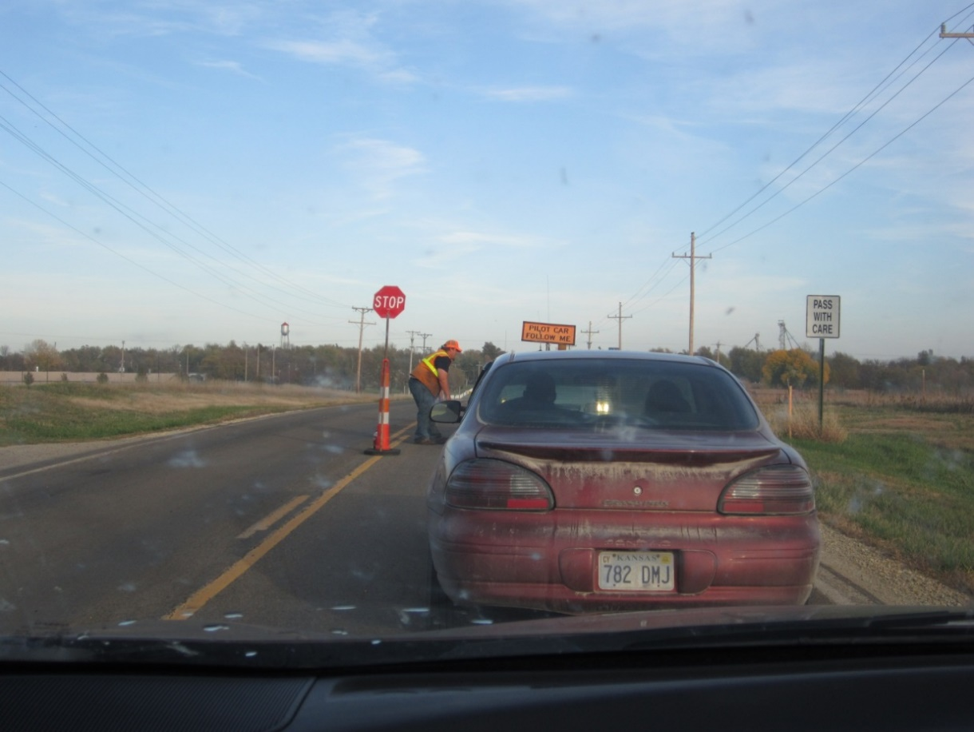

Knowledge Check
Twenty-five (25) True/False questions at four (4) points each
Image: ATSSA
Notes:
Key Message: Commit to immediate actions.
Background Information:
Interaction: Ask attendees to volunteer their next immediate actions based on what they learned today. Take any additional overall questions. Hand back to the host for any final directions for the group.
Notes: This course will only help your work zones if you take action based on what you’ve learned. Commit to pursuing something you’ve learned today, and to taking the first step.

Slide 10
Self Introductions
Name
Agency
Role
Experience with work zone data
What work zone data issue would you like to address today?
Notes:
Key Message: Introduction of participants
Est. Presentation Time: Depending on the number of participants
Explanation of Cues/Builds: None
Suggested Comments: Please tell your name, who you work for, the city and state where you work and the type of work you do.
Suggested Questions: None
Additional Information: This is important, to know the experience of those in the class. Do not skip it!
Possible Problems: Keep this moving. If a student starts to ramble, point to the next person and move on.

Slide 11
About your ATSSA Instructor
Notes:
Key Message: Introduce yourself
Est. Presentation Time: 1-2 minute(s)
Explanation of Cues/Builds: None
Suggested Comments: As I said earlier, my name is _______. I have been teaching for ATSSA for ___ years. I got my experience working for _____ where I worked for __ years. You may call me by my first name.
Suggested Questions: None
Additional Information: The purpose of this is to establish credibility as an instructor. Limit the experience listed to things related to work zone safety.
Possible Problems: Too much of a resume here may create the impression that you are above your audience and may be a barrier to communication. Say that you welcome questions.

Slide 12
Housekeeping
Cell phones off/silent
No texting
Restroom location
Emergency exits
10-min break every hour
Lunch arrangements
Ending time
Notes:
Key Message: Housekeeping rules
Est. Presentation Time: Less than 1 minute(s)
Explanation of Cues/Builds: None
Suggested Comments: Self explanatory
Suggested Questions: None
Additional Information: Make sure you go through the emergency exit procedures. This reinforces safety!
Possible Problems: If lunch is provided, change the slide as needed.

Slide 13
Notes
Any opinions, findings, conclusions or recommendations expressed in this course are those of the trainer and the grantee and do not necessarily reflect the view of FHWA
This course does not constitute a national standard, specification or regulation
Notes:
Key Message: Disclaimer
Est. Presentation Time: Less than 1 minute(s)
Explanation of Cues/Builds: None
Suggested Comments: Self explanatory
Suggested Questions: None
Additional Information: None
Possible Problems: Don’t read this, just say it in a fast manner.

Slide 14
The “Parking Lot”
Questions to be discussed later will be “parked” until they are discussed
Will review at the end to make sure they were answered
Notes:
Key Message: Explain the “parking lot”
Est. Presentation Time: 2 minute(s)
Explanation of Cues/Builds: None
Suggested Comments: As we go through the class, for sure you will have questions. If you ask a question about a topic that we will discuss later, rather than discussing the topic then, we will “park it” by writing it down in the flip chart, so we do not forget. At the end of the course, we will review the “parking lot” to make sure the question was answered.
Suggested Questions: None
Additional Information: Remember this concept may have been used in other course, so keep this brief.
Possible Problems: If there is no flip chart, use a corner of a blackboard or ask a student to keep a list of questions. You may also have a PowerPoint file open to serve as a “parking lot”.

Slide 15
1. Introduction
Work Zone Safety Data
Collection and Analysis
Image: ATSSA
Notes:
Key Message: Module opening
Est. Presentation Time: As needed
Explanation of Cues/Builds: None
Suggested Comments: Let’s discuss {module name}
Suggested Questions: None
Possible Problems: None

Slide 16
Module Objectives
Quantify the work zone safety problem
Discuss the importance of a work zone data collection process
Introduction and objectives of the Guide
Notes:
Key Message: State the module objectives
Est. Presentation Time: Less than 1 minute(s)
Explanation of Cues/Builds: None
Suggested Comments: None
Suggested Questions: None
Additional Information: None
Possible Problems: None

Slide 17
Traffic Safety: Is There a Problem?
891 work zone fatalities in 2022
94 worker fatalities
Source: National Work Zone Safety Information Clearinghouse
Notes:
Key Message: Quantify the safety problem in the USA and in the state
Est. Presentation Time: 2 minute(s)
Explanation of Cues/Builds: None
Suggested Comments: Traffic safety is a serious problem in the US and around the world.
Suggested Questions: Before showing the slide, may ask: How many people die in US work zones every year? After saying approximately 38,000, may say that 58,000 US soldiers were lost at the Vietnam War, or that 40,000 attend an NFL game every week. Try to relate the number to a group of people they can visualize or relate to.
Additional Information: Worker fatalities are included in the “pedestrian” category. For specific state statistics, go to http://www.workzonesafety.org/crash_data/
Other information to be used at the discretion of the instructor.
Possible Problems: This slide reflect the LATEST known data. This is usually 1 or 2 years behind. As new data are released, we will update this slide.
State 2017 Data:
Alabama 948 948
Alaska 79 79
Arizona 1000 1,000
Arkansas 493 493
California 3602 3,602
Colorado 648 648
Connecticut 278 278
Delaware 119 119
District of Columbia 31 31
Florida 3112 3,112
Georgia 1540 1,540
Hawaii 107 107
Idaho 244 244
Illinois 1097 1,097
Indiana 914 914
Iowa 330 330
Kansas 461 461
Kentucky 782 782
Louisiana 760 760
Maine 172 172
Maryland 550 550
Massachusetts 350 350
Michigan 1030 1,030
Minnesota 357 357
Mississippi 690 690
Missouri 930 930
Montana 186 186
Nebraska 228 228
Nevada 309 309
New Hampshire 102 102
New Jersey 624 624
New Mexico 379 379
New York 999 999
North Carolina 1412 1,412
North Dakota 115 115
Ohio 1179 1,179
Oklahoma 655 655
Oregon 437 437
Pennsylvania 1137 1,137
Rhode Island 83 83
South Carolina 988 988
South Dakota 129 129
Tennessee 1040 1,040
Texas 3722 3,722
Utah 273 273
Vermont 69 69
Virginia 839 839
Washington 565 565
West Virginia 303 303
Wisconsin 613 613
Wyoming 123 123
Total 37,133 37,133

Slide 18
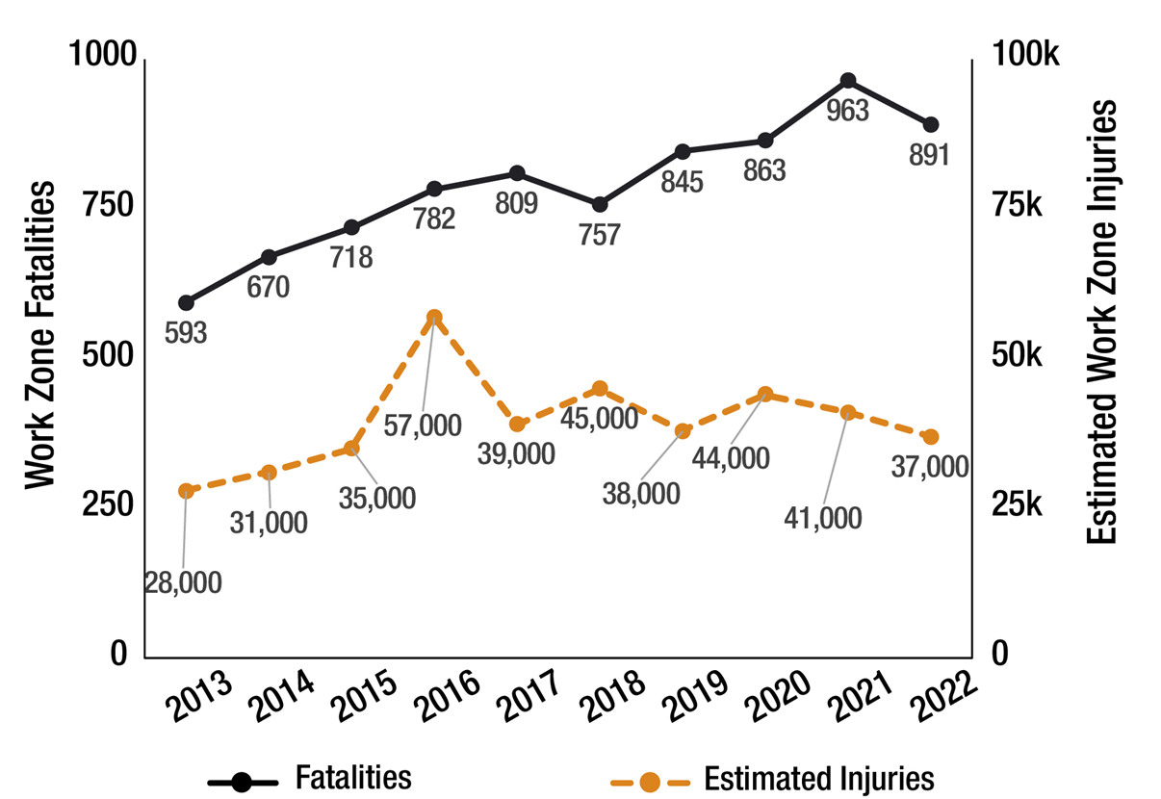
USA Work Zone Fatalities: 2013-2022
Source: National Work Zone Safety Information Clearinghouse
Notes:
Key Message: Quantify WZ fatalities in the USA
Est. Presentation Time: 1-2 minute(s)
Explanation of Cues/Builds: None
Suggested Comments: We reached an all-time high in work zones fatalities in 2002. Since then, the numbers have declined but they are on the upswing again! We can still do better!
Suggested Questions: Do you see any trends?
Additional Information: These figures include both workers, motorists and pedestrians. http://www.workzonesafety.org/crash_data/
2017 STATE DATA: Format 3 numbers):
FATALITIES IN MOTOR VEHICLE TRAFFIC CRASHES IN WORK ZONE BY STATE AND YEAR
FATALITY ANALYSIS REPORTING SYSTEM (FARS) 2016 FINAL AND 2017
(State, 2016 fatalities, 2017 fatalities, 2016+2017)
Alabama 13 24 37
Alaska 2 0 2
Arizona 9 15 24
Arkansas 14 21 35
California 75 48 123
Colorado 7 17 24
Connecticut 5 6 11
Delaware 2 3 5
Dist of Columbia 0 1 1
Florida 80 76 156
Georgia 41 60 101
Hawaii 3 3 6
Idaho 0 7 7
Illinois 44 27 71
Indiana 18 28 46
Iowa 11 10 21
Kansas 6 12 18
Kentucky 11 15 26
Louisiana 12 11 23
Maine 1 5 6
Maryland 5 14 19
Massachusetts 6 2 8
Michigan 18 25 43
Minnesota 12 10 22
Mississippi 7 4 11
Missouri 8 15 23
Montana 1 1 2
Nebraska 13 8 21
Nevada 14 14 28
New Hampshire 3 0 3
New Jersey 7 6 13
New Mexico 8 4 12
New York 8 3 11
North Carolina 13 11 24
North Dakota 6 0 6
Ohio 27 25 52
Oklahoma 17 12 29
Oregon 7 3 10
Pennsylvania 16 20 36
Rhode Island 1 1 2
South Carolina 4 20 24
South Dakota 1 1 2
Tennessee 13 10 23
Texas 172 165 337
Utah 5 5 10
Vermont 1 0 1
Virginia 12 11 23
Washington 7 4 11
West Virginia 1 2 3
Wisconsin 11 9 20
Wyoming 3 5 8
National 781 799 1,580
Puerto Rico 1 0 1

Slide 19
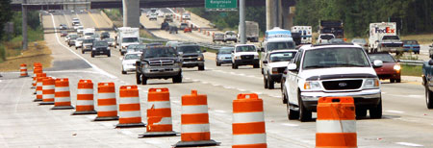
Overview of Problem: Crashes and Strategies
Final Rule on Work Zone Safety and Mobility provides strategies to limit work zone (WZ) impacts
Section 630.1008: requires use of work zone data at the project and program levels to enhance work zone safety and mobility
Image: ATSSA
Notes:
Key Message: Sustained effort towards improving work zone safety using the tools of the workshop is a proven strategy
Background Information:
Final Rule on Work Zone Safety and Mobility published 2004 by FHWA
To focus on WZ impacts, methods, and strategies to limit these impacts
Work zone fatalities have decreased by nearly half.
o help agencies implement these approaches in the most effective manner, Section 630.1008 of the Rule requires agencies to use work zone data at the project and program levels to enhance work zone safety and mobility.
Continuous Improvement: Section 630.1008(c): “States shall use field observations, available work zone crash data, and operational information to manage work zone impacts for specific projects during implementation. States shall continually pursue improvement of work zone safety and mobility by analyzing work zone crash and operational data from multiple projects to improve State processes and procedures.”
FHWA developed guidance documents: Rule Implementation Guide, a Work Zone Impacts Assessment Guide, a technical guidance document on transportation management plans (TMPs) for work zones, and a technical guidance document on work zone public information and outreach strategies.
Interaction: Discuss highlights of the state’s own data and engage them in a conversation about their state of the practice in work zone safety – especially as it relates to data collection, analysis, and application.

Slide 20

FHWA Guidance
Rule Implementation Guide
Impacts Assessments
Transportation Management Plans (TMPs)
Image: FHWA
Notes:
Key Message: Sustained effort towards improving work zone safety using the tools of the workshop is a proven strategy
Background Information:
Final Rule on Work Zone Safety and Mobility published 2004 by FHWA
To focus on WZ impacts, methods, and strategies to limit these impacts
Work zone fatalities have decreased by nearly half.
o help agencies implement these approaches in the most effective manner, Section 630.1008 of the Rule requires agencies to use work zone data at the project and program levels to enhance work zone safety and mobility.
Continuous Improvement: Section 630.1008(c): “States shall use field observations, available work zone crash data, and operational information to manage work zone impacts for specific projects during implementation. States shall continually pursue improvement of work zone safety and mobility by analyzing work zone crash and operational data from multiple projects to improve State processes and procedures.”
FHWA developed guidance documents: Rule Implementation Guide, a Work Zone Impacts Assessment Guide, a technical guidance document on transportation management plans (TMPs) for work zones, and a technical guidance document on work zone public information and outreach strategies.
Interaction: Discuss highlights of the state’s own data and engage them in a conversation about their state of the practice in work zone safety – especially as it relates to data collection, analysis, and application.

Slide 21
Overview of Problem: Implementation Challenges
Resource limitations
Difficulty…
Lack of confidence in treatment selection
Inconsistent WZ crash report definitions across States
Lack of available detail
Identifying real WZ safety problems
Determining most cost-effective solution
Notes:
Key Message: Acknowledging common issues with crashes in work zones and emphasize during this workshop participants will learn strategies to effectively improve the safety of their work zones
Background Information:
Implementation challenges include resource limitations, inconsistent work zone definitions in State crash reports, and lack of available detail.
It can be difficult for agencies to identify their real work zone safety problems or determine the most cost-effective way to address them.
This leads to a lack of confidence in countermeasure selection, as safety professionals do not always know if their safety efforts are solving an actual or perceived problem.
To address these issues, guidance is needed on the most effective ways to collect and analyze work zone safety-related data in order to identify problems and develop solutions.
In order to reduce the number and severity of work zone crashes, it is important to know the size and scope of the problem. This can be determined through the collection and analysis of work zone safety-related data.
Interaction:
Notes: Could use the State’s own crash data to highlight this section and tie back to the previous slide.

Slide 22
Data Collection Process
Collecting and analyzing work zone data does not itself reduce crashes, but may lead to effective treatments that do
Agencies and practitioners can improve safety in work zones by walking through the following process:
Notes:
Key Message: Lays the groundwork and emphasizes the importance of a process
Background Information:
Agencies and practitioners can improve safety in work zones by walking through the following process:
Collection and analysis of WZ safety-related data help identify work zone safety issues, establish the size and scope of the problem, and provide clues regarding countermeasures.
Guide designed around the following process:
Identify Agency Objectives. Objectives must be defined prior to the start of any data collection or analysis process. These objectives can be defined broadly (e.g., increase safety in work zones) or specifically (e.g., decrease work zone crashes in nighttime work zones by 10 percent).
Identify Data Needs. Practitioners must determine which data are required for relevant analysis.
Develop Baseline. Work zone practitioners need to identify and analyze the current level of work zone safety-related data collection and analysis in their home state.
Identify Strategies. Practitioners can learn strategies and techniques currently being implemented around the country and determine if similar strategies are feasible in their State.
Take Next Steps. Practitioners should identify and begin taking steps to improve work zone safety-related data collection, analysis, and implementation.
Collecting and analyzing work zone data may not lead to a direct improvement. It may show areas for future improvement.
Example: study of work zone queue lengths may uncover that end of queue crashes warrant additional study.

Slide 23
The Process
Identify Agency Objectives
Identify Data needs
Develop Baseline
Identify Strategies
Take next Steps
Notes:
Key Message: Lays the groundwork and emphasizes the importance of a process
Background Information:
Agencies and practitioners can improve safety in work zones by walking through the following process:
Collection and analysis of WZ safety-related data help identify work zone safety issues, establish the size and scope of the problem, and provide clues regarding countermeasures.
Guide designed around the following process:
Identify Agency Objectives. Objectives must be defined prior to the start of any data collection or analysis process. These objectives can be defined broadly (e.g., increase safety in work zones) or specifically (e.g., decrease work zone crashes in nighttime work zones by 10 percent).
Identify Data Needs. Practitioners must determine which data are required for relevant analysis.
Develop Baseline. Work zone practitioners need to identify and analyze the current level of work zone safety-related data collection and analysis in their home state.
Identify Strategies. Practitioners can learn strategies and techniques currently being implemented around the country and determine if similar strategies are feasible in their State.
Take Next Steps. Practitioners should identify and begin taking steps to improve work zone safety-related data collection, analysis, and implementation.
Collecting and analyzing work zone data may not lead to a direct improvement. It may show areas for future improvement.
Example: study of work zone queue lengths may uncover that end of queue crashes warrant additional study.

Slide 24
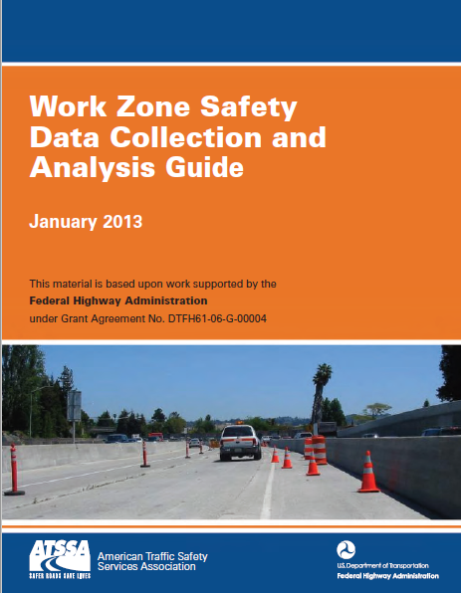
Overview of the Guide
Describes:
Work zone crash data collection and reporting process
Benefits and challenges in developing a unified system across the states
Image: ATSSA
Notes:
Key Message: Focus on the Guide as a go-to manual for agencies
Background Information: Work Zone Safety Data Collection and Analysis Guide
1. Introduction and Objectives of the Guide: Provides readers with an introduction to work zone safety-related data collection and analysis, how it applies to the Final Rule on Work Zone Safety and Mobility, and guide objectives.
2. Work Zone Data Collection: Introduces work zone data collection methods and confronts barriers to collecting data; and contains successful examples.
3. Data Analysis: Focuses on data analysis techniques, tools, and best practices to identifying barriers and overcoming them.
4. Application: Provides guidance on implementation strategies.
5. Your Turn: Provide agencies an opportunities to develop next steps.
Conclusion: Summarizes the guide and relates the previous four sections back to the overall objectives.
Notes: Final Rule on Work Zone Safety and Mobility – pertains to federal-aid projects, and States are encouraged to incorporate provisions on other projects.
Final Rule on Work Zone Safety and Mobility Brochure: http://ops.fhwa.dot.gov/wz/resources/fr_brochure.htm

Slide 25
Overview of the Guide
Background
Work Zone Data Collection and Reporting
Best Practices
Crash Data Reporting
Challenges
Work Zone Crash Data Analysis
Conclusion and Recommendations
Image: ATSSA
Notes:
Key Message: Focus on the Guide as a go-to manual for agencies
Background Information: Work Zone Safety Data Collection and Analysis Guide
1. Introduction and Objectives of the Guide: Provides readers with an introduction to work zone safety-related data collection and analysis, how it applies to the Final Rule on Work Zone Safety and Mobility, and guide objectives.
2. Work Zone Data Collection: Introduces work zone data collection methods and confronts barriers to collecting data; and contains successful examples.
3. Data Analysis: Focuses on data analysis techniques, tools, and best practices to identifying barriers and overcoming them.
4. Application: Provides guidance on implementation strategies.
5. Your Turn: Provide agencies an opportunities to develop next steps.
Conclusion: Summarizes the guide and relates the previous four sections back to the overall objectives.
Notes: Final Rule on Work Zone Safety and Mobility – pertains to federal-aid projects, and States are encouraged to incorporate provisions on other projects.
Final Rule on Work Zone Safety and Mobility Brochure: http://ops.fhwa.dot.gov/wz/resources/fr_brochure.htm

Slide 26
2. Work Zone Safety-Related Data Collection
Work Zone Safety Data
Collection and Analysis
Image: ATSSA
Notes:
Key Message: Module opening
Est. Presentation Time: As needed
Explanation of Cues/Builds: None
Suggested Comments: Let’s discuss {module name}
Suggested Questions: None
Possible Problems: None

Slide 27
Module Objectives
Discuss core elements of data collection
Determine what types of work zone data elements to collect
List sampling and collection methods
Identify barriers to work zone data collection
Identify data collection practices to address these barriers.
Notes:
Key Message: State the module objectives
Est. Presentation Time: Less than 1 minute(s)
Explanation of Cues/Builds: None
Suggested Comments: None
Suggested Questions: None
Additional Information: None
Possible Problems: None

Slide 28
Step 1
Agencies must identify objectives before deciding on data elements to collect
Identify Agency Objectives
Identify Data needs
Develop Baseline
Identify Strategies
Take next Steps
Notes:
Key Message: Objectives with reasonable, and measurable goals help focus efforts
Background Information: SHSP may list some objectives for work zones
Examples of agency objectives
Increase safety in work zones
Decrease work zone crashes in nighttime work zones by 10 percent
Interaction: EXERCISE #1: Ask class what WZ objectives they have now, and how data collection helps achieve objectives. Use flip chart to record answers.
Notes:

Slide 29
EXERCISE #1:
What issues are we attempting to address?
What are our objectives?
How will data collection help?
Who should know these?
How would you ensure understanding?
Notes:
Key Message: Importance of understanding of these objectives and how these interweave throughout the workshop.
Background Information:
Who: Multi-discipline: Construction inspectors, consultants, contractor’s traffic control supervisors, local agencies, designers, law enforcement.
What:
Examples of agency objectives
Increase safety in work zones
Decrease work zone crashes in nighttime work zones by 10 percent
Interaction: Ask the two questions on the slide. Also ask, “What strategies would you suggest towards communicating your agencies work zone objectives?”
Notes:

Slide 30
Step 2
Identify the data elements that are necessary to accomplish and/or monitor the agency’s objectives
Identify Agency Objectives
Identify Data needs
Develop Baseline
Identify Strategies
Take next Steps
Notes:
Key Message: Identifying data needs starts with knowing the elements necessary to accomplish the objectives.
Background Information:
Interaction: What is the most important work zone safety-related data that should be collected?
Ask the group what their most important elements are. Answer may include day-of-week, time-of-day, crash type, etc.
Notes:

Slide 31
Data Collection Background
Collect crash data to…
Learn more about the causes of a crash and how to address
Apply changes to current and future work zones to prevent future crashes
Collect speed data to…
Address a contributing factor in 25% of WZ fatal crashes
Identify when it is combined with inattention and changing roadway conditions
Notes:
Key Message: Begin to zero in on what is collected and what common attributes may exist
Background Information:
Interaction: Any other circumstances which could be important? For example, there could be a link between impaired driving crashes and the location of nearby entertainment districts.
Notes:
Federal Highway Administration, Practitioner-focused Online Collaborative Session, August 31, 2011.
http://www.nsc.org/safety_road/DriverSafety/Pages/Speeding.aspx

Slide 32
Data Collection Background
Collect queue data to…
Determine how it contributes to WZ crashes due to speed differentials
Identify potential locations and WZ types for treatment.
Collect mobility data to…
Identify potential risk of future WZ crashes
Incorporate metrics for travel delay and congestion, which can lead to queuing.
Notes:
Key Message: Begin to zero in on what is collected and what common attributes may exist
Background Information:
Interaction: Any other circumstances which could be important? For example, there could be a link between impaired driving crashes and the location of nearby entertainment districts.
Notes:
Federal Highway Administration, Practitioner-focused Online Collaborative Session, August 31, 2011.
http://www.nsc.org/safety_road/DriverSafety/Pages/Speeding.aspx

Slide 33
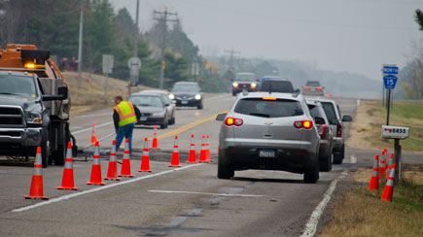
Work zone crashes affect:
Drivers
Passengers
Pedestrians, including the disabled
Bicyclists
Workers
Image: ATSSA
Notes:
Key Message: Moving from high level to specific target areas
Background Information:
Circles show where the types of crash data overlap. Personal decisions are a major contributor to crashes: Inattention, speeding.
Interaction:
Notes:

Slide 34
Categories of Crash Data
Crash Level
Person Level
Vehicle Level
Notes:
Key Message: Moving from high level to specific target areas
Background Information:
Circles show where the types of crash data overlap. Personal decisions are a major contributor to crashes: Inattention, speeding.
Interaction:
Notes:

Slide 35
Work Zone Crash Elements
Severity level of injury for all persons involved
Time and location of crash
Weather, light conditions
Traffic elements (speed, volume, queuing)
Contributing circumstances
Roadway geometry and other characteristics
Work zone – layout, crash location
Notes:
Key Message: Crash data may be fairly easy to collect. Collecting appropriate information is essential for later evaluation.
Background Information:
Crash frequency
Crash severity (motorists and workers)
Crash location, time of day/day of week (including location within the WZ)
Crash narrative
Involvement of pedestrian(s) or bicyclist(s)
Weather conditions / Light condition (daylight, dark, street lights)
Type of work operation; Type of traffic control and layout
Queue length (if present)
Traffic speed
Roadway geometry and characteristics
Crash type (rear-end, run-off-road, pedestrian/worker-related, etc.) and causation
Interaction: What are some easy ways to document a crash? Photographs, sketch crash details on the plan layout of TCP
Notes: Provide them with a checklist which could be a “Best Practice” from other states.

Slide 36
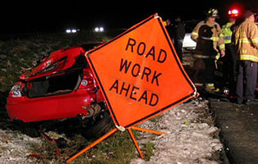
Vehicle Data Elements
Vehicle type
Number of occupants
Travel direction prior to crash
Sequence of events leading to crash
Image: ATSSA
Notes:
Key Message: (Continued from previous slide) Collecting appropriate information is essential for later evaluation.
Background Information:
Age is consistent concern: Younger drivers make poor decisions; mature drivers suffer higher consequences.
Staged construction and changing travel direction can upset GPS devices and the commands or directions offered to drivers.
Interaction: Ask participants to define “impairment.” Prescription drugs are contributing to crashes similar to alcohol 20 years ago.
Notes:

Slide 37
Person Data Elements
Driver age
Contributing factors
Impairment
Inattention
Speeding
Notes:
Key Message: (Continued from previous slide) Collecting appropriate information is essential for later evaluation.
Background Information:
Age is consistent concern: Younger drivers make poor decisions; mature drivers suffer higher consequences.
Staged construction and changing travel direction can upset GPS devices and the commands or directions offered to drivers.
Interaction: Ask participants to define “impairment.” Prescription drugs are contributing to crashes similar to alcohol 20 years ago.
Notes:

Slide 38
Exposure Information
What if crash data are not available or accurate?
Length of work zone
Duration of work activity, lane closure, other impacts
Surrogate safety measures…
Notes:
Key Message: Think through the situation at the time of the crash to ensure all information is captured.
Background Information: Exposure information: Duration, Length
Interaction: What are other impacts which are not listed?
Examples: Dust from construction, water coming off site, sudden changes in ambient temperature, document where skidding occurs.
Notes:

Slide 39
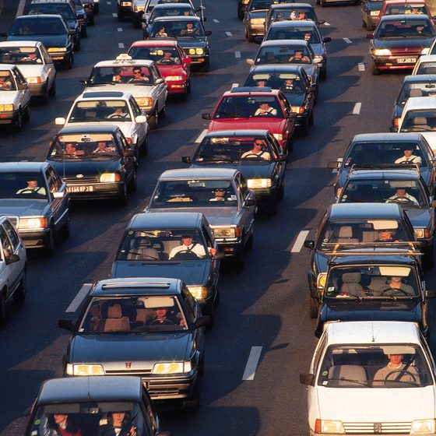
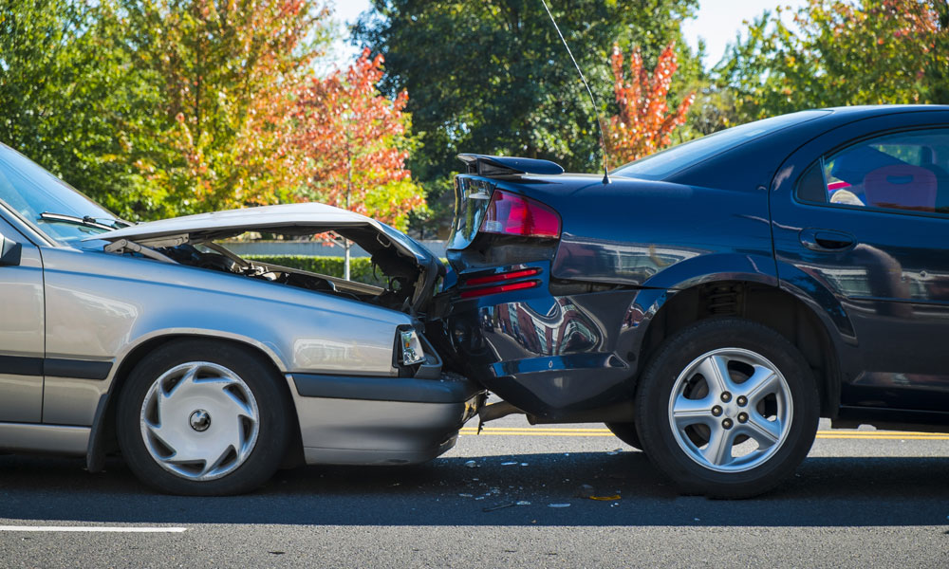
Queues
Disrupt the flow of traffic
Contribute, sometimes severely, to many work zone crashes
Especially so if the queue lengths are dynamic
May lead to secondary crashes
Images: ATSSA
Notes:
Key Message: Back-of-queue crashes are one of the leading WZ crash types. Capturing information related to queues can provide practitioners information to help them develop countermeasures for this common crash.
Background Information:
Queues contribute to WZ crashes: Federal Highway Administration, Practitioner-focused Online Collaborative Session, August 31, 2011.
Queue data elements include queue length, queue duration: Texas Transportation Institute, Monitoring Work Zone Safety and Mobility Impacts in Texas, May 2009
Interaction:
Notes:
Might be opportunity to point causes of queuing from outside of the work zone such as signals downstream or upstream of WZ. Queues can vary widely due to differing times of day; and types of vehicle at the time. Public will adjust travel due to work zone.

Slide 40
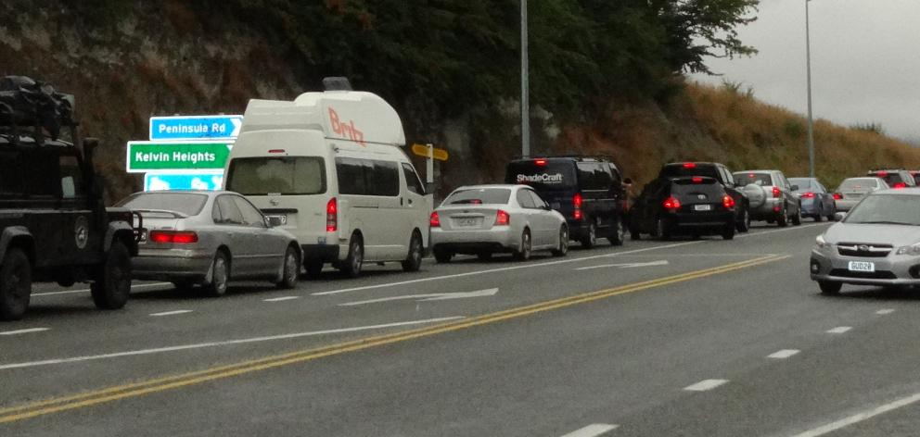
Examples of Queue Data Elements
Queue length
Queue duration
Image: ATSSA
Notes:
Key Message: Back-of-queue crashes are one of the leading WZ crash types. Capturing information related to queues can provide practitioners information to help them develop countermeasures for this common crash.
Background Information:
Queues contribute to WZ crashes: Federal Highway Administration, Practitioner-focused Online Collaborative Session, August 31, 2011.
Queue data elements include queue length, queue duration: Texas Transportation Institute, Monitoring Work Zone Safety and Mobility Impacts in Texas, May 2009
Interaction:
Notes:
Might be opportunity to point causes of queuing from outside of the work zone such as signals downstream or upstream of WZ. Queues can vary widely due to differing times of day; and types of vehicle at the time. Public will adjust travel due to work zone.

Slide 41

Speeding
Contributes to more than 25% of WZ fatal crashes
Combines with
Inattention
Traffic movement, and
Workers in the work zone due to perception-reaction time
Image: FHWA
Notes:
Key Message: Speed is a major contributor to WZ crashes, and it often combines with other issues (e.g., inattention, inadequate traffic control devices, impaired drivers) in those crashes.
Background Information:
Speed contributes to 25% of WZ fatal crashes. http://www.nsc.org/safety_road/DriverSafety/Pages/Speeding.aspx
Interaction:
Notes: Difficulty of accounting for actuals speeds at time of the crash. Be prepared to handle automated speed enforcement questions
Work Zone Mobility and Safety Program website has additional information.
Illinois photo-enforcement program.
Oregon’s photo radar speed enforcement demonstration project.
Maryland SafeZones program.
Virginia Transportation Research Council Report - Work Zone Variable Speed Limit Systems: Effectiveness and System Design Issues.

Slide 42
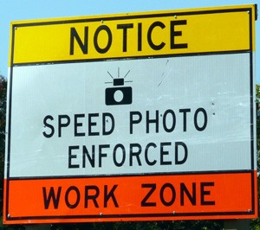
Speed Data Collection Benefits
Identify the potential for future crashes
Proactive
Take action before crashes occur
Image: ATSSA
Notes:
Key Message: Speed is a major contributor to WZ crashes, and it often combines with other issues (e.g., inattention, inadequate traffic control devices, impaired drivers) in those crashes.
Background Information:
Speed contributes to 25% of WZ fatal crashes. http://www.nsc.org/safety_road/DriverSafety/Pages/Speeding.aspx
Interaction:
Notes: Difficulty of accounting for actuals speeds at time of the crash. Be prepared to handle automated speed enforcement questions
Work Zone Mobility and Safety Program website has additional information.
Illinois photo-enforcement program.
Oregon’s photo radar speed enforcement demonstration project.
Maryland SafeZones program.
Virginia Transportation Research Council Report - Work Zone Variable Speed Limit Systems: Effectiveness and System Design Issues.

Slide 43
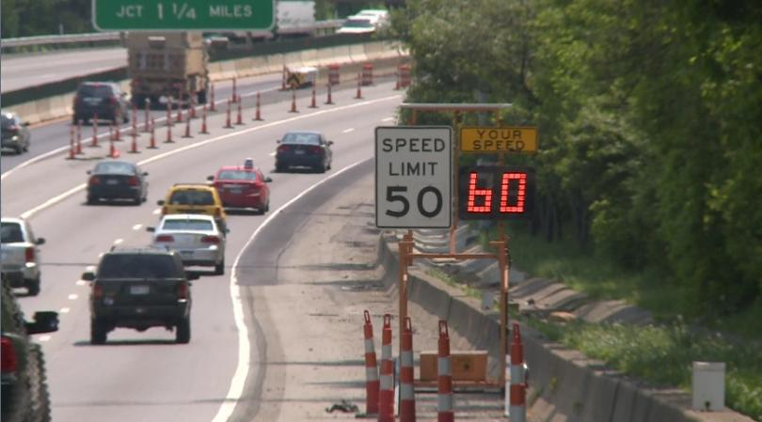
Speed Data Elements
Posted speed
Prevailing speed
85th Percentile
Speed variance
Image: ATSSA
Notes:
Key Message: Speed is a major contributor to WZ crashes, and it often combines with other issues (e.g., inattention, inadequate traffic control devices, impaired drivers) in those crashes.
Background Information:
Speed contributes to 25% of WZ fatal crashes. http://www.nsc.org/safety_road/DriverSafety/Pages/Speeding.aspx
Interaction:
Notes: Difficulty of accounting for actuals speeds at time of the crash. Be prepared to handle automated speed enforcement questions
Work Zone Mobility and Safety Program website has additional information.
Illinois photo-enforcement program.
Oregon’s photo radar speed enforcement demonstration project.
Maryland SafeZones program.
Virginia Transportation Research Council Report - Work Zone Variable Speed Limit Systems: Effectiveness and System Design Issues.

Slide 44
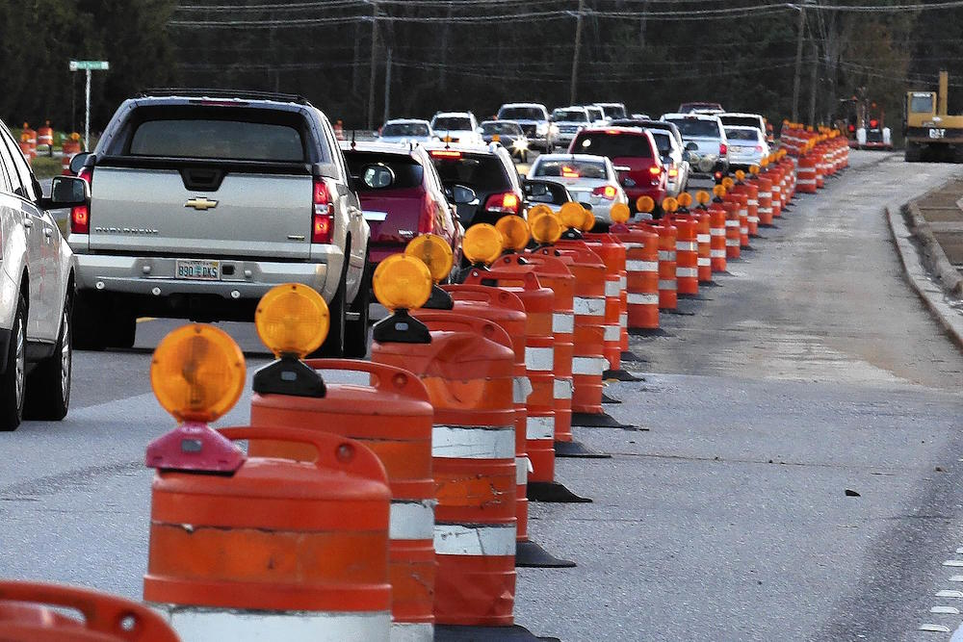
Mobility Data
Can be used as proxy measurements for work zone crash risk
Delay and congestion can lead to queues
Image: ATSSA
Notes:
Key Message: Measuring the impact from reduced capacity due to construction activities can help identify the potential for queuing.
Background Information:
Interaction: What activities generate congestion even during off-peak hours?
Notes:
May point out traffic volumes used for TOD restrictions due to lane closures. In addition, changes in queues may be caused by driver frustrations of work zone

Slide 45
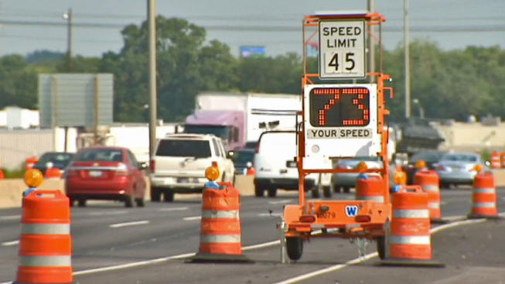
Examples of Mobility Data Elements
Throughput
Delay
Travel time
Image: ATSSA
Notes:
Key Message: Measuring the impact from reduced capacity due to construction activities can help identify the potential for queuing.
Background Information:
Interaction: What activities generate congestion even during off-peak hours?
Notes:
May point out traffic volumes used for TOD restrictions due to lane closures. In addition, changes in queues may be caused by driver frustrations of work zone

Slide 46
Step 3
Assess the agency’s current data collection methods
Identify Agency Objectives
Identify Data needs
Develop Baseline
Identify Strategies
Take next Steps
Notes:
Key Message: Broaden perspective of audience as they move through the course to consider future improvements by looking at current methods.
Background Information:
Interaction:
Consider using a flip chart, writing down general areas of data to collect and a corresponding method with possible pro/con of each.
Keep the chart in view throughout the rest of course for a reference and to point out improvements as you move through case studies and lessons.
What is our agency’s current status regarding data collection?
Notes:
Remind the audience that even simple methods are being used now.
Field diaries: pro/con: easy to use, tradition go to device; but, inaccessible to others, non-standard
Customer complaints: timely but sporadic, exaggerated especially negative
Relationships with other agencies such as freight, and law enforcement
Traditional Methods: various methods of counting from manual to video capture, radar, devices that can be nailed to pavement

Slide 47
Step 4
Explore data collection strategies and sampling methods prior to analysis
Identify Agency Objectives
Identify Data needs
Develop Baseline
Identify Strategies
Take next Steps
Notes:
Key Message: It is important to understand the difference collection strategies and techniques, including their level of effort and the usefulness of the resulting data collected.
Background Information:
Interaction: “As we walk through these data collection techniques, think about which ones would be the most useful and feasible to implement at your agency.”
Notes:

Slide 48
Following are a number of data collection strategies and techniques:
Think: which ones would be the most useful and feasible to implement at your agency?
Notes:
Key Message: It is important to understand the difference collection strategies and techniques, including their level of effort and the usefulness of the resulting data collected.
Background Information:
Interaction: “As we walk through these data collection techniques, think about which ones would be the most useful and feasible to implement at your agency.”
Notes:

Slide 49
Data Sampling: Factors
Sample size
Set of work zone locations
Significant projects
Higher-volume roads
Longer-duration projects
Set of metrics to collect
Queues
Traffic volume
Crash data
Frequency of collection
Notes:
Key Message: We cannot collect all data on every work zone, so we must use sampling techniques to identify a representative sample for analysis.
Background Information:
Interaction: The slide will pop up with the subheadings. Ask the group, “How would you choose locations?” and “What metrics would you collect?”
Notes:

Slide 50
Data Sampling: Frequency Tradeoffs
Cost to collect data
Time to collect data
Safety: workers, road users, data collectors
Identify data usefulness to ensure efficient use of resources
BENEFIT
COST
Notes:
Key Message: There are tradeoffs when making decisions about data sampling. We must balance benefits and cost to efficiently use limited resources.
Background Information:
Interaction: “What are some of the tradeoffs you must make when determine where to collect WZ data, what to collect, and how often?”
Notes:

Slide 51
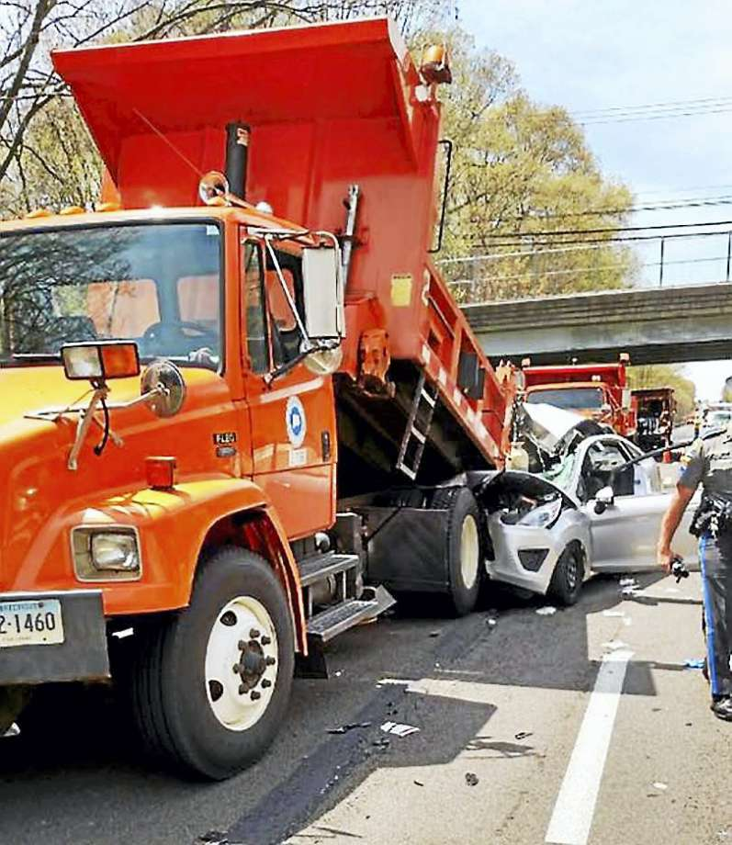
Data Sampling: Crash Curves to Monitor WZ Safety
Used to determine how frequently work zone crash data should be collected and analyzed
Image: ATSSA
Notes:
Key Message: “Crash Curves” can help determine the most appropriate frequency of collection by identifying the traffic volume and project length combinations most likely to result in a significant increase of crashes during the project.
Background Information: We will address crash rate in detail in Module 3: Crash Data Analysis
Interaction:
Notes:
The segment length can be either the entire work zone or a smaller segment within the work zone; however, smaller segments with homogeneous characteristics are ideal so that geometric changes are accounted for.

Slide 52
Crash Curves to Monitor WZ Safety: Inputs Needed:
Work zone segment length
Average daily traffic expected through the work zone
Pre-work zone crash rate per 100 million-vehicle miles (MVM) on the work zone segment
Notes:
Key Message: “Crash Curves” can help determine the most appropriate frequency of collection by identifying the traffic volume and project length combinations most likely to result in a significant increase of crashes during the project.
Background Information: We will address crash rate in detail in Module 3: Crash Data Analysis
Interaction:
Notes:
The segment length can be either the entire work zone or a smaller segment within the work zone; however, smaller segments with homogeneous characteristics are ideal so that geometric changes are accounted for.

Slide 53
CASE STUDY TTI Work Zone Crash Curves
Texas A&M Transportation Institute developed 6 crash curves for pre-work zone crash rates ranging from 50 to 400 crashes per 100 million vehicle miles traveled
Curves recommend how frequently practitioners should collect and analyze crash data in a work zone
EXERCISE #2 on next page…
Notes:
Key Message: Crash curves have been developed to determine WZ crash data collection and analysis frequency.
Background Information: Reiterate the purpose of the crash curves, and describe the graphic that shows real-time monitoring/collection needs.
Interaction: Ask the group how often they typically monitor work zone safety, and if they have every though about changing that frequency.
Notes:

Slide 54
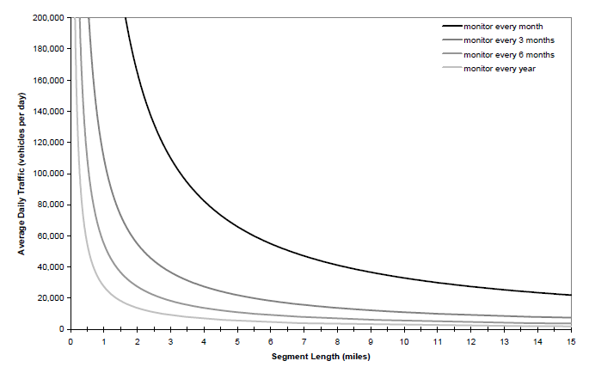
Example A
3-mile segment length
40,000 vehicles per day
Example B
8-mile segment length
40,000 vehicles per day
Example C
3-mile segment length
120,000 vehicles per day
Source: TTI
Notes:
Key Message: Determine crash data collection/analysis frequency by using the crash curve.
Background Information: The curve does not dictate who does the monitoring, and “monitoring” in the table refers to crash data analysis and collection.
Important Note – if a work zone crash problem is identified during construction, that new information should take precedence over this planning-level tool.
Interaction: Begin with the participants completing these examples in their workbooks. After a period of time, walk through the examples with the class, starting with each grey pop-up box (mouse click), and then “drawing” each of the lines (mouse clicks).
Notes:
Source: Texas Transportation Institute, Monitoring Work Zone Safety and Mobility Impacts in Texas, May 2009.

Slide 55
Data Collection: Two Methods
Real-time (or Near-real-time) Data Collection
Lagging
Data Collection
Notes:
Key Message: Balance between having information at your finger-tips and responding to rapidly changing conditions VS having more solid information for careful analysis.
Background Information:
Person – Vehicle – Exposure – Crash can fall into these 2 areas.
Interaction:
Notes:

Slide 56
Real-time Work Zone Data Collection and Compilation
Real-time
On-site collection by
Individuals
Electronic devices
Near-real-time
Law enforcement crash reports submitted electronically
Must still be submitted and archived
Notes:
Key Message: Point out real advantages to automating data collection and retrieval
Background Information:
Major challenges to collecting data with work zones.
Constrained areas or hazardous situations to locate people to collect data. Get in, get out
Staff time is stretched and ITS can offer some relief
Key skill to have: Relationship building and communication with law enforcement
Interaction:
Notes:
ITS devices to collect data have the following advantages
Collect information at any time of day, week or weekend, and during special events or holidays
Data is collected in set reporting formats
Expense is either equipment or contract base and not tied to agency overhead such as personnel
Devices can be deployed in constrained areas without on-going risk to personnel
Interaction with device can be web-based for convenient data analysis and quicker WZ evaluation

Slide 57
Real-time Work Zone Data Collection
How would real-time safety data collection benefit an agency?
What are some limitations of real-time data?
Notes:
Key Message: Broaden the audiences perspective on using real-time data
Background Information:
Interaction: Ask participants the questions on the slide. Answers could be the following:
Benefits
Changes can be made immediately in the active work zone
More detailed data may be available
Ability to predict, mitigate, or prevent future crashes at same work zone
Limitations
Higher costs
High volume of data
Potential for reduced accuracy
Challenge to collect enough of the right data
Must ensure collection does not pose safety concerns
Ask, “What are some situations that could have the most value from real-time monitoring?”
Answers may include: Work zones with known previous issues (previously-identified congestion, crashes); high-profile projects; complicated projects; special situations (e.g., high traffic volume from a sporting event or holiday)
Notes:

Slide 58
Lagging Data Collection
Lagging data can be collected through
Paper crash reports
Archived mobility or safety data
Benefits
A good source of information to make changes on future projects
Can justify modifications to agency-wide policy
Not compiled soon enough to make modifications to an active work zone
Notes:
Key Message: Lagging data can present certain advantages over other real-time data.
Background Information:
Written and archived crash reports go through a rigorous quality control.
Possible Use: Volume and speed data which are stored can be used to calibrate simulation models of work zone impacts.
Interaction:
Notes:

Slide 59
Lagging Data Collection
How does lagging information assist an agency towards improving work zones?
What are limitations from utilizing lagging sources of data?
Notes:
Key Message: Show the applicability of lagging data
Background Information:
Interaction:
What benefits can be derived from lagging data?
Comprehensive source of information to make changes on future projects
Potential for larger sample size
Potential for better accuracy
Can include data from various sources and perspectives
What are some limitations from lagging data?
Delayed
Any missing data elements are likely unobtainable or difficult to obtain
Time required to access and analyze data may mean that modifications cannot be applied immediately
Notes:

Slide 60
Barriers to Work Zone Data Collection
Exist at many levels
Highway agencies
Contractors
Law enforcement officers
Apply across all types of:
Data
Sampling methods and
Types of work zones
Notes:
Key Message: Practitioners will understand what influences each group related to collecting data
Background Information:
Work Zones have a “Get In, Get Out” strategy.
Financial incentives/disincentives necessitate that contractors perform only the most necessary activities. They are often hesitant to add overhead to time or resources.
Agencies stretching people due to scarce resources.
Interaction:
Notes:

Slide 61
EXERCISE #3: Identify Barriers
Identify BARRIERS with highway agencies, contractors, and law enforcement
Follow instructions provided by the workshop instructor
Notes:
Key Message: Lead small groups through this exercise
Background Information:
Interaction: Split participants into 3 (or 6, if a large audience) groups, and assign each one of the types of barriers: Highway Agencies, Contractors, Law Enforcement. Give them 8-12 minutes to identify barriers.
Then come together as a group and have each small group report out while you walk through the following slides.
Notes:

Slide 62
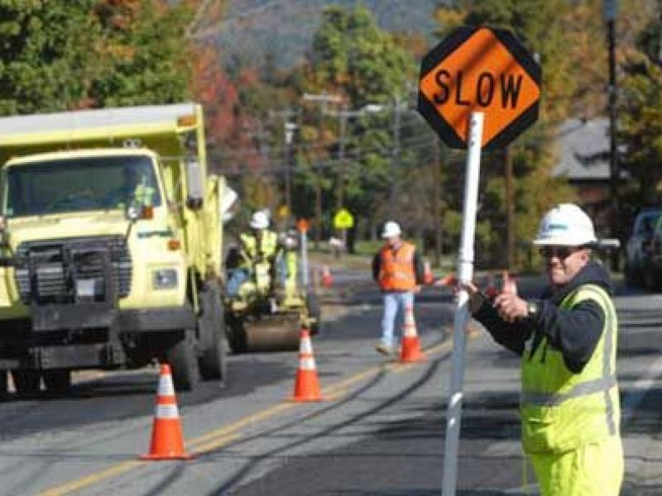
Most Highway Agencies
Are responsible for data collection and analysis
Draw conclusions and select mitigation strategies regarding work zone safety problems
Image: ATSSA
Notes:
Key Message: Improving WZ through collecting and analyzing data is a long-term commitment.
Background Information:
One barrier not mentioned is the time to analyze and report on the data from a program level.
Interaction:
Click once to bring up the heading for right-pane of the slide.
Before clicking again (to bring up the blue boxes with the barriers written in), ask the participants for their ideas of barriers that highway agencies may face.
Notes:

Slide 63
Barriers at Highway Agencies
Reliance on law enforcement and
crash reports for data
Lack of resources to deploy ITS
equipment or collect data
Delayed access to crash reports
Inconsistent work zone crash report definitions
Notes:
Key Message: Improving WZ through collecting and analyzing data is a long-term commitment.
Background Information:
One barrier not mentioned is the time to analyze and report on the data from a program level.
Interaction:
Click once to bring up the heading for right-pane of the slide.
Before clicking again (to bring up the blue boxes with the barriers written in), ask the participants for their ideas of barriers that highway agencies may face.
Notes:

Slide 64
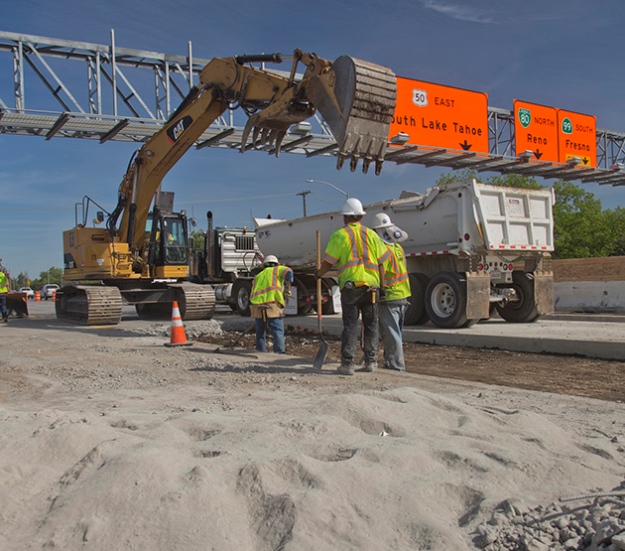
Contractor-Related Barriers
The contractor typically:
Staffs work zone projects under contract from highway agencies
Tracks work zone progress
Image: ATSSA
Notes:
Key Message: It is Critical to stay on message with contractors who are monitoring the WZ for the safety of all users, including workers. Not addressing WZ issues could lead to increased liability.
Background Information:
Interaction:
How would you respond to a contractor accusing the agency of “spying” on the contractor?
Notes:
Click once to bring up the heading for right-pane of the slide.
Before clicking again (to bring up the blue boxes with the barriers written in), ask the participants for their ideas of barriers that highway agencies may face.
Click a third time to show the potential solutions to contractor barriers

Slide 65
Contractor-Related Barriers
Perception of increased liability
Reluctance to add another duty
May delay project progress
Perception as disciplinary measure for mistakes
Notes:
Key Message: It is Critical to stay on message with contractors who are monitoring the WZ for the safety of all users, including workers. Not addressing WZ issues could lead to increased liability.
Background Information:
Interaction:
How would you respond to a contractor accusing the agency of “spying” on the contractor?
Notes:
Click once to bring up the heading for right-pane of the slide.
Before clicking again (to bring up the blue boxes with the barriers written in), ask the participants for their ideas of barriers that highway agencies may face.
Click a third time to show the potential solutions to contractor barriers

Slide 66
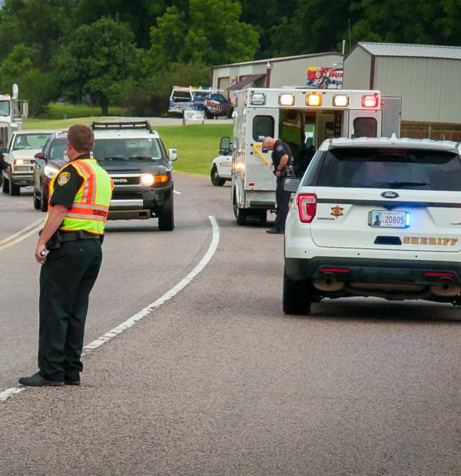
Barriers with Law Enforcement
Law enforcement personnel typically
Arrive at the scene of the crash
Collect evidence
Interview witnesses
Fill out crash reports
Attempt to reduce impact on traffic
Image: ATSSA
Notes:
Key Message: Building a relationship with LE critical. Be aware of their time constraints. Be aware some states allow clearance of non-injury crashes
Background Information:
Barriers to work zone safety analysis from police crash reports
Crash report not accurate or complete
Circumstances surrounding crash not work zone related
Vehicles moved prior to law enforcement arriving
Interaction:
Notes:
Click once to bring up the heading for right-pane of the slide.
Before clicking again (to bring up the blue boxes with the barriers written in), ask the participants for their ideas of barriers that highway agencies may face.

Slide 67
Barriers with Law Enforcement
Urgency to clear the scene
Potential lack of understanding of the value of the data
Crash reports may lack detail or consistency
Specifics of the crash event may be unknown
WZ crash report form may provide limited opportunity for detail
Lack of training may result in flawed reports
Delay in data availability
Notes:
Key Message: Building a relationship with LE critical. Be aware of their time constraints. Be aware some states allow clearance of non-injury crashes
Background Information:
Barriers to work zone safety analysis from police crash reports
Crash report not accurate or complete
Circumstances surrounding crash not work zone related
Vehicles moved prior to law enforcement arriving
Interaction:
Notes:
Click once to bring up the heading for right-pane of the slide.
Before clicking again (to bring up the blue boxes with the barriers written in), ask the participants for their ideas of barriers that highway agencies may face.

Slide 68
EXERCISE #4: Identify Solutions
Identify SOLUTIONS with highway agencies, contractors, and law enforcement
Follow instructions provided by the workshop instructor
Notes:
Key Message: Lead small groups through this exercise
Background Information:
Interaction: Split participants into 3 (or 6, if a large audience) groups, and assign each one of the types of barriers: Highway Agencies, Contractors, Law Enforcement. Give them 8-12 minutes to identify barriers.
Then come together as a group and have each small group report out while you walk through the following slides.
Notes:

Slide 69
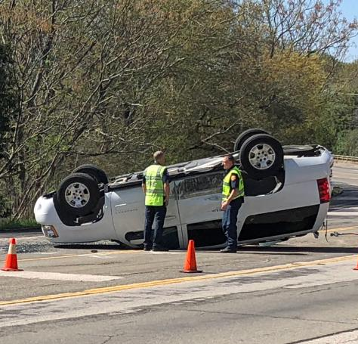
Highway Agency Solutions
Ensure necessary data elements are in the uniform crash report
Improve access to work zone crash reports
Use low-cost traffic monitoring devices to collect information
Image: ATSSA
Notes:
Key Message: Finding ways to overcome barriers to WZ safety data collection.
Background Information:
MOU from past discussion is an opportunity to work with law enforcement to ensure correct data elements are used.
Interaction: Improving access to work zone crash reports depends on what? Discussion should center on relationship with law enforcement agencies.
Notes:

Slide 70
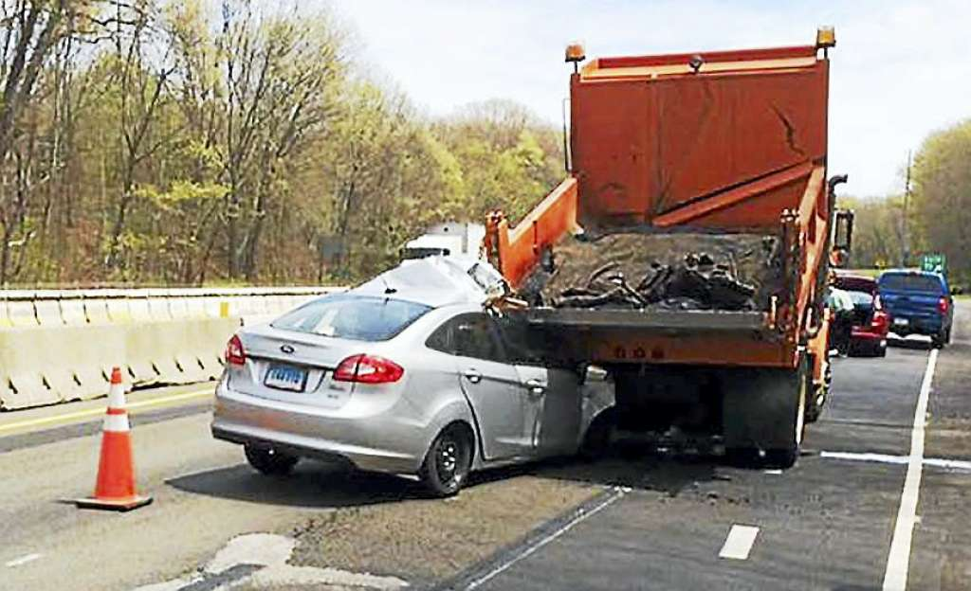
Contractor-Related Solutions
Explain the purpose of data collection in the contract
Include a pay item in the contract requiring data collection
Adding the pay item addresses any reluctance to add a duty
Image: ATSSA
Notes:
Key Message: Be consistent with communication to the contractor as to why the data is important and how the data will be used
Background Information:
Interaction:
How can these data help a contractor?
Provide justification for a larger window to work
Monitor for incidents jeopardizing the safety of workers and impacting the contractor’s liability
Present the contractor in a positive light to the community
Notes:

Slide 71
Solutions with Law Enforcement
Emphasize the importance of detailed crash narratives and sketches
Provide work zone training, preferably web-based, to LE officers
Use technologies such as tablet computers to increase timeliness of crash report availability
Notes:
Key Message: Reemphasize importance of strong positive relationship with LE
Background Information:
Interaction: What are low-impact ways to cultivate a relationship with law enforcement? How do you overcome years of culture of doing something a certain way?
Notes: Possible answers
Emphasize the importance of detailed crash narratives and sketches
Provide work zone training, preferably web-based, to LE officers
Use technologies such as tablet computers to increase timeliness of crash report availability

Slide 72
CASE STUDIES Data Collection
Notes:
Key Message: Introduce Case Studies
Background Information:
Interaction:
Notes:

Slide 73
Real-time Work Zone Data Collection
Memorandum of Understanding (MOU)
Agreement between State DOT and local law enforcement allows more rapid transfer of crash information
Notes:
Key Message: Setting rules of engagement among various groups working in the zone can improve data output.
Background Information:
MOU may not be necessary everywhere, depending on current relationships between highway agency and law enforcement.
Project diary
Written by project and field staff members
Used to track work progress, site conditions, and labor and equipment usage
Essential supplement to crash database information
Provide critical information and first-hand observations about a crash
On-site at time of crash perspective
Construction or engineering background
Familiarity with work zone and roadway environment before, during, and after crash
Interaction:
Notes:
Project diary can be individualized regarding descriptions and terms used.

Slide 74
Real-time Work Zone Data Collection
Project Diary: Supplement to Crash Report
First-hand observations about a crash
Familiarity with work zone and roadway environment before, during, and after crash
Notes:
Key Message: Setting rules of engagement among various groups working in the zone can improve data output.
Background Information:
MOU may not be necessary everywhere, depending on current relationships between highway agency and law enforcement.
Project diary
Written by project and field staff members
Used to track work progress, site conditions, and labor and equipment usage
Essential supplement to crash database information
Provide critical information and first-hand observations about a crash
On-site at time of crash perspective
Construction or engineering background
Familiarity with work zone and roadway environment before, during, and after crash
Interaction:
Notes:
Project diary can be individualized regarding descriptions and terms used.

Slide 75
Portable Traffic Monitoring Device (PTMD)
Technology
Battery-powered
Speed/volume by radar
Satellite/cellular communications
Vehicle speed and traffic volume data collection
Real-time queue identification for treatment
Potential to expand work windows
Image: ATSSA
Notes:
Key Message: Discuss the workings and benefits of a PTMD.
Background Information: The PTMD is a relatively low-cost, easy-to-use device to collect data in a work zone.
Interaction: Ask participants if they see the device in the photo. Show them that it’s the first orange barrel in the picture.
Notes:
PTMD Deployment in California, one collecting speeds and one collecting traffic volumes
Photo Credit: Brian Chandler
Chandler, B.; Beasley, K.; Rephlo, J. California Deployment of Portable Traffic-Monitoring Devices, 2010

Slide 76
Obtaining Travel Times using Bluetooth Technology
Saturation of Bluetooth devices in vehicles (smart phones, tablets, GPS)
Each device emits a unique MAC address, so researchers can capture addresses to calculate travel times
Data sets enable evaluation of the relationship between crashes and work zone queuing
Indiana study was conducted to proactively prevent queue-related crashes before they occur
Notes:
Key Message: Number of Bluetooth devices is an opportunity to collect data
Background:
Can gather large sets of real-time data in a short period of time
Purdue University and Indiana DOT used Bluetooth to study the real-time measurement of travel time and delay in work zones
Capturing MAC addresses at different locations on a roadway, travel times between the two locations can be calculated.
Researchers analyzed 1.4 million travel time records collected
12-week study along a 10-mile section of I-65 in northwestern Indiana in 2009
Data sets enable evaluation of the relationship between crashes and work zone queuing
Bottom line: Proactively prevent queue-related crashes before they occur
Interaction:
Notes: BluFax Data Collection
Record spatially-based data, time and location to measure travel time and speed
Antennas have 130 feet detection radius; Omni-directional – could measure 2 directions
Sample rate about 6-10% of all traffic
No personal information tied to the device
Haseman, R.; Wasson, J.; Bullock, D. Time Measurement of Travel Time Delay in Work Zones and Evaluation Metrics Using Bluetooth Probe Tracking, 2009.

Slide 77
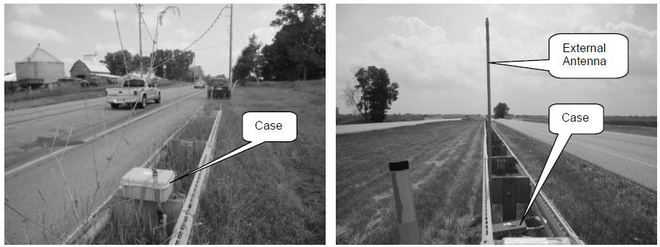
Obtaining Travel Times using Bluetooth Technology
Images: ATSSA
Notes:
Key Message: Show the setup of this Bluetooth data collection technology
Background:
Interaction:
Notes:
Haseman, R.; Wasson, J.; Bullock, D. Time Measurement of Travel Time Delay in Work Zones and Evaluation Metrics Using Bluetooth Probe Tracking, 2009.

Slide 78
Ohio DOT Real-time Data Collection
Real-time crash analysis tool to track WZ crashes on pre-selected work zones
Data are captured in near real-time
Electronic queries
Bi-weekly visits to law enforcement agencies
Allows real-time response
Find problems in active work zones
Investigate the issues and apply enforcement strategies
Notes:
Key Message: See the impact of relationship with agencies such as law enforcement. Ohio DOT started with paper copies and later incorporated electronic database.
Background Information:
Interaction:
Notes:
Stargell, R., Best Practices in Work Zone Assessment, Data Collection and Performance Measurement.

Slide 79
Kansas DOT Real-time Work Zone Data Collection
Law enforcement agencies are required to:
Notify authorized agency personnel of all WZ crashes
Submit complete crash reports ASAP
Work zone supervisors are required to fill out a basic form whenever a crash occurs in a KDOT work zone – Why?
Crash reports are reviewed for contributing factors and stored in a crash database
Notes:
Key Message: Kansas DOT requires special reporting for WZ crashes.
Background Information:
Interaction: Ask the group, “Why do you think KDOT requires their supervisors to fill out this form?”
Notes:
Kansas Department of Transportation, Kansas DOT Reporting Accidents in Construction and Maintenance Work Zones, December 2005, Available at http://www.ops.fhwa.dot.gov/wz/resources/final_rule/ks_acct_const_wz.htm

Slide 80
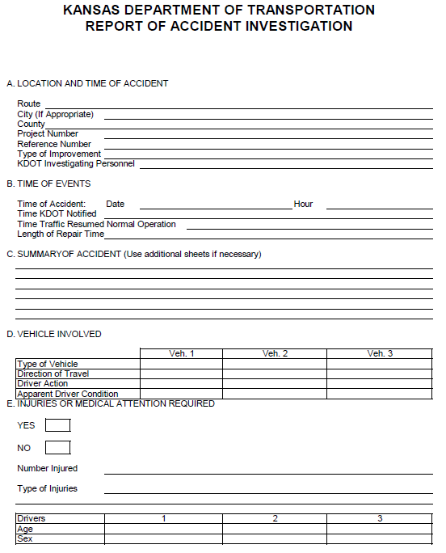
Notes:
Key Message: This is the KDOT Basic Report Form used by WZ supervisors when a crash occurs in a KDOT work zone.
Background Information:
Interaction: Ask the group, “Any concerns with this practice?” Some agencies may cite documenting liability.
Notes:

Slide 81
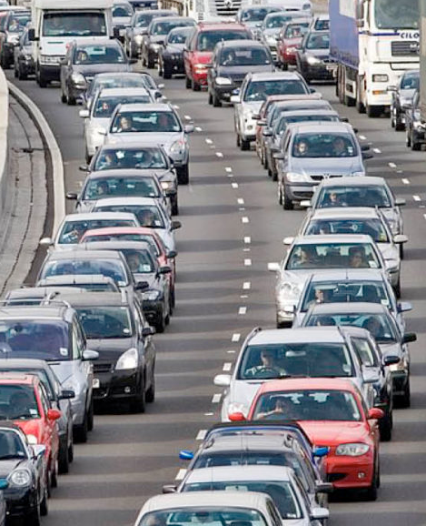
Real-time Work Zone Data Collection
“Near-misses” can be precursors to crashes and identify safety needs
Provide important real-time information to practitioners
Methods to collect information about near-misses
Image: ATSSA
Notes:
Key Message: “Near misses” can provide helpful information for WZ safety.
Background Information:
Near-misses” in work zones can be precursors to crashes and identify safety needs
Typically not recorded or included in a database
Provide important real-time information to practitioners
Methods to collect information about near-misses
Work zone inspectors on-site when the event occurs
Communication between inspector and WZ safety management
Video surveillance
Interaction:
Notes:
Federal Highway Administration, Practitioner-focused Online Collaborative Session, August 31, 2011.

Slide 82
Real-time Work Zone Data Collection
ITS devices can automatically upload information for immediate analysis
Conventional technologies
New technologies
Addressing speed-related concerns
Manual Radar Studies
Tube Counters
Portable traffic monitoring devices (PTMDs)
Portable ITS equipment (sensors on trailers)
Permanent ITS equipment
Targeted law enforcement
Additional traffic control devices
Notes:
Key Message: Data can be collected in a number of ways in real-time, including addressing speed-related crashes.
Background Information:
Interaction:
Write in for Conventional technologies: Manual radar studies; Tube counters
Write in for New Technologies: Portable traffic monitoring devices (PTMDs); Portable ITS equipment (sensors on trailers); Permanent ITS equipment
Write in for Addressing Speed-related concerns: Targeted law enforcement; Additional traffic control devices; Temporary transverse rumble strips
Notes:

Slide 83
Real-Time Data Collection
QUEUE DATA
ITS queue detection tools
Link detectors to upstream warning systems (CMS)
Initiate immediate response
Other methods of near-real-time queue detection
Observe and collect data on congestion and queues
Document queue presence, average, max, and duration
Notes:
Key Message: Tools are available for collecting queue data in real time.
Background Information:
Detectors can be linked to upstream warning systems (e.g., CMS) to warn drivers of potential queue:
ITS queue detection tools
Detection of low travel speeds may mean a queue is forming
Detectors can be linked to upstream warning systems (CMS) to warn drivers of potential queue
Can initiate immediate response to prevent back-of-queue crashes
Other methods of near-real-time queue detection
Observe and collect data on congestion and queues.
Inspectors can document traffic characteristics, including:
Presence of a queue
Estimations of average queue, maximum queue, and duration of queues
Interaction:
Notes:
America Traffic Safety Services Association. ITS Safety and Mobility Solutions, Improving Travel Through America’s Work Zones. July 2008. Available at: http://www.atssa.com/galleries/default-file/2008July21_ITS_Safety_and_Mobility.pdf

Slide 84
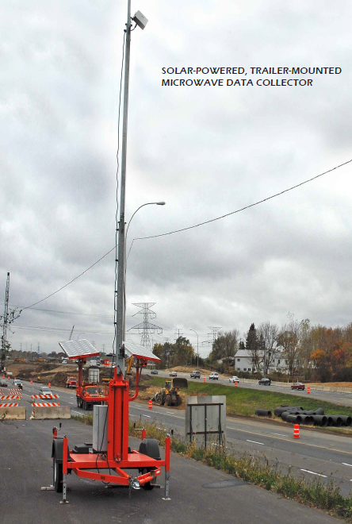
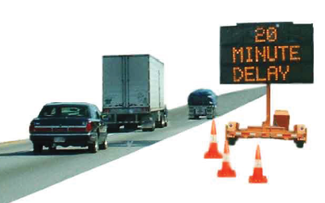
Real-Time Data Collection
Images: ATSSA
Notes:
Key Message: Examples of ITS queue detection tools.
Background Information:
Interaction: “The example on the left dips into application, which we’ll discuss in more detail later today. On the right is a solar-powered, trailer mounted microwave data collector.”
Notes:
America Traffic Safety Services Association. ITS Safety and Mobility Solutions, Improving Travel Through America’s Work Zones. July 2008. Available at: http://www.atssa.com/galleries/default-file/2008July21_ITS_Safety_and_Mobility.pdf

Slide 85
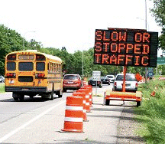
Missouri DOT Real-Time Data Collection
QUEUE DATA
Uses queue detection systems and staff monitoring to identify issues at the WZ
When Traffic Management Center (TMC) identifies an active queue, project staff members are directed to review and remedy the origin of the queue
Image: ATSSA
Notes:
Key Message: Missouri DOT works with their Traffic Management Center (TMC) when queues are identified.
Background Information: In urban areas, MoDOT can identify queues by using cameras. In other areas, MoDOT staff passing through may contact the TMC if there are significant queues.
Interaction:
Notes:
FHWA. Work Zone Operations Best Practices Guidebook. October 2007. Available at: http://ops.fhwa.dot.gov/wz/practices/best/documents/bpguidebook.pdf

Slide 86
Real-Time Data Collection
MOBILITY DATA
ITS and other common devices and technologies to collect data in work zones
Real-time volumes can be obtained from
Existing TMC traffic sensors
Portable ITS equipment
Video analysis from TMC images
Bluetooth technology (travel times)
Manual travel time runs by agency staff
Notes:
Key Message: TMCs can support collection of mobility data.
Background Information: Minnesota DOT travel time report
Interaction: Why would an agency use one or more of these methods?
Notes:

Slide 87
Lagging Data Collection
Real-time (or Near-real-time) Data Collection
Lagging
Data Collection
Notes:
Key Message: In some cases lagging data collection is more appropriate.
Background Information: Practitioners may find that a real-time data collection task is unnecessary as relevant historical data have already been collected and are available at their agency.
Interaction:
Notes:

Slide 88
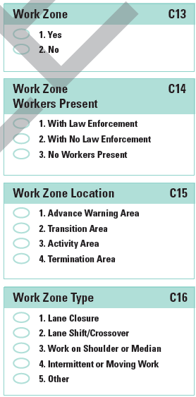
Lagging Data Collection
CRASH DATA
Crash reports
Completed by law enforcement officers
Improve system-wide consistency
Reported with the same uniform crash report as non-work zone crashes
May include check-box for work zone involvement
Virginia’s Crash Reporting Form: Work Zone Section
Notes:
Key Message: Better crash report can improve the quality and quantity of data
Background Information:
Challenges to reporting WZ crashes include:
Determining causality of work zone crashes (the crash might have happened regardless of the WZ being in place)
Connecting countermeasures to work zones
Crash reports
Completed by law enforcement officers at crash scene
System-wide consistency
Reported with the same uniform crash report as non-work zone crashes
May include check-box for work zone involvement
Virginia DOT – recently updated crash reports with more work-zone specific fields
Interaction:
Notes:
Dissanayake, S., Akepati S.R., Characteristics of Work Zone Crashes in the SWZDI Region: Differences and Similarities, August 2009, Available at http://www.intrans.iastate.edu/publications/_documents/midcon-presentations/2009/DissanayakeZone.pdf

Slide 89

Lagging Data Collection
CRASH DATA
Model Minimum Uniform Crash Criteria (MMUCC)
Guidance in collecting consistent crash report elements
Definition includes crashes that are related to a WZ, including those prior to the first work zone warning sign
Notes:
Key Message: The MMUCC provides guidance on WZ crash reporting.
Background Information:
Interaction:
Notes:
Available at http://www.mmucc.us/sites/default/files/2008MMUCCGuideline.pdf

Slide 90
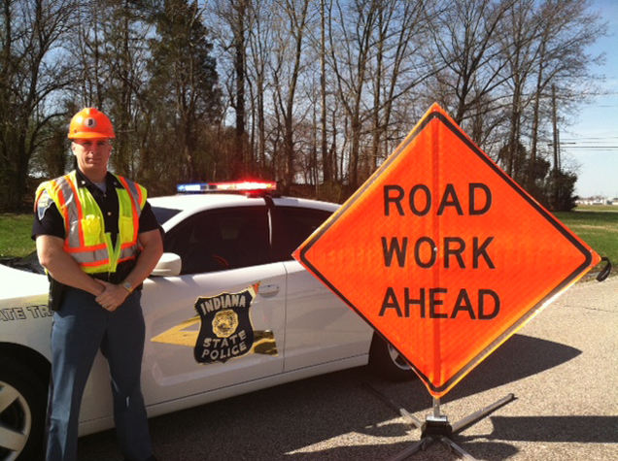
Lagging Data Collection
LAW ENFORCEMENT (LE) CRASH DATA
Shared understanding of the work zone data
Analysis effectiveness depends on data availability, accuracy, and usefulness
Image: ATSSA
Notes:
Key Message: Both the highway agencies and the law enforcement officers need to know what data are being collected and how the data are being used. This may improve officers’ understanding of work zone design and operation
Background Information: Effective management of the LE resource can add depth to the collection of work zone crash data.
Shared understanding of the work zone data
Analysis effectiveness depends on data availability, accuracy, and usefulness
Strategies for improving law enforcement data collection
Meet to discuss the crash reporting forms and training as it related to work zone crashes
An MOA/MOU between law enforcement agencies and State DOTs can help coordinate the timely transfer of data
If needed, an agency can request that changes be made to the State crash data reporting form
Interaction:
Notes:

Slide 91
Lagging Data Collection
LAW ENFORCEMENT CRASH DATA
Improving law enforcement data collection
Meet to discuss the crash reporting forms and training
Initiate an MOU between LE agencies and State DOTs
Request changes be made to the State crash data reporting form
Notes:
Key Message: Both the highway agencies and the law enforcement officers need to know what data are being collected and how the data are being used. This may improve officers’ understanding of work zone design and operation
Background Information: Effective management of the LE resource can add depth to the collection of work zone crash data.
Shared understanding of the work zone data
Analysis effectiveness depends on data availability, accuracy, and usefulness
Strategies for improving law enforcement data collection
Meet to discuss the crash reporting forms and training as it related to work zone crashes
An MOA/MOU between law enforcement agencies and State DOTs can help coordinate the timely transfer of data
If needed, an agency can request that changes be made to the State crash data reporting form
Interaction:
Notes:

Slide 92
Lagging Data Collection
TMC COORDINATION
Coordination with Transportation Management Center (TMC) managers
Detail who will collect the data, which data will be collected, and who can access the data
Traffic volumes
Congestion reports
Notes:
Key Message: TMCs have access to historical traffic volume data to support data analysis.
Background Information:
Coordination with TMC managers helps determine what information (e.g., traffic volumes, congestion reports) should be archived for future use. Addressing Data access needs will increase the availability of valuable data in the future.
Interaction:
Notes:

Slide 93
Lagging Data Collection
MOBILITY DATA
If ITS real-time sources are unavailable, traffic volume data may be obtained through historical counts or estimates
Work zones change roadway usage as some users divert
Alternative route mobility data can also be beneficial
Notes:
Key Message: Historical counts can be beneficial if real-time traffic volume is not available.
Background Information:
Interaction:
Notes:

Slide 94
Lagging Data Collection
INSPECTION REVIEWS
Identify correlations between work zone field inspections or reviews and safety-related data
Integrate annual temporary traffic control review inspections conducted by highway agencies as another lagging-data element
Set up expectations and requirements for inspections beforehand
Notes:
Key Message: By setting up expectations, each requirement can either be met or not, and information can be recorded to the appropriate level of detail.
Background Information:
Interaction: Does the inspection need to be done by a “professional”?
Inspections can be at various levels (basic to advanced) and completed by a variety of “inspectors”
General public (Missouri example with their report card)
Non-technical staff
Non-WZ staff
WZ experts
Notes:

Slide 95
EXERCISE #5
What strategies and techniques would be the most useful and feasible to implement at your agency?
Notes:
Key Message: These are the learning outcomes for Module 2 for review.
Background Information:
You should now be able to:
Understand core elements of data collection: crash level, person level, vehicle level, and exposure
Determine what types of work zone data elements to collect: queue data, speed data, mobility data
List sampling and collection methods for your agency
Identify barriers to work zone data collection: lack of resources (time, funding, staffing), lagging data
Identify data collection practices: Ohio uses a real-time crash analysis tool to track work zone crashes on pre-selected work zones. In Kansas, law enforcement agencies are required to notify authorized agency personnel of all WZ crashes and submit complete crash reports immediately.
Interaction:
Notes:

Slide 96
Learning Outcomes Review
You should now be able to:
Understand core elements of data collection
Determine what types of work zone data elements to collect
List sampling and collection methods
Identify barriers to work zone data collection
Identify data collection practices
Notes:
Key Message: These are the learning outcomes for Module 2 for review.
Background Information:
You should now be able to:
Understand core elements of data collection: crash level, person level, vehicle level, and exposure
Determine what types of work zone data elements to collect: queue data, speed data, mobility data
List sampling and collection methods for your agency
Identify barriers to work zone data collection: lack of resources (time, funding, staffing), lagging data
Identify data collection practices: Ohio uses a real-time crash analysis tool to track work zone crashes on pre-selected work zones. In Kansas, law enforcement agencies are required to notify authorized agency personnel of all WZ crashes and submit complete crash reports immediately.
Interaction:
Notes:

Slide 97
3. Work Zone Safety Related Data Analysis
Work Zone Safety Data
Collection and Analysis
Image: ATSSA
Notes:
Key Message: Module opening
Est. Presentation Time: As needed
Explanation of Cues/Builds: None
Suggested Comments: Let’s discuss {module name}
Suggested Questions: None
Possible Problems: None

Slide 98
Module Objectives
For you to learn how to:
Organize data in a useful manner for analysis
Identify and have familiarity with the use of safety data analysis tools and techniques
Identify examples of data analysis challenges
Understand successful practices that overcome these challenges
Apply your knowledge to analyze work zone safety data
Notes:
Key Message: Identify and share the outcomes of this module.
Background Information:
Interaction:
Notes:

Slide 99
Review of Five Step Process
The agency should answer questions related to the process as it relates to data analysis:
Identify Agency Objectives
Identify Data needs
Develop Baseline
Identify Strategies
Take next Steps
Notes:
Key Message: Data analysis can be broken down into 5 steps
Background Information:
Identify Agency Objectives: What issue is our agency attempting to address, and how will data analysis help achieve that objective?
ID Data Needs: What is the most pertinent work zone safety-related data that should be analyzed?
Develop Baseline: What is our agency’s current status regarding data analysis? Where can we improve?
ID Strategies: What data analysis strategies and techniques would be the most useful and feasible to implement at our agency?
Take Next Steps: Once identified, how do we take the next steps to improve work zone data analysis in our jurisdiction?
Interaction:
Notes:

Slide 100
Challenges to Work Zone Safety-Related Data Analysis
Three main challenges to work zone data analysis
1. Lack of data and limitations in the data sets
2. Confounding factors
3. Lack of resources for analysis
Notes:
Key Message: Work zone data analysis challenges fall under 3 main categories.
Background Information:
Interaction:
Notes:
After collecting work zone related data, work zone practitioners often have challenges with data analysis. This presentation will address some of the common challenges, including:
Lack of Data and Limitations in the Data Sets - Due to the relatively short duration of construction projects (vs. 3-5 years of “after” data in a typical before/after study at a permanent location) and a relatively low number of crashes, there may not be enough data to make statistically significant conclusions from work zone crash data. Lack of detail about some of the data elements may make it difficult or impossible to properly code some of the data into the correct categories. Poor quality data in the data set can result in misleading or incorrect conclusions.
Confounding Factors - Confounding factors related to analyzing safety data in work zones include the relative number of work zones in a jurisdiction from year to year, traffic volume pre-work vs. during-work, and questions related to causation (e.g., if the driver was impaired the work zone may not have been a contributing factor). The variables that can impact crashes within work zones can make the isolation of a single variable difficult.
Lack of Resources for Analysis - Many work zone practitioners do not have safety data analysis experience or staff with data analysis capabilities. Due to this knowledge gap, the benefits of post-construction safety data may be unknown. DOTs cite a lack of personnel and resource availability as an obstacle to analyzing data and making changes to work zone safety.

Slide 101
1. Lack of Data and Limitations in the Data Sets
Short project duration
Low number of crashes
Lack of data
Statistically insignificant conclusions
Lack of detail in data
Difficult to code
Poor quality info for analysis
Incorrect or misleading conclusions
Notes:
Key Message: Sustained effort towards collecting and preparing the data for analysis will ease these areas
Background Information:
Results from these will develop an agency’s source of lagging data.
Interaction:
Notes:
Relatively short duration of construction projects and relatively low number of crashes may lead to lack of data
May not be enough data to make statistically significant conclusions
Lack of detail about some of the data elements may make it difficult or impossible to properly code some of the data into the correct categories
Poor quality data in the data set can result in misleading or incorrect conclusions

Slide 102
2. Confounding Factors
Frequent changes to WZ configuration
Relatively small number of WZ crashes
Traffic volume pre-work vs. during-work
If significantly different, may provide misleading conclusions
Causation questions
Crashes in work zones may be caused by non-work zone issues
Notes:
Key Message: More issues that make WZ safety data analysis difficult.
Background Information:
Frequent changes to the configuration of a work zone
Many projects conducted in very different stages
Relatively small number of work zone crashes in a jurisdiction
Analyze all work zone crashes, not just injuries and fatalities
Look at other surrogate measures (queue length, speed, etc.)
Traffic volume pre-work vs. during-work
If significantly different, may provide misleading conclusions
Causation questions
Crashes in work zones may be caused by non-work zone issues
Interaction:
Traffic volume can fluctuate due to what? Other work zones, incidents on other systems, seasonality,
What are examples of non-work zone issues? Impairment, unauthorized vehicles, break-downs,
Notes:

Slide 103
3. Lack of Resources for Analysis
Many work zone practitioners do not have data analysis experience
Limited number of staff dedicated to data collection and analysis
Little time is left for post-project evaluation
Benefits of post-construction safety-related data may be unknown
Limited number of proven work zone crash modification factors (CMFs)
Notes:
Key Message: “Lost” time reacting to issues could be eliminated through the proper analysis of data
Background Information:
Crashes require investigation due to liability concerns
Interaction:
Is it possible, through the improvement of data collection and analysis, to gain efficiencies?
Notes:

Slide 104
Solutions to Overcome Barriers
Improve data collection practices
Analyze all work zone crashes (not just severe)
Look at other surrogate measures
Analyze causation
Find data analyst expertise in the agency to support WZ analysis
Image: ATSSA
Notes:
Key Message: Barriers can be overcome with the solutions listed here and the strategies/methods we’ve walked through in this module.
Background Information:
Interaction:
“What other solutions apply?”
Notes:

Slide 105
Data Analysis Tools and Techniques Overview
Tools and techniques that can improve work zone data analysis
Crash Frequency and Rate
Crash Modification Factors
Road User Costs
Modeling
Notes:
Key Message: Introducing new process to improve work zones; common techniques to most studies
Background Information:
Interaction:
Notes:

Slide 106
Crash Frequency and Rate
Calculated by dividing the number of crashes by a normalizing factor
Uses exposure data
Traffic volume
Length of work zone
Duration of work zone
Combination of these factors
Provides a more effective comparison of similar locations than analyzing crash frequency alone
Notes:
Key Message: Common technique to allow you to compare apparently dissimilar situations
Background Information:
Crash rates can be impacted by volume. Presence of diversionary routes can alter results through widely fluctuating volumes.
Benefit crash rate analysis v. crash frequency: provides a more effective comparison of similar locations.
Locations where traffic volumes changed significantly during the wz, the crash rate takes this into account.
Crash rate calculations using either real-time or lagging data.
Compare pre-construction values to determine if potential safety hazards exist and if modifications should be considered.
To account for exposure, use either traffic volume or roadway mileage
Used to compare similar roadways, segments, or intersections.
Traffic volumes expressed as ADT
Pre-construction volumes available at agency; otherwise, collect work zone traffic volume.
Interaction:
Can a low crash rate still indicate a problem? Example – every crash is same type, same direction, save vehicle type
Notes:

Slide 107
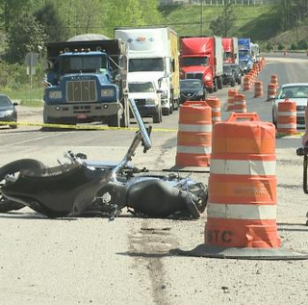
Crash Frequency and Rate
Can be compared to pre-construction values to determine if:
Potential safety hazards exist
Modifications should be considered
Image: ATSSA
Notes:
Key Message: Common technique to allow you to compare apparently dissimilar situations
Background Information:
Crash rates can be impacted by volume. Presence of diversionary routes can alter results through widely fluctuating volumes.
Benefit crash rate analysis v. crash frequency: provides a more effective comparison of similar locations.
Locations where traffic volumes changed significantly during the wz, the crash rate takes this into account.
Crash rate calculations using either real-time or lagging data.
Compare pre-construction values to determine if potential safety hazards exist and if modifications should be considered.
To account for exposure, use either traffic volume or roadway mileage
Used to compare similar roadways, segments, or intersections.
Traffic volumes expressed as ADT
Pre-construction volumes available at agency; otherwise, collect work zone traffic volume.
Interaction:
Can a low crash rate still indicate a problem? Example – every crash is same type, same direction, save vehicle type
Notes:

Slide 108
Examples of Crash Rate Normalizing Factors
Normalizing Factor | Example
Time | Crashes per month
Combination of factors | Crashes per vehicle-hours of travel time through the work zone Crashes per 100 million vehicle-miles traveled (VMT) through the work zone
Distance | Crashes per mile
Duration | Crashes per hour of lane closure in place or workers present
Notes:
Key Message: Important to not be misled by crash rate
Background Information:
A technique which will improve as work zones are included in the analysis and establish a baseline
Interaction: Ask the group, “What are the strengths and weaknesses of each normalizing factor, and of this method overall?”
Notes:
What is the weakness? – Remember your department’s overall objectives may be focused on # of crashes

Slide 109
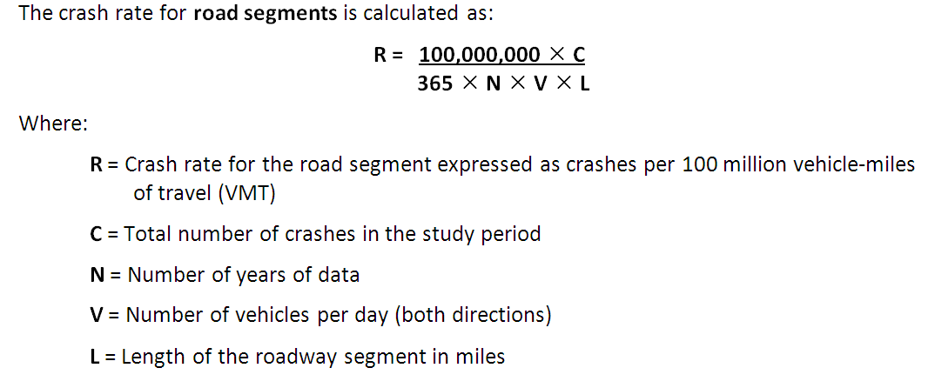
Crash Frequency and Rate
EXERCISE #6
95.9
R
C | 70 crashes
N | 1 year
V | 20,000 vehicles per day
L | 10 miles
Notes:
Key Message: Crash rate can provide a more accurate assessment of safety issues than crash frequency.
Background Information:
Interaction:
EXERCISE: Have the class complete the calculation using the data provided in the example table. After they have had some time, work through the example together. R = 95.9 crashes / HMVMT
After the calculation, talk about what the crash rate information tells the practitioner (relative safety of the segment) and what is does not tell (type of crash, severity of crashes, reasons for the crash occurrence).
Notes:

Slide 110
EXERCISE #7: Crash Rate Comparison
Pre-construction Crashes
Year | Length | AADT | # Fatal Crashes | # Injury Crashes | # PDO Crashes *
2001 | 5.5 | 33,000 | 0 | 24 | 15
2002 | 5.5 | 33,300 | 1 | 14 | 10
2003 | 5.5 | 33,750 | 0 | 37 | 21
2004 | 5.5 | 34,000 | 0 | 26 | 16
2005 | 5.5 | 34,500 | 1 | 32 | 21
95.9 crashes/HMVMT
Notes:
Key Message: Complete a crash rate exercise comparing pre-construction crash rates to during-construction crash rates.
Background Information:
Interaction:
EXERCISE: Have the class complete the exercise (details on next page).
Notes:

Slide 111
EXERCISE #7: Crash Rate Comparison
2006 Crashes
Fatal Crashes | 0
Injury Crashes | 19
PDO Crashes | 21
ADT = 35,000
1. Calculate the crash rate and the fatal crash rate for the 5-year period before the reconstruction project
95.9 crashes/HMVMT
2. Compute the percent change in the total crash rate and fatal crash rate from pre-work zone to work zone periods
Notes:
Key Message: Complete a crash rate exercise comparing pre-construction crash rates to during-construction crash rates.
Background Information:
Interaction:
EXERCISE: Have the class complete the exercise
Notes:

Slide 112
EXERCISE #7: Crash Rate Comparison
Crash Rate (per 100M VMT) | Fatal Crash Rate (per 100M VMT)
2001-2005
64
0.59
Total Crash Rate (per 100M VMT) | % change from pre-construction avg
Fatal Crash Rate (per 100M VMT) | % change from pre-construction avg
114
+78%
2006
0
-100%
Notes:
Key Message: Complete a crash rate exercise comparing pre-construction crash rates to during-construction crash rates.
Interaction: Walk through calculations with the class after they have had a chance to do the work.
Notes:
Total crashes (before) = 1+1+24+14+37+26+32+15+10+21+16+21 = 218
Average ADT (before) = (33,000 + 33,300 + 33,750 + 34,000 + 34,500)/5 = 33,710
Exposure (before) = (33,710*365)*5.5 /100,000,000 = 3.3855 100MVMT
Total crash rate (before) = (100M * 218)/(365 * 5 * 33,710 * 5.5) = 64 crashes per 100 MVMT
Fatal crash rate (before) = (100M * 2)/(365 * 5 * 33,710 * 5.5) = 0.59 crashes per 100 MVMT
Total crashes (during) = 19+21 = 40
Total crash rate (during) = (100M * 40)/ (365 * 0.5 * 35,000 * 5.5) = 114 crashes per 100M VMT
Fatal crash rate (during) = 0 crashes per 100 MVMT
% change in total crash rate = [(114 – 64) / 64]*100 = +78%
% change in fatal crash rate = [(0 – 0.59) / 0.59]*100 = -100%

Slide 113
Case Study – Ohio DOT Near-Real-Time Crash Report Analysis
Pre-Work Zone Crash History
Tracked real-time Crash Performance
Congestion causes crashes
Crashes cause congestion
“Hold the Line”
Historic crash analysis
Near-real-time crash data analysis
Notes:
Key Message: Ohio uses real-time reporting of crashes to adjust work zone TCP and TMP
Background Information: Access to real-time crash reports:
Quickly modify active WZ based on reported crashes.
Biggest challenge is timely data collection.
Ohio works picks up paper crash reports from Law Enforcement.
Second activity is analysis of the crash data.
Ohio DOT routinely run queries on the crash data to draw attention to high crash areas.
While such a system requires an initial programming and set-up effort, after the system is complete, the analysis, graphs, and summary data are produced instantly.
With the collection of historic and real-time crash data,
Monitors crash frequencies at select work zones
Ensure work zones stay at or below the pre-WZ crash frequency
Observe crash trends at their work zones and if developing trend requires changes, these can be made quickly.
Interaction:
What are the keys to success with this system? Ex: Relationship with law enforcement to obtain data; receiving appropriate data;

Slide 114
Case Study – Ohio DOT Near-Real-Time Crash Report Analysis
Keys to Success
Data Collection
Using electronic crash database
Cooperating with enforcement for paper crash reports
Data Analysis
Compare pre-WZ crash frequency to WZ crashes
WZ changes considered as developing trends are observed
Notes:
Key Message: Comparing pre-WZ to during-WZ crash frequency can help identify needs.
Background Information:
Interaction:
Notes:

Slide 115
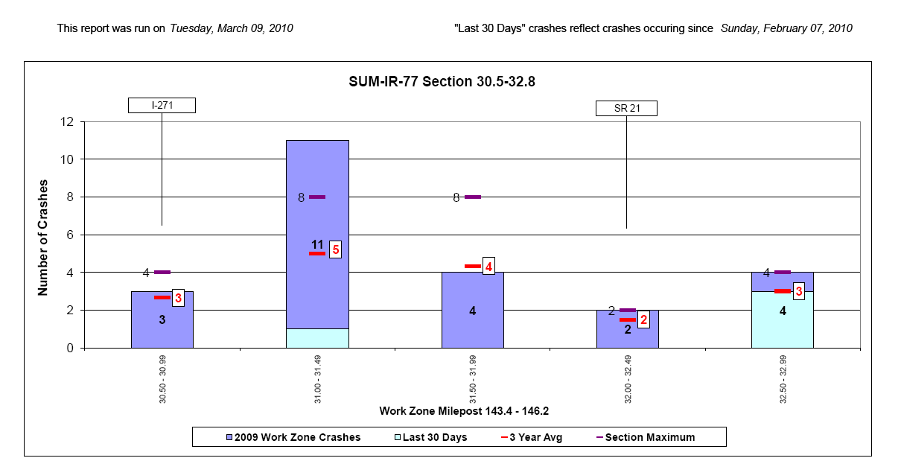
Case Study – Ohio DOT Near-Real-Time Crash Report Analysis
Denotes location of interchange ramps
Average # of crashes for 3 years prior to start of work
# of crashes occurring in the last 30 days
Most crashes to have occurred in any of the 3 years prior to start of work
Source: Ohio DOT
Notes:
Key Message: Ohio compares historical (pre-WZ) crash frequency and rate to during-WZ crash frequency and rate to identify problem areas.
Background Information:
Interaction: Walk through the graph with the class. Note that the red dashes show the 3-year average of crashes by time period at that point of the project. The light color shows the crashes occurring in the past 30 days. You can see the last milepost listed may have a problem that ODOT should deal with – this is a trigger for them to investigate.
Notes:
Source: Stargell, R. Best Practices in Work Zone Assessment, Data Collection and Performance Measurement.
Source: Domestic Scan 08-04 Best Practices in Work Zone Assessment, Data Collection and Performance Measurement

Slide 116
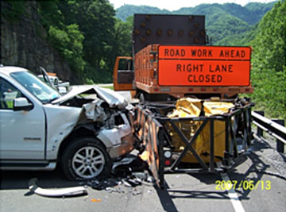
Crash Types
Crash types vary in work zones
Rear-end
Back of queue
Adjacent to activity
Merging
Transition points
Worker-related
Image: ATSSA
Notes:
Key Message: Crash types matter, because some are more severe than others.
Background Information:
Interaction: Ask the class about other potential types of WZ crashes.
Notes:

Slide 117
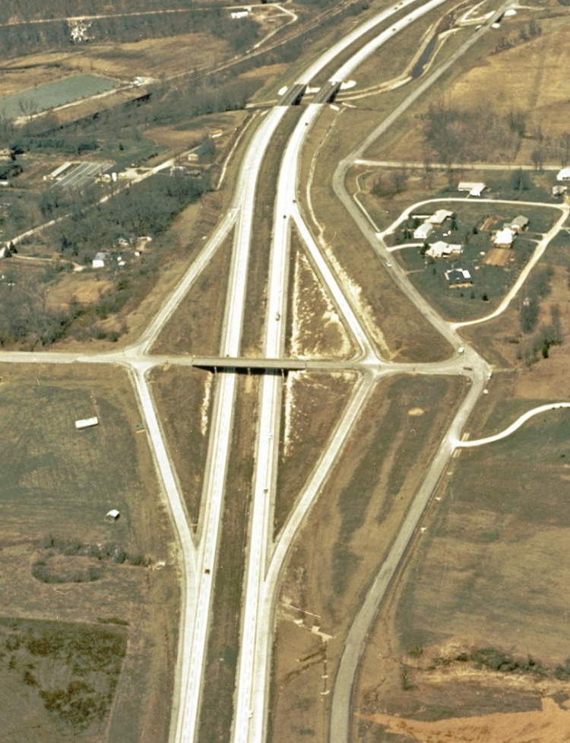
Crash Types
Ohio DOT identified on-ramp merge crashes increasing after removing an acceleration lane
Added pavement for an acceleration lane
Crashes reduced
Image: Ohio DOT
Notes:
Key Message: Discovering a crash problem early can help prevent future crashes.
Background Information: Ohio identified a problem at its interchange on-ramps when they removed the acceleration lane during construction (replacing it with a YIELD sign instead). They were having a number of rear-end crashes on the ramp and merge crashes at the bottom of the ramp.
They added temporary pavement at the on-ramp to allow for the acceleration lane, and in response the crashes were reduced significantly.
Interaction:
Notes: Photo courtesy of Missouri DOT’s Engineering Policy Guide: http://epg.modot.org/files/8/85/234_Photo_1_Diamond_Interchange.jpg

Slide 118
Crash Modification Factor (CMF)
CMF =
Crash Frequency After Treatment
Crash Frequency in Base Condition
The Highway Safety Manual (HSM) addresses two work zone CMF elements
Duration (days)
Length (miles)
Notes:
Key Message: A Crash Modification Factors (CMF) is the ratio of the crash frequency of a site after a treatment compared to the base condition.
Background Information: CMFs represent the relative change in crash frequency due to a change in one specific condition when all other conditions and site characteristics remain constant
Interaction:
Notes:

Slide 119
CMF: Work Zone Duration
The following formula provides an expected average crash frequency for increasing the work zone duration above the base condition (CMF = 1.00) of 16 days.
CMF_{all} = 1.0 + (% increase in duration x 1.11)
100
Where
CMF_{all} = crash modification factor for all crash types and all severities in the work zone; and
% increase in duration = the percentage change in duration (days) of the work zone above the 16-day base condition.
Notes:
Key Message: The Highway Safety Manual provides a CMF for work zone duration
Background Information:
Interaction: How would you measure duration? Where are these data found?
Notes:
This slide explains the HSM method to determine the CMF factor when the work zone will have a duration longer than the base condition of 16 days.
Source: AASHTO, Highway Safety Manual, 1st Edition, 2010.

Slide 120
Module 3 – Work Zone Safety Related Data Analysis Crash Modification Factors Work Zone Duration
EXERCISE #8:
What is the impact to roadway safety for a work zone with a duration of:
20 days?
32 days?
64 days?
Notes:
Key Message: This exercise will help participants learn how to calculate the CMF for work zone duration.
Background Information:
Interaction: Have participants calculate the CMF for each of these three work zone durations. Work through one example as a class after they have had a chance to try it on their own.
Answers: 20 days – 1.28; 32 days – 2.11; 64 days – 4.33
Make a point that a work zone that has 4 times the duration actually has MORE than 4 times the opportunity for more crashes. Ask the group why they think the research indicates this.
Notes:

Slide 121
CMF: Work Zone Length
The following formula provides an expected average crash frequency for increasing the work zone length above the base condition (CMF = 1.00) of 0.51 miles
CMF_{all} = 1.0 + (% increase in length x 0.67)
100
Where
CMF_{all} = crash modification factor for all crash types and all severities in the work zone; and
% increase in length = the percentage change in length (miles) of the work zone compared to the 0.51-mile base
Notes:
Key Message: The Highway Safety Manual provides a CMF for work zone length.
Background Information:
Interaction: How would you measure length?
Notes:
This slide explains the HSM method to determine the CMF factor when the work zone will have a physical length longer than the base condition of 0.51 miles.
Source: AASHTO, Highway Safety Manual, 1st Edition, 2010.

Slide 122
Module 3 – Work Zone Safety Related Data Analysis Crash Modification Factors Work Zone Length
EXERCISE #9:
What is the impact to roadway safety for a work zone with a length of:
1 mile?
5 miles?
20 miles?
Notes:
Key Message: This exercise will help participants learn how to calculate the CMF for work zone length.
Background Information:
Interaction: Have participants calculate the CMF for each of these three work zone lengths. Work through one example as a class after they have had a chance to try it on their own.
Answers: 1 mile – 1.6; 5 miles – 6.9; 20 miles – 26.6
In this case, a work zone that is 4 times longer actually has LESS than 4 times the opportunity for more crashes. Ask the group why they think the research indicates this. (Most WZ crashes occur in transition points, so the length is not as critical.)
Notes:

Slide 123
The USDOT CMF Clearinghouse
Lists 77 CMFs under the category of work zones
Two have been identified to decrease crashes in work zones
States are encouraged to develop CMFs
Mobile automated speed enforcement system
CMF = 0.86 for fatal and injury crashes
Left-hand merge and downstream lane shift
CMF = 0.54 for fatal and injury crashes
Notes:
Key Message: CMF Clearinghouse is a staging area for references and studies which may not be in the HSM.
Background Information: Peer-reviewed and rated studies. USDOT uses a “Star Rating” system related to the confidence level of the results. Search results on a particular topic in the clearinghouse can present conflicting studies and require review by the reader.
Mobile Automated Speed Enforcement
Mobile unit vans parked close to the work zone
Law enforcement monitoring and enforcing the work zone speed limit
Additional signage and media campaigns inform the public
Left-hand merge and downstream lane shift
Lane closure that instructs drivers approaching the closed lane to merge left, regardless of which lane is closed ahead
If left lane is the one closed downstream, traffic is shifted to the right after the merge point and before the lane closure
Found to decrease crashes when compared to a conventional right-lane work zone lane closure
Interaction: Consider going to the website and finding the study so the audience can see what it looks like.

Slide 124
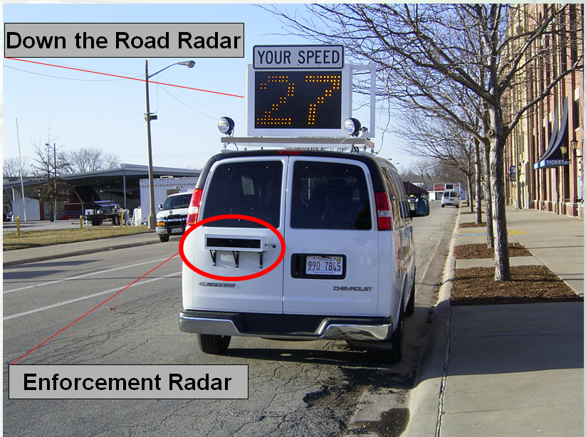
CMF: Photo Enforcement Vehicle
Image: ATSSA
Notes:
Key Message: Mobile automated speed enforcement systems have been installed by a few states, including this example in Illinois.
Background Information:
Interaction:
Notes:
The top radar provides motorists information as they approach the van. They are not enforced by that radar. The enforcement is done at the location of the van by a second radar unit.
Source: Illinois DOT

Slide 125
EXERCISE #10: A work zone has experienced 9 severe crashes (fatal + injury) in the past year
How many severe crashes would be expected in the next year if automated speed enforcement were implemented?
(9 severe crashes) * 0.86 = 7.74 severe crashes
Reduction of 1.26 severe crashes
Notes:
Key Message: This exercise will help participants learn how to apply a real-world treatment CMF to a work zone scenario.
Background Information:
Interaction: Have participants calculate the change in severe crashes using the CMF of 0.86 from the previous slide.
Answers: 9 * 0.86 = 7.74 severe crashes expected the following year. This is reduction of 1.26 severe crashes from the previous year.
Ask the group, “What other factors must we take into account when making decisions about countermeasures?
- Answers include cost, feasibility, State laws, policies, etc.
Notes:

Slide 126
CMF: Left-hand Merge Traffic Control Pattern
Image: ATSSA
Notes:
Key Message: Example of a study with the most effective work zone-related CMF in the current (as of summer 2013) version of the CMF Clearinghouse.
Background Information:
Point out the work area. Show how this is an early-merge situation where cars are forced into single-file well before the work area.
The CMF Clearinghouse shows a range for this treatment from successful (CMF=0.54) to unsuccessful (CMF=2.24).
Interaction:
Why do you think this is effective in reducing crashes?
Notes:
Source: Schrock, Fei See, Becker, and Mulinazzi. “Evaluation of Early Merge Static Work Zone Signing In Oklahoma,” 2008. Available at: http://www.intrans.iastate.edu/smartwz/documents/project_reports/2008-schrock-static-sign.pdf
This is sometimes called the “Iowa Shift”.
www.cmfclearinghouse.org

Slide 127
EXERCISE #11: A work zone has experienced 9 severe crashes (fatal + injury) in the past year
How many severe crashes would be expected in the next year if the “Left Merge” were implemented?
(9 severe crashes) * 0.54 = 4.86 severe crashes
Reduction of 4.14 severe crashes
Notes:
Key Message: This exercise will help participants learn how to apply a real-world treatment CMF to a work zone scenario.
Background Information:
Interaction: Have participants calculate the change in severe crashes using the CMF of 0.54 from the previous slide.
Answers: 9 * 0.54 = 4.86 severe crashes expected the following year. This is reduction of 4.14 severe crashes from the previous year.
Ask the group, “What other factors must we take into account when making decisions about countermeasures?
- Answers include cost, feasibility, State laws, policies, etc.
Notes:

Slide 128
Road User Costs
The additional costs borne by motorists and the community at-large as a result of work zone activity
Notes:
Key Message: Used to justify a “Get In, Get Out” approach.
Background Information: Data collected for other procedures can be used in determining RUCs. RUC types include travel delay, vehicle operating, crash, and emissions.
RUC analysis can assist practitioners in deciding between work zone strategies
Lane closures, nighttime construction, contract incentive/disincentives, or lane rental.
By decreasing negative impacts on the motorists, it is likely that safety and mobility will be improved as well.
Additional source: Work Zone Road User Costs - Concepts and Applications.
Interaction:
Notes:
Mallela, J., Sadasivam, S. Work Zone Road User Costs Concepts and Applications, Report FHWA-HOP-12-005, December 2011.
http://ops.fhwa.dot.gov/wz/resources/publications/fhwahop12005/fhwahop12005.pdf

Slide 129
Road User Costs
Based on:
Travel delay costs
Vehicle operating costs
Crash costs
Emission costs
Analysis yields strategy recommendations
Notes:
Key Message: Used to justify a “Get In, Get Out” approach.
Background Information: Data collected for other procedures can be used in determining RUCs. RUC types include travel delay, vehicle operating, crash, and emissions.
RUC analysis can assist practitioners in deciding between work zone strategies
Lane closures, nighttime construction, contract incentive/disincentives, or lane rental.
By decreasing negative impacts on the motorists, it is likely that safety and mobility will be improved as well.
Additional source: Work Zone Road User Costs - Concepts and Applications.
Interaction:
Notes:
Mallela, J., Sadasivam, S. Work Zone Road User Costs Concepts and Applications, Report FHWA-HOP-12-005, December 2011.
http://ops.fhwa.dot.gov/wz/resources/publications/fhwahop12005/fhwahop12005.pdf

Slide 130
Road User Costs: Mobility
$/hr value of personal travel (passenger cars only)
$/hr value of business travel (passenger cars only)
$/hr value of truck travel (trucks only)
$/hr value of time-related depreciation by vehicle type (all vehicles)
$/hr value of freight inventory (loaded trucks only)
Unit Cost Data
Number of passenger cars on personal travel
Number of passenger cars on business travel
Number of trucks
Number of vehicles by vehicle type
Number of loaded trucks
Number of Vehicles
Work Zone Delay Time
Work Zone Delay Travel Costs
X
X
=
Notes:
Key Message: This sample RUC calculation is for delay time.
Background Information:
Introduce the number of factors that go into this calculation.
Interaction: Ask participants how they would measure this data and a source for the information.
Notes:
Mallela, J., Sadasivam, S. Work Zone Road User Costs Concepts and Applications, Report FHWA-HOP-12-005, December 2011.
http://ops.fhwa.dot.gov/wz/resources/publications/fhwahop12005/fhwahop12005.pdf

Slide 131
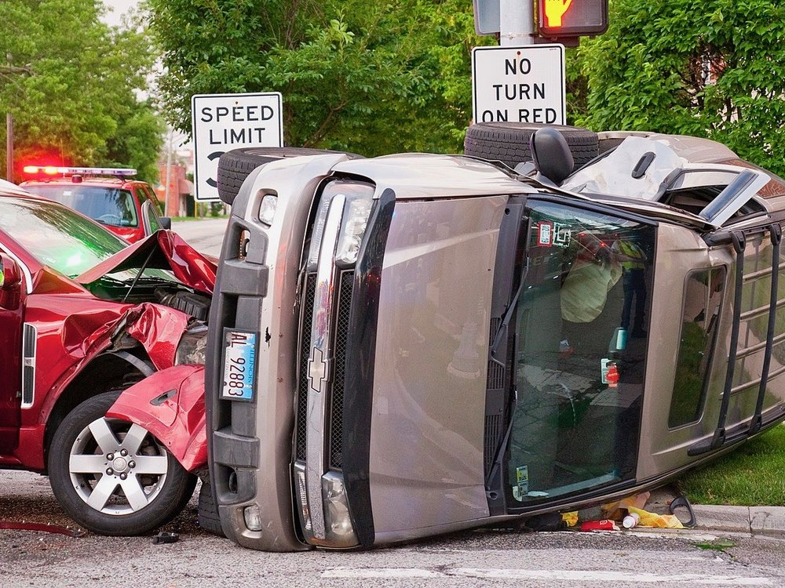
Road User Costs - Crashes
Expected changes to frequency/rate of crashes due to the presence of work zones
Image: ATSSA
Notes:
Key Message: Used to justify a “Get In, Get Out” approach.
Background Information:
Crash costs deal with expected changes to frequency/rate of crashes due to the presence of work zones
Data required for RUCs include crash rate, frequency, severity rating, and unit cost.
Interaction:
Notes:
Mallela, J., Sadasivam, S. Work Zone Road User Costs Concepts and Applications, Report FHWA-HOP-12-005, December 2011.
http://ops.fhwa.dot.gov/wz/resources/publications/fhwahop12005/fhwahop12005.pdf

Slide 132
Data Required for RUCs
Crash rate/frequency at work zones
Crash severity rating
KABCO Scale
K-Killed
A-Severe Injury
B-Moderate Injury
C-Minor Injury
O-Property Damage Only)
Unit cost of crashes
Notes:
Key Message: Used to justify a “Get In, Get Out” approach.
Background Information:
Crash costs deal with expected changes to frequency/rate of crashes due to the presence of work zones
Data required for RUCs include crash rate, frequency, severity rating, and unit cost.
Interaction:
Notes:
Mallela, J., Sadasivam, S. Work Zone Road User Costs Concepts and Applications, Report FHWA-HOP-12-005, December 2011.
http://ops.fhwa.dot.gov/wz/resources/publications/fhwahop12005/fhwahop12005.pdf

Slide 133
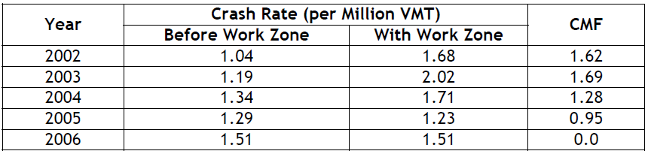
Road User Costs - Crashes
Examples of Crash Modification Factors (CMF) for adding work zones:
Notes:
Key Message: Some states have identified CMFs for temporary lane closures.
Background Information: We discussed CMFs in a previous slide as they are calculated for improvements to work zones. In this case, you’ll see the CMF applied to adding a WZ to a non-WZ situation
Interaction:
Notes:
Mallela, J., Sadasivam, S. Work Zone Road User Costs Concepts and Applications, Report FHWA-HOP-12-005, December 2011. Table 25.
http://ops.fhwa.dot.gov/wz/resources/publications/fhwahop12005/fhwahop12005.pdf

Slide 134
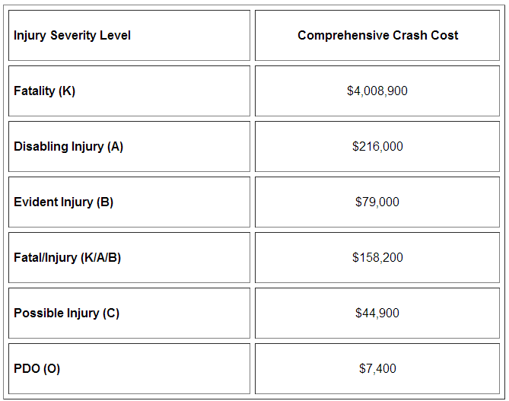
Road User Costs - Crashes
Crash costs by severity level
Notes:
Key Message: Crash costs are calculated by severity level.
Background Information:
Crash costs include everything from the actual cost to society of the crash itself, lost productivity over the lifetime of those involved, property damage, medical and insurance expenses, etc.
Interaction:
Notes:
AASHTO Highway Safety Manual, 1st Edition, 2010

Slide 135
Road User Costs - Tools
Can be categorized into two groups:
Work zone traffic analysis tools
Economic analysis tools
Sketch-planning/HCM based methods | Macroscopic simulation
Travel demand models | Mesoscopic simulation
Traffic signal optimization | Microscopic simulation
RealCost | MicroBENCOST
HERS-ST | BCA.Net
Notes:
Key Message: There are several tools to aid in the computation of RUCs.
Background Information:
Interaction:
Notes:
Mallela, J., Sadasivam, S. Work Zone Road User Costs Concepts and Applications, Report FHWA-HOP-12-005, December 2011.
http://ops.fhwa.dot.gov/wz/resources/publications/fhwahop12005/fhwahop12005.pdf

Slide 136
EXERCISE #12: Road User Costs – Example Calculation
3-mile section
AADTs
Crash History
50 PDOs, 20 injury crashes, 2 fatalities in 4 yrs
12-mile section
CMFs
1.56 for lane closure
0.38 for moving fixed objects
2010 | 20,000 vpd
2009 | 19,500 vpd
2008 | 19,000 vpd
2007 | 18,000 vpd
Notes:
Key Message: Perform calculations to determine safety-related RUC for a sample project.
Background Information:
Assume that a highway agency is planning to reconstruct a 3-mile section of Route 101, a four-lane principal arterial in Green County, in 2010. The agency estimates that the work zone of the proposed project is expected to serve a two-directional annual average daily traffic (ADT) of 20,000 vehicles in 2010, while the historic AADT values were 18000, 19000, and 19500 in 2007, 2008, and 2009. The speed limit of the roadway segment is 55 miles per hour. The estimated work zone duration is 60 days.
The agency’s office of safety reports that there were 50 PDO incidents and 20 incidents involving injuries (no fatalities), as well as 2 fatalities over a 12-mile section of Route 101 in the past 4 years. No data are available on the crash geometry and severity of injury.
The agency is planning to implement a single lane closure in each direction; however, to improve work zone safety, all fixed objects such as signs will be moved 10 feet away from the edge line. The agency typically uses the risk escalation factors reported in the CMF Clearinghouse. Assume that the agency applies 1.56 CMF for single lane closures and 0.58 CMF for relocating fixed objects. Estimate the work zone crash costs.
Interaction: Walk the class through the introductory data, and then begin talking them through the problem.
Notes: Example adapted from the following document:
Mallela, J., Sadasivam, S. Work Zone Road User Costs Concepts and Applications, Report FHWA-HOP-12-005, December 2011.
http://ops.fhwa.dot.gov/wz/resources/publications/fhwahop12005/fhwahop12005.pdf

Slide 137
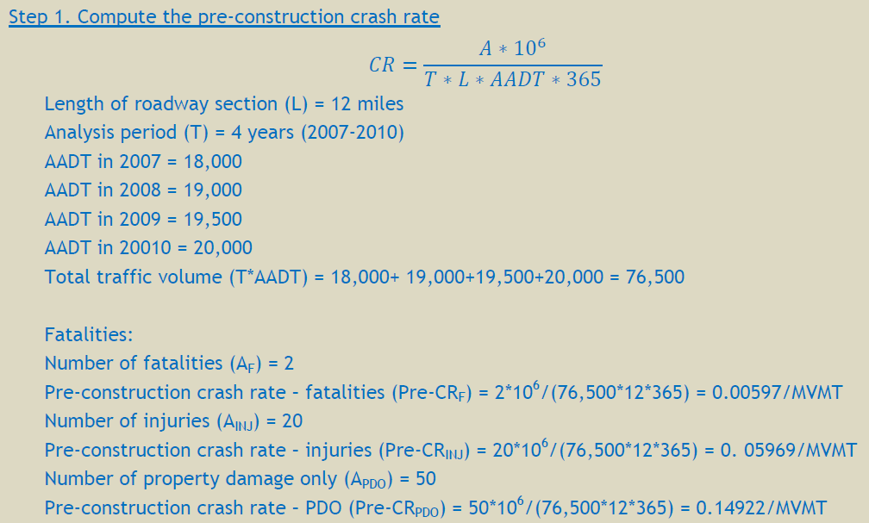
EXERCISE #12: Road User Costs – Example Calculation
Notes:
Key Message: Perform calculations to determine RUC for a sample project.
Background Information: Understanding the components of work zone travel delay time
Interaction: Note that this example uses “1 million vehicles miles traveled” in the numerator instead of our standard 100M VMT. It’s important to watch this carefully because the state of the practice varies.
Notes: Example 2.10 from:
Mallela, J., Sadasivam, S. Work Zone Road User Costs Concepts and Applications, Report FHWA-HOP-12-005, December 2011.
http://ops.fhwa.dot.gov/wz/resources/publications/fhwahop12005/fhwahop12005.pdf

Slide 138
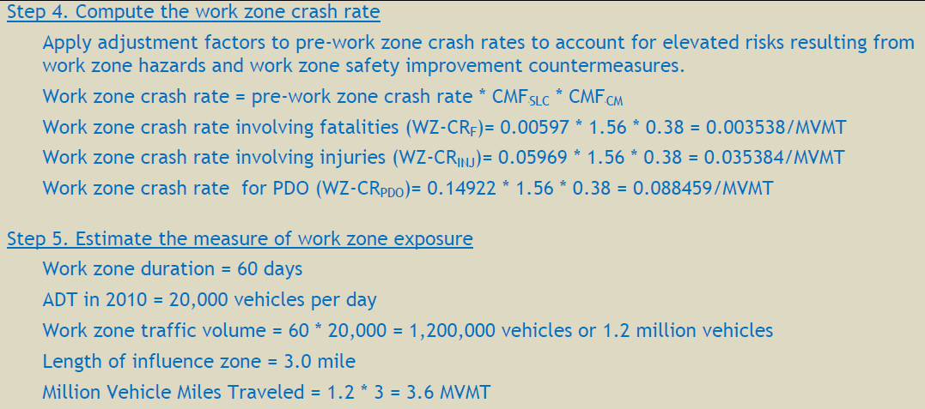
EXERCISE #12: Road User Costs – Example Calculation
Steps 2 and 3 were developing the CMFs. We did that for you.
Notes:
Key Message: Perform calculations to determine RUC for a sample project.
Interaction: Walk through the calculations with the group
Notes:
Mallela, J., Sadasivam, S. Work Zone Road User Costs Concepts and Applications, Report FHWA-HOP-12-005, December 2011.
http://ops.fhwa.dot.gov/wz/resources/publications/fhwahop12005/fhwahop12005.pdf

Slide 139
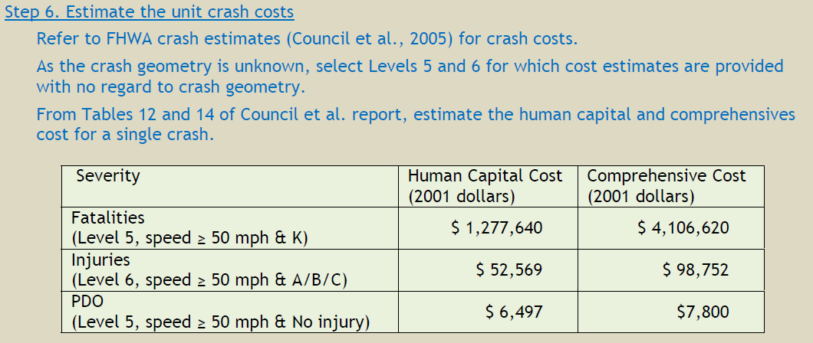
EXERCISE #12: Road User Costs – Example Calculation
Notes:
Key Message: Perform calculations to determine RUC for a sample project.
Interaction: Walk through the calculations with the group
Notes:
Mallela, J., Sadasivam, S. Work Zone Road User Costs Concepts and Applications, Report FHWA-HOP-12-005, December 2011.
http://ops.fhwa.dot.gov/wz/resources/publications/fhwahop12005/fhwahop12005.pdf

Slide 140
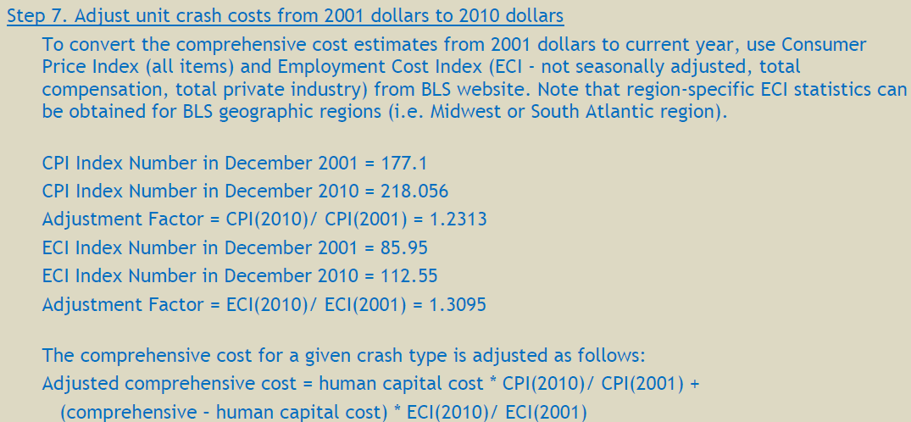
EXERCISE #12: Road User Costs – Example Calculation
Notes:
Key Message: Perform calculations to determine RUC for a sample project.
Interaction: Walk through the calculations with the group
Notes:
Mallela, J., Sadasivam, S. Work Zone Road User Costs Concepts and Applications, Report FHWA-HOP-12-005, December 2011.
http://ops.fhwa.dot.gov/wz/resources/publications/fhwahop12005/fhwahop12005.pdf

Slide 141
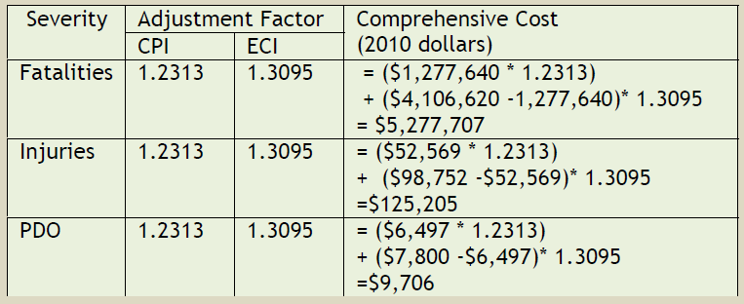
EXERCISE #12: Road User Costs – Example Calculation
Notes:
Key Message: Perform calculations to determine RUC for a sample project.
Interaction: Walk through the calculations with the group
Notes:
Mallela, J., Sadasivam, S. Work Zone Road User Costs Concepts and Applications, Report FHWA-HOP-12-005, December 2011.
http://ops.fhwa.dot.gov/wz/resources/publications/fhwahop12005/fhwahop12005.pdf

Slide 142
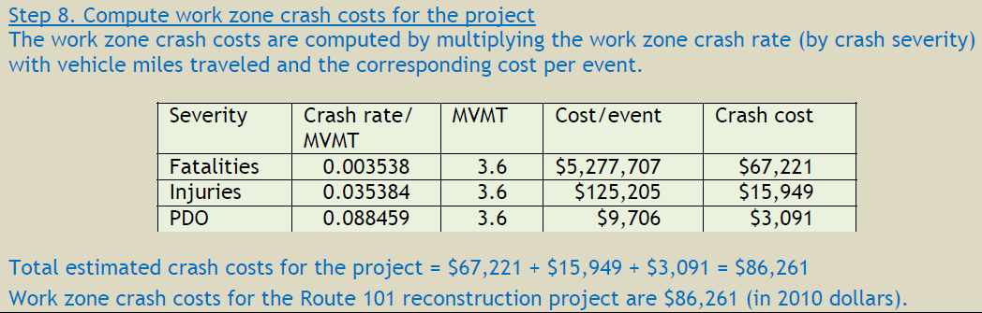
EXERCISE #12: Road User Costs – Example Calculation
Notes:
Key Message: Perform calculations to determine RUC for a sample project.
Interaction: Walk through the calculations with the group
Notes:
Mallela, J., Sadasivam, S. Work Zone Road User Costs Concepts and Applications, Report FHWA-HOP-12-005, December 2011.
http://ops.fhwa.dot.gov/wz/resources/publications/fhwahop12005/fhwahop12005.pdf

Slide 143
Modeling
Focused on surrogate safety measure of mobility impacts
Provide information on the relative safety of work zone setups for comparison
Outputs lead to safety-related decisions involving
Time of day for active work
Lane closure and queuing strategies
Public information safety techniques
Notes:
Key Message: Modeling can provide information on a work zone’s setup as it relates to safety.
Background Information:
Monitoring can provide estimates of when and to what extent stop-and-go traffic or queues may form as a result of congestion in a work zone. Stop-and-go traffic and queues are indicators of disruptions to traffic flow that can lead to speed differentials and greater potential for crashes.
Interaction:
Notes:

Slide 144
Modeling
How are traffic models related to work zone safety?
Estimates compared from 4 models
Can be used during construction to analyze proposed changes to plans
Notes:
Key Message: Studies have compared a variety of models.
Background Information:
Agencies and contractors responsible for the planning, design, and operation of work zones are constantly under pressure to reduce the negative impacts that work zones can have on the traveling public. Modeling techniques can be used to assess the possible negative impacts of a specific work zone prior to it going operational.
Researchers at the University of Massachusetts compared estimates obtained from four work zone simulation models (QuickZone, CA4PRS, CORSIM, and QUEWZ) against actual work zone conditions at eight locations in New England
Interaction:
Notes:

Slide 145
Modeling
How are traffic models related to work zone safety?
Supports planning and design process to estimate traffic flow variations and lead to decisions:
Employ work zone strategies that focus on reducing queues, lowering speed differentials, and improving traffic flow
Reduce the potential for crashes before the work zone is set up
Notes:
Key Message: Studies have compared a variety of models.
Background Information:
Agencies and contractors responsible for the planning, design, and operation of work zones are constantly under pressure to reduce the negative impacts that work zones can have on the traveling public. Modeling techniques can be used to assess the possible negative impacts of a specific work zone prior to it going operational.
Researchers at the University of Massachusetts compared estimates obtained from four work zone simulation models (QuickZone, CA4PRS, CORSIM, and QUEWZ) against actual work zone conditions at eight locations in New England
Interaction:
Notes:

Slide 146
Traffic Impacts Analysis
QuickZone
CORSIM
Well-known
Low cost sketch-planning tool
Reasonable estimates of queue lengths and delay
CA4PRS
Estimates length of pavement that can be rehabilitated or reconstructed
Estimates costs
QUEWZ
Simulates traffic operation around a work zone
Low cost
Reasonable estimates of queue lengths and road user costs
Notes:
Key Message: The most cost-effective time to make a change is before you close a lane.
Background Information: Analysis tools can help evaluate various configurations and operational impacts due to changes in layout of work zones
QuickZone: Low-risk, Low cost. Reasonable estimates of queue lengths compared to field data. Estimates work zone delays. Can be used in policy, planning, design, and operation phases of project.
CA4PRS: Estimates length of pavement that can be rehabilitated or reconstructed. Estimates how costs will arise from various alternatives.
CORSIM: Well-known, Simulates traffic operation around a work zone. Not WZ-specific.
QUEWZ: Low-risk, Low cost. Reasonable estimates of queue lengths compared to field data. Simulates queue lengths and road user costs.
Interaction: Ask the participants what models they’ve used from this list? Other models not on the list (e.g., VISSIM)?
“Once you receive answers from these models (queue length, delay), how do you relate that to the safety of the work zone, and what decisions might you make based on the software’s analyses?”
Notes:
FHWA Traffic Analysis Toolbox Volume XII: WZ Traffic Analysis – Application and Decision Framework. Section 3, Selecting an Appropriate Type of Traffic Analysis Tool.
http://www.ops.fhwa.dot.gov/publications/fhwahop12009/sec3.htm#sec31

Slide 147
Learning Outcomes Review
You should now be able to:
Organize data in a useful manner for analysis
Identify and have familiarity with the use of safety data analysis tools and techniques
Identify examples of data analysis challenges
Understand successful practices that overcome these challenges
Apply your knowledge to analyze work zone safety data
Notes:
Key Message: Review learning outcomes of this module.
Background Information:
Interaction:
Notes:

Slide 148
4. Application
Work Zone Safety Data
Collection and Analysis
Image: ATSSA
Notes:
Key Message: Module opening
Est. Presentation Time: As needed
Explanation of Cues/Builds: None
Suggested Comments: Let’s discuss {module name}
Suggested Questions: None
Possible Problems: None

Slide 149
Module Objectives
For you to learn how to:
Use work zone data analysis results to improve
Goals and objectives
Policies, practices, and standards
Sources for future data
Analysis capabilities
Understand that the application of the data collected and analyzed is vital to improving safety in work zones
Notes:
Key Message: Move into pulling everything together. Collect and analyze the data to determine recommended improvements.
Background Information:
Once data are collected and analyzed by an agency, it is important that the results are used to address issues in current and future work zones
The collection and analysis of both real-time and lagging work zone safety-related data allow highway agencies to make changes to upcoming projects that have similar characteristics to past projects. Once an agency identifies strategies that are feasible and cost effective, they can begin taking steps toward implementing modifications to current work zone policy, design standards, or practices. These can vary widely, as the needs of the State and the current policies vary
Interaction:
Notes:

Slide 150
EXERCISE 13: Investigating Crash Data
Identify patterns in Statewide work zone crash database:
Crash types
Contributing circumstances
Work zone environment (day/night, weather)
Driver behavior
Worker involvement
Notes:
Key Message: Investigate crash data
Background Information: Each state has a crash database, as discussed previously. Practitioners investigate the data from those crashes to determine trends and patterns.
Interaction: Point participants to the tables in Exercise 13 in their Participant Workbook. Give them time (individually or in small groups) to identify some patterns from the available data.
Discuss the identified patterns as a large group.
Notes:

Slide 151
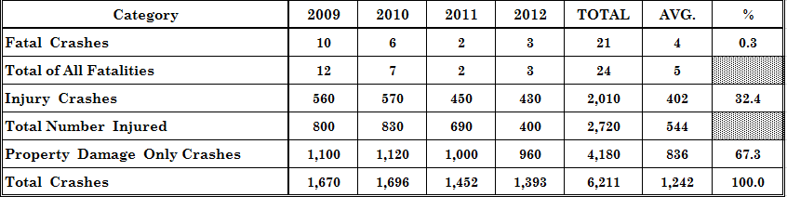
EXERCISE 13: Investigating Crash Data
Notes:
Key Message: Showing one of the tables
Background Information: This is one of the tables that participants will have in their workbook. It can be used as the backdrop during discussions.
Interaction: Talk with the group about what they have found from their packet of data in the participant workbook.
Notes:

Slide 152
Case Study: Ohio DOT Changes to Future Projects
Ohio DOT used crash data to change work zone standards in these areas
Construction vehicle-related crashes
Motorcycle-related crashes
Nighttime crashes
Notes:
Key Message: Process can elevate an agency’s confidence in making changes.
Background Information:
Viewing work zone crash data and addressing project-level issues is a first step in using crash data to address work zone safety and mobility issues. Gathering and viewing work zone crash data on an aggregate level can uncover findings that may enable the agency to make changes that can prevent future crashes.
Similar to the process we went through as a group at the beginning of this module, Ohio DOT investigated their State work zone crash database to identify any common contributing circumstances.
Reviewing historic crash data in work zone and non-work zone conditions led Ohio DOT to select three emphasis areas for work zone crashes: 1. Construction vehicles; 2. Motorcycles; 3. Nighttime
By conducting similar work zone crash data reviews to identify trends or areas of emphasis on a regular basis, agencies can ensure that they are aware of any developing work zone crash trends in their jurisdiction
Interaction:
Notes:
Source: Stargell, R., Best Practices in Work Zone Assessment, Data Collection and Performance Measurement.

Slide 153
Case Study: Ohio DOT Changes to Future Projects
Construction Vehicle- Related Crashes
Developed guidelines for access points to reduce the risk of rear-end collisions due to construction vehicle ingress/egress
Motorcycle-Related Crashes
Developed a qualified product list for blackout tape
Nighttime Crashes
Adjusted policies for construction vehicle delineation, work zone delineation, raised pavement markers
Limited use to 45 days maximum
Notes:
Key Message: Ohio made some key changes to their WZ policies.
Background Information:
Construction vehicles
- Identified rear-end collisions in the left-hand lane on some work zones
- Many of the crashes were upstream of construction access points
- Drafted a Plan Insert Sheet to establish guidelines for construction access points to limit rear-end collisions due to construction equipment ingress and egress
Motorcycles
- Found a rising trend of fatal motorcycle-related crashes in work zones
- Officials reviewed standards for pavement marking and marking removal
- Concerns were raised that blackout tape was causing crashes because it reduced traction
- Ran multiple tests and developed a qualified product list
- Limited use of blackout tape to 45 days maximum
Nighttime
- Determined that 50% of Ohio’s work zone fatalities over a 10-year period occurred during nighttime hours
- Adjusted construction vehicle and work zone delineation policies
- Modified specifications to require strobe or rotating lights on all work vehicles and reflective sheeting to all vehicles <=10,000 pounds
- Required usage of raised pavement markers and barrier reflectors on temporary construction projects
Interaction:
Notes:

Slide 154
Case Study: Nighttime Work Zones (NCHRP Report 627)
Research question: How do daytime and nighttime work zones affect traffic safety?
Grouped crashes into 6 categories and analyzed the data
Daytime
Project was inactive
Work activity occurring, no lane closure
Work activity and temporary lane closure occurring
Notes:
Key Message: Will not find a definite yes/no answer to utilizing Day v. Night.
Background Information:
Studied 64 projects’ work activity & crash data: CA, NC, NY, OH, WA
Developed crash rates;
Determined the nature of the crashes and identified similarities and differences
Identified and evaluated management practices that promote work zone safety and mobility
Developed work zone crash reporting recommendations to further improve the data collected
Research activities included analysis of New York’s work zone accident database and multiple State crash databases.
Management strategies with most potential to lower crash rates:
Reduce the overall number of work zones necessary
Use time-constrained contracts to reduce work zone duration
Use medians or detours for full directional roadway closures
Move work activities that include lane closures to nighttime
Use enhanced traffic law enforcement
Incorporate future work zone capacity into highway designs (e.g., design for a wider sub-base than needed on initial construction projects so that if future roadway expansion is needed, construction duration can be reduced)
Use ITS to reduce congestion and increase safety
Use crash report forms with all of the recommended work zone crash analysis elements
Interaction:
Notes:
NCHRP Report 627: http://onlinepubs.trb.org/onlinepubs/nchrp/nchrp_rpt_627.pdf

Slide 155
Case Study: Nighttime Work Zones (NCHRP Report 627)
Results
Crash rates by category
Similarities and differences
Evaluation of management practices
Work zone crash reporting recommendation
Nighttime
Project was inactive
Work activity occurring, no lane closure
Work activity and temporary lane closure occurring
Notes:
Key Message: Will not find a definite yes/no answer to utilizing Day v. Night.
Background Information:
Studied 64 projects’ work activity & crash data: CA, NC, NY, OH, WA
Developed crash rates;
Determined the nature of the crashes and identified similarities and differences
Identified and evaluated management practices that promote work zone safety and mobility
Developed work zone crash reporting recommendations to further improve the data collected
Research activities included analysis of New York’s work zone accident database and multiple State crash databases.
Management strategies with most potential to lower crash rates:
Reduce the overall number of work zones necessary
Use time-constrained contracts to reduce work zone duration
Use medians or detours for full directional roadway closures
Move work activities that include lane closures to nighttime
Use enhanced traffic law enforcement
Incorporate future work zone capacity into highway designs (e.g., design for a wider sub-base than needed on initial construction projects so that if future roadway expansion is needed, construction duration can be reduced)
Use ITS to reduce congestion and increase safety
Use crash report forms with all of the recommended work zone crash analysis elements
Interaction:
Notes:
NCHRP Report 627: http://onlinepubs.trb.org/onlinepubs/nchrp/nchrp_rpt_627.pdf

Slide 156
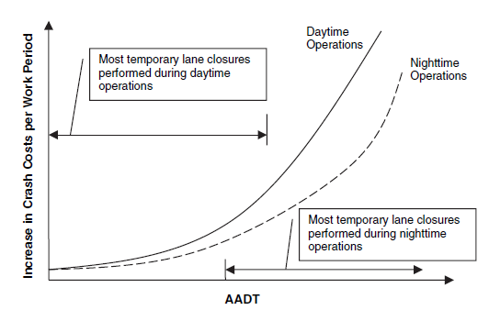
Case Study: Nighttime Work Zones (NCHRP Report 627)
Image: NCHRP
Notes:
Key Message: Nighttime and daytime work zones respond differently.
Background Information:
Relationships between increased traffic crash risk and roadway traffic demand at nighttime and daytime work operations that require temporary lane closures
Non-linear relationship – expected that traffic volume increases significantly impact crash risks and the costs associated with them
Interaction:
Notes:

Slide 157
Case Study: Montana DOT Review: Every 2 Years
Program Level
Continuously pursue improvements in work zone safety and mobility
Project Level
Analyze project data for trends to use at the program level
Notes:
Key Message: Montana DOT reviews information every 2 years
Background Information: Work Zone Safety and Mobility Goal and Objectives, Procedures, and Guidelines
Developed a variety of data collection procedures and guidelines at the project and program levels.
Used to recognize improvement needs and make those improvements.
The WZ Safety and Mobility Guidelines: set up procedures to collect traffic delay and traffic volume data for significant construction zone projects.
The following procedures are some of the steps:
Statewide analysis of crash records every 2 years, along with changes in trends.
Determine recommendations for enhancing safety and mobility on current and future projects
Assess work zone crashes annually for immediate changes and to determine the topics for the biannual program review
Interaction: Introduce other sources such as SHSPs
Notes:

Slide 158
Learning Outcomes
You should now be able to:
Use work zone data analysis results to improve
Goals and objectives
Policies, practices, and standards
Sources for future data
Analysis capabilities
Understand that the application of the data collected and analyzed is vital to improving safety in work zones
Notes:
Key Message: End of Module review
Background Information:
Interaction:
Notes:

Slide 159
5. Your Turn
Work Zone Safety Data
Collection and Analysis
Image: ATSSA
Notes:
Key Message: Module opening
Est. Presentation Time: As needed
Explanation of Cues/Builds: None
Suggested Comments: Let’s discuss {module name}
Suggested Questions: None
Possible Problems: None

Slide 160
Module Objectives
For you to learn how to:
Apply the workshop to your specific situation
Pull everything together
Take action to improve work zone safety
Notes:
Key Message: Move into pulling everything together. Collect and analyze the data to determine recommended improvements.
Background Information:
Once data are collected and analyzed by an agency, it is important that the results are used to address issues in current and future work zones
The collection and analysis of both real-time and lagging work zone safety-related data allow highway agencies to make changes to upcoming projects that have similar characteristics to past projects. Once an agency identifies strategies that are feasible and cost effective, they can begin taking steps toward implementing modifications to current work zone policy, design standards, or practices. These can vary widely, as the needs of the State and the current policies vary
Interaction:
Notes:

Slide 161
Applying the Workshop to You
Develop Baseline – Where are we now?
Identify the most beneficial and feasible strategies from the workshop
Take steps to improve work zone safety-related data collection, analysis, and implementation
Notes:
Key Message: Feedback tool slides throughout the workshop should help participants identify which areas offer significant benefits.
Background Information:
Interaction:
Notes:

Slide 162
Identifying Next Steps
Critical Steps to Implementation template
Critical Step | Responsible Party | Key Decision(s) Associated with Step | Decision-maker | Required Preparation | Estimated Timeframe to Complete Step (time from when activity begins) | Date Completed
Notes:
Key Message:
Background Information:
Determine the steps needed to implement each strategy by completing the table on the following slide, and identify the other elements as follows:
Critical Step. What is the first/next step in the process to move this strategy from concept to implementation?
Responsible Party. Who will be responsible for the completion of this step? Assigning a lead for each step increases the likelihood of completion.
Key Decision(s) Associated with Step. What must be decided before moving to the next step?
Decision-maker. Who must make the key decision? Senior management? A work zone safety partner?
Required Preparation. What are the activities that must be completed to ensure this critical step occurs?
Estimated Timeframe to Complete Step. By when must this step be completed to ensure timely implementation?
Date Completed. On what date did the responsible party complete this critical step?
Interaction: Class activity to talk through an example
Notes:

Slide 163
Example: Implement Portable Traffic Monitoring Devices (PTMDs) for Speed and Queue Data Collection
Critical Step | Responsible Party | Key Decision(s) Associated with Step | Decision-maker | Required Preparation | Timeframe to Complete Step
1. Further evaluate current deployments of PTMDs in your State and other States. | Work Zone Engineer, State DOT | Should we deploy this strategy on our work zones? | Work Zone Engineer, State DOT | Prepare literature review report on current applications. | 3 months
2. Determine most applicable sites/project types in our jurisdiction for deployment. | Work Zone Engineer, District Resident Engineers | Choose sites for deployment. | Resident Engineers, Work Zone Engineer | Review temporary traffic control (TTC) plans. | 6 months
3. Secure funding source and purchase PTMDs. | Work Zone Engineer, Management | Determine funding source and authorize purchase. | DOT Management | Analyze purchase options (e.g., lease vs. buy) and other costs. | 9 months
4. Deploy PTMDs and collect data. | Resident Engineers, Construction Inspectors | Identify responsible party for data collection. | Resident Engineers | Identify process for data collection and archival. | 10-12 months
5. Examine effects of the treatment where implemented. | Resident Engineers, Construction Inspectors, Work Zone Engineer | Determine what effect this treatment has on the safety and mobility of the work zone. | Work Zone Engineer, Resident Engineers | Identify objectives and performance measures. | 12-15 months
6. Analyze data and evaluate effectiveness. | Work Zone Engineer, Traffic Engineer | Determine performance measures and desired metrics. | Work Zone Engineer | Understand data output. | 12-15 months
7. If evaluation supports additional deployment, identify applicable sites. | Work Zone Engineer, Resident Engineers, Construction Inspectors | Choose sites for additional deployment. | Resident Engineers, Work Zone Engineer | Review TTC plans and TMP. | 12-24 months
8. Institutionalize PTMD use in appropriate work zones based on most important criteria. | Work Zone Engineer, Resident Engineers | Identify criteria for choosing deployments. Develop special provisions for use of PTMDs on projects. | Work Zone Engineer, Resident Engineers | Determine most appropriate type of document (e.g., standard plan/drawing, special provision, specification). | 24+ months
Notes:
Key Message: This is an example of the steps one might take.
Background Information: Examples are provided in the Guide for each of the recommended strategies.
Interaction: Notice the columns are not quite like the previous slide – make the chart work for you
Notes: Don’t walk through the slide, but rather show it as an example of what is in the Guide.

Slide 164
EXERCISE 14: Address Your Issues
Split up into groups, as directed by the workshop facilitator, to discuss these items and report out to the group
Notes:
Key Message: This exercise will lead you to post-workshop next steps to improve WZ safety data collection, analysis, and application in your jurisdiction.
Background Information:
Interaction: Split the room into small groups, each focused on a different issue discussed earlier in the workshop. (Tracking these issues throughout the day will prove helpful at this point in the workshop.)
Have each group complete a blank version of the “Critical Steps” table for their topic.
Notes:

Slide 165
Evaluation
Critical!
Guides future decisions stemming from work zone safety-related analysis
Documentation needs
List of work zone improvements
Location and time of these improvements
Reasons for the changes
Objective: Continuous Improvement
Notes:
Key Message: Judging against agency’s objectives is essential to improving the processes, techniques for long-term
Background Information:
After analyzing work zone data and making safety-related work zone improvements, it is important to evaluate these improvements to determine their effectiveness
For example, if revisions to standard work zone layouts were made due to an observation of an increasing trend of work zone crashes throughout a region, officials should make note of this change as well as the number of observed crashes before and after the change. Periodic assessments of crash reports from work zones in this region will allow for the determination of any changes to the trend and an assessment of the effect on work zone safety.
Interaction: Are there other reasons besides continuous improvement for evaluation?
Are there risks with making changes during a project?
Discussion may lead to legality:
You are part of a chain towards evaluation, and validation of decisions along the design/construction path.
These decisions are not done in a vacuum but by seasoned professionals armed with the best information available.
Notes:

Slide 166
Learning Outcomes Review
You should now be able to:
Use work zone data analysis results to improve
Goals and objectives
Policies, practices, and standards
Sources for future data
Analysis capabilities
Understand that the application of the data collected and analyzed is vital to improving safety in work zones
Notes:
Key Message: Review learning objectives.
Background Information:
Interaction:
Notes:

Slide 167
Closing
Work Zone Safety Data
Collection and Analysis
Image: ATSSA
Notes:
Key Message: Module opening
Est. Presentation Time: As needed
Explanation of Cues/Builds: None
Suggested Comments: Let’s discuss {module name}
Suggested Questions: None
Possible Problems: None

Slide 168
Summary
Work Zone Safety Data Collection
Type of Data to Collect
Collection Methods
Barriers and Solutions
Work Zone Safety Data Analysis
Challenges
Tools and Techniques
Application
Case Studies
Next Steps
Notes:
Key Message: This is an overview of what we’ve discussed today.
Background Information:
Interaction: Ask for any feedback on the summary of the course.
Notes: Briefly walk through the main points of the course.

Slide 169
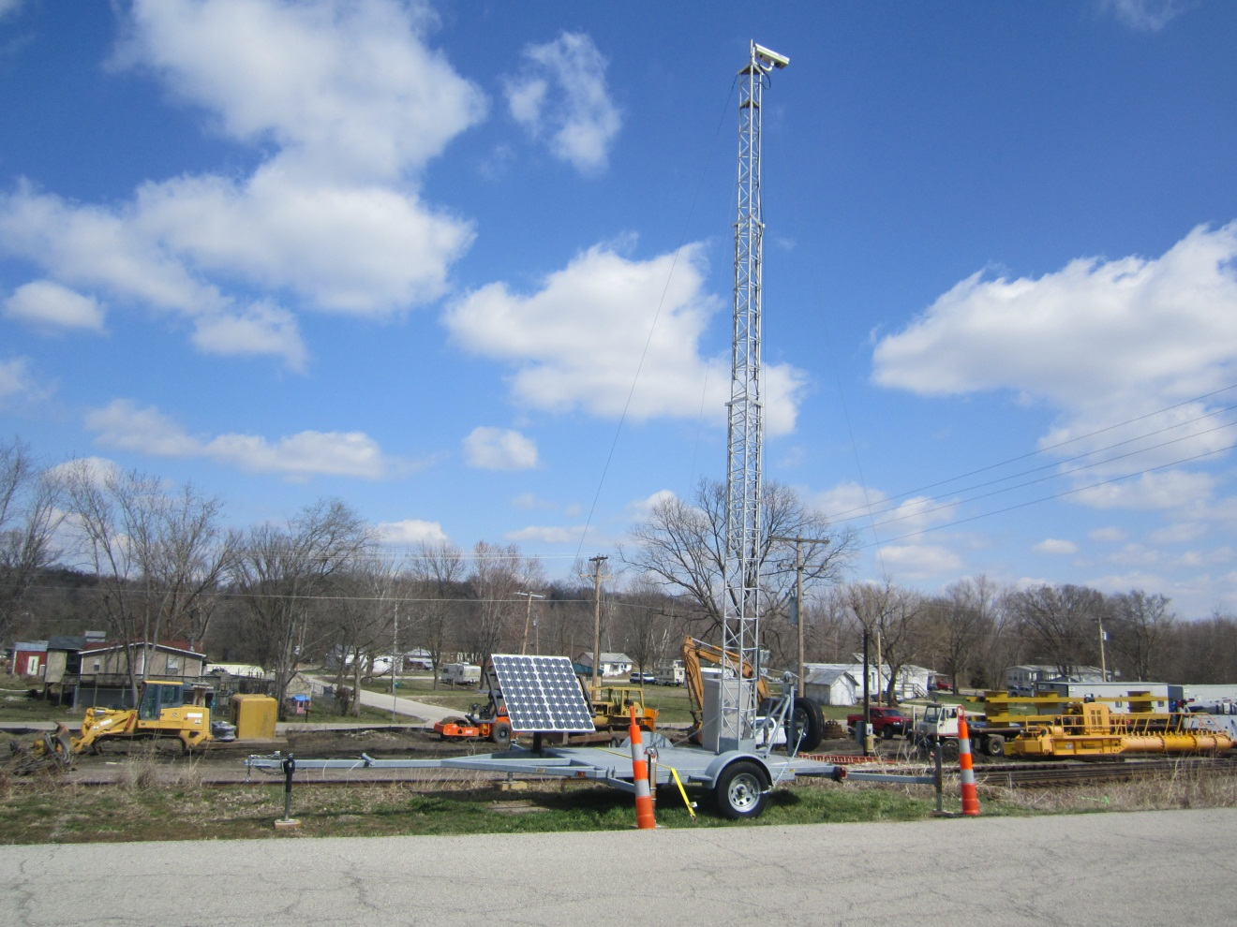
Knowledge Check / Evaluations
Conduct Knowledge Check
Evaluations
Image: ATSSA
Notes:
Key Message: Conduct knowledge check
Background Information:
Interaction:
What methods do you see most promise for your agency?
Notes:

Slide 170
Closing
Work Zone Safety Data
Collection and Analysis
Image: ATSSA
Notes:
Key Message: Module opening
Est. Presentation Time: As needed
Explanation of Cues/Builds: None
Suggested Comments: Let’s discuss {module name}
Suggested Questions: None
Possible Problems: None

Slide 171
Review the “Parking Lot”
Anything pending?
Notes:
Key Message: Explain the “parking lot”
Est. Presentation Time: 2 minute(s)
Explanation of Cues/Builds: None
Suggested Comments: As we go through the class, for sure you will have questions. If you ask a question about a topic that we will discuss later, rather than discussing the topic then, we will “park it” by writing it down in the flip chart, so we do not forget. At the end of the course, we will review the “parking lot” to make sure the question was answered.
Suggested Questions: None
Additional Information: Remember this concept may have been used in other course, so keep this brief.
Possible Problems: If there is no flip chart, use a corner of a blackboard or ask a student to keep a list of questions. You may also have a PowerPoint file open to serve as a “parking lot”.

Slide 172
Review Course Objectives
To provide an introduction to work zone safety-related data collection and analysis, how it applies to the Final Rule on Work Zone Safety and Mobility
To introduce work zone data collection methods and discuss barriers to collecting data
To discuss data analysis techniques, tools, and best practices to identifying barriers and overcoming them
Notes:
Key Message: Discuss course objectives
Est. Presentation Time: 1-2 minute(s)
Explanation of Cues/Builds: None
Suggested Comments: Self explanatory
Suggested Questions: Are these the objectives you expect from this course?
Additional Information: None
Possible Problems: None

Slide 173

Conclusion
Questions?
Knowledge check
Twenty-five (25) True/False questions at four (4) points each
Image: ATSSA
Notes:
Key Message: Commit to immediate actions.
Background Information:
Interaction: Ask attendees to volunteer their next immediate actions based on what they learned today. Take any additional overall questions. Hand back to the host for any final directions for the group.
Notes: This course will only help your work zones if you take action based on what you’ve learned. Commit to pursuing something you’ve learned today, and to taking the first step.

