Slide 1


Designing Temporary Traffic Control (TTC) Zones for Pedestrian Accessibility
American Traffic Safety Services Association
Images: US Access Board and FHWA
Notes:
Key Message: Course opening
Est. Presentation Time: As needed
Explanation of Cues/Builds: None
Suggested Comments: Good morning. I would like to welcome you to the Designing Temporary Traffic Control Zones for Pedestrian Accessibility training course.
Suggested Questions: Why are we here?
Additional Information: Greet students as they come in.
Possible Problems: None

Slide 2
Disclaimer
This material is based upon work supported by the U.S. Department of Transportation under Cooperative Agreement No. 693JJ31750002. The material was prepared by ATSSA.
Any opinions, findings and conclusions or recommendations expressed in this publication are those of the trainer and the grantee and do not necessarily reflect the view of the U.S. Department of Transportation.
This course does not constitute a national standard, specification, or regulation. The U.S. Government does not endorse products or manufacturers. Trademarks or manufacturers’ names appear in this document only because they are considered essential to the objective of the document.
Notes:
Key Message: FHWA disclaimer
Est. Presentation Time: Less than 1 minute(s)
Explanation of Cues/Builds: None
Suggested Comments: Self explanatory
Suggested Questions: None
Additional Information: Information about the grant can be found at www.atssa.com
Possible Problems: None

Slide 3
Instructor
Notes:
Key Message: Introduce yourself
Est. Presentation Time: Less than 1 minute(s)
Explanation of Cues/Builds: None
Suggested Comments: My name is ____. I will be your instructor today. I will tell you a bit more about myself later.
Suggested Questions: None
Additional Information: None
Possible Problems: Avoid telling your experience and credentials here. This will be done a bit later.

Slide 4
Notes
Any opinions, findings, conclusions or recommendations expressed in this course are those of the trainer and the grantee and do not necessarily reflect the views of FHWA or ATSSA
This course does not constitute a national standard, specification or regulation
Notes:
Key Message: Disclaimer
Est. Presentation Time: Less than 1 minute(s)
Explanation of Cues/Builds: None
Suggested Comments: Self explanatory
Suggested Questions: None
Additional Information: None
Possible Problems: Don’t read this, just say it in a fast manner.
Image Credit: Keep Calm It's Just My Opinion
http://sd.keepcalm-o-matic.co.uk/i/keep-calm-it-s-just-my-opinion-1.png

Slide 5

Developed and Presented by
American Traffic Safety Services Association
Notes:
Key Message: Introduce ATSSA
Est. Presentation Time: Less than 1 minute(s)
Explanation of Cues/Builds: None
Suggested Comments: This course is presented to you by ATSSA, a national leader in work zone training.
Suggested Questions: How many of you have taken courses with ATSSA before? Which ones?
Additional Information: None
Possible Problems: Spell out the acronym. Do not assume everyone is familiar.

Slide 6
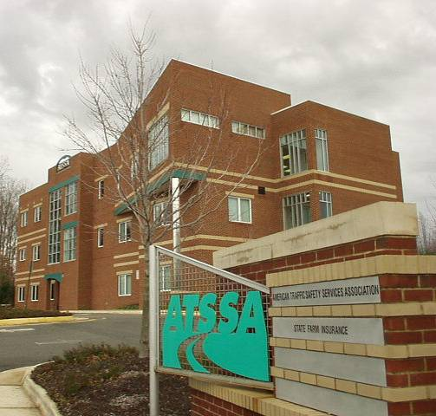
About ATSSA
International trade association
Headquarters: Fredericksburg, VA
1,800 company members
atssa.com
1-800-272-8772
Image: ATSSA
Notes:
Key Message: Briefly describe ATSSA
Est. Presentation Time: 1-minute(s)
Explanation of Cues/Builds: None
Suggested Comments: Self explanatory
Suggested Questions: None
Additional Information: Fredericksburg is off I-95 between Richmond and Washington DC. ATSSA does not have individual membership.
Possible Problems: This is not a sales pitch. The purpose of this slide is to give credibility to ATSSA and to you, as an ATSSA instructor. Keep this brief.

Slide 7
ATSSA’s Mission
To advance traffic safety
through training!
Notes:
Key Message: Define ATSSA’s mission
Est. Presentation Time: Less than 1 minute(s)
Explanation of Cues/Builds: None
Suggested Comments: We strongly believe that we can improve traffic safety through training. So thank you for being here.
Suggested Questions: None
Additional Information: Picture is from Pennsylvania DOT’s public relations campaign
Possible Problems: None

Slide 8
Introductions
Name
Employer
City and State
Experience
Notes:
Key Message: Introduction of participants
Est. Presentation Time: Depending on the number of participants
Explanation of Cues/Builds: None
Suggested Comments: Please tell your name, who you work for, the city and state where you work and the type of work you do.
Suggested Questions: None
Additional Information: This is important, to know the experience of those in the class. Do not skip it!
Possible Problems: Keep this moving. If a student starts to ramble, point to the next person and move on.

Slide 9
About your ATSSA Instructor
Notes:
Key Message: Introduce yourself
Est. Presentation Time: 1-2 minute(s)
Explanation of Cues/Builds: None
Suggested Comments: As I said earlier, my name is _______. I have been teaching for ATSSA for ___ years. I got my experience working for _____ where I worked for __ years. You may call me by my first name.
Suggested Questions: None
Additional Information: The purpose of this is to establish credibility as an instructor. Limit the experience listed to things related to work zone safety.
Possible Problems: Too much of a resume here may create the impression that you are above your audience and may be a barrier to communication. Say that you welcome questions.

Slide 10
Housekeeping
Cell phones off/silent
No texting
Restroom location
Emergency exits
10-min break every hour
Lunch arrangements
Ending time
Notes:
Key Message: Housekeeping rules
Est. Presentation Time: Less than 1 minute(s)
Explanation of Cues/Builds: None
Suggested Comments: Self explanatory
Suggested Questions: None
Additional Information: Make sure you go through the emergency exit procedures. This reinforces safety!
Possible Problems: If lunch is provided, change the slide as needed.
Image Credits:
No cellphone
http://i.i.com.com/cnwk.1d/i/tim/2010/08/06/no-iphone_270x270.jpg
Exit Sign
http://emergencylighting.org/wp-content/uploads/emergency-exit-signs.jpg

Slide 11
Course Objectives
Identify some of the challenges faced by persons with disabilities within the Public Right-of-Way (PROW)
Identify applicable laws, regulations, guidelines, and standards pertaining to accessibility for persons with disabilities
Discuss their application to temporary traffic control (TTC) zones
  Design elements
  Best practices
Notes:
Key Message: Discuss course objectives
Est. Presentation Time: 1-2 minute(s)
Explanation of Cues/Builds: None
Suggested Comments: These are the objectives of this course. Notice that this course is not only for you to learn TTC standards and guidelines but to learn how to apply them, how to use them, particularly in urban areas, where you are likely to find pedestrians.
Suggested Questions: What is a TTC zone?
Additional Information: None
Possible Problems: None

Slide 12

Course Materials
Course notebook
Applying the ADA in Work Zones Practitioner Guide
Pencil
Tent name sign
Image: FHWA
Notes:
Key Message: Discuss course materials
Est. Presentation Time: 1 minute(s)
Explanation of Cues/Builds: None
Suggested Comments: Let’s check your course materials.
Suggested Questions: Does everyone have the materials? Anything missing?
Additional Information: None
Possible Problems: The referenced document has discrepancies and is to be reviewed by the National TTC committee. Be cautious in referencing this document and/or consider not referencing it until the TTC committee has reviewed.

Slide 13
Exam
25 multiple choice questions @ 4 points each = 100 pts
Open book, open notes
30 minute time limit
Passing score: 80%
Notes:
Key Message: Discuss the exam
Est. Presentation Time: 2 minute(s)
Explanation of Cues/Builds:
Suggested Comments: Self explanatory,
Suggested Questions: To get 80, how many questions can you miss and still pass? Eight.
Additional Information: None
Possible Problems: None

Slide 14
The “Parking Lot”
Questions to be discussed later will be “parked” until they are discussed
Will review at the end to make sure they were answered
Notes:
Key Message: Explain the “parking lot”
Est. Presentation Time: 2 minute(s)
Explanation of Cues/Builds: None
Suggested Comments: As we go through the class, for sure you will have questions. If you ask a question about a topic that we will discuss later, rather than discussing the topic then, we will “park it” by writing it down in the flip chart, so we do not forget. At the end of the course, we will review the “parking lot” to make sure the question was answered.
Suggested Questions: None
Additional Information: None
Possible Problems: If there is no flip chart, use a corner of a blackboard or ask a student to keep a list of questions. You may also have a PowerPoint file open to serve as a “parking lot”.

Slide 15
Notes
This course is based on the Federal TTC standards and guidelines included in the 2009 Edition of the Manual on Uniform Traffic Control Devices (MUTCD)
State and local standards may vary
Students are encouraged to check their State and local standards before applying the information learned in this course
Notes:
Key Message: NOTES
Est. Presentation Time: Less than 1 minute(s)
Explanation of Cues/Builds: None
Suggested Comments: Self explanatory
Suggested Questions: None
Additional Information: This is a disclaimer. Emphasize the state and local standards may vary and students should be proactive about them.
Possible Problems: None

Slide 16
Why this Course?
TTC zones affecting any pedestrian facility shall be accessible: It is the law!
The MUTCD is vague in this area
More specific guidance is needed on the implementation of the ADA in highway work zones
Notes:
Key Message: Why this Course?
Est. Presentation Time: 1-2 minute(s)
Explanation of Cues/Builds: None
Suggested Comments: The ADA standards apply in TTC zones but Part 6 of the MUTCD is rather vague. More guidance is needed on the implementation of the ADA in highway work zones. The MUTCD has only a few typical applications for pedestrian temporary traffic control treatments, and these seem mainly applicable to urban intersections. Within the MUTCD, there are two situations that are illustrated in Typical Applications 28 and 29; both of these state that where a sidewalk exists, provisions shall be made for disabled pedestrians. However, there is little to no discussion as to what types of devices should be used in order to make these provisions. Additionally, these typical applications seem focused on urban settings, while pedestrian issues also arise at temporary traffic control zones that are in suburban, small-town, and essentially rural environments. In these instances the engineer responsible for developing the pedestrian traffic control must rely on previous experience and judgment, which can result in a lack of consistency in pedestrian traffic control treatments from region to region.
Suggested Questions: Why this are we here?
Additional Information: None
Possible Problems: None

Slide 17
Course Modules
1. Understanding the Disability Challenge
2. Laws, Standards and Guidelines
3. Approaches to Routing Pedestrians
4. Temporary Pedestrian Accessible Routes
5. Field Exercise
6. Closing
Notes:
Key Message: Discuss course format and modules
Est. Presentation Time: 3 minute(s)
Explanation of Cues/Builds: None
Suggested Comments: These are modules we will cover.
Suggested Questions: None
Additional Information: Briefly discuss the content of each module and what will be covered to whet their appetite for the information.
Possible Problems: Avoid giving details. Do this in general terms and keep moving

Slide 18
Questions
Notes:
Key Message: End slide
Est. Presentation Time: Less than 1 minute(s)
Explanation of Cues/Builds: None
Suggested Comments: Self explanatory
Suggested Questions: Any questions? Let’s get started!
Additional Information: None
Possible Problems: None

Slide 19
1. Understanding the Disability Challenge
American Traffic Safety Services Association
Images: US Access Board and FHWA
Notes:
Key Message: Module Introduction
Est. Presentation Time: As needed
Explanation of Cues/Builds: None
Suggested Comments: Let’s go to the next module! In this module, we will discuss understanding the disability challenge.
Suggested Questions: None
Additional Information: None
Possible Problems: None

Slide 20
Module Objectives
Quantify the disability challenge
Discuss the varied pedestrian environment
Discuss the disability challenge in work zones
Discuss the types of disabilities and their challenges in TTC environments
Notes:
Key Message: Module Objectives
Est. Presentation Time: As needed
Explanation of Cues/Builds: None
Suggested Comments: These are the things we will do in this module. Let’s start!
Suggested Questions: None
Additional Information: None
Possible Problems: None

Slide 21
Question 1
According to the 2010 Census, what percent of the U.S. population over the age of 15 has a disability?
Notes:
Key Message: Question 1
Est. Presentation Time: 1-2 minute(s)
Explanation of Cues/Builds: None
Suggested Comments: Let me ask you this:
Suggested Questions: According to the 2010 Census, what percent of the U.S. population over the age of 15 has a disability?
Additional Information: None
Possible Problems: None

Slide 22
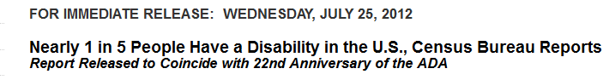

Answer to Question 1
About 20%
  57 million!
50% of them had severe disabilities
Notes:
Key Message: Question 1
Est. Presentation Time: 1-2 minute(s)
Explanation of Cues/Builds: None
Suggested Comments: Approximately 56.7 million people (18.7 percent) of the 303.9 million in the civilian non institutionalized population had a disability in 2010. About 38.3 million people (12.6 percent) had a severe disability (Table 1). About 12.3 million people aged 6 years and older (4.4 percent) needed assistance with one or more activities of daily living (ADLs) or instrumental activities of daily living (IADLs).
Suggested Questions: Are you surprised?
Additional Information: Other highlights:
People in the oldest age group — 80 and older — were about eight times more likely to have a disability as those in the youngest group — younger than 15 (71 percent compared with 8 percent). The probability of having a severe disability is only one in 20 for those 15 to 24 while it is one in four for those 65 to 69.
About 8.1 million people had difficulty seeing, including 2.0 million who were blind or unable to see.
About 7.6 million people experienced difficulty hearing, including 1.1 million whose difficulty was severe. About 5.6 million used a hearing aid.
Roughly 30.6 million had difficulty walking or climbing stairs, or used a wheelchair, cane, crutches or walker.
About 19.9 million people had difficulty lifting and grasping. This includes, for instance, trouble lifting an object like a bag of groceries, or grasping a glass or a pencil.
Difficulty with at least one activity of daily living was cited by 9.4 million non institutionalized adults. These activities included getting around inside the home, bathing, dressing and eating. Of these people, 5 million needed the assistance of others to perform such an activity.
About 15.5 million adults had difficulties with one or more instrumental activities of daily living. These activities included doing housework, using the phone and preparing meals. Of these, nearly 12 million required assistance.
Approximately 2.4 million had Alzheimer’s disease, senility or dementia.
Being frequently depressed or anxious such that it interfered with ordinary activities was reported by 7.0 million adults.
Adults age 21 to 64 with disabilities had median monthly earnings of $1,961 compared with $2,724 for those with no disability.
Overall, the uninsured rates for adults 15 to 64 were not statistically different by disability status: 21.0 percent for people with severe disabilities, 21.3 percent for those with non severe disabilities and 21.9 percent for those with no disability.
Possible Problems: None
Source:
https://www.usatoday.com/story/news/nation/2015/07/30/american-adults-disability/30881975/

Slide 23
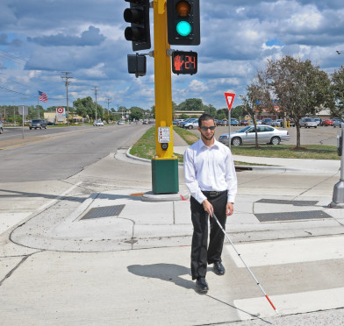

Question 2
How many Americans would you guess have vision disabilities?
Image: Crossroads Blog
Notes:
Key Message: Question 2
Est. Presentation Time: 1-2 minute(s)
Explanation of Cues/Builds: None
Suggested Comments: Let me ask you this:
Suggested Questions: How many Americans would you guess have vision disabilities?
Additional Information: None
Possible Problems: None
Image Credit: https://mntransportationresearch.org/2014/03/27/cell-phone-app-guides-blind-through-work-zones/

Slide 24
Answer to Question 2
10-12 million!
3X as many wheelchair users
70 percent of USA’s population will eventually have a temporary or permanent disability
Image: Crossroads Blog
Notes:
Key Message: Question 2
Est. Presentation Time: 1-2 minute(s)
Explanation of Cues/Builds: None
Suggested Comments: According to the National Council on Disabilities, 10 - 12 million Americans have vision disabilities. There are three times as many people with severe visual disabilities than there are wheelchair users. Visual disability can range from total blindness to low vision.
The Council also estimates that 70 percent of our country’s population will eventually have a temporary or permanent disability that makes climbing stairs impossible.
Suggested Questions: Are you surprised?
Additional Information: None
Possible Problems: None
Image Credit: https://mntransportationresearch.org/2014/03/27/cell-phone-app-guides-blind-through-work-zones/

Slide 25
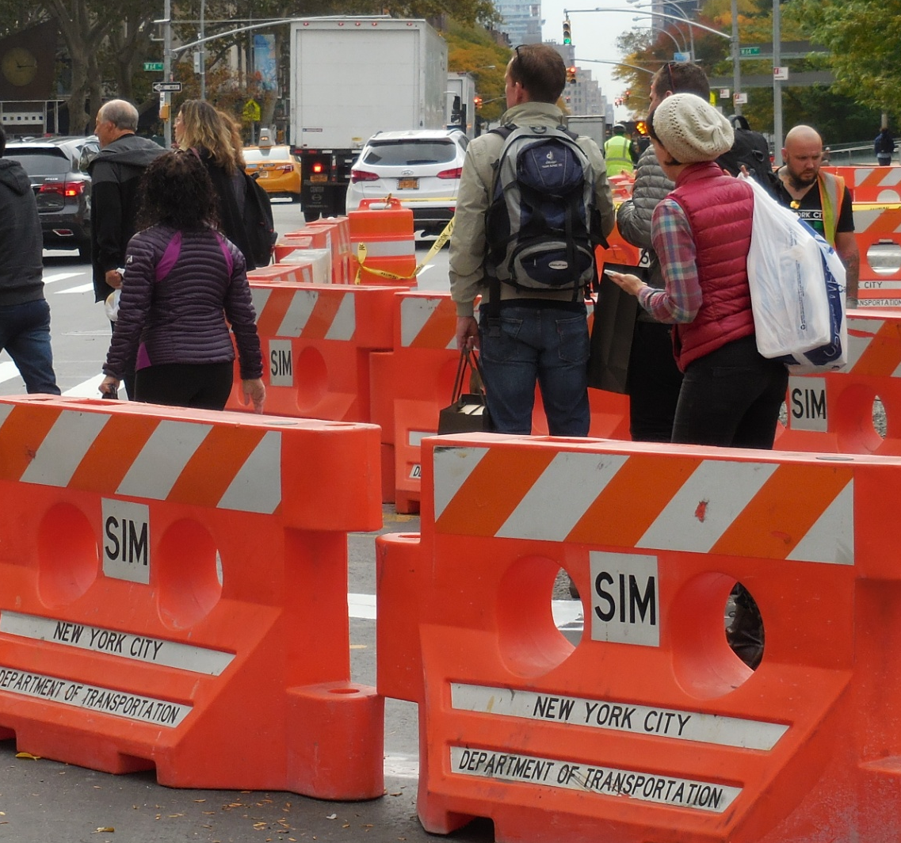
Question 3
Why are pedestrians in work zones a challenge?
Image: ATSSA
Notes:
Key Message: Question 3
Est. Presentation Time: 1-2 minute(s)
Explanation of Cues/Builds: None
Suggested Comments: Let me ask you this:
Suggested Questions: Why are pedestrians in work zones a challenge?
Additional Information: NYC
Possible Problems: Barriers are not connected.

Slide 26

Answer to Question 3
Pedestrians are more difficult to control than vehicles!
Pedestrians are more vulnerable!
Accessibility is required!
Image: FHWA
Notes:
Key Message: Question 3
Est. Presentation Time: 1-2 minute(s)
Explanation of Cues/Builds: None
Suggested Comments: The need to provide improved consistency and quality of pedestrian traffic control devices has become more important with the implementation of the Americans with Disabilities Act of 1990 (ADA), which was passed to eliminate barriers to employment, transportation, public accommodations, public services, and telecommunications. The ADA requires that pedestrians with physical and/or mental disabilities be accommodated not only in completed facilities, but also during times of construction.
Suggested Questions: Are you surprised?
Additional Information: None
Possible Problems: None

Slide 27
The Pedestrian Environment is Diverse!
Notes:
27
Key Message: The Pedestrian Environment
Est. Presentation Time: As needed
Explanation of Cues/Builds: None
Suggested Comments: The pedestrian environment is made up of sidewalks, crosswalks (both marked and unmarked), shared use trails, paved shoulders and more. The current transportation system assumes users are able-bodied, have good vision and hearing and can understand traffic control devices. Many such as children, elderly and persons with disabilities however, do not fit these assumptions . In order to design a pedestrian environment that is usable by all persons, it is important to understand some of the unique characteristics of pedestrians.
Suggested Questions: None
Additional Information: None
Possible Problems: None

Slide 28

Highway Users Are Also Diverse
Motorized vehicles
Pedestrians
  Including the disabled
Bicyclists
Motorcyclists
Others
http://www.nhtsa.gov/staticfiles/communications/images/traffic3.jpg
Notes:
Key Message: Highway Users
Est. Presentation Time: As needed
Explanation of Cues/Builds: None
Suggested Comments: Part of the challenge is that we need to design and assess the needs of ALL highway users, not only vehicles, and pedestrians, including those with disabilities.
Suggested Questions: Who are the users of the highway?
Additional Information: None
Possible Problems: None
Image Credit: Cars on the highway
http://www.nhtsa.gov/staticfiles/communications/images/traffic3.jpg

Slide 29
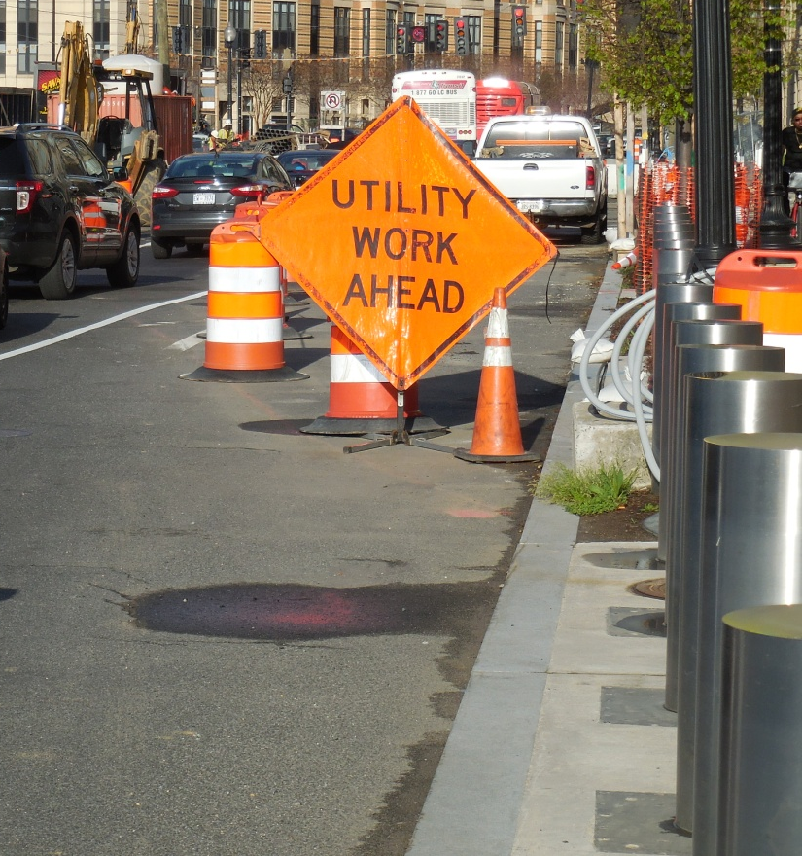
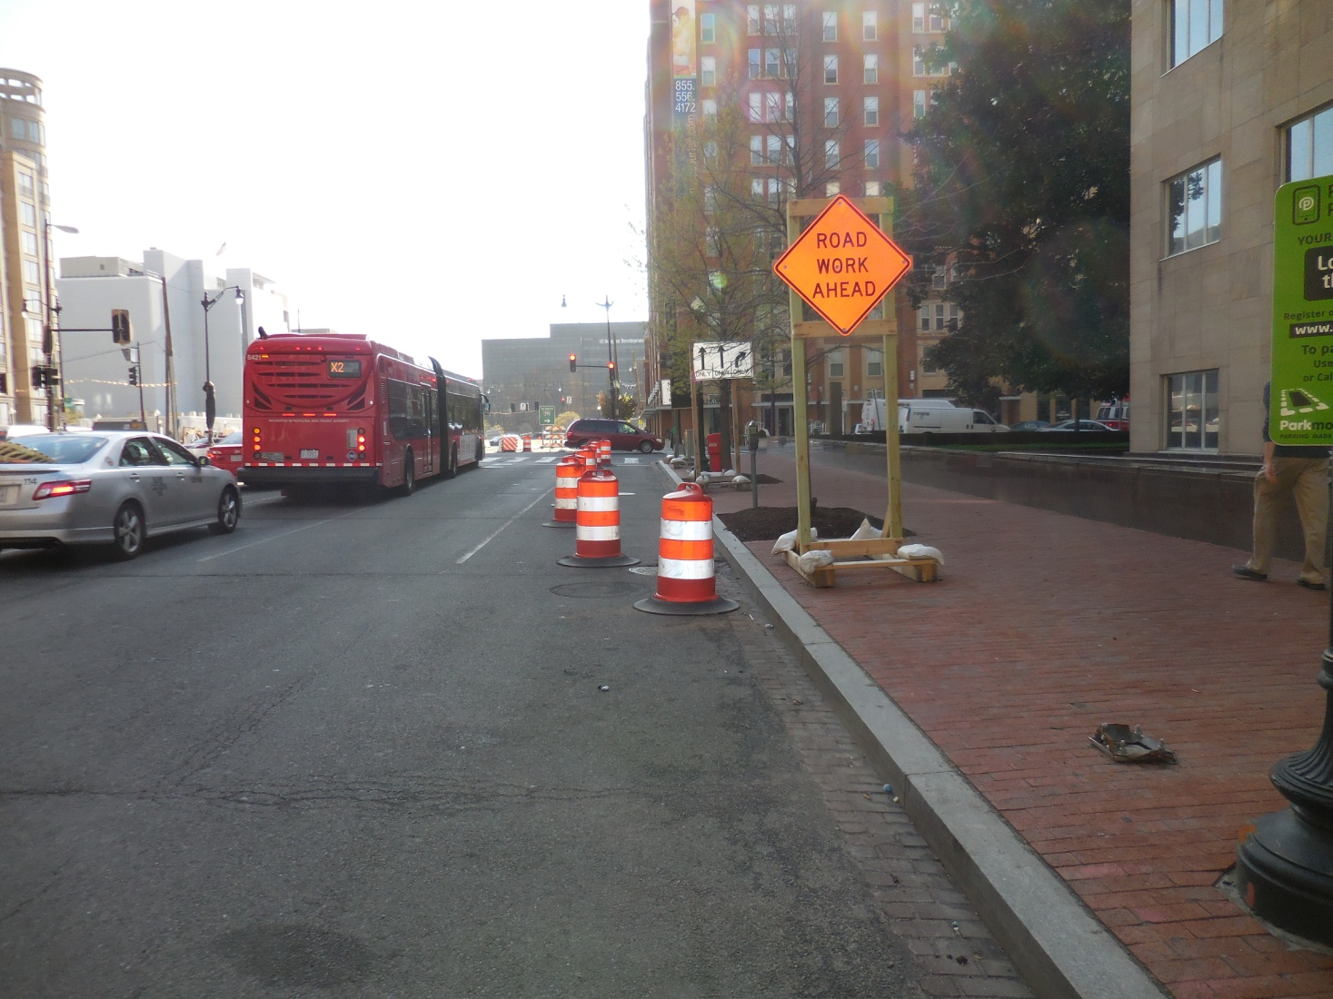
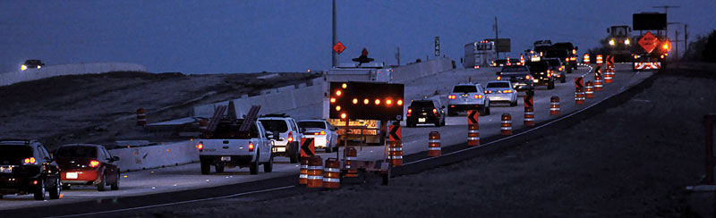
TTC Zones are Diverse Too!
Image: ATSSA
Image: ATSSA
Image: FHWA
Notes:
Key Message: The TTC Environment
Est. Presentation Time: As needed
Explanation of Cues/Builds: None
Suggested Comments: TTC zones are also diverse, in scope and duration, and other factors. The MUTCD allows flexibility to address these variations. Every work zone is different! The needs and control of all road users (motorists, bicyclists, and pedestrians within the highway, or on private roads open to public travel including persons with disabilities in accordance with the Americans with Disabilities Act of 1990 (ADA), Title II, Paragraph 35.130) through a TTC zone shall be an essential part of highway construction, utility work, maintenance operations, and the management of traffic incidents.
Suggested Questions: None
Additional Information: MUTCD Section 6A.01.
Possible Problems: None

Slide 30
TTC Zones Can Be Of:
Varying durations
Varying highway types
Varying locations
  Urban or rural
Varying staff levels
Day or night
Notes:
Key Message: Highway Users
Est. Presentation Time: As needed
Explanation of Cues/Builds: None
Suggested Comments: TTC zones may have variations, based on some of the factors on the screens. This makes designing for all possibilities very difficult!
Suggested Questions: None
Additional Information: None
Possible Problems: None

Slide 31
Can we DESIGN for ALL users and
ALL TTC zones all the time?
NO!
But we can:
CONSIDER their needs all the time!
Make a REASONABLE effort to provide for their needs!
Notes:
Key Message: Highway Users
Est. Presentation Time: As needed
Explanation of Cues/Builds: None
Suggested Comments: What we can do is
CONSIDER their needs all the time!
Make a REASONABLE effort to provide for their needs!
Suggested Questions: Can we DESIGN for ALL users all the time? No!
Additional Information: None
Possible Problems: None

Slide 32
Accessible Design Principles
(including work zones)
Design for a broad spectrum of users
Enable users to travel independently
Integrate accessibility into planning and design
Notes:
Key Message: Types of Disabilities: Summary
Est. Presentation Time: Less than 1 minute(s)
Explanation of Cues/Builds:
Suggested Comments: In summary, we need to plan, design and construct public right-of-way facilities to be usable by a broad spectrum of users. By doing so, we enable users to travel independently. The facility should accommodate all users, users shouldn’t have to adapt to the facility. It is important to integrate accessible pedestrian facilities into the earliest stages of transportation decision-making, not as an afterthought.
Suggested Questions: None
Additional Information: None
Possible Problems: None

Slide 33
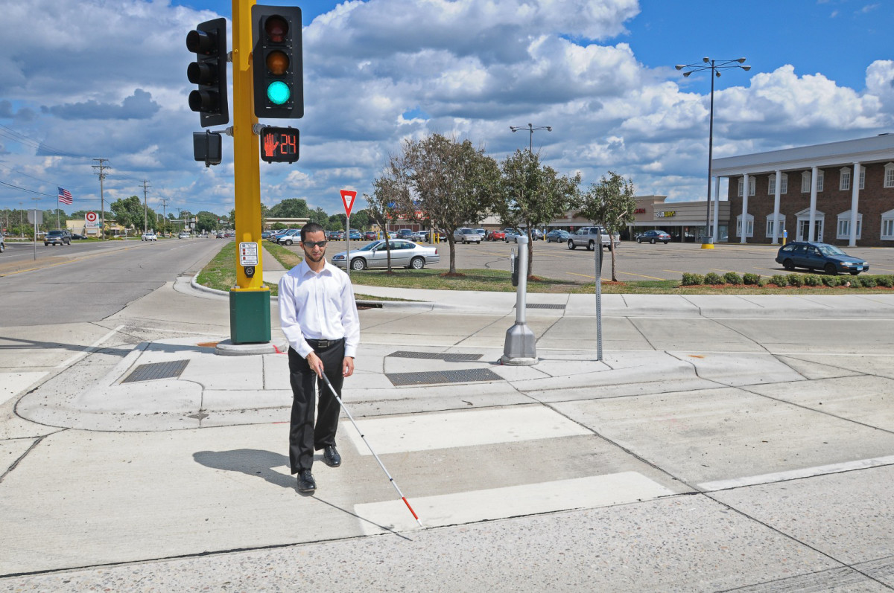
Disabled Individuals RELY on information for their safety and mobility
Image: Crossroads Blog
Notes:
Key Message: Highway Users
Est. Presentation Time: As needed
Explanation of Cues/Builds: None
Suggested Comments: Disabled Individuals RELY on information for their safety and mobility.
Suggested Questions: Are disabled individuals part of the cohort that we design for? Yes!
Additional Information: None
Possible Problems: None
Image Credit: https://mntransportationresearch.org/2014/03/27/cell-phone-app-guides-blind-through-work-zones/

Slide 34
Definition of a Disability
Under the ADA
A person who has a physical or mental impairment that substantially limits one or more major life activities
A person with a record of an impairment even if he or she does not currently have a disability and
A person who does not have a disability, but is regarded by others as having a disability
Notes:
Key Message: Definition of a Disability
Est. Presentation Time: As needed
Explanation of Cues/Builds: None
Suggested Comments: The ADA defines a person with a disability as:
• A person who has a physical or mental impairment that substantially limits one or more major life activities. Examples of major life activities include caring for one’s self, performing manual tasks, walking, seeing, hearing, speaking, learning, and working,
• A person with a record of an impairment even if he or she does not currently have a disability and,
• A person who does not have a disability, but is regarded by others as having a disability. An example may be a person who has severe facial scarring.
Suggested Questions: What is a disability?
Additional Information: None
Possible Problems: None

Slide 35
Types of Disabilities
Mobility
Visual
Hearing
Cognitive
Let’s discuss!
Notes:
Key Message: Definition of a Disability
Est. Presentation Time: As needed
Explanation of Cues/Builds: None
Suggested Comments: There are hundreds of different types of disabilities. While one person may have multiple disabilities, another may have a single disability with symptoms that fluctuate. There are some disabilities that are less obvious, such as diseases of the heart or lungs, neurological diseases, or arthritis that may reduce physical stamina, decrease coordination or cause pain. Most architectural design standards are based on the needs of people defined by one of the following four general categories:
Mobility
Visual
Hearing
Cognitive
Let’s discuss them!
Suggested Questions: What is a disability?
Additional Information: None
Possible Problems: None
Image Credit:
People with disabilities - in wheelchairs and walkers
This Photo by Unknown Author is licensed under CC BY-SA-NC

Slide 36
1. Mobility Disabilities
May have limited:
  Agility
  Speed/Endurance
May benefit from:
  Firm level surfaces
  Clear width
  Curb ramps
  Limited cross slope
NEED A PICTURE HERE
Image: US Access Board
Notes:
Key Message: Types of Disabilities
Est. Presentation Time: As needed
Explanation of Cues/Builds: None
Suggested Comments: Persons with mobility disabilities may have limited agility, speed, and endurance. They benefit from firm level, surfaces, adequate clear width, curb ramps, and limited cross slope. Persons with mobility disabilities often face what we term as “movement barriers”.
Suggested Questions: None
Additional Information: NOTE: Temporary conditions that cause disability for a short time — such as broken bones, illness, trauma or surgery — are not considered disabilities as defined under the ADA unless they are expected to continue over a long period of time.
Possible Problems: None

Slide 37
Mobility Disabilities
Wheelchair users
Ambulatory mobility disabilities
Notes:
Key Message: Types of Disabilities
Est. Presentation Time: As needed
Explanation of Cues/Builds: None
Suggested Comments: Wheelchair Users - Some people with severe mobility disabilities use power-driven or manually operated wheelchairs or a three- and four-wheeled cart or scooter to maneuver through their environment. People who use wheelchairs encounter some of the most obvious access problems, including maneuvering through narrow spaces, going up or down steep paths, moving over rough or uneven surfaces, making use of toilet and bathing facilities, reaching and seeing items placed at conventional heights, and negotiating steps or abrupt changes in level.
Ambulatory Mobility Disabilities - This category includes people who walk with difficulty or who have a disability that affects gait or balance. People who use crutches, canes, walkers, braces, or artificial limbs to assist them in walking are also included in this category. Activities that may be difficult for people with mobility disabilities include walking, climbing steps or slopes, standing for extended periods of time, reaching and fine finger manipulation. Both people who use wheelchairs and those who use other types of mobility aids sometimes use service animals for assistance. For example, a specially trained service dog may be used to retrieve items or even pull a wheelchair.
Suggested Questions: None
Additional Information: None
Possible Problems: None
Image Credit: Man in a wheelchair
http://www.stroke4carers.org/wp-content/uploads/man_in_wchr.jpg

Slide 38
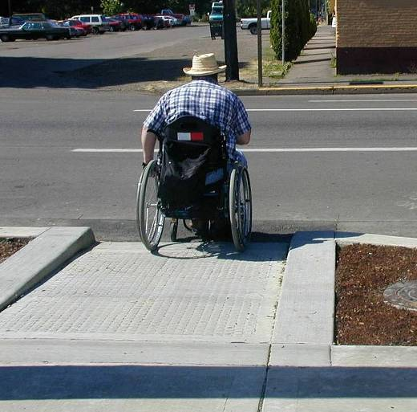
Movement Barriers
Restrict a person’s ability to physically move or progress along or within an environment
Image: AARP
Notes:
38
Key Message: Types of Disabilities
Est. Presentation Time: As needed
Explanation of Cues/Builds: None
Suggested Comments: Movement barriers are defined as those features that restrict a person’s ability to physically move or progress along or within an environment. This image depicts a fairly obvious movement barrier – a curb. A is ramp provided on one side of the street, but not the other. Some States, such as Washington, have a State law that requires a companion ramp be constructed on the opposite side of the street if there is a curb preventing access to the adjoining sidewalk.
Suggested Questions: None
Additional Information: None
Possible Problems: None
Image Credit: https://www.aarp.org/livable-communities/info-2014/slideshow-dangerous-streets.html

Slide 39
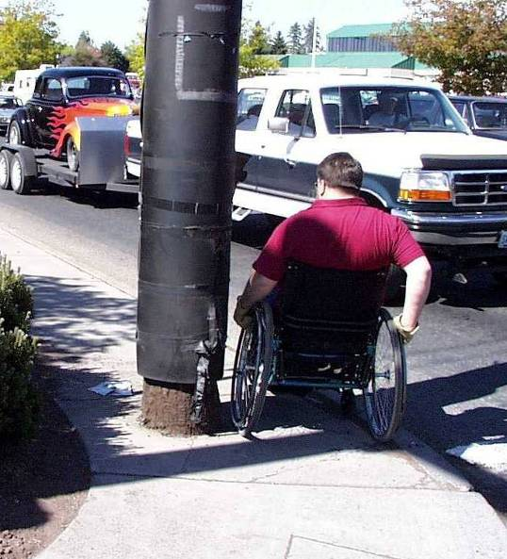
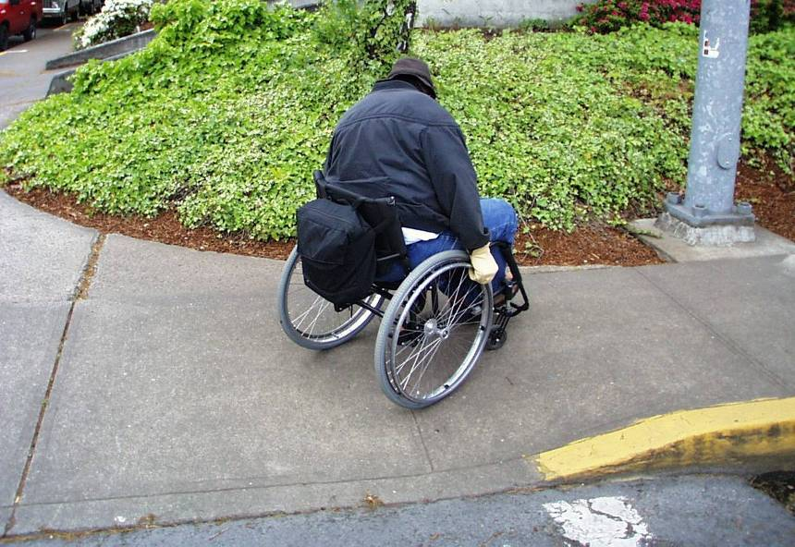
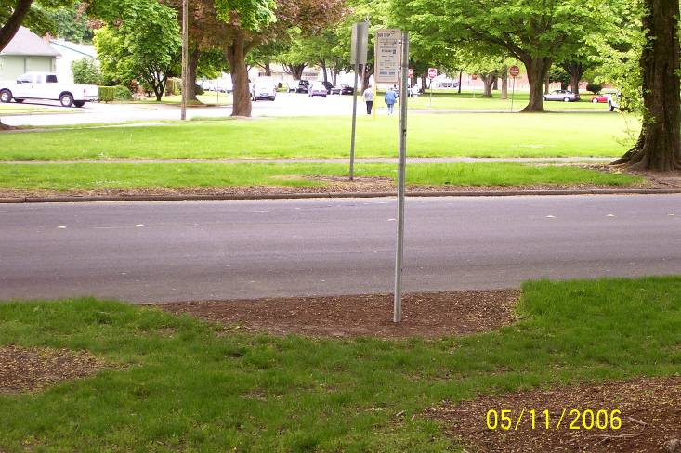
Examples of Movement Barriers
B
C\
Images: ATSSA
A
C
Notes:
Key Message: Examples of Movement Barriers
Est. Presentation Time: As needed
Explanation of Cues/Builds: None
Suggested Comments:
Obstacles along the sidewalk, such as utility poles, fire hydrants
Steep Ramp with no level landing, makes maneuvering a wheelchair unsafe
Route from sidewalk to bus stop is not accessible – oftentimes persons in wheelchairs are forced to travel in the roadway
Suggested Questions: None
Additional Information: None
Possible Problems: None

Slide 40
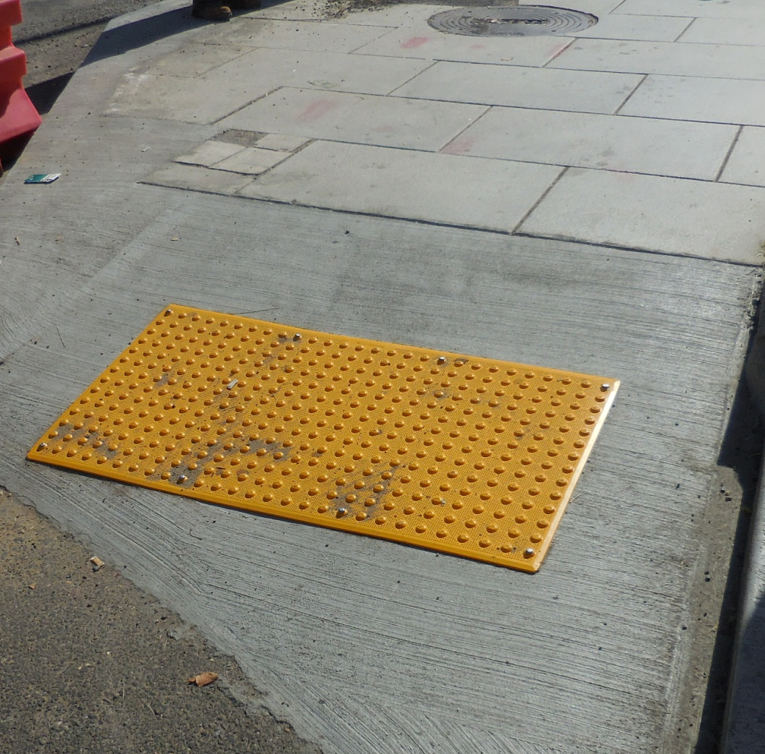
Mobility-Impaired Pedestrian
Issues During TTC:
Lack of temporary ramps
Ramps that are:
  Too steep
  Wobble
  Not flush
Pathways that are too narrow
Uneven surfaces
Image: ATSSA
Notes:
Key Message: Types of Disabilities
Est. Presentation Time: As needed
Explanation of Cues/Builds: None
Suggested Comments: Mobility impaired pedestrians also face significant challenges, including:
• Temporary ramps that are too steep, wobble, or don’t have an adequate side guard rail to hold on to. Many curb ramps have slopes that are too steep, have too much surface warp or cross slope, and have insufficient room for a person using a wheelchair to turn out of the ramp onto a level area. These conditions are dangerous and can cause many who use manual wheelchairs to tip and fall.
• Pathways and turns or turnarounds that are too narrow for wheelchairs, motorized scooters, or those who travel with service animal assistance.
• Ramps or pathways with inadequate bottom barrier protection, which, during wet weather, can allow mud to flow over the surface of the ramp or path, creating slippery conditions that can be very dangerous to those who are on crutches, canes, or walkers.
Suggested Questions: None
Additional Information: Source Washington, DC. Photo is of a ramp that is too steep.
Possible Problems: None

Slide 41
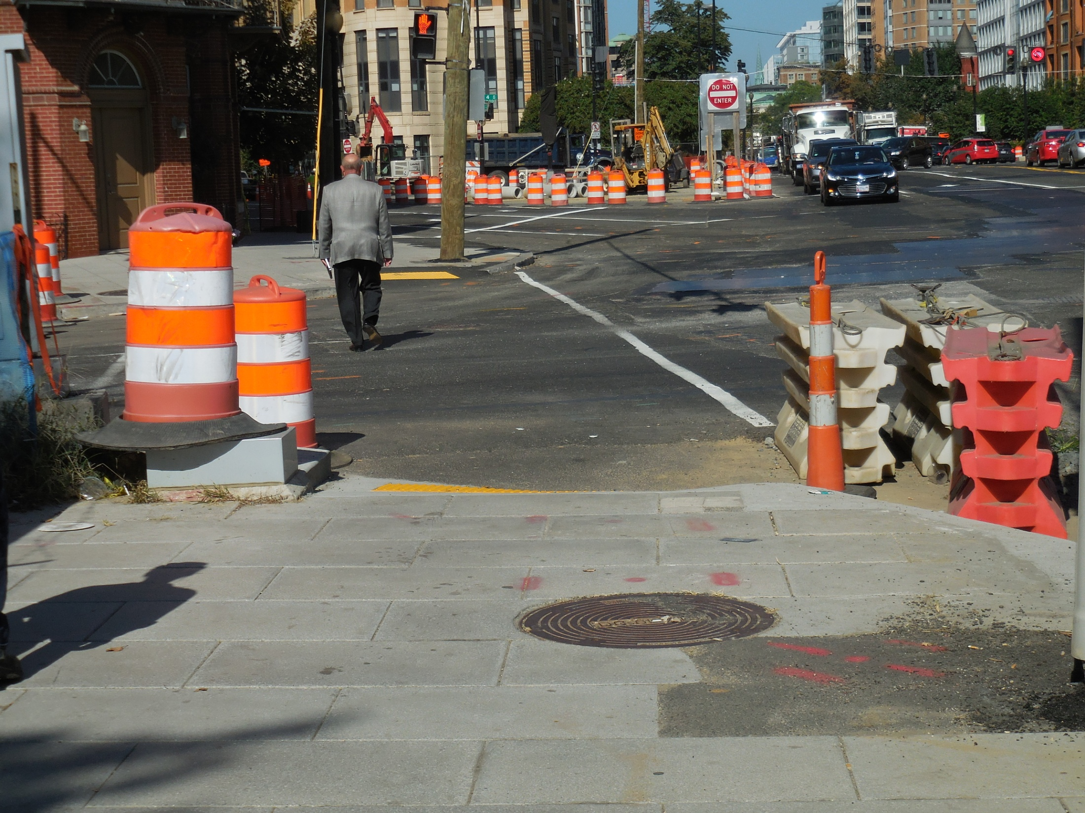
Image: ATSSA
Notes:
Key Message: Types of Disabilities
Est. Presentation Time: As needed
Explanation of Cues/Builds: None
Suggested Comments: This is the same ramp from the other side.
Suggested Questions: Is this ramp compliant?
Additional Information: Source Washington, DC
Possible Problems: None

Slide 42
2. Visual Disabilities
Includes people with
  Partial vision loss
  Total vision loss
Receive information from
  Sounds
  Textures
  Contrast
  Memory
Image: US Access Board
Notes:
Key Message: Types of Disabilities
Est. Presentation Time: As needed
Explanation of Cues/Builds: None
Suggested Comments: This category includes people with partial vision or total vision loss. Some people with a visual disability can distinguish between light and dark, sharply contrasting colors, or large print, but may not be able to read small print, negotiate dimly lit spaces, or tolerate high glare. Many people who are blind generally depend upon their other senses to perceive their environment and communicate with others, though this does not mean their other senses are much more acute. Many use a cane or have a guide animal to facilitate moving about. Some problems experienced by people with visual impairments may include orientation, receiving written or graphic information, using controls that are not adequately labeled, and avoiding hazardous protruding objects which they cannot detect. Persons with vision disabilities receive information from sounds, textures and contrast. They benefit from information in non-visual formats such as audible/vibro-tactile crossing information, tactile indication of boundary between pedestrian and vehicular way (such as truncated domes at curb ramps, curbs edge or landscaping), and clearly defined paths. Persons with low vision benefit from high color contracts (signage, truncated dome applications, et al).
Suggested Questions: None
Additional Information: None
Possible Problems: None

Slide 43
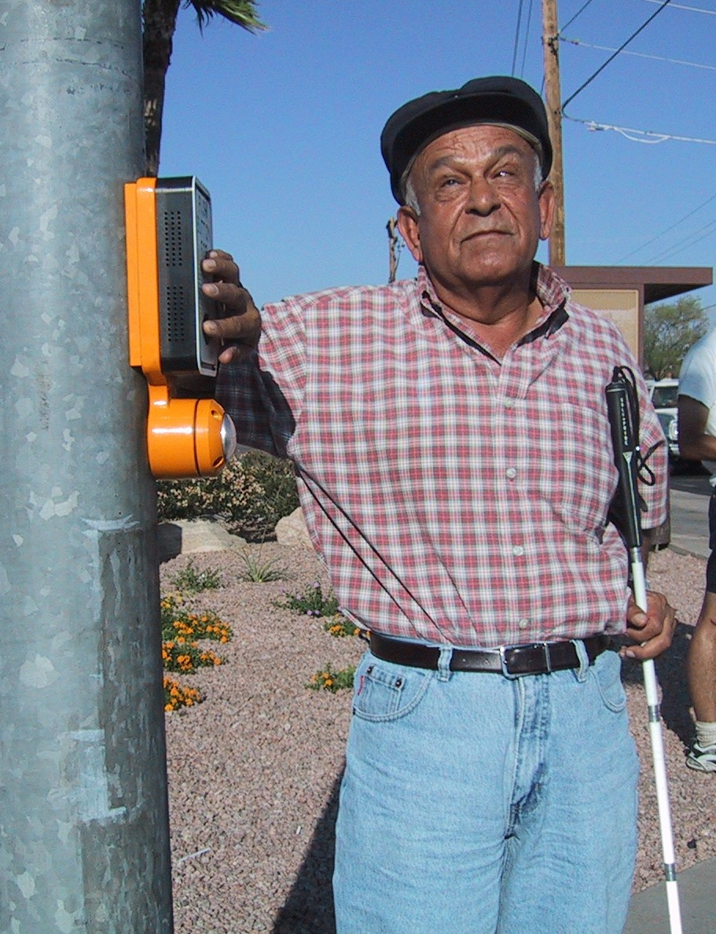

People with vision disabilities…
Benefit from information
in non-visual formats:
  Audible/vibrotactile crossing
  information
  Tactile indication
  Clearly defined pathways
  High color contrasts
Image: accessforblind.org
Notes:
Key Message: Types of Disabilities
Est. Presentation Time: As needed
Explanation of Cues/Builds: None
Suggested Comments: Persons with vision disabilities receive information from sounds, textures and contrast. They benefit from information in non-visual formats such as audible/vibro-tactile crossing information, tactile indication of boundary between pedestrian and vehicular way (such as truncated domes at curb ramps, curbs edge or landscaping), and clearly defined paths. Persons with low vision benefit from high color contracts (signage, truncated dome applications, et al). This category includes people with partial vision or total vision loss. Some people with a visual disability can distinguish between light and dark, sharply contrasting colors, or large print, but may not be able to read small print, negotiate dimly lit spaces, or tolerate high glare. Many people who are blind generally depend upon their other senses to perceive their environment and communicate with others, though this does not mean their other senses are much more acute. Many use a cane or have a guide animal to facilitate moving about. Some problems experienced by people with visual impairments may include orientation, receiving written or graphic information, using controls that are not adequately labeled, and avoiding hazardous protruding objects which they cannot detect.
Suggested Questions: None
Additional Information: None
Possible Problems: None

Slide 44
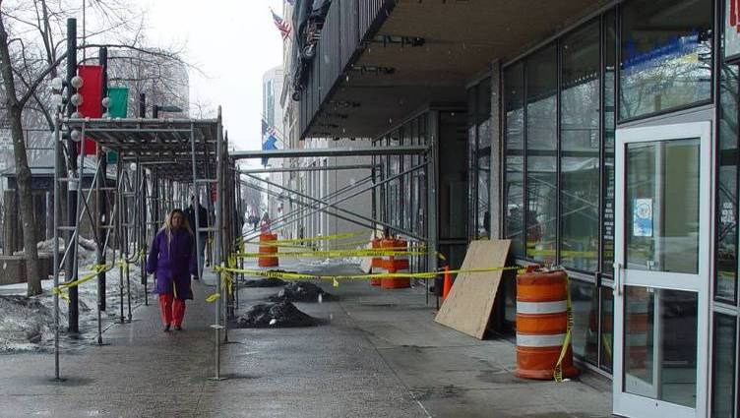
Examples of Information Barriers
Image: ATSSA
Notes:
Key Message: Examples of Information Barriers
Est. Presentation Time: As needed
Explanation of Cues/Builds: None
Suggested Comments: Information barriers are anything that restricts the individual’s ability to use the information contained within the street, sidewalk and trail environment. This slide shows how construction impacting the sidewalk changes the pedestrian route. Someone who is blind would not be able to detect the change in direction.
Suggested Questions: None
Additional Information: None
Possible Problems: None

Slide 45
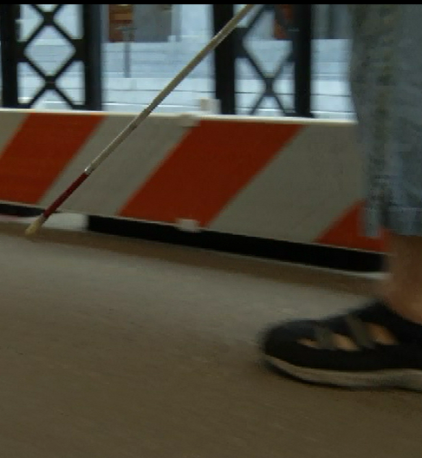
Blind Pedestrian Issues During TTC:
Not Knowing:
Of its presence
If there is a safe alternate path
Whether they should cross the street or continue
If a cane would be sufficient
Image: ATSSA
Notes:
Key Message: Blind Pedestrian Issues During TTC
Est. Presentation Time: As needed
Explanation of Cues/Builds: None
Suggested Comments: Some of the types of safety issues a blind pedestrian will often face include:
• Not knowing the TTC is there until they reach it;
• Not knowing if there is a safe alternative way to proceed (in other words, is the sidewalk closed, or has a safe
pathway through the TTC been set up?);
• Not knowing if they should attempt to cross the street and continue by walking on the other side or if they
should retrace their steps and use another route;
• Not knowing if a cane can provide a safe way to continue through the detour;
Suggested Questions: None
Additional Information: None
Possible Problems: None
• Not knowing if there might be someone nearby who could offer them assistance; and
• Not knowing if barriers have exposed nails or jagged edges that can injure someone feeling their way along
by hand.

Slide 46
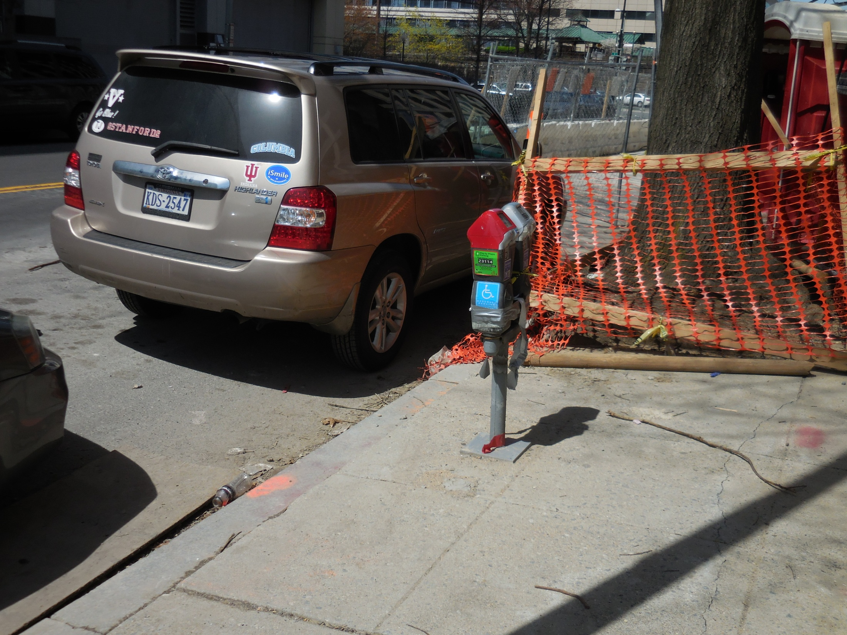

Image: ATSSA
Notes:
Key Message: Example
Est. Presentation Time: As needed
Explanation of Cues/Builds: None
Suggested Comments: This is an example of a poor design. Notice the handicapped parking meter so chances are this work zone is also blocking access.
Suggested Questions: Options if I’m blind?!
Additional Information: Washington DC. By J. Morales
Possible Problems: None

Slide 47
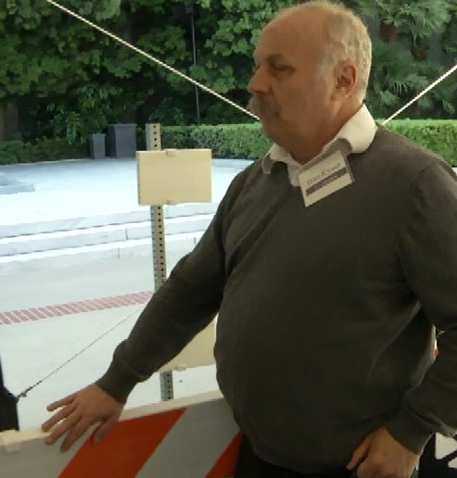

Blind Pedestrian Issues During TTC:
Not Knowing:
If there is someone to offer assistance
If there are exposed nails or jagged edges
Image: FHWA
Notes:
Key Message: Blind Pedestrian Issues During TTC
Est. Presentation Time: As needed
Explanation of Cues/Builds: None
Suggested Comments: Some of the types of safety issues a blind pedestrian will often face include:
• Not knowing if there might be someone nearby who could offer them assistance; and
• Not knowing if barriers have exposed nails or jagged edges that can injure someone feeling their way along by hand.
Suggested Questions: None
Additional Information: None
Possible Problems: None
Image Credit: A hand with a splinter in the finger
http://3zw8pfy0xu-flywheel.netdna-ssl.com/wp-content/uploads/splinter_in_finger.jpg

Slide 48
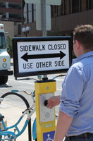
Work Zone Audible Devices
Might not be needed if detectable channelizing devices make an alternate route of travel evident to pedestrians with visual disabilities
Are available
Image: MNDOT
Notes:
Key Message: Work Zone Audible Devices
Est. Presentation Time: Less than 1 minute(s)
Explanation of Cues/Builds:
Suggested Comments: Might not be needed if detectable channelizing devices make an alternate route of travel evident to pedestrians with visual disabilities.
Suggested Questions: How would a visually-impaired person detect a work zone?
Additional Information: Photo is SpeakMaster (next slide) http://www.mditrafficcontrol.com/ada_speakmaster
Possible Problems: None

Slide 49
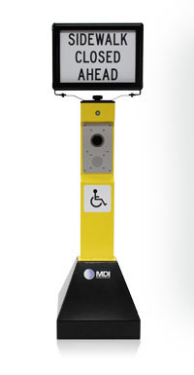
SpeakMaster
As the pedestrian approaches, he/she hears a unique locator tone which is familiar to the visually impaired
Proprietary
Image: MDI Traffic Control
49
Notes:
Key Message: Work Zone Audible Devices
Est. Presentation Time: Less than 1 minute(s)
Explanation of Cues/Builds:
Suggested Comments: The all-aluminum ADA SpeakMaster stands 5' 6" high, is completely weather resistant, and ADA compliant. The two-sided frame at the top has snap-open side rails to easily change custom signs. The frame can rotate 360° to accommodate different site conditions.
Suggested Questions:
Additional Information: http://www.mditrafficcontrol.com/ada_speakmaster: The unit is powered by an extended-life battery stored in a key-locked compartment in the base, which can be weighted for added stability and security. The electronics are housed in a separate key-locked compartment in the upright section, and messages can be programmed on-site via USB. The base tilts and rolls on hidden wheels.
How the SpeakMaster Works:
The ADA SpeakMaster is positioned approximately 100 feet before the actual sidewalk closure. As the pedestrian approaches, he hears a unique locator tone which is familiar to the visually impaired. The tone can be programmed to play continuously or activate by an optional motion sensor, and indicates that there is more information. The pedestrian locates the push button and activates the voice module to hear navigation instructions. He can then safely pass through the temporary pedestrian accessible route.
Possible Problems: Proprietary device. Shown for educational purposes only.

Slide 50
3. Hearing Disabilities
Rely on vision or lip reading
They benefit from:
  Good sight lines for assessing street crossing conditions
  Information in visual
  or vibrotactile format
Image: US Access Board
Notes:
Key Message: Types of Disabilities
Est. Presentation Time: Less than 1 minute(s)
Explanation of Cues/Builds:
Suggested Comments: People in this category use a variety of methods to compensate for their inability to hear sound. Those with partial hearing may depend on hearing aids or lip reading. Some people who are totally deaf also use speech-reading but must be able to clearly see the face of the individual speaking. Others use a standard means of communication called American Sign Language. People can learn sign language to become qualified interpreters. Some people with hearing disabilities may use service animals to alert them to sounds. Problems for people with hearing impairments include communicating with many hearing people and using equipment that is exclusively auditory, such as telephones and fire alarms. Lack of sign language interpreters and inadequately trained interpreters also can be a problem. Persons with hearing disabilities rely on vision; they benefit from good sight lines for assessing street crossing conditions and information in visual or vibro-tactile format.
Suggested Questions: None
Additional Information: None
Possible Problems: None

Slide 51
4. Cognitive Disabilities
Different processing and decision-making skills
They benefit from:
  Standards!
  Clear environments
  Uncomplicated crossings
  Easy to understand symbols and colors
Image: US Access Board
Notes:
Key Message: Types of Disabilities
Est. Presentation Time: Less than 1 minute(s)
Explanation of Cues/Builds:
Suggested Comments: There are many other disabling conditions which are not apparent from an individual’s outward appearance. These usually involve cognitive and/or learning abilities and may affect understanding, communication, or behavior. People with these types of disabilities may have difficulty navigating facilities, particularly where the signage system is unclear or complicated. People who have seizure disorders may be sensitive to environmental features, such as lighting, which can activate seizures.
Suggested Questions: None
Additional Information: A hidden condition gaining greater awareness is a condition known as multiple chemical sensitivity. People with this condition experience a physical reaction that generally affects breathing when they come in contact with a chemical or combination of chemicals that may be present in many buildings and consumer products. These can include items such as lawn pesticides and herbicides, room deodorants, printing inks, and even colognes or perfumes. Reactions can range from mild to life threatening.
Possible Problems: None

Slide 52
Module Recap
Can we design for all users all the time?
Name the four types of disabilities
Name 2-3 issues that blind pedestrians face in a work zone
Notes:
Key Message: Module Recap
Est. Presentation Time: Less than 1 minute(s)
Explanation of Cues/Builds: None
Suggested Comments: Let’s recap. How would you answer these questions:
Can we design for all users all the time? NO, but we can consider their needs and make a reasonable attempt to make provision for all.
Name the four types of disabilities: Mobility, visual, hearing, cognitive
Name 2-3 issues that blind pedestrians face in a work zone. Not knowing of its presence, no continuity, debris, ramps too steep, ramps wobble, no detectable edging, etc.
Suggested Questions: How would you answer these questions?
Additional Information: Let the students answer. Repeat the answer to make sure everyone gets the answer.
Possible Problems: Turn into a discussion if needed.

Slide 53
Questions
Notes:
Key Message: End slide
Est. Presentation Time: Less than 1 minute(s)
Explanation of Cues/Builds: None
Suggested Comments: Self explanatory
Suggested Questions: None
Additional Information: None
Possible Problems: None

Slide 54
2. Laws, Standards and Guidelines
American Traffic Safety Services Association
Images: US Access Board and FHWA
Notes:
Key Message: Module Introduction
Est. Presentation Time: As needed
Explanation of Cues/Builds: None
Suggested Comments: Let’s go to the next module! In this module, we will discuss laws, standards, and guidelines.
Suggested Questions: None
Additional Information: None
Possible Problems: None

Slide 55
Module Objectives
Discuss the legal background of the American with Disabilities Act (ADA) and its applicability to temporary traffic control
Discuss what triggers ADA improvements
Discuss the MUTCD accessibility requirements
Notes:
Key Message: Module Objectives
Est. Presentation Time: As needed
Explanation of Cues/Builds: None
Suggested Comments: These are the things we will do in this module. Let’s start!
Suggested Questions: None
Additional Information: None
Possible Problems: None

Slide 56
The American with Disabilities Act
A 1990 federal civil rights law that prohibits discrimination against people with disabilities in the areas of:
  Employment
  Transportation
  Access to private and state and local government sites and
  Telecommunications
Notes:
Key Message: Module Objectives
Est. Presentation Time: As needed
Explanation of Cues/Builds: None
Suggested Comments: The American with Disabilities Act 1990 federal civil rights law that prohibits discrimination against people with disabilities in the areas of:
Employment
Transportation
Access to private and state and local government sites and
Telecommunications
Suggested Questions: What is the ADA? Is a work zone considered transportation?
Additional Information: None
Possible Problems: None

Slide 57
Legal Background
1968
Architectural Barriers Act (ABA)
1973
Rehabilitation Act
1987
Civil Rights Restoration Act
1990
Americans with Disabilities Act (ADA)
Now
ADA-ABA guidelines were updated/combined in 2004, further supplemented in 2007 and adopted by USDOJ in 2010
Notes:
Key Message: ADA Legal Background
Est. Presentation Time: As needed
Explanation of Cues/Builds: None
Suggested Comments: The current ADA is the culmination of a legal evolution:
The ABA required buildings & on-site facilities designed, constructed, altered, or leased with Federal funds to comply with Accessible Design Standards (American National Stds. Institute and the Uniform Federal Accessibility Stds. after 1982). ADA-ABA guidelines were updated/combined in 2004, further supplemented in 2007 and adopted by USDOJ in 2010.
Section 504 – Prohibited discrimination in programs and activities funded with Federal funds (administered by Federal recipients/sub recipients). Required curb ramps on Federal-aid projects.
The Civil Rights Restoration Act of 1987 clarified the intent of many nondiscrimination laws/statutes by stating that if an entity receives Federal funds in any of its programs and activities, ALL of the operations of that entity are subject to the requirements of these nondiscrimination laws/statutes whether they are Federally funded or not. In short, the Restoration Act extended the reach of Section 504 to the entire operation of Federal recipients/sub recipients.
The ADA is a Civil Rights law that prohibits discrimination against persons with disabilities in all aspects of life. The ADA applies to all entities (public, private, et al) regardless of funding source. Similar to ABA, the ADA primarily pertains to buildings. The requirements of ADA closely mirror those of Section 504.
Suggested Questions: None
Additional Information: USDOJ = US Department of Justice
Possible Problems: None

Slide 58
ADA Accessibility Guidelines (ADAAG)
Developed primarily for buildings & on-site facilities
Do not address all situations (especially those that are unique to the public right-of-way)
Notes:
Key Message: The ADA Accessibility Guidelines (1991 ADAAG) and the subsequent ADA-ABA Accessibility Guidelines (2005) were developed primarily for buildings and on-site facilities. While they address certain features that may be common to public sidewalks, they do not adequately cover elements that are unique to the public right-of-way.

Slide 59

The U.S Access Board
An independent Federal agency devoted to the issue of accessibility for people with disabilities
Develops and maintains design criteria for the built environment (including the transportation system) under the ADA Accessibility Guidelines
Provides support
Notes:
Key Message: The U.S Access Board
Est. Presentation Time: 1 minutes
Explanation of Cues/Builds: None
Suggested Comments: The U.S. Access Board is a federal agency that promotes equality for people with disabilities through leadership in accessible design and the development of accessibility guidelines and standards for the built environment, transportation, communication, medical diagnostic equipment, and information technology.
Suggested Questions: None
Additional Information: https://www.access-board.gov/
Possible Problems: None

Slide 60
Five Titles of the ADA
No. | Title
Title I | Employment
Title II | State & Local Governments
Title III | Public Accommodations
Title IV | Telecommunications
Title V | Misc., including requirements for the U.S. Access Board to develop design guidelines
Notes:
Key Message: The ADA
Est. Presentation Time: As needed
Explanation of Cues/Builds: None
Suggested Comments: The ADA is comprised of five sections or “titles” that address discrimination in different areas of society:
Title I covers private sector employment.
Title II covers state and local government programs, activities, services, and employment.
Title III covers private businesses and nonprofit service organizations (public accommodations and commercial facilities).
Title IV covers telecommunications.
Title V covers certain miscellaneous legal and procedural aspects of the law.
Titles I, II, and III are the most relevant to someone who is planning a temporary event
Suggested Questions: None
Additional Information: NOTE: Title II is specific to State and local governments and incorporates specific prohibitions of discrimination on the basis of disability from Titles I, III, and IV.
Possible Problems: None

Slide 61
Title II - State and Local Governments
Basic Requirements:
Must ensure that individuals with disabilities are not excluded from:
  Programs
    Sidewalks
    Work zones
  Services, and
  Activities
Notes:
Key Message: The ADA
Est. Presentation Time: As needed
Explanation of Cues/Builds: None
Suggested Comments: Title II of the ADA applies to all programs, services and activities provided or made available by public entities (State & local governments) or any of their instrumentalities or agencies. Like the Civil Rights Act of 1964 that prohibits discrimination on the bases of race, color, national origin, and sex, the ADA seeks to ensure nondiscrimination - but on the basis of disability. All governmental activities of public entities are covered, even if they are carried out by contractors. In other words, similar to other nondiscrimination laws the scope of Title II coverage extends to the entire operations of a public entity. As clarified in Barden vs. City of Sacramento, sidewalks/pedestrian facilities are considered a “program” of a public entity.
Suggested Questions: None
Additional Information: None
Possible Problems: None
Image Credit: https://www.essentialaids.com/mobility/wheelchairs/folding-wheelchair.html

Slide 62
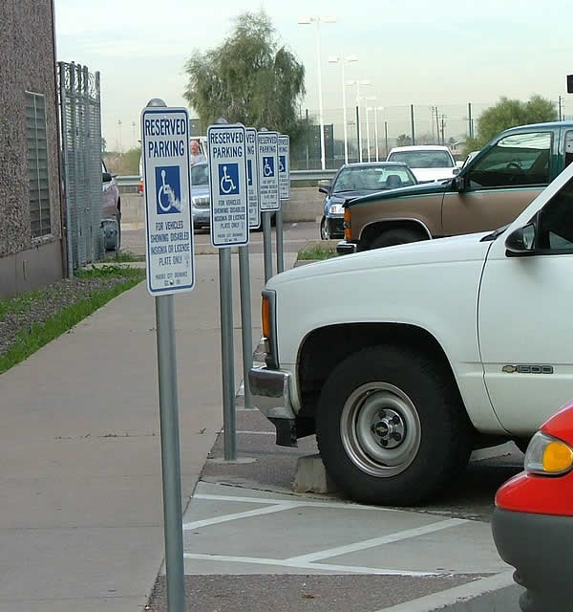
Transition Plan Elements Public
Right-of-Way (ROW) Facilities
Curb ramps
Sidewalks
Parking lots
Pedestrian signals
Bus stops
Shared use trails
Parks/recreational facilities
Image: Assistive Technology Arizona
Notes:
Key Message: The ADA
Est. Presentation Time: As needed
Explanation of Cues/Builds: None
Suggested Comments: Nearly all early self-evaluations/Transition Plans did not include an entity’s public right-of-way facilities. The focus tended to be on buildings and those walkways/parking facilities on-site. As a result, we are seeing more and more complaints/lawsuits associated with public right-of-way facilities due to their lack of accessibility. It is incumbent upon State and local agencies to ensure that their self-evaluations/transition plans are up-to-date and incorporate public right-of-way facilities within their respective jurisdictions. Sidewalks, curb ramps, parking lots, pedestrian signals, shared use trails, et al should all be considered when developing a Transition Plan – although curb ramps are the primary intent
Suggested Questions: None
Additional Information: FHWA is one of the agencies under USDOT responsible for monitoring State and local agencies’ compliance with Section 504/ADA requirements. The increased number of ADA complaints/lawsuits around the country has necessitated FHWA’s renewed emphasis in this area.
Possible Problems: None
http://atarizona.com/

Slide 63
Title II – New Construction
(28 CFR 35.151)
New construction (and altered facilities) must be designed and constructed to be accessible to and usable by persons with disabilities unless technically infeasible to do so
Notes:
Key Message: The ADA
Est. Presentation Time: As needed
Explanation of Cues/Builds: None
Suggested Comments: New construction is expected to provide the highest level of accessibility, free from architectural and communication barriers. New construction (and altered facilities) must be designed and constructed to be accessible to and usable by persons with disabilities unless technically infeasible to do so.
Possible Problems: None
Suggested Questions: None
Additional Information: None

Slide 64
Title II – Alterations
(28 CFR 35.151)
DOJ and court decisions consider roadway resurfacing an alteration (1993)
Roadway resurfacing triggers requirement for curb ramp installations/retrofits (to current standards)
Notes:
Key Message: The ADA
Est. Presentation Time: As needed
Explanation of Cues/Builds: None
Suggested Comments: Similar to new construction, each facility altered by or on behalf of a public entity must be readily accessible and usable by persons with disabilities (if the alteration commenced after January 26, 1992). Altered portions (including reconstruction) of facilities must meet new construction guidelines to the maximum extent feasible. There are numerous court cases around the country that could have been avoided had the entities included accessibility as part of their day-to-day operations. Two cases worth noting, that have directly impacted how State and local governments address ADA and alterations in the public right-of-way are Kinney v. Yerusalim and Barden v. the City of Sacramento. In Kinney v. Yerusalim (Pennsylvania DOT) the court’s conclusion was that roadway resurfacing is an alteration, which triggers the requirement for curb ramp installations/retrofits. In Barden v. the City of Sacramento the court’s conclusion was that sidewalks are a “program” under ADA, and resulted in a requirement for the City of Sacramento to annually dedicate 20% of its overall transportation budget to provide compliant curb ramps and to remove access barriers in the pedestrian rights-of-way for which the City has responsibility or authority over (includes sidewalks, curb ramps, crosswalks, pathways, et al). A key point to remember is that curb ramps are only usable if the sidewalk is also accessible.
Possible Problems: None
Suggested Questions: What is an “alteration”?
Additional Information: More recently, the California Department of Transportation (CalTrans) finally reached a settlement in a class action lawsuit that began in 2006. The settlement calls for CalTrans to dedicate $1.1 billion over 30 years, to stand-alone pedestrian projects that improve accessibility for persons with disabilities. The 2013 Department of Justice/Department of Transportation Joint Technical Assistance on the Title II of the Americans with Disabilities Act Requirements to Provide Curb Ramps when Streets, Roads, or Highways are Altered through Resurfacing https://www.ada.gov/doj-fhwa-ta.htm DOJ/DOT Q&A https://www.ada.gov/doj-fhwa-ta-supplement-2015.html
Image Credit:
Street paving in Philadelphia.
https://www.phila.gov/2022-03-31-the-fy23-28-capital-program-our-plan-for-better-safer-and-cleaner-streets/

Slide 65
Title II – Maintaining Accessibility
(28 CFR 35.133)
State & local governments must maintain the accessible features of facilities in operable working conditions
Notes:
Key Message: The ADA
Est. Presentation Time: As needed
Explanation of Cues/Builds: None
Suggested Comments: Entities are obligated (under ADA) to ensure that facilities are readily accessible to and usable by persons with disabilities. This requirement extends to pedestrian facilities that are in disrepair, as well as blocked/restricted access due to obstructions (such as overgrown landscaping, street furniture, utilities, construction activities, snow accumulation, et al). In the case of construction activities that block/restrict use of pedestrian facilities, an alternate route should be provided if more than a temporary disruption).
Possible Problems: None
Suggested Questions: None
Additional Information: None
Image Credit: https://sewerlinecheck.files.wordpress.com/2011/10/sidewalk1.jpg

Slide 66
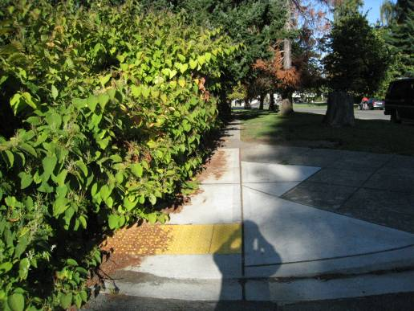
Maintenance Examples
Sidewalks that are in disrepair
Overgrown landscaping
Snow accumulation
Work zones
Image: ATSSA
Notes:
Key Message: The ADA
Est. Presentation Time: As needed
Explanation of Cues/Builds: None
Suggested Comments: Entities are obligated (under ADA) to ensure that facilities are readily accessible to and usable by persons with disabilities. This requirement extends to pedestrian facilities that are in disrepair, as well as blocked/restricted access due to obstructions (such as overgrown landscaping, street furniture, utilities, construction activities, snow accumulation, et al). In the case of construction activities that block/restrict use of pedestrian facilities, an alternate route should be provided if more than a temporary disruption).
Possible Problems: None
Suggested Questions: Are work zones are maintenance/construction projects? Yes!
Additional Information: None

Slide 67


Public Right-of-Way Accessibility Guidelines (PROWAG)
Originally intended to supplement the ADAAG
Now formatted as a stand-alone document
  www.access-board.gov
Undergoing the rulemaking process
Images: USDOT and DOJ
Notes:
Key Message: The ADA
Est. Presentation Time: As needed
Explanation of Cues/Builds: None
Suggested Comments: The Public Right-of-Way Accessibility Guidelines (PROWAG) were originally intended to supplement the ADAAG, providing standards specific to the public rights-of-way. More recently, however, it was decided that the PROWAG will be a stand-alone document as the primary focus is the pedestrian environment within the public right-of-way. The PROWAG are currently in the rulemaking process. These guidelines become enforceable when they are adopted by the standard setting agency, in this case USDOT and USDOJ. Many entities are/have been hesitant to use the PROWAG until they become standards. Until such time as the PROWAG is adopted as standards, entities should use the PROWAG when designing and constructing facilities in the public right-of-way. The Public Right-of-Way Accessibility Guidelines are consistent with the ADA’s requirement that all new facilities (and altered facilities to the maximum extent feasible) be designed and constructed to be accessible and useable by persons with disabilities. Further, Title II regulations and implementing standards (the original ADAAG and the updated ADA-ABA Accessibility Guidelines) allow for the use of PROWAG – under the Equivalent Facilitation provision.
Possible Problems: If the PROWAG is not the law? We use the AASHTO Green Book and its supplements, which comply with the Uniform Federal Accessibility Standards (UFAS), (which uses PROWAG). Background:;Section 502 of the Rehabilitation Act established the U.S. Architectural and Transportation Barriers ompliance Board (U.S. Access Board or U.S. ATBCB) as
an independent regulatory agency with authority to enforce the ABA. In addition to its enforcement role, the U.S. Access Board developed the guidelines that formed the Uniform Federal Accessibility Standards (UFAS) and works with the four Federal agencies that set accessibility standards under the ABA. In 1982, the U.S. Access Board published the Minimum Guidelines and Requirements for Accessible Design
(MGRAD). The technical specifications of MGRAD were largely based on ANSI A117-1980. Scoping specifications were derived from State accessibility codes, U.S. Access Board research, public comment, and existing Federal agency standards. The four Federal agencies charged with developing accessibility standards for the ABA used the
specifications in MGRAD to develop UFAS. All Federal agencies also have designated UFAS as the accessibility standard for new construction and alterations under Section 504 of the Rehabilitation Act.
Suggested Questions: None
Additional Information: Published in the Federal Register on July 26, 2011.
36 CFR Part 1190
Docket No. ATBCB 2011-04

Slide 68
The PROWAG
Not fully adopted
Not yet considered a “standard” with the force of law behind it
Considered “guidelines”
Includes TTC zones
Notes:
Key Message: The PROWAG
Est. Presentation Time: As needed
Explanation of Cues/Builds: None
Suggested Comments: Although the PROWAG has not yet been fully adopted and so is not considered a “standard” with the force of law behind it, these Draft Guidelines are the
currently recommended best practices and can be considered the state of the practice for those issues that are not fully addressed by the ADAAG and ABA. The PROWAG specifically states that temporary facilities covered by its proposed standards include, but are not limited to, temporary routes around work zones.
Possible Problems: None
Suggested Questions: None
Additional Information: None
Image Credit: http://www.publicworksgroup.com/blog/wp-content/uploads/2011/07/ADA-curb-ramp.png

Slide 69
R205 Alternate
Pedestrian Access Route (PAR)
Required to the maximum extent feasible when an existing pedestrian access route is blocked by:
  Construction
  Alteration
  Maintenance, or
  Other temporary condition
Alternate PAR = Temporary PAR (TPAR)
Notes:
Key Message: The PROWAG
Est. Presentation Time: Less than 1 minute(s)
Explanation of Cues/Builds: None
Suggested Comments: The PROWAG language when it comes to the TPAR is clear: A TPAR is required to the maximum extent feasible when an existing pedestrian access route is blocked by construction, alteration, maintenance, or other temporary condition. It may not be feasible, however.
Suggested Questions: Is alternate the same as temporary? In this case, yes! Who can think of examples of not feasible?
Additional Information: Overall Language: Construction in the public right-of-way can be particularly hazardous to pedestrians with visual or mobility impairments. Using caution tape and traffic cones/sidewalk closed signs alone is not acceptable. Consistent with the Title II requirement to maintain features of facilities in order to provide ready access to individuals with disabilities, PROWAG R205 requires that alternate pedestrian access routes be provided (to the maximum extent feasible) when an existing pedestrian access route is blocked by construction, alteration, maintenance, or other temporary condition. 28 CFR 35.133(b) The temporary route must be detectable and include accessibility features (such as curb ramps). The affected route must provide a warning alerting pedestrians to the construction and alternate route. Cones and construction tape are not adequate to warn persons with visual disabilities of the route closure and path guidance to temporary routes. Rather, a continuous detectable edging should be provided throughout the length of the project. One example would be chain link fencing with a continuous bottom rail, which would be detectable by individuals using a white cane or accompanied by a guide dog. Chapter 6 of the Manual on Uniform Traffic Control Devices provides useful information on temporary traffic control (including maintaining accessibility) and includes various examples of detectable edging , which will be discussed in this course.
Possible Problems: None

Slide 70

The Manual on Uniform Traffic
Control Devices (MUTCD)
Part 6 contains minimum federal TTC standards, guidelines and options
Applicable to ALL streets & highways open to the public (PROW)
Image: FHWA
Notes:
Key Message: Introduce the MUTCD
Est. Presentation Time: 1-2 minute(s)
Explanation of Cues/Builds: None
Suggested Comments: We know that the “MUTCD” gives us uniformity in traffic control devices and procedures throughout the USA. It is applicable to ALL streets & highways open to the public (PROW), including TTC zones, which are included in Part 6.
Suggested Questions: None
Additional Information: http://mutcd.fhwa.dot.gov
Possible Problems: None

Slide 71
What does the MUTCD say about accessibility?
Temporary facilities, including pedestrian routes around worksites, are also covered by the accessibility requirements of the Americans with Disabilities Act of 1990 (ADA)
    MUTCD Section 6A.01
Notes:
Key Message: Discuss MUTCD accessibility requirements
Est. Presentation Time: Less than 1 minute(s)
Explanation of Cues/Builds: None
Suggested Comments: Temporary facilities, including pedestrian routes around worksites, are also covered by the accessibility requirements of the Americans with Disabilities Act of 1990 (ADA). The conclusion we can reach from this language is that the ADA applies to TTC zones!
Suggested Questions: None
Additional Information: MUTCD Section 6A.01
Possible Problems: None

Slide 72
What does the MUTCD say about accessibility?
If the TTC zone affects the movement of pedestrians, adequate pedestrian access and walkways shall be provided
If the TTC zone affects an accessible and detectable pedestrian facility, the accessibility and detectability shall be maintained along the alternate pedestrian route
    MUTCD Section 6D.01
Notes:
Key Message: MUTCD and accessibility
Est. Presentation Time: Less than 1 minute(s)
Explanation of Cues/Builds: None
Suggested Comments: If the TTC zone affects the movement of pedestrians, adequate pedestrian access and walkways shall be provided. If the TTC zone affects an accessible and detectable pedestrian facility, the accessibility and detectability shall be maintained along the alternate pedestrian route.
Suggested Questions: What does the MUTCD say about accessibility? What is detectable?
Additional Information: MUTCD Section 6D.01
Possible Problems: None

Slide 73
What if we can’t comply?
Where existing physical constraints make it impractical to comply with these requirements, compliance is required to the extent practicable
Alternate means may be provided
Notes:
Key Message: MUTCD and accessibility
Est. Presentation Time: Less than 1 minute(s)
Explanation of Cues/Builds: None
Suggested Comments: Where existing physical constraints make it impractical to comply with the above requirements, compliance is required to the extent practicable. All physical constraints shall be documented. “Impractical” is based on engineering judgment.
Suggested Questions: What is “impractical” to you?
Additional Information: None
Possible Problems: None

Slide 74
Existing physical constraints include…
Underlying terrain
limited right-of-way availability
Underground structures
Adjacent facilities
Drainage, or
The presence of notable natural or historic features
Notes:
Key Message: MUTCD and accessibility
Est. Presentation Time: Less than 1 minute(s)
Explanation of Cues/Builds: None
Suggested Comments: Existing physical constraints include, but not limited to, underlying terrain, limited right-of-way availability, underground structures,
adjacent facilities, drainage, or the presence of notable natural or historic features.
Suggested Questions: Can you think of others? What about cost?
Additional Information: None
Possible Problems: None

Slide 75
Attention should be given to work zones near high-pedestrian areas:
Schools and parks
Transit stops
Senior and assistance living centers
Commercial and residential areas
Office complexes, and
Medical facilities
Notes:
Key Message: MUTCD and accessibility
Est. Presentation Time: Less than 1 minute(s)
Explanation of Cues/Builds: None
Suggested Comments: Specific attention should be given to work zone near or within areas that generate pedestrian traffic, such as but not limited to, schools, parks, transit stops, senior and assistance living centers, commercial and residential areas, office complexes, and medical facilities.
Suggested Questions: Can you think of others?
Additional Information: None
Possible Problems: None

Slide 76
Alternate means may include…
Adding free bus service around the project or
Assigning someone the responsibility to assist pedestrians with disabilities through the project limits (spotter)
    MUTCD Section 6D.01
Notes:
Key Message: MUTCD and accessibility
Est. Presentation Time: Less than 1 minute(s)
Explanation of Cues/Builds: None
Suggested Comments: If establishing or maintaining an alternate pedestrian route is not feasible during the project, an alternate means of providing for pedestrians may be used, such as adding free bus service around the project or assigning someone the responsibility to assist pedestrians with disabilities through the project limits.
Suggested Questions: How can we spot a disabled person? Remember, most are not blind or in wheelchair! This may not be easy!
Additional Information: MUTCD Section 6D.01
Possible Problems: None

Slide 77
Temporary Accessible Paths Include…
Sidewalks
Overpasses and underpasses
Street crossings
Refuge islands
Pedestrian signs
Pedestrian signals
Notes:
Key Message: MUTCD and accessibility
Est. Presentation Time: Less than 1 minute(s)
Explanation of Cues/Builds: None
Suggested Comments: Pedestrian circulation and pedestrian circulation paths readily accessible to and usable by pedestrians with disabilities include but are not limited to: Sidewalks, overpasses and underpasses; Street crossings and refuge islands with ramps and detectable warning surfaces; Pedestrian signs, including requirements for visible characters and alternative requirements for audible sign systems as well as other technologies; Pedestrian signals, including requirements for accessible pedestrian signals and push-buttons, and pedestrian activated signals at multi-lane crossings. Pedestrian signs, including requirements for visible characters and alternative requirements for audible sign systems as well as other technologies.
Suggested Questions: Which feature of the temporary path need to be accessible?
Additional Information: MUTCD Section 6D.01
Possible Problems: None

Slide 78
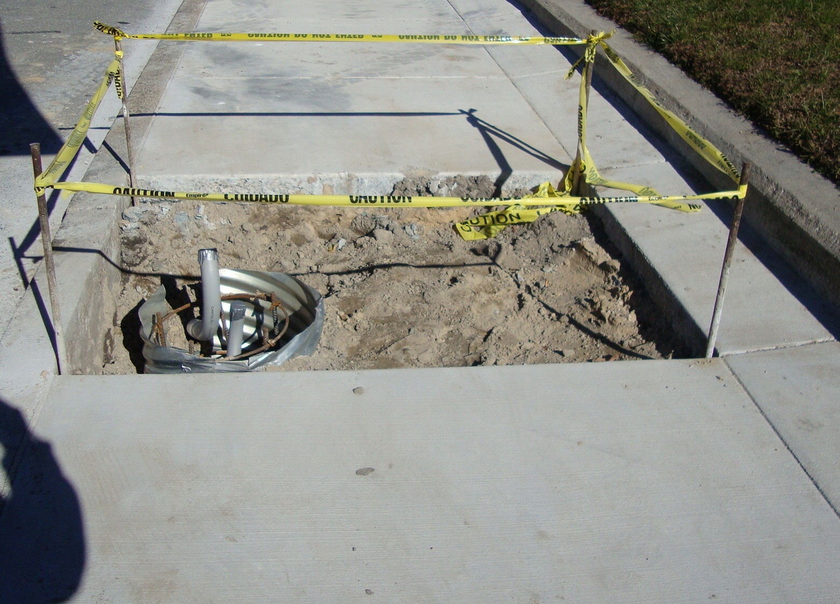
Not Detectable…
Individual channelizing devices
Tape or rope
Plastic chain connecting individual devices
Discontinuous barriers
Pavement markings
Image: ATSSA
Notes:
Key Message: Discuss items that are NOT detectable.
Est. Presentation Time: 1-2 minute(s)
Explanation of Cues/Builds: None
Suggested Comments: Individual channelizing devices, tape or rope used to connect individual devices, other discontinuous barriers and devices, and pavement markings are not detectable by persons with visual disabilities and are incapable of providing detectable path guidance on temporary or realigned sidewalks or other pedestrian facilities.
Suggested Questions: Why not?
Additional Information: MUTCD 6D.01: Tape, rope, or plastic chain strung between devices are not detectable, do not comply with the design standards in the “Americans with Disabilities Act Accessibility Guidelines for Buildings and Facilities (ADAAG)” (see Section 1A.11), and should not be used as a control for pedestrian movements.
Possible Problems: None

Slide 79
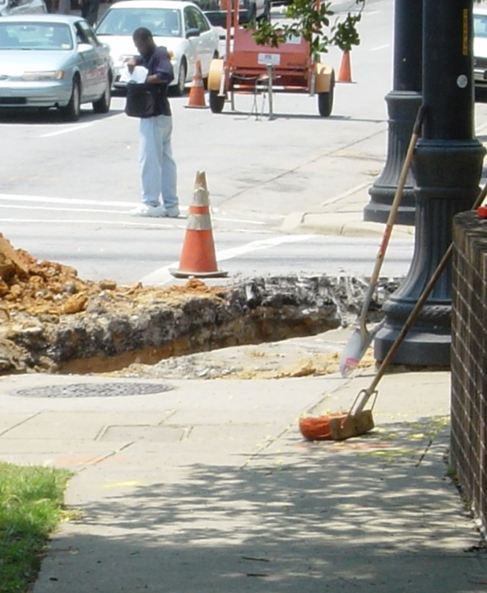
Detectable?
Image: ATSSA
Notes:
Key Message: MUTCD and accessibility
Est. Presentation Time: Less than 1 minute(s)
Explanation of Cues/Builds: None
Suggested Comments: This excavation is not detectable! A blind person, or a distracted person can easily fall in this hole. By definition, this is not detectable?
Suggested Questions: Is this detectable by a blind person? Can a wheelchair go in?
Additional Information: MUTCD Section 6D.01
Possible Problems: None

Slide 80
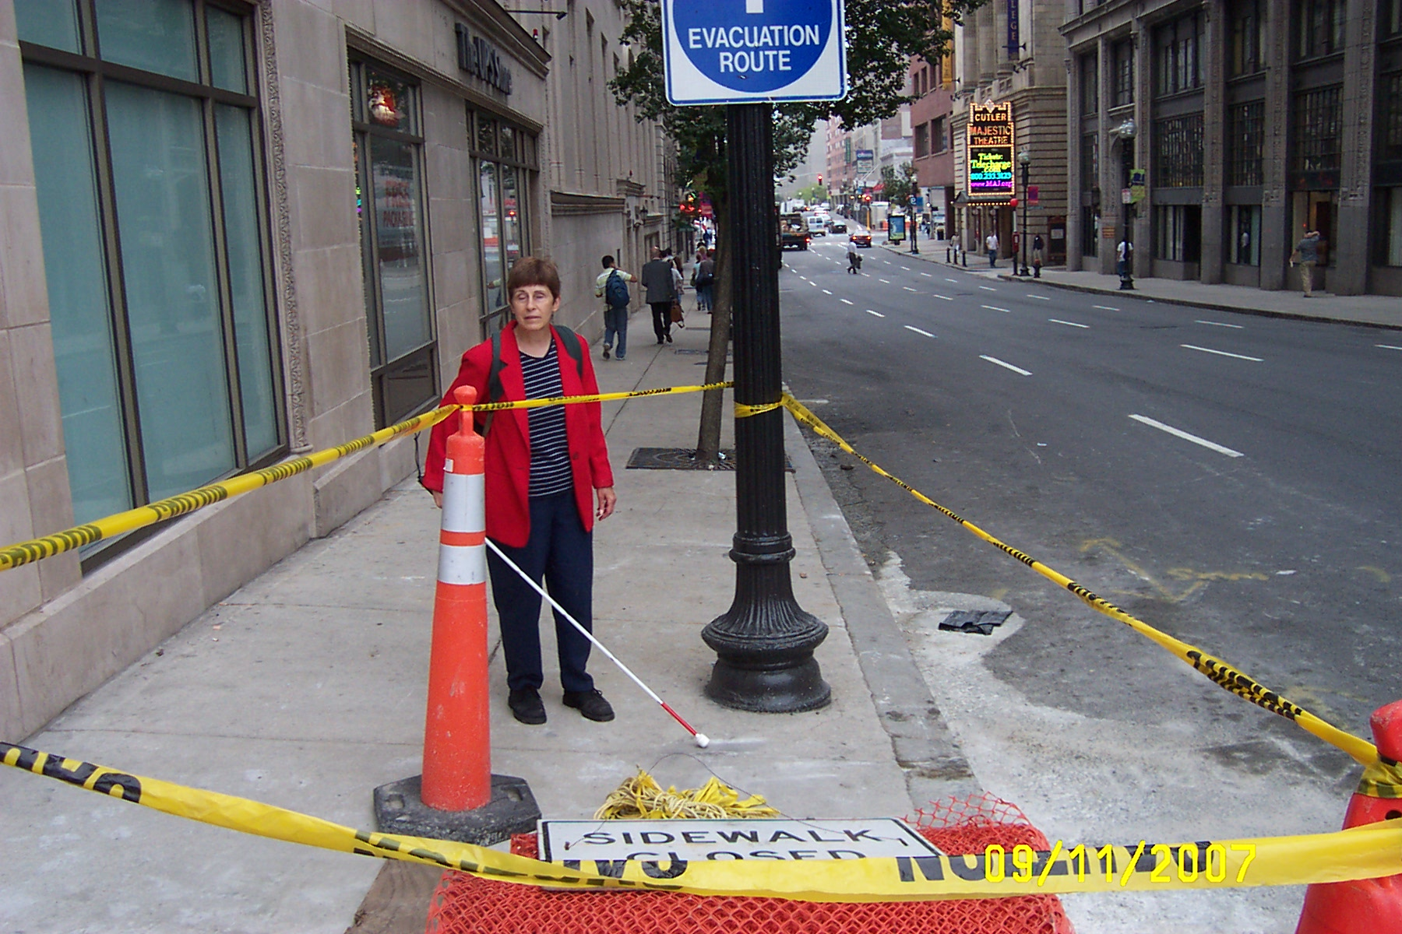
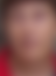
Tape or rope are not detectable!
Image: FHWA
Notes:
Key Message: Illustrate previous point
Est. Presentation Time: 1 minute(s)
Explanation of Cues/Builds: None
Suggested Comments: (Illustrate previous point, self explanatory)
Suggested Questions: Do you see the problem?
Additional Information: Photo is from FHWA
Possible Problems: None

Slide 81
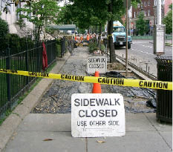
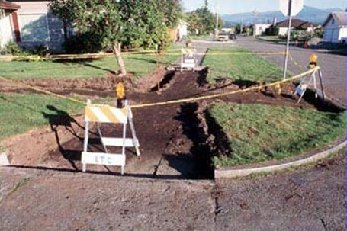
Accessible? Detectable?
Images: ATSSA
Notes:
Key Message: Examples
Est. Presentation Time: Less than 1 minute(s)
Explanation of Cues/Builds:
Suggested Comments: Accessible means everybody can use it! Detectable means a person with vision disabilities can detect its presence!
Suggested Questions: Accessible? Detectable? No! Why not?
Additional Information: None
Possible Problems: None

Slide 82
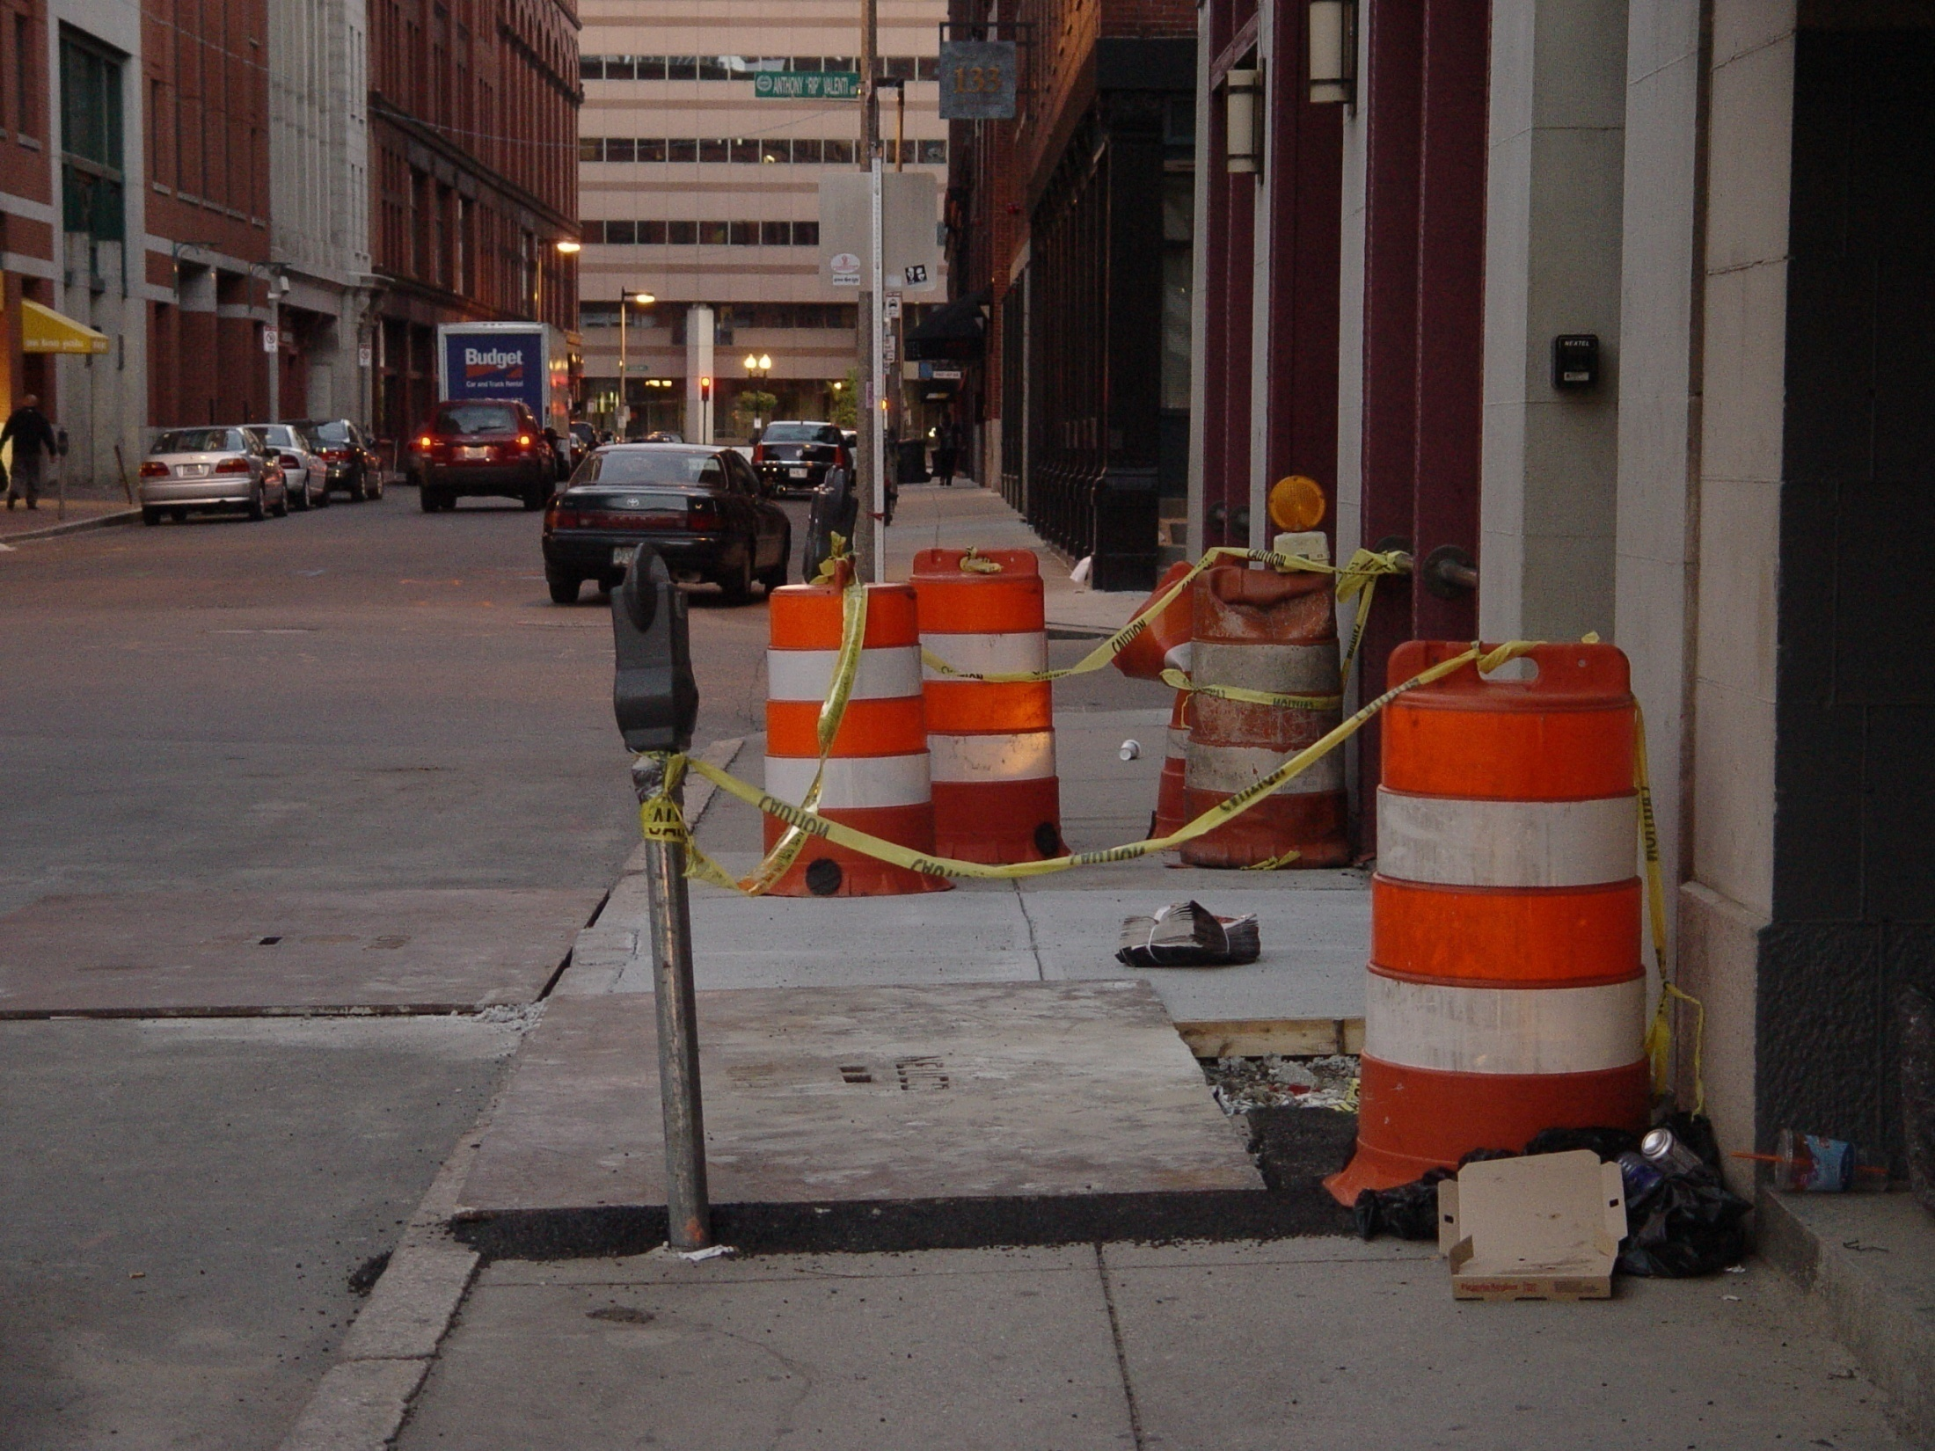
Not Detectable
Image: FHWA
Notes:
Key Message: Provide an example of the previous point.
Est. Presentation Time: Less than 1 minute(s)
Explanation of Cues/Builds: None
Suggested Comments: Safe travel path? No. Caution tape is not “detectable” and therefore cannot be used to channelize pedestrians.
Suggested Questions: Safe travel path? No.
Additional Information: Photo source: FHWA
Possible Problems: None

Slide 83
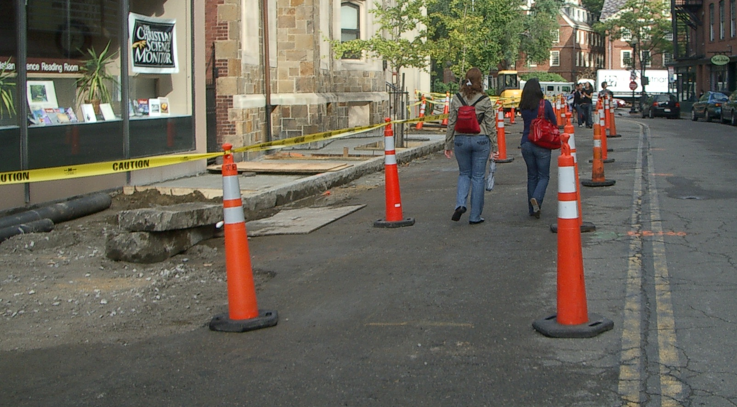
Not Detectable
Image: ATSSA
Notes:
Key Message: Provide an example of the previous point.
Est. Presentation Time: Less than 1 minute(s)
Explanation of Cues/Builds: None
Suggested Comments: What about this one?
Suggested Questions: What would a visually impaired person do?
Additional Information: Cambridge, MA
Possible Problems: None

Slide 84
Module Recap
Which part of the ADA addresses highway work zones?
What constitutes a “detectable edge”?
Is caution tape detectable? Rope?
Does the MUTCD require compliance with accessibility guidelines?
Notes:
Key Message: Module Recap
Est. Presentation Time: Less than 1 minute(s)
Explanation of Cues/Builds: None
Suggested Comments: Let’s recap. How would you answer these questions:
Which part of the ADA addresses highway work zones? The PROWAG
What constitutes a “detectable edge”? A continuous detectable edge that it at least 6 inches from the pavement surface
Is caution tape detectable? Rope? No, No.
Does the MUTCD require compliance with accessibility guidelines? Yes!
Suggested Questions: How would you answer these questions?
Additional Information: Let the students answer. Repeat the answer to make sure everyone gets the answer.
Possible Problems: Turn into a discussion if needed.

Slide 85
Questions
Notes:
Key Message: End slide
Est. Presentation Time: Less than 1 minute(s)
Explanation of Cues/Builds: None
Suggested Comments: Self explanatory
Suggested Questions: None
Additional Information: None
Possible Problems: None

Slide 86
3. Approaches to Routing Pedestrians
American Traffic Safety Services Association
Images: US Access Board and FHWA
Notes:
Key Message: Module Introduction
Est. Presentation Time: As needed
Explanation of Cues/Builds: None
Suggested Comments: Let’s go to the next module! In this module, we will discuss approaches to routing pedestrians.
Suggested Questions: None
Additional Information: None
Possible Problems: None

Slide 87
Module Objectives
Discuss MUTCD considerations when planning for pedestrians in TTC zones
Discuss approaches to routing pedestrians
Provide best practices
Notes:
Key Message: Module Objectives
Est. Presentation Time: As needed
Explanation of Cues/Builds: None
Suggested Comments: These are the things we will do in this module. Let’s start!
Suggested Questions: None
Additional Information: None
Possible Problems: None

Slide 88
Routing Pedestrians
Where existing pedestrian routes are blocked or detoured, information should be provided about alternative routes that are usable by pedestrians with disabilities, particularly those who have visual disabilities
Image: FHWA
    MUTCD Section 6C.1
Notes:
Key Message: Routing Pedestrians
Est. Presentation Time: As needed
Explanation of Cues/Builds: None
Suggested Comments: Where existing pedestrian routes are blocked or detoured, information should be provided about alternative routes that are usable by pedestrians with disabilities, particularly those who have visual disabilities.
Suggested Questions: None
Additional Information: None
Possible Problems: None

Slide 89
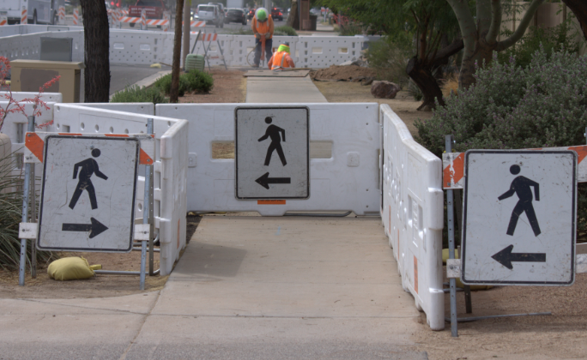
Good Information
Image: FHWA
Notes:
Key Message: Routing Pedestrians
Est. Presentation Time: As needed
Explanation of Cues/Builds: None
Suggested Comments: This shows good information provided for individuals with disabilities.
Suggested Questions: None
Additional Information: None
Possible Problems: None

Slide 90
Considerations When Planning For Pedestrians In TTC Zones
Pedestrians should not be led into conflicts with:
  Vehicles
  Equipment
  Operations
Notes:
Key Message: Routing Pedestrians
Est. Presentation Time: As needed
Explanation of Cues/Builds: None
Suggested Comments: The following three items should be considered when planning for pedestrians in TTC zones: Pedestrians should not be led into conflicts with vehicles, equipment, and operations. Try to keep pedestrians out of the work zone. Information is the key. Which option do I have?
Suggested Questions: None
Additional Information: MUTCD Section 6D.01 Pedestrian Considerations
Possible Problems: None

Slide 91
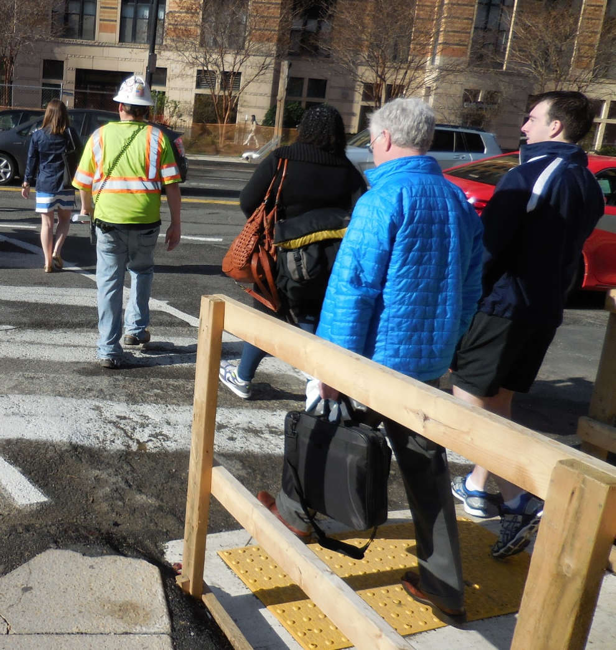
Considerations When Planning For Pedestrians In TTC Zones
Pedestrians should be provided with a convenient and accessible path that replicates as nearly as practical the most desirable characteristics of the existing sidewalk(s) or footpath(s)
Image: ATSSA
Notes:
Key Message: Routing Pedestrians
Est. Presentation Time: As needed
Explanation of Cues/Builds: None
Suggested Comments: Pedestrians should be provided with a convenient and accessible path that replicates as nearly as practical the most desirable characteristics of the existing sidewalk(s) or footpath(s). If this is not possible, then detours should be considered. More on this later, when we discuss scaffolding. Consideration should be made to separate pedestrian movements from both worksite activity and vehicular traffic. Unless an acceptable route that does not involve crossing the roadway can be provided, pedestrians should be appropriately directed with advance signing that encourages them to cross to the opposite side of the roadway. In urban and suburban areas with high vehicular traffic volumes, these signs should be placed at intersections (rather than midblock locations) so that pedestrians are not confronted with midblock worksites that will induce them to attempt skirting the worksite or making a midblock crossing.
Suggested Questions: None
Additional Information: MUTCD Section 6D.01 Pedestrian Considerations
Possible Problems: None

Slide 92
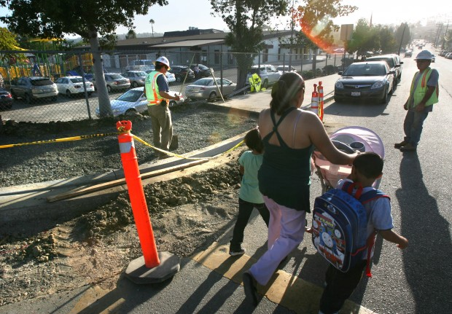
Accommodating Pedestrians
Provisions for continuity of accessible paths for pedestrians should be incorporated into the TTC plan
Access to transit stops should be maintained
Image: ATSSA
Notes:
Key Message: Accommodating Pedestrians
Est. Presentation Time: As needed
Explanation of Cues/Builds: None
Suggested Comments: A. Provisions for continuity of accessible paths for pedestrians should be incorporated into the TTC plan. Put yourself in the position of a pedestrian!
Suggested Questions: None
Additional Information: MUTCD Section 6D.01 Pedestrian Considerations
Possible Problems: None

Slide 93
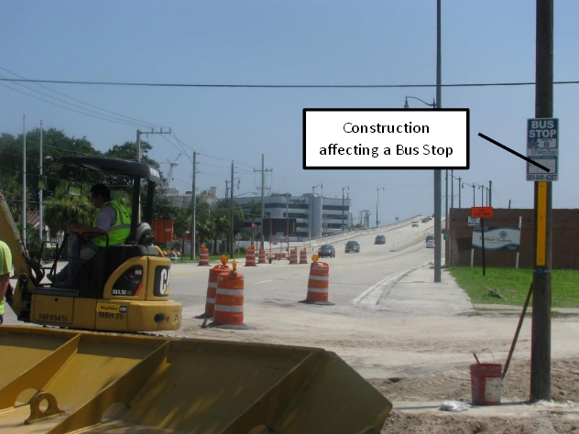
Construction affecting a bus stop
Image: FHWA
Notes:
Key Message: Accommodating Pedestrians
Est. Presentation Time: As needed
Explanation of Cues/Builds: None
Suggested Comments: Access to transit stops should be maintained!
Suggested Questions: Is this stop accessible?
Additional Information: None
Possible Problems: None

Slide 94
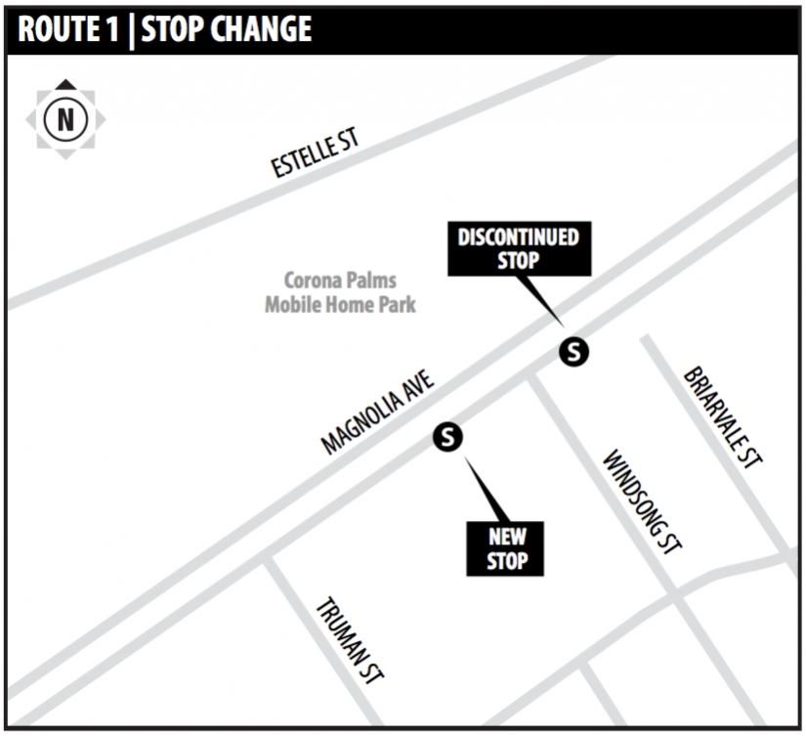
Relocated Bus Stop Information
Furnish in timely and effective manner
  New location
  Effective date
  New schedule
  Contact information
  Accessible?
https://rosap.ntl.bts.gov/view/dot/28632
Notes:
Key Message: Relocated Bus Stop Information
Est. Presentation Time: As needed
Explanation of Cues/Builds: None
Suggested Comments: Relocation of a bus stop can generate a lot of confusion for transit patrons. It is extremely important for the engineer/contractor to furnish information about the relocated bus stop in a timely and effective manner. Throughout the construction period, information should be continuously displayed at the relocated bus stop. That information should include, but is not limited to, items such as the effective start and end date of the relocated bus stop, new system map and schedule, fare information, and contact information for the engineer/contractor in charge.
Suggested Questions: None
Additional Information: Source: Guidelines for Bus Transit Stops in Highway Construction Work Zones BDV29-977-06. According to the “Accessing Transit Design Handbook,” providing system maps and fare information at bus passenger facilities is useful to passengers and gives the transit agency an opportunity to educate passengers and potential passengers about bus transit services. Route maps and schedules should be presented in a manner that allows all transit patrons to understand. Maps and schedules should be provided in a uniform graphic standard, sizes, and color codes. Color schemes should be highly contrasted in a manner that complies with the ADA guidelines.
Possible Problems: None
https://rosap.ntl.bts.gov/view/dot/28632

Slide 95
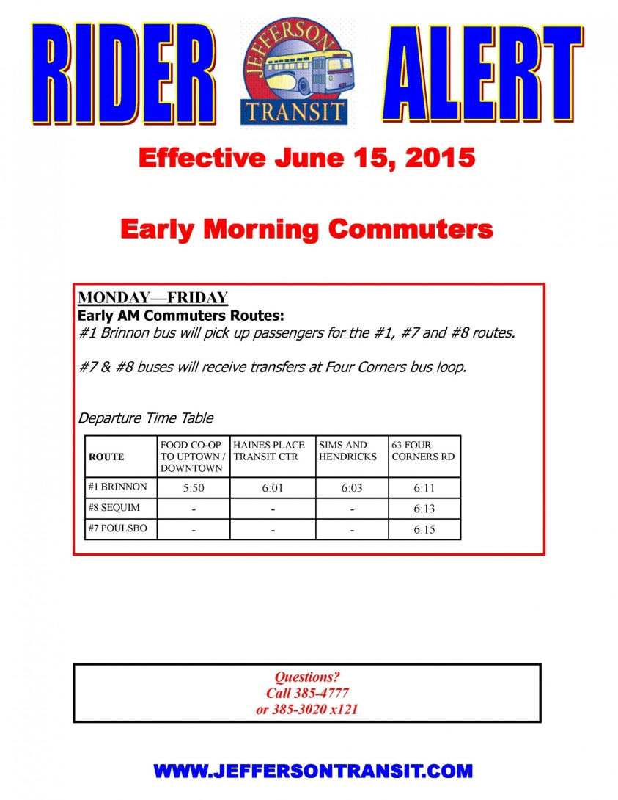
Transit Rider Information
Informational fliers
  Duration of new conditions
  Walkway restrictions
  Contact number
  Any non-accessible conditions
Public outreach campaign
Jeffersontransit.com
Notes:
Key Message: Transit Rider Information
Est. Presentation Time: As needed
Explanation of Cues/Builds: None
Suggested Comments: Before bus stops are removed due to impending construction work, transit agencies/construction companies should have available in advance the affected stops posted with an informational flier. This alerts transit customers and allows the time that is needed to receive rider comments. The typical message for a temporary change could include the information on the tentative duration of the new traffic conditions, or of any walkway restrictions. A contact number for questions and/or for reporting hazards could be provided. Conditions that are beyond recommended standards, non-compliant, or with missing key restrictions or hazardous with non-ADA recommended elements should be reported. According to the Accessing Transit Design Handbook for Florida Bus Passenger Facilities, throughout the construction period, information should be displayed at the relocated bus stops and provide the transit agency the opportunity to educate patrons about the bus transit services being provided. A public outreach campaign that targets the general public should also be a consideration. This pre-work notification in a website or in the immediate vicinity of the relocated bus stop locations allows bus patrons to be well informed.
Suggested Questions: None
Additional Information: Source: Guidelines for Bus Transit Stops in Highway Construction Work Zones BDV29-977-06
Possible Problems: None

Slide 96
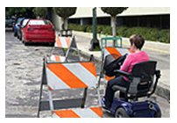
Accommodating Pedestrians
C. A smooth, continuous hard surface should be provided throughout the entire length of the temporary pedestrian facility
  No curbs
  No abrupt changes
  No tripping hazards
  No barriers to wheelchairs
https://www.workzonesafety.org/files/documents/training/fhwa_wz_grant/images/atssa_pedestrian_work_zones/s16.jpg
Notes:
Key Message: Accommodating Pedestrians
Est. Presentation Time: As needed
Explanation of Cues/Builds: None
Suggested Comments: C. A smooth, continuous hard surface should be provided throughout the entire length of the temporary pedestrian facility. There should be no curbs or abrupt changes in grade or terrain that could cause tripping or be a barrier to wheelchair use. The geometry and alignment of the facility should meet the applicable requirements of the “Americans with Disabilities Act Accessibility Guidelines for Buildings and Facilities (ADAAG)” (see Section 1A.11)
Suggested Questions: None
Additional Information: MUTCD Section 6D.01 Pedestrian Considerations
Possible Problems: None

Slide 97
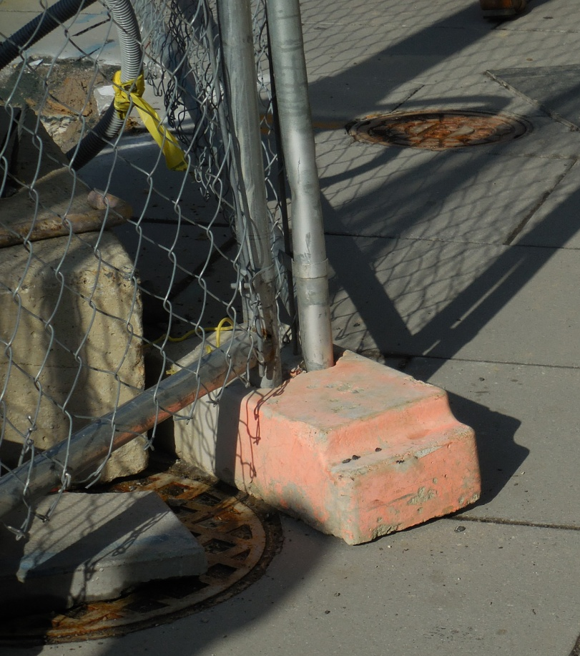
Accommodating Pedestrians
D. Provide width of the existing pedestrian facility if practical
  Do not intrude into the usable width of the pedestrian facility
Image: ATSSA
Notes:
Key Message: Accommodating Pedestrians
Est. Presentation Time: As needed
Explanation of Cues/Builds: None
Suggested Comments: . D. The width of the existing pedestrian facility should be provided for the temporary facility if practical. Traffic control devices and other construction materials and features should not intrude into the usable width of the sidewalk, temporary pathway, or other pedestrian facility.
Suggested Questions: None
Additional Information: MUTCD Section 6D.01 Pedestrian Considerations
Possible Problems: None

Slide 98
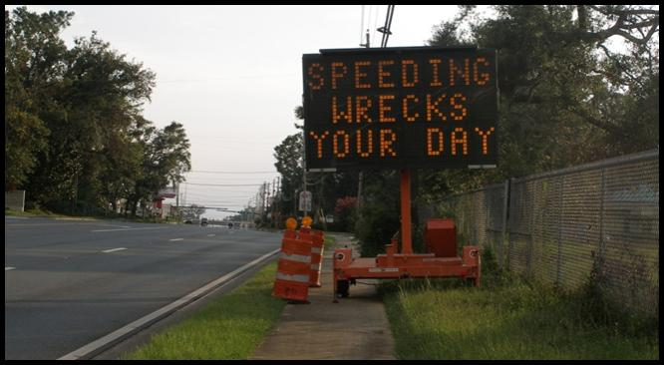
Intruding?
Image: ATSSA
Notes:
Key Message: Accommodating Pedestrians
Est. Presentation Time: As needed
Explanation of Cues/Builds: None
Suggested Comments: . This shows an example of a blocked sidewalk.
Suggested Questions: Intruding?
Additional Information: None
Possible Problems: None

Slide 99
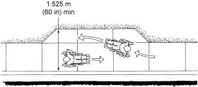
Accommodating Pedestrians
When it is not possible to maintain a minimum width of 60 inches throughout the entire length of the pedestrian pathway, a 60 x 60-inch passing space should be provided at least every 200 feet to allow individuals in wheelchairs to pass
200 ft
5.O ft
5.O ft
Images: US Access Board
Notes:
Key Message: Accommodating Pedestrians
Est. Presentation Time: As needed
Explanation of Cues/Builds: None
Suggested Comments: . When it is not possible to maintain a minimum width of 60 inches throughout the entire length of the pedestrian pathway, a 60 x 60-inch passing space should be provided at least every 200 feet to allow individuals in wheelchairs to pass. Section R301.3.2 of the PROWAG addresses the width at passing spaces. Both the updated ADAAG and the PROWAG require a 5’x 5’ passing area every 200’. Hence, a 5-foot wide pedestrian zone is more practical.
Suggested Questions: None
Additional Information: MUTCD Section 6D.01 Pedestrian Considerations
Possible Problems: None

Slide 100
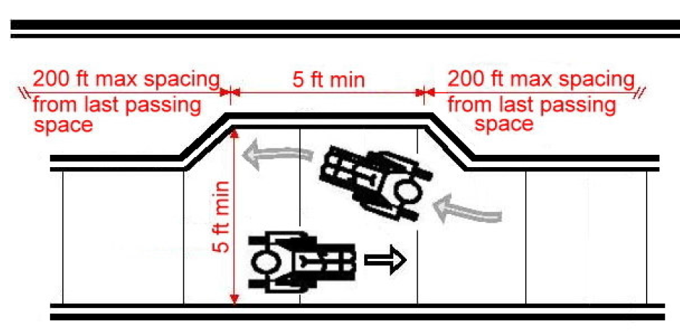
Width at Passing Spaces
Image: US Access Board
Notes:
Key Message: Width at Passing Spaces
Est. Presentation Time: As needed
Explanation of Cues/Builds: None
Suggested Comments: Here we see the details of this requirement.
Suggested Questions: None
Additional Information: MUTCD Section 6D.01 Pedestrian Considerations
Possible Problems: None

Slide 101
Accommodating Pedestrians
E. Blocked routes, alternate crossings, and sign and signal information should be communicated to pedestrians with visual disabilities by providing devices such as:
  Audible information devices
  Accessible pedestrian signals (APS), or
  Detectable barriers and channelizing devices
Notes:
Key Message: Accommodating Pedestrians
Est. Presentation Time: As needed
Explanation of Cues/Builds: None
Suggested Comments: E. Blocked routes, alternate crossings, and sign and signal information should be communicated to pedestrians with visual disabilities by providing devices such as audible information devices, accessible pedestrian signals, or barriers and channelizing devices that are detectable to the pedestrians traveling with the aid of a long cane or who have low vision.
Suggested Questions: None
Additional Information: MUTCD Section 6D.01 Pedestrian Considerations
Possible Problems: None

Slide 102
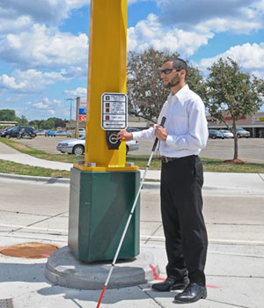
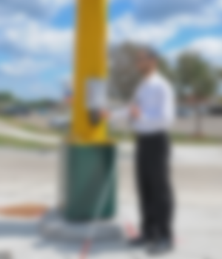
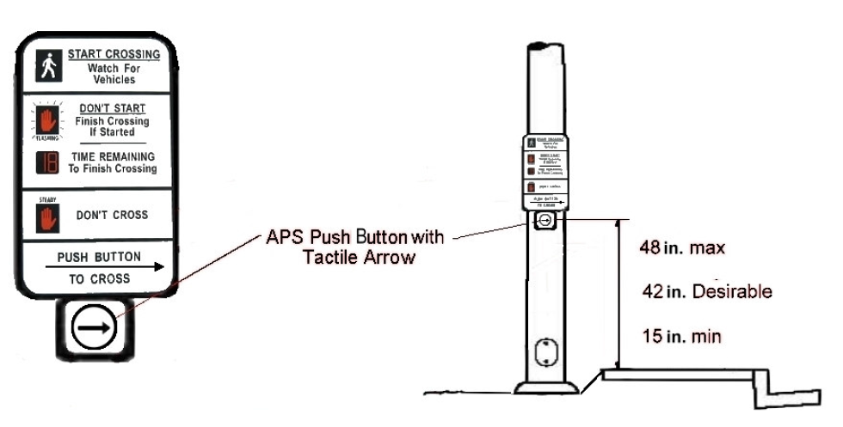
Accessible Pedestrian
Signals in TTC Zones
Maintain access if possible
Image: Crossroads blog
Images: US Access Board
Notes:
Key Message: Accessible Pedestrian Signals in TTC Zones
Est. Presentation Time: As needed
Explanation of Cues/Builds: None
Suggested Comments: Accessible pedestrian signals (APS) and detectors are designed to accommodate the needs of all pedestrians, including those with vision and mobility impairments. They provide information in non visual formats such as audible tones, speech messages, and vibrating surfaces to indicate the appropriate time for pedestrians to cross the street. By the ADA definition, pedestrian push buttons are operable parts that must be installed to be accessible to and usable by people with disabilities. As such, several accessibility criteria apply to pedestrian push button installations, including location, mounting height, provision of a level clear space for operable parts within reach range of the button, and potentially additional maneuvering space (dependent on site-specific conditions). It is important to note that the information is NOT intended to alert a pedestrian that it is safe to cross; rather, the APS provides information about the conditions and status (red/green) of the signal at the intersection. The pedestrian, with the information in hand, is ultimately responsible for making the crossing decision, basis on the totality of information available, including training, the use of other audible cues such as hearing the direction of moving traffic, etc.
Suggested Questions: None
Additional Information: MUTCD Section 6D.01 Pedestrian Considerations
Possible Problems: None

Slide 103
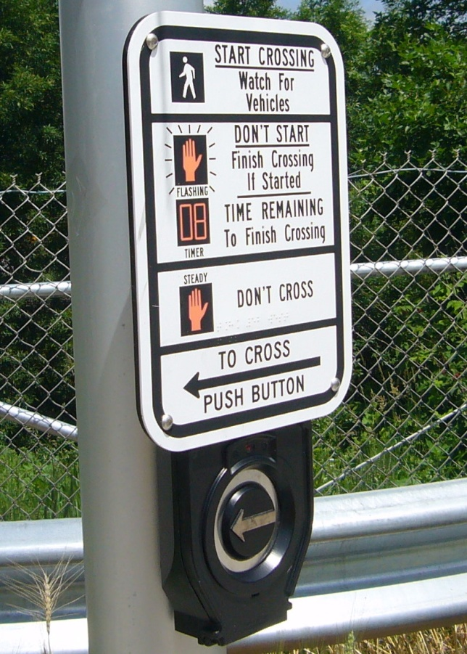
Accommodating Pedestrians
Where pedestrian traffic is detoured to a TTC signal, engineering judgment should be used to determine if pedestrian signals or accessible pedestrian signals should be considered for crossings along an alternate route
Image: Access for Blind
Notes:
Key Message: Accommodating Pedestrians
Est. Presentation Time: As needed
Explanation of Cues/Builds: None
Suggested Comments: . Where pedestrian traffic is detoured to a TTC signal, engineering judgment should be used to determine if pedestrian signals or accessible pedestrian signals should be considered for crossings along an alternate route.
Suggested Questions: What is engineering judgment?
Additional Information: MUTCD Section 6D.01 Pedestrian Considerations
Possible Problems: None

Slide 104
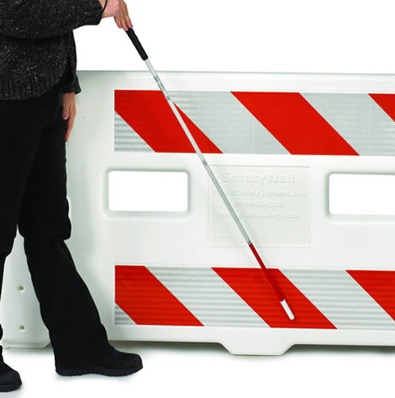
Accommodating Pedestrians
F. When channelization is used to delineate a pedestrian pathway, a continuous detectable edging should be provided throughout the length of the facility such that pedestrians using a long cane can follow it
Image: Plastic Safety Systems
Notes:
Key Message: Accommodating Pedestrians
Est. Presentation Time: As needed
Explanation of Cues/Builds: None
Suggested Comments: . F. When channelization is used to delineate a pedestrian pathway, a continuous detectable edging should be provided throughout the length of the facility such that pedestrians using a long cane can follow it.
Suggested Questions: Which devices provide this detectable edge?
Additional Information: MUTCD Section 6D.01 Pedestrian Considerations
Possible Problems: None

Slide 105
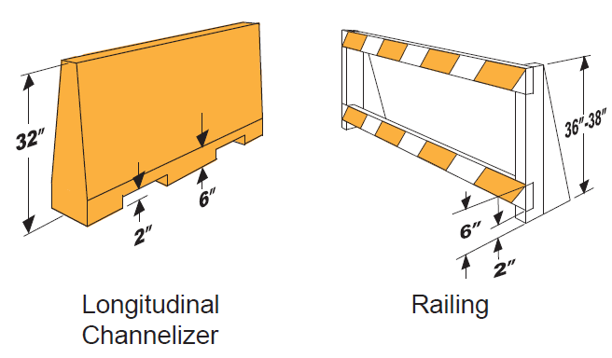
Continuous Detectable Edge Devices
Source: Virginia Pedestrian and Bicycle Guidance
Notes:
Key Message: Discuss Continuous Detectable Edge Devices
Est. Presentation Time: 1-2 minute(s)
Explanation of Cues/Builds: None
Suggested Comments: These are examples of detectable devices. They are a continuous detectable edge along the bottom that is at least six inches high. The one on the left is a longitudinal channelizing device, or LCD.
Suggested Questions: None
Additional Information: VDOT
Possible Problems: None

Slide 106
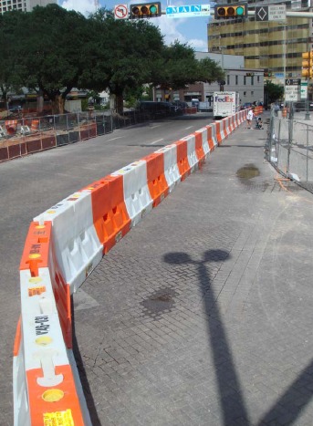
Longitudinal Channelizing Devices (LCDs)
Continuous detectable edge
Not protection devices
Shall be
  Interlocked
  Supplemented with retroreflective material or delineation
Image: ATSSA
Notes:
Key Message: Longitudinal Channelizing Devices
Est. Presentation Time: 1-2 minute(s)
Explanation of Cues/Builds: None
Suggested Comments: LCD are channelizing devices that are ideal for pedestrian channelization. Why? They are a continuous edge and can be interconnected. They ARE NOT protection devices however. They shall be interlocked and supplemented with retroreflective material or delineation for improved nighttime visibility. If we wish to provide BOTH positive protection AND pedestrian channelization then an anchored portable concrete barrier should be considered.
Suggested Questions: None
Additional Information: None
Possible Problems: None

Slide 107
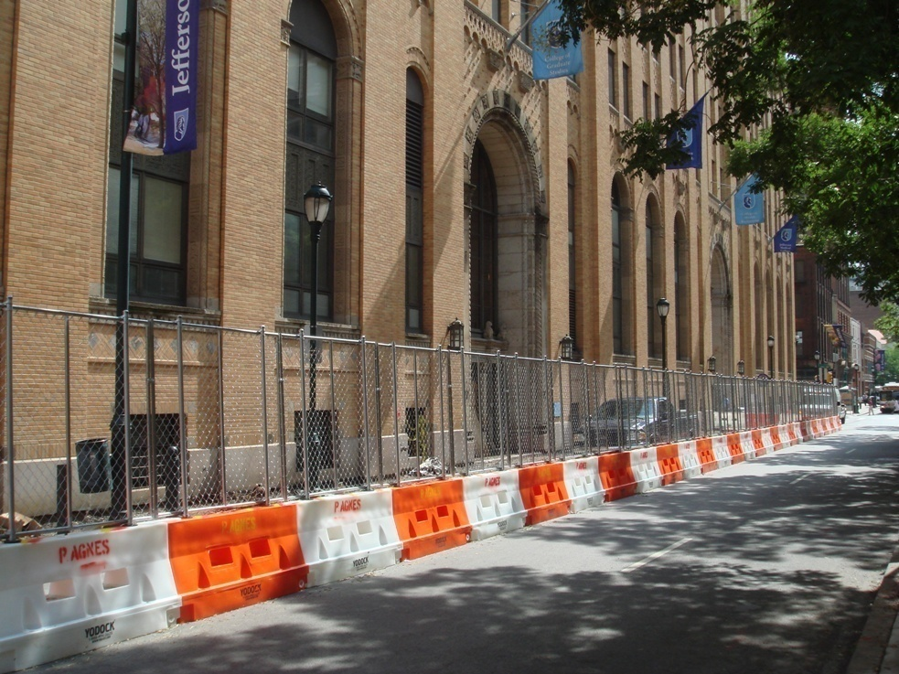
Detectable
Image: ATSSA
Notes:
Key Message: Provide an example of the previous point.
Est. Presentation Time: Less than 1 minute(s)
Explanation of Cues/Builds: None
Suggested Comments: Safe travel path? Yes. Notice the continuous baseboard.
Suggested Questions: Safe travel path? YES.
Additional Information: Photo is Washington, DC
Possible Problems: These LCDs have a slope which some may say is not acceptable. The ADA requires a continuous detectable edge that is at least 6 inches. There is no reference to a slope.

Slide 108

Detectable
Image: ATSSA
Notes:
Key Message: Provide an example of the previous point.
Est. Presentation Time: Less than 1 minute(s)
Explanation of Cues/Builds: None
Suggested Comments: Safe travel path? Yes. Notice the temporary ramp.
Suggested Questions: Safe travel path? YES.
Additional Information: Photo is Brooklyn, NYC
Possible Problems: None

Slide 109

Detectable
Image: ATSSA
Notes:
Key Message: Provide an example of the previous point.
Est. Presentation Time: Less than 1 minute(s)
Explanation of Cues/Builds: None
Suggested Comments: Safe travel path? Yes. Notice the temporary ramp.
Suggested Questions: Safe travel path? YES.
Additional Information: Photo is Phoenix, AZ
Possible Problems: None

Slide 110


Detectable Warning (Guide) Strips
Provide direction
Image: Virginia DOT
Notes:
Key Message: Detectable Warning (Guide) Strips
Est. Presentation Time: Less than 1 minute(s)
Explanation of Cues/Builds: None
Suggested Comments: These guide strips are excellent to help guide blind pedestrians in the intended direction.
Suggested Questions: Have you seen these?
Additional Information: None
Possible Problems: None

Slide 111

Source: Virginia Pedestrian and Bicycle Guidance
111
Image: Virginia DOT
Notes:
Key Message: Detectable Warning Strips
Est. Presentation Time: 1 minute(s)
Explanation of Cues/Builds: None
Suggested Comments: This figure from Virginia is similar to the MUTCD’s but shows more of the PAR details, such as the use of LCDs. Notice the guide strips!
Suggested Questions: What is the minimum width?
Additional Information: Bottom arrow point to the right lane closure TA from VA. Source: VDOT.
Possible Problems: Partial figure

Slide 112

Detectable
Image: ATSSA
Notes:
Key Message: Provide an example of the previous point.
Est. Presentation Time: Less than 1 minute(s)
Explanation of Cues/Builds: None
Suggested Comments: Safe travel path? Yes!
Suggested Questions: Is this ADA compliant? Yes, it is detectable!
Additional Information: None
Possible Problems: This may be considered by some a tripping hazard. The concrete barrier on the right is deemed detectable even though a concrete barrier only has three inches of continuous detectable edge. (This is ATSSA’s interpretation)

Slide 113

Detectable
Image: Caltrans
Notes:
Key Message: Provide an example of the previous point.
Est. Presentation Time: Less than 1 minute(s)
Explanation of Cues/Builds: None
Suggested Comments: Safe travel path? Yes!
Suggested Questions: Is this ADA compliant? Yes, it is detectable!
Additional Information: None
Possible Problems: Signs are not MUTCD compliant. Stripes may point in wrong direction!
Image Credit: http://website.dot.ca.gov/hq/construc/safety/Temporary_Pedestrian_Facilities_Handbook.pdf

Slide 114
Accommodating Pedestrians
G. Signs and other devices mounted lower than 7 feet above the temporary pedestrian pathway should not project more than 4 inches into accessible pedestrian facilities
Notes:
Key Message: Accommodating Pedestrians
Est. Presentation Time: As needed
Explanation of Cues/Builds: None
Suggested Comments: . G. Signs and other devices mounted lower than 7 feet above the temporary pedestrian pathway should not project more than 4 inches into accessible pedestrian facilities. Will discuss protruding objects later.
Suggested Questions: None
Additional Information: MUTCD Section 6D.01 Pedestrian Considerations. Photo source: David Emory (@martarider) | Twitter
Possible Problems: None

Slide 115

Approaches for Routing Pedestrians
Maintain as is
Pedestrian detour
Pedestrian diversion
Image: ATSSA
Let’s discuss…
Notes:
Key Message: Approaches for Routing Pedestrians
Est. Presentation Time: As needed
Explanation of Cues/Builds: None
Suggested Comments: Addressing pedestrian accessibility in a temporary traffic control area can be distilled down into three approaches. These include the ones you see on the screen, which will discuss in a few moments. The first and most important consideration for all pedestrians is safety. Pedestrians must be kept in a safe environment, ideally on a smooth, well-marked travel path. The following are general considerations to take into account when assessing the best approach to use for pedestrian accommodation and accessibility.
Suggested Questions: None
Additional Information: None
Possible Problems: None

Slide 116
1. Maintain as is
Existing pedestrian pathways can remain if the temporary accessible route criteria is met
Allows for business/ resident access
Minimizes impact
Notes:
Key Message: 1. Maintain as is
Est. Presentation Time: As needed
Explanation of Cues/Builds: None
Suggested Comments: Maintaining the existing pedestrian pathways if the sidewalks can remain open during construction is the preferred option. Obviously, the accessibilty design criteria that we have discussed must be met. If it is determined that the current pedestrian facility can remain safely open to all users during construction, the MUTCD clearly states that temporary facilities must include accessibility features consistent with the features present in the existing pedestrian facility. For example, if the current facility features accessible curb ramps with detectable warning surfaces, then the TTC facility must provide the equivalent elements.
Suggested Questions: None
Additional Information: None
Possible Problems: None

Slide 117

MUTCD Ifs:
If the TTC zone affects the movement of pedestrians, adequate pedestrian access and walkways shall be provided
If the TTC zone affects an accessible and detectable pedestrian facility, the accessibility and detectability shall be maintained along the alternate pedestrian route
Image: FHWA
    MUTCD Section 6D.01
Notes:
Key Message: 1. Maintain as is
Est. Presentation Time: As needed
Explanation of Cues/Builds: None
Suggested Comments: The MUTCD states that: If the TTC zone affects the movement of pedestrians, adequate pedestrian access and walkways shall
be provided. If the TTC zone affects an accessible and detectable pedestrian facility, the accessibility and detectability shall be maintained along the alternate pedestrian route. In other words, if the TTC zones does not affect the movement of pedestrians, the recommended approach is not to modify it. If we modify then all the other MUTCD requirements, including accessibility, would have to be addressed.
Suggested Questions: None
Additional Information: MUTCD: Section 6D.01 Pedestrian Considerations
Possible Problems: None

Slide 118

Access to Businesses = Less Impact
Sign should be orange!
Image: ATSSA
Notes:
Key Message: Business Access in Maintained
Est. Presentation Time: As needed
Explanation of Cues/Builds: None
Suggested Comments: This approach allows business access to be maintained.
Suggested Questions: None
Additional Information: None
Possible Problems: Sign is not MUTCD compliant (regulatory). It should be orange (or blue).

Slide 119

2. Sidewalk Detour
Should be avoided
Advance notification of the closure
Regulatory signs
Alternate route should also be accessible
Image: FHWA
Notes:
Key Message: 2. Sidewalk Detour
Est. Presentation Time: As needed
Explanation of Cues/Builds: None
Suggested Comments: It must be recognized that pedestrians are reluctant to retrace their steps to a prior intersection for a crossing or to add distance or out-of-the-way travel to a destination so pedestrian detours should be avoided. Developing an alternative pedestrian pathway that is parallel to or easily reached from the current pathway if the current pathway must be closed is an alternative. For example, using concrete or other crashworthy barriers for protection, pedestrians can be detoured into a channelized pathway on a road adjacent to the work area. The pedestrian detour should have an equivalent level of accessibility as the route being detoured from.
Suggested Questions: None
Additional Information: None
Possible Problems: None

Slide 120
MUTCD Support Information
It must be recognized that pedestrians are reluctant to retrace their steps to a prior intersection for a crossing or to add distance or out-of-the-way travel to a destination
Image: FHWA
    MUTCD Section 6D.01
Notes:
Key Message: MUTCD Support Information
Est. Presentation Time: As needed
Explanation of Cues/Builds: None
Suggested Comments: The MUTCD states that “It must be recognized that pedestrians are reluctant to retrace their steps to a prior intersection for a crossing or to add distance or out-of-the-way travel to a destination”.
Suggested Questions: What does this mean? That they need information at the corner!
Additional Information: None
Possible Problems: None

Slide 121

Pedestrian Detours
Should be a last resort since pedestrians seldom follow them
Image: ATSSA
Notes:
Key Message: Pedestrian Detours
Est. Presentation Time: Less than 1 minute(s)
Explanation of Cues/Builds:
Suggested Comments: Pedestrian detours should be a last resort since pedestrians seldom follow them and are reluctant to trace their steps.
Suggested Questions:
Additional Information: None
Possible Problems: None
AVOID Image Credit: http://cdn.xl.thumbs.canstockphoto.com/canstock24781016.jpg

Slide 122

Accessible Pedestrian Detour?
Image: ATSSA
Notes:
Key Message: Accessible Pedestrian Detour?
Est. Presentation Time: Less than 1 minute(s)
Explanation of Cues/Builds: None
Suggested Comments: This layout forces pedestrians to the street and it is not accessible.
Suggested Questions: Mid block crossings?
Additional Information: College Park, MD
Possible Problems: None

Slide 123


Advance Notification of Closure
Shall be provided
Mount on Type 3 barricade if possible
Image: ATSSA
Image: FHWA
Notes:
Key Message: Advance Notification of Closure
Est. Presentation Time: Less than 1 minute(s)
Explanation of Cues/Builds: None
Suggested Comments: Advance notification of sidewalk closures shall be provided by the maintaining agency. If not provided, pedestrians will cut through the work space! Block the sidewalk by utilizing type 3 barricades.
Suggested Questions: None
Additional Information: MUTCD Section 6D.01
Possible Problems: Some may argue that a Type 3 may physically close the sidewalk at that point. Discuss the pros and cons.

Slide 124

3. Sidewalk Diversion
48” MIN, 60” DESIRABLE
Maintain accessibility
  Min. width
  Continuous detectable edging
  Temporary curb ramps (will discuss later)
Image: FHWA
Notes:
Key Message: Discuss sidewalk diversions.
Est. Presentation Time: 1 minute(s)
Explanation of Cues/Builds: None
Suggested Comments: This shows a pedestrian diversion, where the pedestrians remain on the same route but are diverted around an obstruction. Notice that the minimum pedestrian route width for ADA-compliance is 48 inches and not 36 as shown in this MUTCD TA. Also the devices used here must provide a “continuous detectable edging” to assist visually-impaired individuals. A ramp may also have to be provided. The ADA ramp slope is 50:1, or 2%.
Suggested Questions: What is a “diversion”? A diversion is a temporary rerouting of road users onto a temporary highway or alignment placed around the work area.
Additional Information: Provisions for effective continuity of accessible circulation paths for pedestrians should be incorporated into the TTC process. Where existing pedestrian routes are blocked or detoured, information should be provided about alternative routes that are usable by pedestrians with disabilities, particularly those who have visual disabilities. Access to temporary bus stops, reasonably safe travel across intersections with accessible pedestrian signals (see Section 4E.06), and other routing issues should be considered where temporary pedestrian routes are channelized. Barriers and channelizing devices that are detectable by people with visual disabilities should be provided.
Possible Problems: 09 MUTCD shows 36 inches. ADA requires 48 inches. This has been recognized as an error by FHWA. Also, if pedestrian ramps are needed, they shall have a 2% (1:50) slope.

Slide 125

Image: ATSSA
Notes:
Key Message: Provide an example of the previous point.
Est. Presentation Time: Less than 1 minute(s)
Explanation of Cues/Builds: None
Suggested Comments: Safe travel path? Yes!
Suggested Questions: Is this ADA compliant? Yes, it is detectable!
Additional Information: None
Possible Problems: If these barriers don’t have a stiffener, they would be considered longitudinal channelizing devices and not barriers, since they would deflect if impacted. Chances are there is no curb ramp here so this is not 100% correct.

Slide 126

Source: Virginia Pedestrian and Bicycle Guidance
Notes:
Est. Presentation Time: 1 minute(s)
Explanation of Cues/Builds: None
Suggested Comments: This figure from Virginia is similar to the MUTCD’s but shows more of the PAR details, such as the use of LCDs.
Suggested Questions: What is the minimum width?
Additional Information: Bottom arrow point to the right lane closure TA from VA. Source: VDOT.
Possible Problems: Partial figure

Slide 127
Image: ATSSA
Notes:
Est. Presentation Time: 1 minute(s)
Explanation of Cues/Builds: None
Suggested Comments: Notice the temporary curb ramp, in this case done with concrete.
Suggested Questions: None
Additional Information: Brooklyn, NYC. By J. Morales
Possible Problems: None

Slide 128

Image: ATSSA
Notes:
Key Message: Discuss sidewalk detours
Est. Presentation Time: 1 minute(s)
Explanation of Cues/Builds: None
Suggested Comments: This shows a detectable sidewalk diversion with a temporary concrete ramp.
Suggested Questions: Detour or divert?
Additional Information: NYC
Possible Problems: None

Slide 129


Detour or divert?
Image: ATSSA
Notes:
Key Message: Discuss sidewalk detours
Est. Presentation Time: 2 minute(s)
Explanation of Cues/Builds: None
Suggested Comments: This sidewalk should be closed and pedestrians detoured to the other side. Plus it is not ADA-compliant. Enough width (48”) shall be provided for ADA compliance.
Suggested Questions: What would you do if you walk up to this sign? Walk on the roadway, with your back to traffic? Turn around? It must be recognized that pedestrians are reluctant to retrace their steps to a prior intersection for a crossing or to add distance or out-of-the-way travel to a destination.
Additional Information: Photo taken in Fort Lauderdale, FL, by Juan Morales.
Possible Problems: None

Slide 130

Good!
Image: FHWA
Notes:
Key Message: Provide an example of the previous point.
Est. Presentation Time: Less than 1 minute(s)
Explanation of Cues/Builds: None
Suggested Comments: Safe travel path? Yes!
Suggested Questions: Is this ADA compliant? Yes, it is detectable!
Additional Information: None
Possible Problems: None

Slide 131
4. Temporary Pedestrian Accessible Routes
American Traffic Safety Services Association
Images: US Access Board and FHWA
Notes:
Key Message: Module Introduction
Est. Presentation Time: As needed
Explanation of Cues/Builds: None
Suggested Comments: Let’s go to the next module! In this module, we will discuss Temporary Pedestrian Accessible Routes.
Suggested Questions: None
Additional Information: None
Possible Problems: None

Slide 132
Module Objectives
Discuss TPAR features
Discuss temporary ramp details
Discuss detectable and not detectable features
Discuss best practices
Discuss covered walkways
Discuss accessibility during short duration operations
Notes:
Key Message: Module Objectives
Est. Presentation Time: As needed
Explanation of Cues/Builds: None
Suggested Comments: These are the things we will do in this module. Let’s start!
Suggested Questions: None
Additional Information: None
Possible Problems: None

Slide 133

Non-Compliant Work Zones Force Wheelchairs to the Street!
Image: ATSSA
Notes:
Key Message: Non-Compliant Work Zones Force Wheelchairs to the Street!
Est. Presentation Time: Less than 1 minute(s)
Explanation of Cues/Builds:
Suggested Comments: Here is an example of what was referred to in the former slide when driveways combined with sidewalks are not designed correctly. The installation of ADA compliant driveways has lagged behind the construction of curb ramps. Years ago, wheelchair users didn’t use sidewalks because there were no ramps. Now, driveways are often as much of a problem. Many states and local jurisdictions have standard drawings for sidewalk ramps but not necessarily all have standard plans for driveways.
Suggested Questions:
Additional Information: None
Possible Problems: None

Slide 134

Temporary Pedestrian
Accessible Route Features
Minimum width
Minimum vertical clearance
No hazards
Good even surfaces
Temporary ramps and landings
Detectable warnings
Image: FHWA
Let’s discuss…
Notes:
Key Message: Temporary Pedestrian Accessible Route Features
Est. Presentation Time: Less than 1 minute(s)
Explanation of Cues/Builds:
Suggested Comments: Let’s discuss the features (or design characteristics) of a TPAR. They are listed on the screen. Some of these we have mentioned already but we will dig a bit deeper.
Suggested Questions: None
Additional Information: None
Possible Problems: None
Summary of the next few slides:
An accessible pedestrian route must meet these requirements:
Be at least 36 inches wide. Exception: at doors or short passageways, where the accessible route may be reduced to 32 inches in width for a maximum distance of 24 inches.
Have a minimum 60-inch by 60-inch clear space, at least every 200 feet, so two people using wheelchairs may pass.
Have a minimum of 80 inches vertical clearance or headroom along its entire length.
Be free of any hazardous, protruding objects.
Be on stable, firm, slip-resistant and compact surfaces.
Slope no more than 1:20 unless a ramp with handrails and edge protection is installed. Ramps are limited to a slope of 1:12. All cross slopes are limited to 1:48.
Have no abrupt vertical changes in floor or ground level unless it is limited to 1/4 inch with vertical changes between 1/4 inch and 1/2 inch permitted only if the change is beveled with a slope of 1:2 or less.
Level changes greater than 1/2 inch, such as a step, stairway, or full floor level, can be accomplished using a ramp, lift, or elevator.

Slide 135
1. TPAR Minimum Continuous Width
4 feet: AASHTO’s Policy on Geometric Design of Highways and Streets” (Green Book)
4 feet: AASHTO Pedestrian Guide, 2004
3 (and 4) feet: 2009 MUTCD
5 feet: “Designing Sidewalks and Trails for Access”, FHWA, 2002
4 feet: PROWAG
5 feet: “Building a True Community”, U.S. Access Board
Notes:
Key Message: 1. TPAR Minimum Continuous Width
Est. Presentation Time: Less than 1 minute(s)
Explanation of Cues/Builds: None
Suggested Comments: The first feature to discuss is the minimum width of the TPAR. Here we have problem because there is no consistency, as you see on the screen. The MUTCD says 36” minimum but the PROWAG say 48”. We feel the PROWAG governs so we recommend 48 inches minimum. 60 inches is preferred.
Suggested Questions:
Additional Information: AASHTO - "Guide for the Planning, Design and Operation of Pedestrian Facilities" - 2004
• U.S. Department of Transportation, Federal Highway Administration, "Designing Sidewalks and Trails for Access, Part II of II, Best Practices Design Guide"
Possible Problems: None

Slide 136

TPAR Minimum Continuous Width
The MINIMUM continuous and unobstructed clear width of a pedestrian access route shall be 4.0 ft, exclusive of the width of the curb
Measured from back of curb!
Image: US Access Board
4’
Notes:
Key Message: TPAR Minimum Continuous Width
Est. Presentation Time: Less than 1 minute(s)
Explanation of Cues/Builds:
Suggested Comments: Similar to ADAAG, the PROWAG contains MINIMUM requirements. The minimum continuous and unobstructed clear width of a pedestrian access route shall be 4.0 ft. (48 inches), exclusive of the width of the curb. The 4-feet minimum refers to that portion of a pedestrian route that is unobstructed (meaning no trees, park benches, light poles, and parking meters.).
Suggested Questions:
Additional Information: In measuring the width of a sidewalk, the measurement is taken from the back of curb.
Possible Problems: None

Slide 137

Three Feet For One Wheelchair User
Image: ATSSA
Notes:
Key Message: TPAR Minimum Continuous Width
Est. Presentation Time: Less than 1 minute(s)
Explanation of Cues/Builds:
Suggested Comments: The rationale behind wider sidewalks takes various factors into consideration, such as placement of utility poles, street furniture, and so on. A person using a wheelchair needs at least 3 feet clear width. This takes into account the width of a wheelchair plus the arms of its occupant.
Suggested Questions:
Additional Information: None
Possible Problems: None

Slide 138
3.5 Feet For A Person Using Crutches
Notes:
Key Message: TPAR Minimum Continuous Width
Est. Presentation Time: Less than 1 minute(s)
Explanation of Cues/Builds:
Suggested Comments: On the other hand, a person using crutches requires at least 3.5 feet clear width.
Suggested Questions:
Additional Information: None
Possible Problems: None

Slide 139


4 Ft For User W/Guide Dog, Sighted Guide Or One Person Assisting Another
Image: ATSSA
Notes:
Key Message: TPAR Minimum Continuous Width
Est. Presentation Time: Less than 1 minute(s)
Explanation of Cues/Builds: None
Suggested Comments: At least four feet is needed for persons accompanied by a guide dog, sighted guide or one person assisting another in order to walk side-by-side
Suggested Questions: None
Additional Information: None
Possible Problems: None
.

Slide 140


5 Ft For A Wheelchair User & Walking Companion, 6 Ft For 2 Wheelchair Users
Image: ATSSA
Notes:
Key Message: TPAR Minimum Continuous Width
Est. Presentation Time: Less than 1 minute(s)
Explanation of Cues/Builds: None
Suggested Comments: Five feet width can accommodate a wheelchair user and walking companion – side-by-side, whereas 6 feet will accommodate two wheelchair users either side-by-side or in order to pass alongside.
Suggested Questions: None
Additional Information: None
Possible Problems: None

Slide 141

5 Ft For A Turning Wheelchair
Image: ATSSA
Notes:
Key Message: TPAR Minimum Continuous Width
Est. Presentation Time: Less than 1 minute(s)
Explanation of Cues/Builds: None
Suggested Comments: Five feet clear width is also needed in order to provide adequate space for a wheelchair to turn. This is an area often overlooked in design of wheelchair ramps
Suggested Questions: None
Additional Information: None
Possible Problems: None
.

Slide 142
5 Ft For Two People To Walk Comfortably Side By Side Or To Pass Each Other
Notes:
Key Message: TPAR Minimum Continuous Width
Est. Presentation Time: Less than 1 minute(s)
Explanation of Cues/Builds: None
Suggested Comments: Five feet enables two people to walk comfortably side-by-side or to pass each other. ADA compliant facilities benefit the public at large, whereas facilities that are not ADA compliant exclude persons with disabilities
Suggested Questions: None
Additional Information: None
Possible Problems: None

Slide 143

2. Minimum Vertical Clearance
Minimum of 80 inches vertical clearance or headroom along its entire length
  No protruding objects like advance warning signs
Image: ATSSA
Notes:
Key Message: 2. Minimum Vertical Clearance
Est. Presentation Time: Less than 1 minute(s)
Explanation of Cues/Builds:
Suggested Comments: The minimum vertical clearance shall be 80 inches. The MUTCD requires the minimum height for the bottom of signs to be 84 inches. The required clear area must be maintained without obstruction.
Suggested Questions:
Additional Information: Washington DC by J. Morales
Possible Problems: None

Slide 144


Image: ATSSA
Notes:
Key Message: 2. Minimum Vertical Clearance
Est. Presentation Time: Less than 1 minute(s)
Explanation of Cues/Builds:
Suggested Comments: Eliminate vertical obstructions, like this PCMS in an urban area.
Suggested Questions: Why is this PCMS here?
Additional Information: Washington DC by J Morales
Possible Problems: None

Slide 145
Protruding Objects
Provisions apply across the entire width of the pedestrian circulation path
Examples
  Utility poles
  Sign supports
  Cabinets
  Tools
  Parked
Notes:
Key Message: Protruding Objects
Est. Presentation Time: Less than 1 minute(s)
Explanation of Cues/Builds:
Suggested Comments: Provisions for protruding objects apply across the entire width of the pedestrian circulation path. Protruding objects on pedestrian circulation paths (sidewalks/walkways) shall not reduce the clear width required for pedestrian access routes. Protrusions/obstructions can be permanent or temporary mounted or free-standing objects. Examples are: utility poles; sign supports; trees limbs; vegetation; fire hydrants; cabinets; mail boxes; phone booths; temporary stands/signs; water fountains; stairs; furniture; guy wires; signs; wall phones; and parked car overhangs.
Suggested Questions: None
Additional Information: None
Possible Problems: None

Slide 146

Image: Washington State DOT
Notes:
Key Message: Protrusion Limits
Est. Presentation Time: Less than 1 minute(s)
Explanation of Cues/Builds:
Suggested Comments: Objects with leading edges between 27 inches and 80 inches above the finished ground surface may protrude a maximum of 4 inches horizontally into the pedestrian circulation path.
Suggested Questions: None
Additional Information: Source: Washington State DOT - https://wsdot.wa.gov/Publications/Manuals/fulltext/m0000/ADA_Field_Guide.pdf
Possible Problems: None

Slide 147

Protruding Limits
4 inches horizontally for objects with leading edges between 27 inches and 80 inches above the finished ground surface
Image: Washington Sate DOT
Notes:
Key Message: Protrusion Limits
Est. Presentation Time: Less than 1 minute(s)
Explanation of Cues/Builds:
Suggested Comments: Objects with leading edges between 27 inches and 80 inches above the finished ground surface may protrude a maximum of 4 inches horizontally into the pedestrian circulation path.
Suggested Questions: None
Additional Information: None
Possible Problems: None
Image Credit: https://wsdot.wa.gov/Publications/Manuals/fulltext/m0000/ADA_Field_Guide.pdf

Slide 148

3. Free of Hazards
Tripping hazards
Excavations
Steel plates
Mud and debris
Image: ATSSA
Notes:
Key Message: 3. Free of Hazards
Est. Presentation Time: Less than 1 minute(s)
Explanation of Cues/Builds:
Suggested Comments: The TPAR must be free of hazards such as the ones listed.
Suggested Questions: Others?
Additional Information: Right photo: Washington, DC by J. Morales
Possible Problems: None

Slide 149

Image: ATSSA
Notes:
Key Message: 3. Free of Hazards
Est. Presentation Time: Less than 1 minute(s)
Explanation of Cues/Builds:
Suggested Comments: The TPAR must be free of hazard!
Suggested Questions: More than 4 inches?
Additional Information: Washington, DC by J. Morales
Possible Problems: None

Slide 150

Image: ATSSA
Notes:
Key Message: 3. Free of Hazards
Est. Presentation Time: Less than 1 minute(s)
Explanation of Cues/Builds:
Suggested Comments: The TPAR must be free of hazard!
Suggested Questions: Tripping hazards?
Additional Information: Washington, DC by J. Morales
Possible Problems: None

Slide 151


Image: ATSSA
Notes:
Key Message: 3. Free of Hazards
Est. Presentation Time: Less than 1 minute(s)
Explanation of Cues/Builds:
Suggested Comments: The TPAR must be free of hazard!
Suggested Questions: Tripping hazards?
Additional Information: Washington, DC by J. Morales
Possible Problems: None

Slide 152

Accessible to All?
Image: ATSSA
Notes:
Key Message: 3. Free of Hazards
Est. Presentation Time: Less than 1 minute(s)
Explanation of Cues/Builds:
Suggested Comments: The TPAR must be free of hazard!
Suggested Questions: Accessible? Options?
Additional Information: None
Possible Problems: None

Slide 153


4. Good Even Surfaces
Firm, stable, and slip resistant
Cross slope 2% max.
¼” maximum difference in elevation
½” maximum grate opening
Image: ATSSA
Notes:
Key Message: 4. Good Even Surfaces
Est. Presentation Time: Less than 1 minute(s)
Explanation of Cues/Builds:
Suggested Comments: The surface of the pedestrian access route shall be firm, stable, and slip resistant.
Suggested Questions: Accessible? Options?
Additional Information: This applies to grates within the walkway.
Possible Problems: None

Slide 154

TPAR Cross Slope
The cross slope of the walkway of a pedestrian access route shall be 2 percent maximum
Construction tolerances do not apply!
Image: Washington State DOT
Notes:
Key Message: TPAR Cross Slope
Est. Presentation Time: Less than 1 minute(s)
Explanation of Cues/Builds:
Suggested Comments: The cross slope of the walkway of a pedestrian access route shall be no more than 2 percent. A level surface is best for wheelchair users, yet some slope is needed for drainage. The 2 percent maximum cross slope allows for both. Steep cross slopes can be problematic for all users, more so for persons in wheelchairs.
Suggested Questions: None
Additional Information: None
Possible Problems: None

Slide 155
Cross Slopes Challenges
Pedestrians must work against gravity
  Crutch, walker, and prosthesis users may be forced to walk sideways
Wheelchair users must make significant efforts just to travel straight
Notes:
Key Message: Cross Slopes Challenges
Est. Presentation Time: Less than 1 minute(s)
Explanation of Cues/Builds: None
Suggested Comments: Even in a crosswalk, steep cross slopes can pose difficulty for users. Pedestrians must work against gravity, especially those using crutches and walkers. In order to travel in a straight direction, wheelchair users must use one arm for turning the wheels and the other arm to hold the chair straight as they too are working against the force of gravity.
Suggested Questions: None
Additional Information: None
Possible Problems: None

Slide 156

Street or Highway Grade
Where the walkway of a TPAR is contained within a street or highway border, its grade shall not exceed the general grade established for the adjacent street or highway
Image: Washington State DOT
Notes:
Key Message: Street or Highway Grade
Est. Presentation Time: Less than 1 minute(s)
Explanation of Cues/Builds: None
Suggested Comments: Section R301.4.2 of the PROWAG allows for pedestrian facilities to follow the roadway grade, but cannot exceed it. On the other hand, where the pedestrian access route is supported by a structure, such as a bridge – the grade should not exceed 5% (in new construction) – R301.4.3. In new construction designers have the ability to control the slope of a bridge. It’s important to recognize that steeper grades can present significant challenges to persons with mobility impairments. The best practice is to maintain the same grade.
Suggested Questions: None
Additional Information: None
Possible Problems: None

Slide 157


Good Practice: Provide Advance Information
Provide signs that indicate:
  Grade and length
  Alternate routes with lesser grades
Images: US Access Board
Notes:
Key Message: Best Practice: Reducing Impact of Steep or Long Grades
Est. Presentation Time: Less than 1 minute(s)
Explanation of Cues/Builds: None
Suggested Comments: Advance information placed at appropriate distances before the work zone allows pedestrians to make timely decisions about routes through or around the work zone. Similar to posting steep downgrades on roadways, it is important to post grade and distance information on steep and/or long pedestrian routes. This provides pedestrians with advance warning of the potential challenges associated with the respective facility. It is also beneficial to post information on alternate routes having lesser grades.
Suggested Questions: None
Additional Information: None
Possible Problems: These signs appear to be permanent and not necessarily temporary.

Slide 158

Grate Openings in Pedestrian Direction
Image: US Access Board
Notes:
Key Message: Grate Openings in Pedestrian Direction
Est. Presentation Time: Less than 1 minute(s)
Explanation of Cues/Builds: None
Suggested Comments: A grate or grille located in the accessible route must not have any openings wider than 1/2 inch in the direction of pedestrian travel. Openings any larger can catch the tips of crutches or canes and wheelchair wheels, causing the occupant to pitch out of the wheelchair. Hazardous grates can be covered or blocked off or the accessible route redirected.
Suggested Questions: None
Additional Information: None
Possible Problems: None

Slide 159


Horizontal Surface Openings
Image: US Access Board
Image: FHWA
Notes:
Key Message: Horizontal Surface Openings
Est. Presentation Time: Less than 1 minute(s)
Explanation of Cues/Builds: None
Suggested Comments: Horizontal surface openings shall not permit passage of a sphere more than ½ inch diameter. Horizontal grate openings shall be placed so that the long dimension is perpendicular to the dominant direction of wheelchair travel. Bottom picture is a trench grate.
Suggested Questions: None
Additional Information: Note: Vertical discontinuities and horizontal surface openings are not allowed in curb ramps, landings, gutter areas within the PAR, or required clear spaces.
Possible Problems: None

Slide 160

Small Abrupt Vertical Changes
Smooth transitions are best
Bevel or repair
  1:2 maximum
Image: US Access Board
Notes:
Key Message: Small Abrupt Vertical Changes
Est. Presentation Time: Less than 1 minute(s)
Explanation of Cues/Builds: None
Suggested Comments: Small, abrupt vertical level changes often occur where surface materials change, such as from asphalt to concrete or brick to wood. This condition also can result as surfaces become buckled or cracked from wear or weather. Smooth transitions are always best because they also eliminate tripping hazards. However, people using wheelchairs and scooters can negotiate vertical changes of up to 1/4 inch. Bevels can be created with wood or other material planed into a wedge shape. For sidewalks and other concrete surfaces, it may be possible to trowel additional concrete onto cracked and uneven areas to smooth and level out the surface. If a vertical level change is high enough, it may require the use of a ramp, lift, or elevator.
Suggested Questions: None
Additional Information: None
Possible Problems: None

Slide 161

Image: ATSSA
Notes:
Key Message: Small Abrupt Vertical Changes
Est. Presentation Time: Less than 1 minute(s)
Explanation of Cues/Builds: None
Suggested Comments: Small abrupt vertical changes should be repaired or small bevels installed to create gradual transitions. Changes of 1/4 to 1/2 inch can be transitioned with a bevel sloped as steeply as 1:2. Small changes greater than 1/2 inch must slope at 1:20 (or in the case of a ramp, 1:12)
Suggested Questions: None
Additional Information: Washington DC
Possible Problems: None

Slide 162

Compliant Bevel?
Compliant Bevel?
Image: ATSSA
Notes:
Key Message: Provide an example of the previous point.
Est. Presentation Time: Less than 1 minute(s)
Explanation of Cues/Builds: None
Suggested Comments: What about this one?
Suggested Questions: Compliant?
Additional Information: Cambridge, MA
Possible Problems: This may be compliant.

Slide 163
Typically Acceptable Surfaces
Crushed stone or soil, if compact, stable, and free of loose debris
Grass, if cut close to ground
Synthetic matting
Interlocking rubber tiles
Perforated plastic mats
Notes:
Key Message: Often Acceptable Surfaces
Est. Presentation Time: Less than 1 minute(s)
Explanation of Cues/Builds: None
Suggested Comments: Crushed stone or soil—if compact, stable, and free of loose debris—is often a usable surface. If the surface is grass, it too may be serviceable if the soil is not soft and the grass is cut close to the ground. Tall grass is often slippery and difficult to roll a wheelchair across. Synthetic matting can provide a temporary compact and stable surface over sand, gravel, or wet areas. Low profile, non-slip rubber doormats might work for short distances provided their edges are secured or beveled. Interlocking rubber tiles are probably the best method of providing an accessible route over unstable ground surfaces, especially when long distances must be covered. Perforated plastic mats are another good option because they do not kill the grass they are covering.
Suggested Questions: None
Additional Information: None
Possible Problems: Perforated plastic mats with beveled edges apparently are difficult to find.

Slide 164
Avoid Irregular Surfaces Such as…
Cobblestones
Uneven bricks
Concrete pavers
Can cause :
Wheelchairs to rock and tilt
Loss of balance or falls
Notes:
Key Message: Surfaces to Avoid
Est. Presentation Time: Less than 1 minute(s)
Explanation of Cues/Builds: None
Suggested Comments: Irregular surfaces, such as cobblestones and similar uneven brick or concrete pavers, are uncomfortable as these can cause wheelchairs to rock and tilt. Unstable and uneven surfaces also can be a problem for people who walk using crutches or canes, often causing a loss of balance or falls.
Suggested Questions: None
Additional Information: None
Possible Problems: None

Slide 165



5. Temporary Ramps and Landings
Flush
Securely attached
Improper design may cause wheelchair to topple
Image: ATSSA
Image: US Access Board
Notes:
Key Message: Surfaces to Avoid
Est. Presentation Time: Less than 1 minute(s)
Explanation of Cues/Builds: None
Suggested Comments: Curb ramps, or “cuts,” are used to overcome level changes along streets and parking lots. A curb ramp designed to meet the specifications of the Standards must have slopes no steeper than 1 in 12 (1 inch of rise for every 12 inches of run). They may have flared sides that slope as steeply as 1 in 10 if the flare is not directly in the pedestrian path of travel. Numerous manufacturers fabricate portable ramps. Some are specially designed to bridge curbs and are appropriate for use at a temporary event. The ramp must be securely attached so it does not move or shift during use. Temporary wood curb ramps also can be fabricated as needed. Landings are areas on the ramp that are level with the ground. Landings allow a person in a wheelchair to perform tasks like transferring out of a vehicle at the ramp’s bottom, opening a door at the top, navigating corners in ramps that make turns, or resting in the middle of longer ramps.
Suggested Questions: None
Additional Information: None
Possible Problems: None

Slide 166

Parts of Accessible Ramps
Image: US Access Board
Notes:
Key Message: Understanding Accessible Ramps
Est. Presentation Time: Less than 1 minute(s)
Explanation of Cues/Builds: None
Suggested Comments: Let’s spend a few minutes discussing accessible ramps and terminology! These are the parts of a ramp. The flared side is only needed if meant to be walked on perpendicularly.
Suggested Questions:
Additional Information: The flared side is only required if intended to be walked on perpendicularly.
Possible Problems: The illustration is for a permanent ramp. This discussion is meant to illustrate parts of ramps and their applicability to the TPAR.

Slide 167

Understanding Accessible Ramps:
Ramp Cross Section
Level
Landing
Level
Landing
Rise
Surface of Ramp
Horizontal Projection Run
Image: US Access Board
Notes:
Key Message: Maximum Ramp Slopes
Est. Presentation Time: Less than 1 minute(s)
Explanation of Cues/Builds:
Suggested Comments: Ramp running slopes shall be 8.3% maximum. Ramp cross slopes shall be 2.0% maximum. The cross slope at midblock crossings shall be permitted to match street or highway grade. A slope between 1:10 and 1:12 is allowed for a maximum rise of 6 inches. The maximum rise for any ramp shall be 30 inches.
Suggested Questions:
Additional Information: Running Slope: The slope that is parallel to the direction of travel.
Possible Problems: None

Slide 168

Perpendicular Curb Ramps
Intersects the curb at a 90-degree angle
Must have flared sides if walk across
Slope depends on “X”
Image: US Access Board
Notes:
Key Message: Perpendicular Curb Ramps
Est. Presentation Time: Less than 1 minute(s)
Explanation of Cues/Builds:
Suggested Comments: Flared sides with a slope of 10% maximum, measured parallel to the curb line, are needed when a pedestrian circulation path crosses the curb ramp from the side.
Suggested Questions: None
Additional Information: None
Possible Problems: None

Slide 169

Maximum Ramp Running Slopes
Image: US Access Board
http://www.thagroup.org/wp-content/uploads/2010/12/wheelchair-ramp1.jpg?w=300
100/12 = 8.33%
Notes:
Key Message: Maximum Ramp Slopes
Est. Presentation Time: Less than 1 minute(s)
Explanation of Cues/Builds:
Suggested Comments: Ramp running slopes shall be 8.3% maximum. Ramp cross slopes shall be 2.0% maximum. The cross slope at midblock crossings shall be permitted to match street or highway grade. A slope between 1:10 and 1:12 is allowed for a maximum rise of 6 inches. The maximum rise for any ramp shall be 30 inches.
Suggested Questions: None
Additional Information: Running Slope: The slope that is parallel to the direction of travel.
Possible Problems: None
Lower image credit: http://www.thagroup.org/wp-content/uploads/2010/12/wheelchair-ramp1.jpg?w=300

Slide 170

Alternative Ramp Design
Two ramps joined in the middle by a landing that is level with the roadway
Image: US Access Board
Notes:
Key Message: Alternative Ramp Design
Est. Presentation Time: Less than 1 minute(s)
Explanation of Cues/Builds: None
Suggested Comments: When the 48 inches are not available, we can have two parallel ramps join at a 48 inch landing. Detectable warnings would be required.
Suggested Questions: None
Additional Information: None
Possible Problems: None

Slide 171


Types of Temporary Curb Ramps
Min. width:
  Parallel: 60 in.
  Perpendicular: 48 in.
Detectable warnings if into the street
12:1 maximum slope
Source: Virginia DOT Pedestrian and Bicycle Guidance
Notes:
Key Message: Discuss temporary curb ramps
Est. Presentation Time: 1-2 minute(s)
Explanation of Cues/Builds: None
Suggested Comments: These are examples of temporary curb ramps.
Suggested Questions: None
Additional Information: VDOT (Paul Kelley)
Possible Problems: None

Slide 172

Temporary Ramp: Parallel to Curb
Image: ATSSA
Notes:
Key Message: Parallel to Curb Temporary Ramp
Est. Presentation Time: 1-2 minute(s)
Explanation of Cues/Builds: None
Suggested Comments: This is a good temporary ramp. Because the rise is more than six inches, handrails may be required. They are not required on temporary curb ramps on streets. Notice the non-slip surface, the edge protection and the level landing.
Suggested Questions: None
Additional Information: None
Possible Problems: The black color may be an issue. Yellow would be better.

Slide 173

Image: Minnesota DOT
Notes:
Key Message: Parallel to Curb Temporary Ramp
Est. Presentation Time: 1-2 minute(s)
Explanation of Cues/Builds: None
Suggested Comments: Here is an excellent example of a parallel ramp.
Suggested Questions: None
Additional Information: Source: Ted Ulven, Minnesota DOT.
Possible Problems: None

Slide 174

Temporary Wood Curb Ramp Details
Image: adata.org
Notes:
Key Message: Perpendicular to Curb Temporary Ramp
Est. Presentation Time: 1 minute(s)
Explanation of Cues/Builds: None
Suggested Comments: Numerous manufacturers fabricate portable ramps. Some are specially designed to bridge curbs and are appropriate for use at a work zones. The ramp must be securely attached so it does not move or shift during use. Temporary wood curb ramps also can be fabricated as needed, as the one shown.
Suggested Questions: None
Additional Information: Source: www.adata.org
Possible Problems: None

Slide 175

Non-Compliant Ramp
Non-Compliant Ramp
Image: ATSSA
Notes:
Key Message: Illustrate previous point
Est. Presentation Time: Less than 1 minute(s)
Explanation of Cues/Builds: None
Suggested Comments: This is a non-compliant ramp. It would wobble. There is no edge protection and the detectable warning are missing. It would also be very slippery.
Suggested Questions: Proper slope? Edge protection?
Additional Information:
Possible Problems: None

Slide 176

Compliant Temporary Ramp
Image: ATSSA
Notes:
Key Message: Illustrate previous point
Est. Presentation Time: Less than 1 minute(s)
Explanation of Cues/Builds: None
Suggested Comments: This is a compliant ramp.
Suggested Questions: None
Additional Information: Phoenix, AZ
Possible Problems: None

Slide 177

Temporary Concrete Ramps
Durable and stable
For long-term projects
Same design standards apply
Brush concrete for increased friction
Image: ATSSA
Notes:
Key Message: Temporary Concrete Ramps
Est. Presentation Time: Less than 1 minute(s)
Explanation of Cues/Builds: None
Suggested Comments: For long term projects, concrete ramps may be a possibility. They are the most stable and durable. The same design criteria would apply. The concrete may be brushed for increased friction.
Suggested Questions: None
Additional Information: Brooklyn, NYC
Possible Problems: None

Slide 178

Portable Ramps
Image: ATSSA
Notes:
Key Message: Portable Ramps
Est. Presentation Time: Less than 1 minute(s)
Explanation of Cues/Builds: None
Suggested Comments: The are several portable ramps available in the market. Here is one example.
Suggested Questions: None
Additional Information:
Possible Problems: None

Slide 179

Temporary Pedestrian Modular Ramp
Image: Plastic Safety Systems
Notes:
Key Message: Portable Ramps
Est. Presentation Time: Less than 2 minute(s)
Explanation of Cues/Builds: None
Suggested Comments: Here is another example called the BoardWalk.
Suggested Questions: None
Additional Information: www.plasticsafety.com
• Each modular section consists of two Edge Support Castings and two boards.
• Modular sections connect for ramp length needed. No hardware required.
• Sections are portable at 30 lbs.
• Durable cast iron Edge Support Castings are 8” High x 12” Wide.
• Edge Support Castings designed for 2” x 6” slip-resistant lumber.
• Metal Approach Plates are 18” x 48” with slip-resistant grip tape.
• Ramp rated at 800 lb. capacity for 48” maximum width.
Possible Problems: None

Slide 180
Other Ramp Safety Features
Non-slip surfaces
Handrails
Guardrails
Edge protection
Flush
Landing
Detectable warning surfaces
Drainage
Image: Virginia DOT
Let’s discuss!
Notes:
Key Message: Other Ramp Safety Features
Est. Presentation Time: Less than 1 minute(s)
Explanation of Cues/Builds: None
Suggested Comments: We have mentioned some of these features already. Let’s discuss them in more detail. We will discuss:
Non-slip surface
Handrails
Guardrails
Edge protection
Flush
Landing
Drainage
Suggested Questions: None
Additional Information:
Possible Problems: None

Slide 181
1. Non-Slip Ramp Surfaces
Increasing friction by:
  Adding sand grit tape
  Putting down strips of rolled roofing material
  Sprinkling sand into freshly applied coats of polyurethane
Notes:
Key Message: 1. Non-Slip Ramp Surfaces
Est. Presentation Time: Less than 1 minute(s)
Explanation of Cues/Builds: None
Suggested Comments: Ramps that may become wet, either from weather conditions or from foot traffic, should have an anti-slip surface. Some ways to increase traction on wooden ramps include adding sand-grit tape, putting down strips of rolled roofing material, or sprinkling sand into freshly applied coats of polyurethane. Non-slip surfaces should be inspected annually and replaced when they lose traction.
Suggested Questions: None
Additional Information:
Possible Problems: None

Slide 182

2. Handrails
Required on both sides if:
  Rise more than six inches
  Length more than six feet
Graspable
34 to 38 inches up from the ramp’s surface
At least 1 ½ inches from the wall or guardrail
Image: ATSSA
Notes:
Key Message: 2. Handrails
Est. Presentation Time: Less than 1 minute(s)
Explanation of Cues/Builds: None
Suggested Comments: According to the Americans with Disabilities Act, a wheelchair ramp more than six inches in height or more than six feet long must have handrails on both sides. These handrails must be able to support at least 250 pounds of weight at any point along their length. The handrail should be 34 to 38 inches up from the ramp’s surface, and at least 1 ½ inches from the wall or guardrail. Wood is the preferred material for handrails, which should have smooth or rounded edges. Current requirements are that the top of the handrails shall be between thirty four inches and thirty eight inches (34 in-38 in) from grade; the clearance between the handrail gripping surface and the adjacent surface shall be a minimum of one and one half inches (1 ½ in); the rails cannot be obstructed along their top or sides; and handrails shall extend horizontally above the landing for twelve inches (12 in) minimum beyond the top and bottom of ramp runs. Extensions shall return to a wall, guard, or the landing surface, or shall be continuous with an adjacent rail.
Suggested Questions: What do blind people associate handrails with? Steps! What is graspable?
Additional Information: Washington DC by J. Morales
Possible Problems: None

Slide 183

Image: ATSSA
Notes:
Key Message: 2. Handrails
Est. Presentation Time: Less than 1 minute(s)
Explanation of Cues/Builds: None
Suggested Comments: This shows a good ramp, with hand rails.
Suggested Questions: None.
Additional Information: Washington DC by J. Morales
Possible Problems: Detectable warnings direct the visually disabled to the diagonal crossing.

Slide 184

Hand Edge or Rail
https://www.workzonesafety.org/files/documents/training/fhwa_wz_grant/images/atssa_ada_guide/f21.png
Notes:
Key Message: 2. Handrails
Est. Presentation Time: Less than 1 minute(s)
Explanation of Cues/Builds: None
Suggested Comments: This shows a good ramp, with hand rails.
Suggested Questions: What do you notice about the detectable warnings.
Additional Information: Washington DC
Possible Problems: Detectable warnings direct the visually disabled to the diagonal crossing. Handrails are not required.

Slide 185
3. Guardrails
Along the length of the ramp
Ensure that wheelchairs will not roll off of the side
Slats should be no more than 3.5 in. apart
Notes:
Key Message: 3. Guardrails
Est. Presentation Time: Less than 1 minute(s)
Explanation of Cues/Builds: None
Suggested Comments: Vertical guardrails go along the length of a ramp and ensure that wheelchairs will not roll off of the side. Rail slats should be no more than three and a half inches apart to avoid head entrapment if children are using the ramp.
Suggested Questions: None
Additional Information: None
Possible Problems: None

Slide 186
4. Edge Protection
Keeps wheelchair wheels or canes from slipping off the edge of the ramp
Wooden lips or bump boards on both sides of the ramp
Mounted:
  Onto the ramp surface, or
  ½ inch above the ramp surface
  At least two inches high
Notes:
Key Message: 4. Edge Protection
Est. Presentation Time: Less than 1 minute(s)
Explanation of Cues/Builds: None
Suggested Comments: Without edge protection, there’s a risk of wheelchair wheels or canes slipping off the edge of the ramp. One way to fix this is to add a wooden lip, also called a curb, crutch-stop, or bump board, to both sides of the ramp. The wooden lip can be mounted onto the ramp surface, or a half an inch above the ramp surface to aid water run-off. It should be at least two inches high.
Suggested Questions: None
Additional Information: None
Possible Problems: None

Slide 187

Edge Protection
2 in. minimum!
Images: adata.org
Notes:
Key Message: 4. Edge Protection
Est. Presentation Time: Less than 1 minute(s)
Explanation of Cues/Builds: None
Suggested Comments: It should be at least two inches high.
Suggested Questions: None
Additional Information: None
Possible Problems: None
Image credit: https://adata.org/sites/adata.org/files/images/f4_tif.png

Slide 188

5. Flush
All grade breaks must be flush
¼” maximum difference
Image: adata.org
Notes:
Key Message: 5. Flush
Est. Presentation Time: Less than 1 minute(s)
Explanation of Cues/Builds: None
Suggested Comments: Vertical alignment of pedestrian access routes shall be planar within curb ramps, landings, and gutter areas, and within required clear spaces for operable parts. Grade breaks must be flush. A ¼” maximum difference is allowed.
Suggested Questions: None
Additional Information: None
Possible Problems: None

Slide 189

6. Landings
Level
Landing
When adding turns in the ramp, the following guidelines should be followed:
  90-degree turn: Landing should be at least five feet by five feet
  180-degree turn: Create a landing at least five feet by eight feet
Images: US Access Board
Notes:
Key Message: 6. Landings
Est. Presentation Time: Less than 1 minute(s)
Explanation of Cues/Builds: None
Suggested Comments: The 6th feature is the landing. A ramp without a landing, at the bottom and a the top, is pretty useless. A landing of 4 feet by 4 feet minimum (5 feet by the width of the sidewalk is desirable) shall be provided between the ramps and shall be permitted to overlap other landings and clear floor or ground space. The running slopes and cross slopes shall be 2.0% maximum. Running slopes and cross slopes at midblock crossings may match the street or highway grade.
Suggested Questions: None
Additional Information: None
Possible Problems: None

Slide 190
7. Detectable Warning Surfaces (DWS)
Small “truncated domes” that contrast in color with the surrounding sidewalk or street
Must be integrated into the walking surface
Specific measurements for the size and spacing of the domes
Notes:
Key Message: 7. Detectable Warnings
Est. Presentation Time: Less than 1 minute(s)
Explanation of Cues/Builds:
Suggested Comments: Detectable warning surfaces shall be provided where a curb ramp, landing, or shared-use path connects to a street, and where the pedestrian accessible route crosses a railroad, traffic island, or median. Detectable warning surfaces shall be placed at the back of curb. These are commonly called “truncated domes” because of their cross section.
Suggested Questions: What are these for? Not for traction!
Additional Information: Truncated = cut
Possible Problems: None

Slide 191
Detectable Warning Details
A 2’ x 4’ pad near the bottom of the ramp for the full width of the ramp
Contrasting color
Ideally perpendicular to direction of travel
Only when traffic on one side
Notes:
Key Message: Truncated Dome Details
Est. Presentation Time: Less than 1 minute(s)
Explanation of Cues/Builds:
Suggested Comments: The 1991 ADAAG required detectable warnings the full length of the curb ramp, whereas the PROWAG only requires a 24-inch strip near the bottom of the ramp for the full width of the ramp. The PROWAG requirement provides maximum detectability for persons with visual impairments while minimizing the negative impacts on persons who rely on wheeled devices for mobility. Placement: Detectable warning surfaces shall be placed at the back of curb. Detectable warning surfaces extend 2 feet minimum in the direction of travel and the full width of the curb ramp (exclusive of flares) or the landing.
Suggested Questions:
Additional Information: Common color is federal yellow (Number 595C,#33538) . Other contrasting colors may be used on projects where cities or counties have jurisdiction.
Possible Problems: None

Slide 192

Detectable Warning Surface Detail
Image: Washington State DOT
Notes:
Key Message: Detectable Warning Surface Detail
Est. Presentation Time: Less than 1 minute(s)
Explanation of Cues/Builds:
Suggested Comments: Here we see the location of the detectable warnings.
Suggested Questions: None
Additional Information: Source: Washington State DOT
Possible Problems: None

Slide 193
Contrasting Color
Helps locate the ramp from the other end
Notes:
Key Message: Contrasting Color
Est. Presentation Time: Less than 1 minute(s)
Explanation of Cues/Builds:
Suggested Comments: Common color is federal yellow (Number 595C,#33538) . Other contrasting colors may be used on projects where cities or counties have jurisdiction.
Suggested Questions: None
Additional Information: None
Possible Problems: None

Slide 194

Detectable Warning Surface
Location and Alignment
Image: FHWA
Notes:
Key Message: Detectable Warning Location and Alignment
Est. Presentation Time: Less than 1 minute(s)
Explanation of Cues/Builds:
Suggested Comments: Proper placement and alignment of truncated domes is important to ensure detection by persons with visual impairments and at the same time allow unobstructed passage by persons using wheelchairs. As shown in the photo, detectable warning surfaces shall extend 24 in minimum in the direction of travel and the full width of the curb ramp (exclusive of flares), the landing, or the blended transition.
Suggested Questions:
Additional Information: None
Possible Problems: None

Slide 195


Detectable Warning Surface Placement on Perpendicular Curb Ramps
Place at back of curb or at grade break
2’
Images: US Access Board
Notes:
Key Message: Detectable Warning Placement on Perpendicular Curb Ramps
Est. Presentation Time: Less than 1 minute(s)
Explanation of Cues/Builds: None
Suggested Comments: Ideally, truncated dome detectable warnings shall be placed at the back of the curb or at the grade break, perpendicular to the curb. Why? Blind individuals tent to align themselves with them. This is not required however.
Suggested Questions: None
Additional Information: None
Possible Problems: None

Slide 196


Directional Perpendicular Ramp
Place DWS at grade break if level landing at bottom of ramp is less than 5’ deep
Place DWS on bottom landing if landing is more than 5’ deep at any point
> 5’
< 5’
196
Image: US Access Board
Notes:
Key Message: Directional Perpendicular Ramp
Est. Presentation Time: Less than 1 minute(s)
Explanation of Cues/Builds: None
Suggested Comments: On perpendicular ramps, place the detectable warning at the grade break if the level landing at bottom of ramp is less than 5 feet deep (as illustrated on the left). Place the detectable warning on the bottom landing if landing is more than 5 feet deep at any point (as illustrated on the right).
Suggested Questions:
Additional Information: None
Possible Problems: None

Slide 197


Detectable Warning Surfaces at Parallel Curb Ramp
48” wide
Image: ATSSA
Notes:
Key Message: Detectable Warnings at Parallel Curb Ramp
Est. Presentation Time: Less than 1 minute(s)
Explanation of Cues/Builds:
Suggested Comments: As shown in the diagram above, a parallel curb ramp has two ramps leading down towards a center level landing at the bottom. A level landing is required at the top of each ramp. Detectable warnings should be contained within the lower landing bordering the roadway.
Suggested Questions:
Additional Information: None
Possible Problems: None

Slide 198




Proper Placement of Truncated Domes
Images: ATSSA
Notes:
Key Message: Proper Placement of Truncated Domes
Est. Presentation Time: Less than 1 minute(s)
Explanation of Cues/Builds: None
Suggested Comments: Here are a few more examples of properly placed detectable warnings.
Suggested Questions: None
Additional Information: None
Possible Problems: None

Slide 199
8. Drainage
Minimize restriction to water flow in the curb/gutter
Locate ramp where there is a catch basin just upstream
Image: Virginia DOT
Notes:
Key Message: 8. Drainage
Est. Presentation Time: Less than 1 minute(s)
Explanation of Cues/Builds: None
Suggested Comments: The last feature is proper drainage. Although not in the PROWAG, this is an important consideration. We don’t want water at the bottom of the ramp. Consider the drainage impacts of the installation and consider locating the temporary where there is a catch basin just upstream of the obstructed gutter pan. Another solution is a narrow (one inch) cast iron trench drain across the ramp toe to collect drainage.
Suggested Questions: None
Additional Information: None
Possible Problems: None

Slide 200




Drainage
Images: FHWA
Notes:
Key Message: 8. Drainage
Est. Presentation Time: Less than 1 minute(s)
Explanation of Cues/Builds: None
Suggested Comments: Notice the drainage pipe on the left. Water accumulation at the bottom of the ramp, as you see on the right, is a common problem.
Suggested Questions: None
Additional Information: None
Possible Problems: None

Slide 201

Image: ATSSA
Notes:
Key Message: 8. Drainage
Est. Presentation Time: Less than 1 minute(s)
Explanation of Cues/Builds: None
Suggested Comments: Notice the drainage pipe.
Suggested Questions: Proper slope?
Additional Information: None
Possible Problems: None

Slide 202

Overhead Work
Sometimes called scaffolding
Used for long-term urban building construction or renovation
Primary function is to protect pedestrians from flying debris
Image: ATSSA
Notes:
Key Message: Overhead Work
Est. Presentation Time: Less than 1 minute(s)
Explanation of Cues/Builds: None
Suggested Comments: Another consideration is overhead work sometime called scaffolding. It is used for long-term urban building construction or renovation. Its primary function is to protect pedestrians from flying debris. These may be a challenge to the disabled population. The same design criteria will apply. The MUTCD refers to these as conopied walkways.
Suggested Questions:
Additional Information: None
Possible Problems: None

Slide 203

Canopied Walkways
Keep pedestrian facilities clear of obstructions
Sturdily constructed
Lighted for nighttime use
Designed to accommodate site conditions.
Image: ATSSA
Notes:
Key Message: Canopied Walkways
Est. Presentation Time: Less than 1 minute(s)
Explanation of Cues/Builds: None
Suggested Comments: A canopied walkway may be used to protect pedestrians from falling debris, and to provide a covered passage for pedestrians. Covered walkways should be sturdily constructed and adequately lighted for nighttime use. When pedestrian and vehicle paths are rerouted to a closer proximity to each other, consideration should be given to separating them by a temporary traffic barrier. If a temporary traffic barrier is used to shield pedestrians, it should be designed to accommodate site conditions.
Suggested Questions: None
Additional Information: MUTCD 6D.01
Possible Problems: None

Slide 204

Covered Pedestrian Walkways
Source: City of Phoenix Barricade Manual
Notes:
Key Message: Construction Fences (Corner)
Est. Presentation Time: Less than 1 minute(s)
Explanation of Cues/Builds: None
Suggested Comments: Here we see a typical application from Phoenix, for a covered walkway.
Suggested Questions: None
Additional Information: Source: City of Phoenix Barricade Manual - https://www.phoenix.gov/streetssite/Documents/d_039129.pdf
Possible Problems: None

Slide 205
Accessibility During Short-Term and Short Duration Operations
Short-Term: Stationary daytime work that occupies a location for more than one hour
Short Duration: Work that occupies a location up to one hour
    MUTCD Section 6G.02
Notes:
Key Message: Accessibility During Short-Term and Short Duration Operations
Est. Presentation Time: Less than 1 minute(s)
Explanation of Cues/Builds: None
Suggested Comments: Accessibility during short-term and short duration operations is one of the most difficult challenges. The duration of the operation make this a challenge. The MUTD provides little or no guidance on this topic, other than saying the ADA applies. Decisions regarding the selection of the most appropriate typical application to use as a guide for a specific TTC zone require an understanding of each situation. Work duration is a major factor in determining the number and types of devices used in TTC zones. Most utility work would fall in these categories.
The duration of a TTC zone is defined relative to the length of time a work operation occupies a spot location. Let’s define these terms:
Short-term stationary is daytime work that occupies a location for more than 1 hour within a single daylight period.
Short duration is work that occupies a location up to 1 hour.
Suggested Questions: None
Additional Information: MUTCD Section 6G
Possible Problems: None

Slide 206
Accessibility During Short-Term and Short Duration Operations
A challenge for pedestrians, including the disabled
Most maintenance and utility work
A TPAR is usually not required
Use your judgment
Notes:
Key Message: Accessibility During Short-Term and Short Duration Operations
Est. Presentation Time: Less than 1 minute(s)
Explanation of Cues/Builds: None
Suggested Comments: Accessibility during short-term and short duration operations is one of the most difficult challenges. The duration of the operation make this a challenge. The MUTCD provides little or no guidance on this topic, other than saying the ADA applies. Decisions regarding the selection of the most appropriate typical application to use as a guide for a specific TTC zone require an understanding of each situation. Each TTC zone is different. Many variables, such as location of work, highway type, geometrics, vertical and horizontal alignment, intersections, interchanges, road user volumes, road vehicle mix (buses, trucks, and cars), and road user speeds affect the needs of each zone. The goal of TTC in work zones is safety with minimum disruption to road users. The key factor in promoting TTC zone safety is proper judgment. We can use judgment to alter the typical applications. Typical applications should be altered, when necessary, to fit the conditions of a particular TTC zone.
Suggested Questions: None
Additional Information: MUTCD Section 6G.01
Possible Problems: None

Slide 207
Best Practices
Allow 48 inches for passing
Signs on portable supports
Use detectable devices:
  LCDs
  Type 3 barricades
Use spotters
Notes:
Key Message: Best Practices
Est. Presentation Time: Less than 1 minute(s)
Explanation of Cues/Builds: None
Suggested Comments: The best practices involve:
Allowing 48 inches for passing
Signs on portable supports
Using portable detectable devices such as LCDs and type 3 barricades
If no detectable devices, using cones that touch each other to close the area
Using spotters to offer help to disable individuals.
Suggested Questions: None
Additional Information: A spotter is not a flagger!
Possible Problems: Cones touching each other may not be compliant. Turn into a discussion.

Slide 208
Discussion: Are these acceptable practices for short duration work?
Cone bars
Cones touching
Notes:
Key Message: Discuss Practices
Est. Presentation Time: Less than 1 minute(s)
Explanation of Cues/Builds: None
Suggested Comments: We know these are not acceptable for long term, but what about short duration. What do you think?
Suggested Questions: Are these acceptable practices for short duration?
Additional Information: The manufacturers often claim their devices are ADA compliant.
Possible Problems: Cones touching each other may not be compliant. Turn into a discussion.

Slide 209

Image: ATSSA
Notes:
Key Message: Discuss Practices
Est. Presentation Time: Less than 1 minute(s)
Explanation of Cues/Builds: None
Suggested Comments: This shows the cone bar in a work zone.
Suggested Questions: Are these acceptable practices for short duration?
Additional Information: Washington, DC
Possible Problems: Turn into a discussion.

Slide 210
Module Recap
What are three approaches for accommodating pedestrians in a work zone, including those with disabilities?
Should provisions for continuity of accessible paths for pedestrians be incorporated into the TTC plan?
What is the maximum “ADA slope” of a curb ramp?
Names three parts of a typical ramp
Notes:
Key Message: Module Recap
Est. Presentation Time: Less than 1 minute(s)
Explanation of Cues/Builds: None
Suggested Comments: Let’s recap. How would you answer these questions:
What are three approaches for accommodating pedestrians in a work zone, including those with disabilities? Leave as is, divert and detour.
Should provisions for continuity of accessible paths for pedestrians be incorporated into the TTC plan? Yes!
What is the maximum “ADA slope” of a curb ramp? 12:1, or 8.33%
Names three parts of a typical ramp: Ramp, landing and flare.
Suggested Questions: How would you answer these questions?
Additional Information: Let the students answer. Repeat the answer to make sure everyone gets the answer.
Possible Problems: Turn into a discussion if needed.

Slide 211
Questions
Notes:
Key Message: End slide
Est. Presentation Time: Less than 1 minute(s)
Explanation of Cues/Builds: None
Suggested Comments: Self explanatory
Suggested Questions: None
Additional Information: None
Possible Problems: None
Image Credit:
Question Button
https://encrypted-tbn1.gstatic.com/images?q=tbn:ANd9GcTIsJ5LjQxy17iC9mzx6eiBvR8g2zL6MC6U184CAfLKHKCcSGswoQ

Slide 212
5. Field Exercise
American Traffic Safety Services Association
Images: US Access Board and FHWA
Notes:
Key Message: Module Introduction
Est. Presentation Time: As needed
Explanation of Cues/Builds: None
Suggested Comments: Let’s go to the next module! In this module, we will discuss the field exercise included in this course.
Suggested Questions: None
Additional Information: None
Possible Problems: None
Image Credit:
Road Work Ahead
http://imgsrv.kfor1240.com/image/kfor2/UserFiles/Image/road_work.gif

Slide 213
Module Objectives
Perform field visit to assess accessibility features
Discuss afterwards
Notes:
Key Message: Module Objectives
Est. Presentation Time: As needed
Explanation of Cues/Builds: None
Suggested Comments: These are the things we will do in this module. Let’s start!
Suggested Questions: None
Additional Information to Instructor: This should take 1-2 hours depending on location. Travel by foot to an intersection nearby. It does not have to be part of a work zone but if one is available it would be better. PROCURE A WHEELCHAIR in advance. Have participants experience a wheelchair on various slopes and surfaces (pavers, gravel, dirt, etc.). Have them use the wheelchair for at least 5 minutes each so they experience the effort and stamina need to do this. If available, PROCURE or bring with you a blind fold and a white cane.
Possible Problems: None

Slide 214
Useful Equipment
High-visibility safety apparel
Measuring tape
Clinometer (smart level)
  May download from app store
A wheelchair
Blindfold/white cane
Notes:
Key Message: Equipment Needed
Est. Presentation Time: As needed
Explanation of Cues/Builds: None
Suggested Comments: We are going to the field. We will need {discuss}.
Suggested Questions: None
Additional Information: Instructor may bring these items with him/her and share as needed.
Possible Problems: None

Slide 215
Assess and Report on…
Minimum width
Minimum height
No hazards
Good even surfaces
Temporary ramps and landings
Detectable warnings
Notes:
Key Message: Equipment Needed
Est. Presentation Time: As needed
Explanation of Cues/Builds: None
Suggested Comments: We need to assess these items and report back to class.
Minimum width
Minimum height
No hazards
Good even surfaces
Temporary ramps and landings
Detectable warnings
Suggested Questions: None
Additional Information: None
Possible Problems: None

Slide 216
Field Visit Logistics
Instructor: Read the notes.
Notes:
Key Message: Field Visit Logistics
Est. Presentation Time: As needed
Explanation of Cues/Builds: None
Suggested Comments: Discuss course logistics as needed.
Suggested Questions: None
Additional Information to Instructor: This should take 1-2 hours depending on location. Travel by foot to an intersection nearby. It does not have to be part of a work zone but if one is available it would be better. PROCURE A WHEELCHAIR in advance. Have participants experience a wheelchair on various slopes and surfaces (pavers, gravel, dirt, etc.). Have them use the wheelchair for at least 5 minutes each so they experience the effort and stamina need to do this. If available, PROCURE or bring with you a blind fold and a white cane.
Possible Problems: None

Slide 217
Questions
Notes:
Key Message: End slide
Est. Presentation Time: Less than 1 minute(s)
Explanation of Cues/Builds: None
Suggested Comments: Self explanatory
Suggested Questions: None
Additional Information: None
Possible Problems: None

Slide 218
6. Closing
American Traffic Safety Services Association
Images: US Access Board and FHWA
Notes:
Key Message: Module Introduction
Est. Presentation Time: As needed
Explanation of Cues/Builds: None
Suggested Comments: Let’s go to the next module! In this module, we will discuss {Module Name}.
Suggested Questions: None
Additional Information: None
Possible Problems: None

Slide 219
Module Objectives
Review the parking lot
Review course objectives
Complete course evaluations
Take exam
Adjourn
Notes:
Key Message: Module Objectives
Est. Presentation Time: As needed
Explanation of Cues/Builds: None
Suggested Comments: These are the things we will do in this module.
Suggested Questions: None
Additional Information: None
Possible Problems: None

Slide 220
Review the “Parking Lot”
Any questions that we “parked” until later?
Any final questions?
Notes:
Key Message: Explain the “parking lot”
Est. Presentation Time: 2 minute(s)
Explanation of Cues/Builds: None
Suggested Comments: As we go through the class, for sure you will have questions. If you ask a question about a topic that we will discuss later, rather than discussing the topic then, we will “park it” by writing it down in the flip chart, so we do not forget. At the end of the course, we will review the “parking lot” to make sure the question was answered.
Suggested Questions: None
Additional Information: None
Possible Problems: If there is no flip chart, use a corner of a blackboard or ask a student to keep a list of questions. You may also have a PowerPoint file open to serve as a “parking lot”.

Slide 221
Review the Course Objectives
Identify some of the challenges faced by persons with disabilities within the Public Right-of-Way (PROW)
Identify applicable laws, regulations, guidelines, and standards pertaining to accessibility for persons with disabilities
Discuss their application to temporary traffic control (TTC) zones
  Design elements
  Best practices
Notes:
Key Message: Discuss course objectives
Est. Presentation Time: 1-2 minute(s)
Explanation of Cues/Builds: None
Suggested Comments: These were the objectives of this course.
Suggested Questions: Did we meet these objectives?
Additional Information: None
Possible Problems: None

Slide 222
Course Evaluation Form
Let us know how you feel about the course
  Please be specific
Name optional
Won’t affect your grade in any way
Notes:
Key Message: Completion of evaluation forms
Est. Presentation Time: 10 minutes
Explanation of Cues/Builds: None
Suggested Comments: Please complete the evaluation form using a pen or a thin felt tip There is no need to enter any personal information or information about the course (date, etc.). Simple X the box that best represents your views. Written comments (4.2) are always welcomed. You may turn it in along with your exam and exam booklet.
Suggested Questions: None
Additional Information: None
Possible Problems: You may want to collect the forms here so they don’t get lost later. Avoid looking at the forms. Shuffle them as you collect them.

Slide 223
Exam
25 multiple choice questions @ 4 points each = 100 pts
Open book, open notes
30 minutes
Passing score: 80%
Notes:
Key Message: Introduce exam
Est. Presentation Time: 2-3 minute(s)
Explanation of Cues/Builds: None
Suggested Comments: The last thing to do is take the exam. You may remember the exam is 25 True/False questions @ 4 points each. It is open book and open notes. You must work independently. You will have one-hour to complete this test. Your passing score is 80% (you cannot miss more than 5 questions).
Suggested Questions: None
Additional Information: None
Possible Problems: None

Slide 224
When Done…
Return both the exam and answer sheet
Return evaluation form
Exam grading/make-up
ATSSA will mail your results within 2-4 weeks
May leave!
Images: US Access Board and FHWA
Notes:
Key Message: Complete exam procedure
Est. Presentation Time: Less than 1 minute(s)
Explanation of Cues/Builds: None
Suggested Comments: When you are done with the test, return both the exam and answer sheet to me. If you still have it, also return the evaluation form to me. You may leave then. ATSSA will send your test results within 2-4 weeks. Good luck and thank you for choosing ATSSA for your training needs. We hope you found this course a learning experience. Thank you!
Suggested Questions: None
Additional Information: None
Possible Problems: None
Image Credit: Road Work Ahead
http://imgsrv.kfor1240.com/image/kfor2/UserFiles/Image/road_work.gif

Slide 225
Thank you for choosing ATSSA for your training needs!
American Traffic Safety Services Association
Images: US Access Board and FHWA
Notes:
Key Message: Closing
Est. Presentation Time: As needed
Explanation of Cues/Builds: None
Suggested Comments: Thank you! Thank you for choosing ATSSA for your training needs! Be safe!
Suggested Questions: None
Additional Information: None
Possible Problems: None
Image Credit: Road Work Ahead
http://imgsrv.kfor1240.com/image/kfor2/UserFiles/Image/road_work.gif

