Slide 1


Work Zone
Road Safety Audits
American Traffic Safety Services Association
Images: FHWA
Notes:
Key Message: Course opening
Est. Presentation Time: As needed
Explanation of Cues/Builds: None
Suggested Comments: Good morning and welcome you to the Work Zone Road Safety Audits training course.
Suggested Questions: Why are we here?
Additional Information: Greet students as they come in.
Possible Problems: None

Slide 2
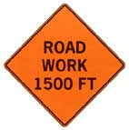
About This Course
This material is based upon work supported by the U.S. Department of Transportation under Cooperative Agreement No. 693JJ31750002. The material was prepared by ATSSA.
Any opinions, findings and conclusions or recommendations expressed in this publication are those of the trainer and the grantee and do not necessarily reflect the view of the U.S. Department of Transportation.
This course does not constitute a national standard, specification, or regulation. The U.S. Government does not endorse products or manufacturers. Trademarks or manufacturers’ names appear in this document only because they are considered essential to the objective of the document.
Notes:
Key Message: FHWA disclaimer
Est. Presentation Time: Less than 1 minute(s)
Explanation of Cues/Builds: None
Suggested Comments: Self explanatory
Suggested Questions: None
Additional Information: Information about the grant can be found at www.atssa.com
Possible Problems: None

Slide 3



Developed and Presented by
Images: ATSSA
Notes:
Key Message: Introduce ATSSA
Est. Presentation Time: Less than 1 minute(s)
Explanation of Cues/Builds: None
Suggested Comments: This course is presented to you by ATSSA, a national leader in work zone training.
Suggested Questions: How many of you have taken courses with ATSSA before? Which ones?
Additional Information: None
Possible Problems: Spell out the acronym. Do not assume everyone is familiar.

Slide 4
The Goal: Begin with the End In Mind
Reduce the number and severity of transportation related crashes for roadway users and workers!
Notes:
Key Message: Work zone road safety audits are a mechanism to reduce fatalities and severe injuries in work zones.
Background Information:
A WZRSA is but one tool in our quest towards zero deaths.
We know where we want to be, so it is wise to keep that in mind as we plan.
Our goal is to further reduce the number and severity of crashes in WZ
Paying attention to both the safety of the motorists and our WZ workers
Interaction:
Notes:
Photo from: https://wsdotblog.blogspot.com/2021/06/rise-in-work-zone-crashes-concern-for.html

Slide 5
Workshop Objectives
Describe work zone road safety audits (WZRSA)
Summarize WZRSA basics
Describe work zone safety issues
Describe what a WZRSA IS and IS NOT
Illustrate the 8-step WZRSA process
Evaluate a case study
Perform a WZRSA
Notes:
Key Message: Define Objectives
Background Information:
To introduce Work Zone Road Safety Audit (WZRSA) as a useful tool to reduce roadway and worker fatalities and injuries
to provide a process to individuals or agencies for performing a formal safety examination of a work zone in order to improve the safety of workers and all roadway users in active work zones.
These guidelines expand on the current WZRSA guidance to include details on how the Eight-Step WZRSA process and prompt lists can apply specifically to work zones.
Give an overview of the WZRSA
Review Work Zone issues such as:
the overall problem
Factors contributing to work zone crashes
Difference between WZRSA, WZ Inspection, WZ Process Review
How to Choose the Right Project and Phase to Conduct a WZRSA
Anticipated Challenges in Conducting a WZRSA
Discuss what a WZRSA IS and IS NOT
Discuss the Eight-Step WZRSA Process
And examine a recent case in Florida
Perform a WZRSA
Interaction:
Notes: (Photo: http://www.iowadot.gov/workzone/images/work_zone_safety_header.jpg)

Slide 6
Workshop Agenda/Modules
 | DAY 1
1 | Overview of Work Zone RSAs
2 | Work Zone RSA Eight-Step Process Exam
 | DAY 2
3 | Conduct WZRSA
 | Closing
Notes:
Key Message: Produce highly‐productive and engaging class room
Background Information: Review workshop agenda/times with attendees, as noted in the instructor guide.
Interaction:
Notes: Give a timeline for completing each module; expectation for the test

Slide 7
Introductions
Who are you?
What is your position?
Who is your employer?
What is your expectation(s) for this workshop?
Notes:
Key Message: Get to know attendees and their roles
Background Information:
Facilitator leads a self-introduction session for the attendees
Questions for each attendee:
Who are you?
What is your position?
Who is your employer?
What is your expectation for this workshop?
The presenter may write the class expectations on a flip chart and review them at the end of the workshop to ensure that the expectations were met.
Interaction: Ask them about their experience with work zones or RSAs.
Notes: < Use this section to record any improvements to the course>

Slide 8
About your Instructor(s)
Notes:
Key Message: Introduce yourself
Est. Presentation Time: 1-2 minute(s)
Explanation of Cues/Builds: None
Suggested Comments: As I said earlier, my name is _______. I have been teaching for ATSSA for ___ years. I got my experience working for _____ where I worked for __ years. You may call me by my first name.
Suggested Questions: None
Additional Information: The purpose of this is to establish credibility as an instructor. Limit the experience listed to things related to work zone safety.
Possible Problems: Too much of a resume here may create the impression that you are above your audience and may be a barrier to communication. Say that you welcome questions.

Slide 9
Housekeeping
Cell phones off/silent
No texting
Restroom location
Emergency exits
10 min. break every hour
Lunch arrangements
Ending time
Notes:
Key Message: Housekeeping rules
Est. Presentation Time: Less than 1 minute(s)
Explanation of Cues/Builds: None
Suggested Comments: Self explanatory
Suggested Questions: None
Additional Information: Make sure you go through the emergency exit procedures. This reinforces safety!
Possible Problems: If lunch is provided, change the slide as needed.

Slide 10
WZRSA Exam
25 multiple choice questions @ 4 points each = 100 pts
Passing score: 80%
One hour time limit
Open book, open notes
Notes:
Key Message: Discuss the exam
Est. Presentation Time: 2 minute(s)
Explanation of Cues/Builds:
Suggested Comments: Self explanatory,
Suggested Questions: To get 80, how many questions can you miss and still pass? Eight.
Additional Information: None
Possible Problems: None

Slide 11
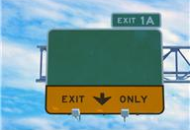
What is an RSA?
A formal safety performance examination
Existing road or future project
Independent, multidisciplinary team
RSA
Image: ATSSA
Notes:
Key Message: Define Road Safety Audit (RSA).
Background Information:
Definition of Road Safety Audit (RSA): A formal safety performance examination of an existing or future road or intersection by an independent, multidisciplinary team. It qualitatively estimates and reports on potential road safety issues, identifies opportunities for improvements in safety for all road users, and culminates in the development and presentation of a final report citing safety enhancement recommendations.
An RSA has three main attributes:
An RSA is a formal safety performance examination
An RSA can be used on an existing road or a future road
The RSA is an independent look at a road or project by a multidisciplinary team of subject matter experts.
A RSA can review the potential for safety enhancements to roadway elements, human factor considerations, enforcement and emergency services issues, and facility operations, whether they currently exist or are planned. In some cases, the formal safety performance examination can occur during a specific project phase, but it can also take place over the course of the project’s life.
Interaction:
Notes:

Slide 12
What is an RSA?
Audit or assessment?
History
Some states with active RSA programs:
  Florida
  Kansas
  Nevada
  Arizona
  Maryland
  Massachusetts
RSA
Image: ATSSA
Notes:
Key Message: Overview of RSAs.
Background Information:
Some agencies refer to RSAs as an assessment, others call it an audit. These terms mean essentially the same; however, some agencies believe that the term audit has legal implications and use the term assessment instead.
The RSA was first performed in the United Kingdom in the 1980’s. The idea quickly spread that rather than wait until collision problems emerged on new schemes, the design process should be using the road safety engineering expertise to reduce the likelihood of collisions taking place once the roads were opened. Road Safety Audit spread from the UK, initially to
Australia and New Zealand, and to Denmark and Ireland. By 2007, road safety audit practices were common throughout much of Western Europe, North America, and South-East Asia. (Source: Road Safety Audit by the Institution of Highways and Transport, October 2008)
States with active RSA programs include: Florida, Kansas, Nevada, Arizona, Maryland and Massachusetts to name a few.
Interaction:
Notes:

Slide 13
This workshop discusses the application of the RSA process to highway work zones

Slide 14
The “Parking Lot”
Questions to be discussed later will be “parked” until they are discussed
Will review at the end to make sure they were answered
Notes:
Key Message: Explain the “parking lot”
Est. Presentation Time: Less than a minute.
Explanation of Cues/Builds: None
Suggested Comments: As we go through the class, for sure you will have questions. If you ask a question about a topic that we will discuss later, rather than discussing the topic then, we will “park it” by writing it down in the flip chart, so we do not forget. At the end of the course, we will review the “parking lot” to make sure the question was answered.
Suggested Questions: None
Additional Information: Remember this concept may have been used in the TCT course, so keep this brief.
Possible Problems: If there is no flip chart, use a corner of a blackboard or ask a student to keep a list of questions. You may also have a PowerPoint file open to serve as a “parking lot”.

Slide 15
Notes
Any opinions, findings, conclusions or recommendations expressed in this course are those of the trainer and the grantee and do not necessarily reflect the view of FHWA
This course does not constitute a national standard, specification or regulation
Notes:
Key Message: Disclaimer
Est. Presentation Time: Less than 1 minute(s)
Explanation of Cues/Builds: None
Suggested Comments: Self explanatory
Suggested Questions: None
Additional Information: None
Possible Problems: Don’t read this, just say it in a fast manner.

Slide 16
Work Zone Road Safety Audits
Module 1:
Overview of Work Zone RSAs
Images: FHWA
Notes:
Key Message: Introduce Module 1
Background Information:
Interaction:
Notes:

Slide 17
Module 1 Objectives
Describe why work zone crashes occur
Differentiate among WZRSA, WZ Inspection, WZ Process Review
Identify challenges in conducting a WZRSA
Notes:
Key Message: Define Module 1 Objectives
Background Information:
Describe why work zone crashes occur
Differentiate among WZRSA, WZ Inspection, WZ Process Review
Identify challenges in conducting a WZRSA
Interaction:
Notes: (Photo: http://www.iowadot.gov/workzone/images/work_zone_safety_header.jpg)

Slide 18
The Problem
Competition for Resources
  Budget
  Staffing
Increase in:
  Drivers & vehicles
  Miles traveled
  Number of work zones
  Congestion
  Crashes
  Distractions
Notes:
Key Message: Discuss the general reasons work zone crashes occur.
Background Information: (This slide has two animations, one for each set of sub bullets.)
It is said that there are Three Certainties in Life that we can be sure of:
Death, Taxes, & Change
Change being the key word.
So, How does this figure into a WZ?
It’s change that is contributing to the crash problem in work zones
Increase in:
Drivers & Vehicles
Miles Traveled
Number of Work Zones
Congestion
Crashes
Distractions
Competition for Resources – Every agency faces these dilemmas
Budget
Staffing
Interaction:
Notes:

Slide 19
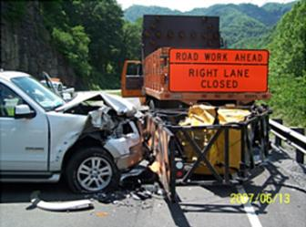

The Work Zone Safety Facts
Fact: Work zone fatalities have been reduced dramatically since 2002
Fact: They are increasing again!
Fact: There is work to be done!
  .
Images: ATSSA
Notes:
Key Message: Present facts on work zone fatalities.
Background Information:
Interaction:
Notes:
Statistics from FARS data
Photo credit: FHWA Work Zone Traffic Control Training (http://www.ops.fhwa.dot.gov/wz/resources/final_rule/webcast/020112wztpdi/rush_ppt/rush.htm)

Slide 20
Traffic Safety: Is There a Problem?
    891 work zone fatalities in 2022
    94 worker fatalities
Source: National Work Zone Safety Information Clearinghouse
Notes:
Key Message: Quantify the safety problem in the USA and in the state
Est. Presentation Time: 2 minute(s)
Explanation of Cues/Builds: None
Suggested Comments: Traffic safety is a serious problem in the US and around the world.
Suggested Questions: Before showing the slide, may ask: How many people die in US work zones every year? After saying approximately 38,000, may say that 58,000 US soldiers were lost at the Vietnam War, or that 40,000 attend an NFL game every week. Try to relate the number to a group of people they can visualize or relate to.
Additional Information: Worker fatalities are included in the “pedestrian” category. For specific state statistics, go to http://www.workzonesafety.org/crash_data/
Other information to be used at the discretion of the instructor.
Possible Problems: This slide reflect the LATEST known data. This is usually 1 or 2 years behind. As new data are released, we will update this slide.
State 2017 Data:
Alabama 948 948
Alaska 79 79
Arizona 1000 1,000
Arkansas 493 493
California 3602 3,602
Colorado 648 648
Connecticut 278 278
Delaware 119 119
District of Columbia 31 31
Florida 3112 3,112
Georgia 1540 1,540
Hawaii 107 107
Idaho 244 244
Illinois 1097 1,097
Indiana 914 914
Iowa 330 330
Kansas 461 461
Kentucky 782 782
Louisiana 760 760
Maine 172 172
Maryland 550 550
Massachusetts 350 350
Michigan 1030 1,030
Minnesota 357 357
Mississippi 690 690
Missouri 930 930
Montana 186 186
Nebraska 228 228
Nevada 309 309
New Hampshire 102 102
New Jersey 624 624
New Mexico 379 379
New York 999 999
North Carolina 1412 1,412
North Dakota 115 115
Ohio 1179 1,179
Oklahoma 655 655
Oregon 437 437
Pennsylvania 1137 1,137
Rhode Island 83 83
South Carolina 988 988
South Dakota 129 129
Tennessee 1040 1,040
Texas 3722 3,722
Utah 273 273
Vermont 69 69
Virginia 839 839
Washington 565 565
West Virginia 303 303
Wisconsin 613 613
Wyoming 123 123
Total 37,133 37,133

Slide 21
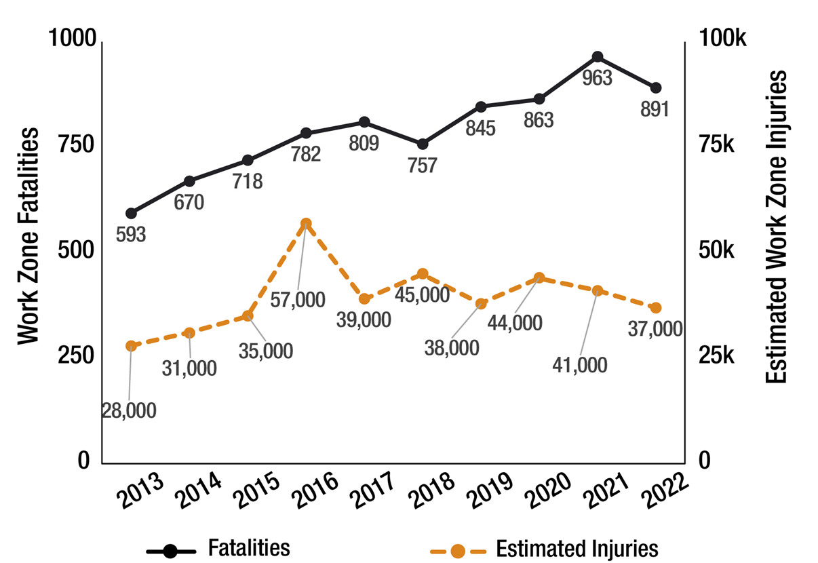
USA Work Zone Fatalities: 2013-2022
Source: National Work Zone Safety Information Clearinghouse
Notes:
Key Message: Quantify WZ fatalities in the USA
Est. Presentation Time: 1-2 minute(s)
Explanation of Cues/Builds: None
Suggested Comments: We reached an all-time high in work zones fatalities in 2002. Since then, the numbers have declined but they are on the upswing again! We can still do better!
Suggested Questions: Do you see any trends?
Additional Information: These figures include both workers, motorists and pedestrians. https://workzonesafety.org/work-zone-data/
2017 STATE DATA: Format 3 numbers):
FATALITIES IN MOTOR VEHICLE TRAFFIC CRASHES IN WORK ZONE BY STATE AND YEAR
FATALITY ANALYSIS REPORTING SYSTEM (FARS) 2016 FINAL AND 2017
(State, 2016 fatalities, 2017 fatalities, 2016+2017)
Alabama 13 24 37
Alaska 2 0 2
Arizona 9 15 24
Arkansas 14 21 35
California 75 48 123
Colorado 7 17 24
Connecticut 5 6 11
Delaware 2 3 5
Dist of Columbia 0 1 1
Florida 80 76 156
Georgia 41 60 101
Hawaii 3 3 6
Idaho 0 7 7
Illinois 44 27 71
Indiana 18 28 46
Iowa 11 10 21
Kansas 6 12 18
Kentucky 11 15 26
Louisiana 12 11 23
Maine 1 5 6
Maryland 5 14 19
Massachusetts 6 2 8
Michigan 18 25 43
Minnesota 12 10 22
Mississippi 7 4 11
Missouri 8 15 23
Montana 1 1 2
Nebraska 13 8 21
Nevada 14 14 28
New Hampshire 3 0 3
New Jersey 7 6 13
New Mexico 8 4 12
New York 8 3 11
North Carolina 13 11 24
North Dakota 6 0 6
Ohio 27 25 52
Oklahoma 17 12 29
Oregon 7 3 10
Pennsylvania 16 20 36
Rhode Island 1 1 2
South Carolina 4 20 24
South Dakota 1 1 2
Tennessee 13 10 23
Texas 172 165 337
Utah 5 5 10
Vermont 1 0 1
Virginia 12 11 23
Washington 7 4 11
West Virginia 1 2 3
Wisconsin 11 9 20
Wyoming 3 5 8
National 781 799 1,580
Puerto Rico 1 0 1

Slide 22
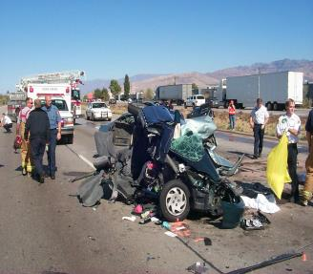
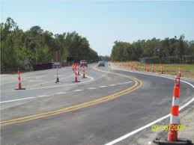
Work Zone Crash Causes
Driver expectations/ behavior
Roadside hazards
Unsuccessful mitigation strategies
Roadway characteristics
Environmental conditions
Secondary crashes
Combined effects
Images: ATSSA
Notes:
Key Message: Examine factors that contribute to work zone crashes.
Background Information: Contributors include:
Driver Expectations: Crashes can occur if a road user does not expect the work zone as they approach it, or if traffic control does not match the road user’s expectations. This can be a result of improper use of: traffic control; inconsistent use of traffic control from one work zone to another; the use of experimental or not-widely-used traffic control devices.
Driver Behavior: Crashes associated with unexpected conditions, unfamiliarity, speed, aggressive driving, driver inattention, impaired driving, and other common causes can occur anywhere, anytime.
Roadside Hazards: Work zone traffic control elements (and workers) can be struck in a crash. Unsuccessful Mitigation Strategies/TTC Deployment: Despite attempts to identify and mitigate potential sources of safety and mobility concerns, strategies can still fail. It is also possible to mismatch potential impacts and effective strategies.
Roadway Characteristics: Existing or changed pavement conditions, uneven pavement or edges, steel plates, horizontal or vertical geometry, clear zones, and impacts to interchange merge areas can contribute to a work zone crash.
Environmental Conditions: The presence of wet, snow-covered, or ice-covered roadways can contribute to drivers’ control of their vehicles or pedestrians’ ability to traverse the work zone. Limited visibility from dark conditions or sun glare can also affect their abilities (e.g., new asphalt pavement can be difficult to see during night conditions).
Secondary Crashes Caused by Roadway Incidents: Crashes occurring within the work zone can leave the upstream roadway susceptible to additional incidents.
Combined Effects: In certain situations, deployed work zone TTCD can appear to provide roadway users with the guidance needed to direct them through an active work zone; however, when conditions at the work zone location change the guidance can actually contribute to crashes. For example, pavement markings that have been milled or covered with black paint can appear as positive guidance under certain sunny, wet, or dark conditions.
Interaction: Can the group name more?
Notes: None

Slide 23
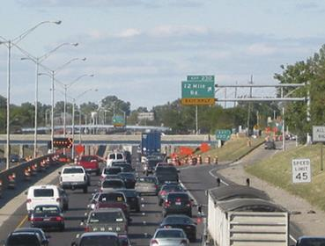
Mobility Considerations
Minimize work zone impact on mobility and safety
26% of California work zone fatalities occurred at the back of a queue
Image: FHWA
Source: https://ops.fhwa.dot.gov/wz/workersafety/wzfrwebinar/ca/index.htm
Notes:
Key Message: Factors that contribute to successful mobility operations in work zones can also positively impact work zone safety.
Background Information:
Attempts to mitigate and reduce congestion and queuing can significantly reduce work zone fatalities and serious injuries.
Studies have indicated crashes secondary to other incidents range from 14 to 30 percent of all crashes. The United State Department of Transportation (USDOT) estimates that 18% of fatalities on freeways were due to secondary crashes. (Source: O'Laughlin, J. and A. Smith. Operational Issues Discussion Paper on "Incident Management 4 Operations: Top Five Issues". In Proceedings of the National Conference on Traffic Incident 5 Management: A Road Map to the Future. June 2002, pp. C–2)
The following mobility considerations in work zones can also have an effect on safety:
Queuing. After analyzing their work zone crash data, the California Department of Transportation (Caltrans) learned that 26 percent of their work zone fatalities occurred at the back of a queue.
Efforts to reduce or eliminate queuing in work zones help to alleviate unexpected speed reductions and better conform to drivers’ expectations.
In some cases, queuing can be inevitable and advanced notification to road users can prove extremely beneficial.
Congestion. Significant congestion can lead to risky behaviors and aggressive driving, especially when road users are subjected to the congestion on a daily basis.
Repeated exposure to congested work zones can lead to frustrated, desperate drivers who make impulsive and often dangerous driving decisions. The use of intelligent transportation systems (ITS), news media, social media, and other means of data collection and public notification can assist road users in selecting other routes before or during their commute.
Interaction: What other mobility considerations affect safety in work zones?
Notes:

Slide 24
Crash Considerations
Real-time safety needs
Potential for cost savings if mitigation happens early
Accessible to emergency vehicles/workers
Notes:
Key Message: Work zone crashes have similar and dissimilar traits from those that occur outside a work zone.
Background Information:
Crashes occurring within work zones have both similarities and disparities to those occurring outside work zone limits. Likewise, work zone crash analyses should consider how elements within the work zone may have impacted the crash. Elements of the work zone can change on a daily basis:
TTCDs can be relocated, activity staging can require a different navigational path, and lanes can temporarily close. The issues below illustrate how crash analyses within work zones differ from crash analyses in other locations:
Real-time Safety Needs during Active Work Zones. The temporary nature of work zones often leave little time to assess crashes and determine the contributing factors and an appropriate remediation within the project’s duration. Given the need for immediate solutions to field-level work zone safety issues, receiving work zone crash data in a timely manner is very important, while the depth of analysis is typically less robust than non-work zones.
Potential for Cost Savings. Practitioners can analyze work zones for potential safety issues and include work zone safety strategies as plan development progresses. When identified early in the project life cycle, safety and/or mobility strategies can be combined or streamlined, possibly allowing for reduced project duration, efficiencies gained by deploying fewer TTCDs, reduced interruption of roadways users, and lower mobilization costs.
Included in this planning is the adequate ingress and egress of emergency vehicles, including tow vehicles, into the area. This equipment needs the ability to access the scene of a crash, tend to the victims, and protect the scene from further incidents. Quick response and clearance has a significant impact on mobility and safety.
Interaction:
Notes:

Slide 25
Work Zone Safety and Mobility Rule
Consideration of safety and mobility impacts, from project development to implementation
Address corridor, network, and regional issues
Develop Transportation Management Plans (TMPs)
Notes:
Key Message: The Work Zone Safety and Mobility Rule affects all transportation agencies that receive federal funding and has three distinct goals.
Background Information:
The Work Zone Safety and Mobility Rule (Rule) was published on September 9, 2004 in the Federal Register. All state and local governments that receive federal-aid funding were required to comply with the provisions of the rule no later than October 12, 2007. The Rule updates and broadens the former regulation at 23 CFR 630 Subpart J to address more of the current issues affecting work zone safety and mobility. The changes to the regulation encourage the broader consideration of the safety and mobility impacts of work zones across project development and the implementation of strategies that help manage these impacts during project delivery. Subpart J and Subpart K have specific language that outlines State and local agency responsibilities with respect to work zone safety and mobility.
The goals of the new rule are to:
Expand thinking to address corridor, network, and regional issues while planning and designing road projects.
Expand work zone impact mitigation beyond traffic safety and control by developing Transportation Management Plans (TMPs) for road projects. A TMP always consists of temporary traffic control strategies, and where necessary, it also consists of transportation operations and public information strategies.
Advocate innovative thinking in work zone planning, design, and management, so as to consider alternative/innovative design, construction, contracting, and transportation management strategies.
The rule can be defined by three primary components:
Policy-level provisions that help states implement an overall work zone safety and mobility policy for the systematic consideration and management of work zone impacts.
State-level processes and procedures that help states implement and sustain their respective work zone policies.
Project-level procedures that help states assess and manage the work zone impacts of individual projects.
Interaction:
Notes:

Slide 26
Work Zone Safety and Mobility Rule
Consider strategies:
  Alternative/innovative design
  Construction
  Contracting
  Transportation management
Affects all State and local governments that receive federal-aid funding
Notes:
Key Message: The Work Zone Safety and Mobility Rule affects all transportation agencies that receive federal funding and has three distinct goals.
Background Information:
The Work Zone Safety and Mobility Rule (Rule) was published on September 9, 2004 in the Federal Register. All state and local governments that receive federal-aid funding were required to comply with the provisions of the rule no later than October 12, 2007. The Rule updates and broadens the former regulation at 23 CFR 630 Subpart J to address more of the current issues affecting work zone safety and mobility. The changes to the regulation encourage the broader consideration of the safety and mobility impacts of work zones across project development and the implementation of strategies that help manage these impacts during project delivery. Subpart J and Subpart K have specific language that outlines State and local agency responsibilities with respect to work zone safety and mobility.
The goals of the new rule are to:
Expand thinking to address corridor, network, and regional issues while planning and designing road projects.
Expand work zone impact mitigation beyond traffic safety and control by developing Transportation Management Plans (TMPs) for road projects. A TMP always consists of temporary traffic control strategies, and where necessary, it also consists of transportation operations and public information strategies.
Advocate innovative thinking in work zone planning, design, and management, so as to consider alternative/innovative design, construction, contracting, and transportation management strategies.
The rule can be defined by three primary components:
Policy-level provisions that help states implement an overall work zone safety and mobility policy for the systematic consideration and management of work zone impacts.
State-level processes and procedures that help states implement and sustain their respective work zone policies.
Project-level procedures that help states assess and manage the work zone impacts of individual projects.
Interaction:
Notes:

Slide 27
Strategies to Improve Work Zone Safety
Transportation Management Plans (TMP)
Intelligent Transportation Systems (ITS)
Positive protection
Training
Proactive and reactive solutions
Performance measures
WZ Road Safety Audits!
Notes:
Key Message: Agencies can use one or more solutions in combination to improve work zone safety, which are typically planned for during the design phase and applied during the active work zone phase.
Background Information:
The following solutions represent the most common techniques.
Transportation Management Plans (TMP) are formal plans that define project-specific strategies to be employed during the active work zone phase to lessen the effects of the work zone on the users.
If major impacts are anticipated, projects will have TMPs comprised of three components:
Temporary Traffic Control strategies; Public Information strategies; and Transportation Operations (including emergency response) strategies.
Intelligent Transportation Systems (ITS). ITS use can provide the means to collect both safety and mobility data and relay messages to road users of upcoming incidents, congestion, and delay, in addition to suggesting alternate routes.
Positive Protection. Several types of positive protection devices are available to enhance worker and motorist safety in work zones. They include several types of rigid traffic barriers, shadow vehicles with truck-mounted attenuators, and vehicle arresting systems that prevent road users from entering a closed section of roadway.
Proactive and Reactive Solutions. Variable speed limits (VSL) can be used to proactively address potential or existing safety issues prior to work zones; for example, VSL can be used to slow road users upstream of an active work zone in order to mimic speed limit conditions at the site.
Changing existing work zone layout or TTCDs can be a reactive solution to address safety issues that have occurred near the active work zone.
Performance Measures. Agencies may establish performance measures to quantify safety or operational goals or limits. For example, an agency can set a goal of zero work zone fatalities or fewer than 10 minutes of additional delay to be when traveling through a work zone.
Interaction: Ask participants to identify solutions before showing the bullets.
Notes:

Slide 28
Basic Work Zone RSA Concepts
What is a WZRSA?
Why do we need WZRSAs?
When do we conduct a WZRSA?
Notes:
Key Message: Understand basic WZRSA concepts.
Background Information:
In this section, we will answer these questions:
What is a work zone road safety audit?
Why do we need WZRSAs?
When do we conduct a WZRSA? Audits can be conducted at the planning stage, in the design process, or during an active work zone. These slides deal with the different stages at which audits can be conducted.
Interaction:
Notes:

Slide 29
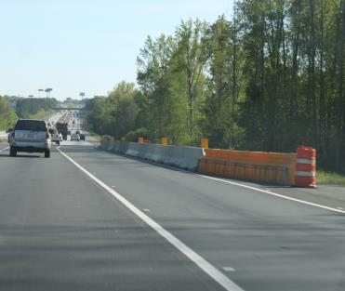
What is a WZRSA?
Formal safety performance examination with a structured process
Existing or future work zone
Independent, multidisciplinary team
Focused solely on safety
Image: ATSSA
Notes:
Key Message: Define work zone road safety audit.
Background Information:
Definition of Work Zone Road Safety Audit (WZRSA): A formal safety performance evaluation which can be performed at any stage of a planned or existing work zone (project planning and design, or in active work zones) by an independent, multidisciplinary team. It qualitatively estimates and reports on potential work zone safety issues, identifies opportunities for improvements in work zone safety for all road users and workers, and culminates in the development and presentation of a final report citing work zone safety enhancement recommendations.
A WZRSA has three main attributes:
A WZRSA is a formal safety performance examination with a structured process
A WZRSA can be used on an existing WZ or when planning a future work zone
The WZRSA is an independent look at the work area by a multidisciplinary team of subject matter experts.
A WZRSA focuses solely on safety.
Interaction:
Notes:

Slide 30
What is a WZRSA?
Safety of all work zone users
Mitigation measures
Interaction of:
  Work zone elements
  Road users
  Workers
  Site-specific conditions
Notes:
Key Message: Further clarify the meaning of WZRSA.
Background Information:
What is a WZRSA? The basic principles of a RSA are used to conduct WZRSA, however, the difference between the two can be found in the tailored approach and considerations toward work zones that takes place during a specific project phase.
Specifically:
It is also important to note that the WZRSA team may need to consider the safety performance of the project from the perspective of all work zone users. Participants may be able to name other possible road users, such as public safety vehicles (police or fire), maintenance vehicles, older drivers, pedestrians, etc.
How do various work zone elements interact with road users and workers? What site specific conditions exist that affect the work zone?
An WZRSA does not simply identify potential problems – it may also identify potential solutions and possible mitigation measures to address these risks.
Interaction: Ask the class for an example of a potential work zone safety issue and solution. Example issue: drivers are particularly aggressive within the work zone. Potential solution: Targeted enforcement effort.
Notes:

Slide 31
A Work Zone RSA is NOT:
A simple standards check for adherence to State and Federal guidelines
An opportunity to redesign the project
A work zone inspection
Notes:
Key Message: Define what a WZRSA is not.
Background Information:
As covered in the previous slide, a WZRSA is not a simple standards check for adherence to State and Federal guidelines – Remember, it is a formal process.
Because we conduct a WZRSA, it should not be viewed as an just an opportunity to redesign the project, and
It is much more than a work zone inspection.
The WZRSA involves an independent, multi-disciplinary team of stakeholder, subject matter experts, and professionals that take a holistic look at the entire area measured against acceptable standards.
Interaction:
Notes:

Slide 32
Types of Safety Evaluations
Evaluations to Improve WZ Safety and Mobility
WZ Process Review
WZ Inspec-tion
WZRSA
Image: FHWA
Notes:
Key Message: Discuss different types of safety evaluations that can be performed to promote work zone safety.
Background Information: Evaluating work zone safety is not a new concept. This slide presents a few of safety evaluations that are performed on work zones.
Work Zone Process Review: A work zone process review is a periodic evaluation of work zone policies, processes, procedures, and work zone impacts that aids in the process of addressing and managing the safety and mobility impacts of work zones. The process review helps assess the effectiveness of a program or a set of processes and procedures.
Work Zone Inspection: A work zone inspection is a review of temporary traffic control devices (TTCD) and safety/mobility strategies that have been deployed per an approved plan, standards and specifications in an active work zone. Specific project inspections are typically performed by a member of the agency responsible for the road work. Compliance and deficiencies are documented formally, using a work zone inspection sheet, or informally, using visual judgment. Work zone inspection sheets can vary in complexity and categories, but typically identify criteria deemed most critical to the work zone (e.g., signing quality/location, whether the work zone set-up matches design plans, presence of flaggers, safety/mobility concerns, etc.).
WZRSA: A WZRSA is a formal safety performance evaluation which can be performed at any stage of a planned or existing work zone (project planning and design, or in active work zones) by an independent, multidisciplinary team, and considers methods of improving safety in a work zone.
The recommendation to perform a WZRSA may arise as a result of conducting a work zone process review or a work zone inspection.
Interaction:
Notes:

Slide 33
Comparing WZ Review Types
WZ Inspection | WZRSA
Typically reactive | Proactive & reactive
In-house team | Independent team
Field review only | Enhances safety beyond minimum standards
Standards compliance | Field and plan reviews
Active WZ only | Comprehensive w/human factors
 | Planning, design, or active phases
Notes:
Key Message: Discuss the differences between work zone inspections and a WZRSA.
Background Information: Let’s take a look at WZ Inspections v. WZRSA. Most state DOTs have established work zone inspection processes through their hazard elimination and correction programs.
Work Zone Inspection –
Definition: A work zone inspection is a review of temporary traffic control devices (TTCD) and safety/mobility strategies that have been deployed per an approved plan, standards and specifications in an active work zone. Specific project inspections are typically performed by a member of the agency responsible for the road work.
Compliance and deficiencies are documented formally, using a work zone inspection sheet, or informally, using visual judgment. Work zone inspection sheets can vary in complexity and categories, but typically identify criteria deemed most critical to the work zone (e.g., signing quality/location, whether the work zone set-up matches design plans, presence of flaggers, safety/mobility concerns, etc.).
work zone inspections are often motivated by a high frequency and/or severity of crashes, and are consequently “reactive” in nature; RSAs are a more “proactive” review of a design or finished project that attempts to prevent conflicts before they occur.
work zone inspections often involve an in-house team of engineers, whereas, a WZRSA involves an independent team who consequently bring “fresh eyes” to the project.
work zone inspections may rely primarily on crash reports to identify likely problems, but a WZRSA relies on the field review, which we will discuss in greater detail.
work zone inspections are based in large part on compliance with standards in the MUTCD, whereas, a WZRSA uses compliance with standards and guidelines as a starting point, but looks also at issues such as traffic operations and human factors. A WZRSA looks for ways to enhance safety beyond minimum standards.
work zone inspections are performed during active work zone conditions; WZRSA can be performed during the planning and design phases, or during an active work zone.
Interaction: Ask participants to compare a WZ inspection with a WZRSA before showing the bullets for the WZRSA.
Notes:

Slide 34
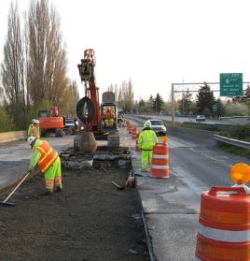
Why Do We Need WZRSAs?
Few WZ safety issues are identified in crash reports
Proactive safety anticipates driver errors
Results can be incorporated into planning and design
Results can be implemented immediately
Image: Washington State DOT
Notes:
Key Message: Introduce practitioners to why a WZRSA is a useful tool.
Background Information:
The previous slides have shown that a RSA is useful to address deficiencies in the work zone environment, as well as to mitigate the consequences of driver error.
The next two slides show that a WZRSA is also needed to make work zone safety an explicit consideration in road projects and explain WHY we need them.
Relatively few work zone safety issues are identified in crash reports.
Executing a WZRSA can make a work zone safer, resulting in mitigating risk claims, reducing the societal cost of crashes, reducing project costs, mitigating congestion, and lessening the crash severity levels.
Proactive safety anticipates driver errors.
Results can be incorporated into planning and design documents affording early detection of safety issues and ultimately conserve cost and increase mobility.
Results can be implemented immediately.
Interaction:
Notes:

Slide 35
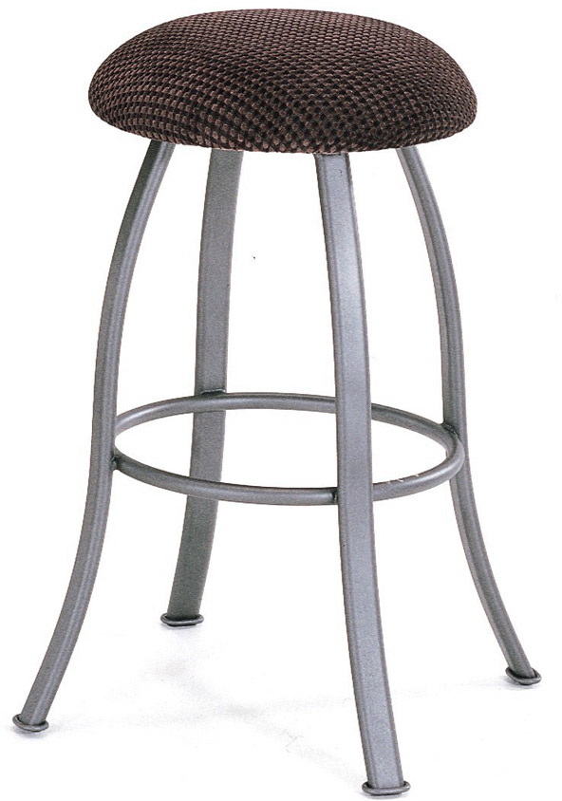
Why Do We Need WZRSA?
To manage the competing interests at play in work zones:
Construct-
ability
Cost
Mobility
Safety
Image: ATSSA
Notes:
Key Message: A WZRSA helps to make safety an explicit consideration during the planning, design, and implementation of work zones.
Background Information: USE THIS SLIDE AS A BRAINSTORMING SLIDE. Get audience participation to draft the list of competing interests. See where they’re coming from then relate all of their ideas back to the WZRSA.
This list shows the competing interests that typically affect roadway design, construction, and maintenance:
right of way: Limited land (right of way) is often associated with cost, since acquiring additional land for improved roads is often very costly, especially in developed areas.
environment: concerns include limiting or reducing the amount of land taken for roadways, with the object of preserving land for aesthetic purposes or wildlife buffer/habitat.
topographic and geotechnical conditions: concerns include unstable soil, steep terrain, or large rock formations that the road must go through or around.
socioeconomic issues: issues include the disruption to established land uses by a new or upgraded roadway, the temporary impacts of roadway construction, and the impacts of roadways on communities.
capacity/efficiency: the need for safety and efficiency improvements may contradict each other. An example is the introduction of a four-way STOP, which may be unwarranted under volume criteria, but warranted under collision criteria.
politics: concerns could include redirecting traffic from one street to another in an effort to satisfy vocal neighborhood interests.
Finally, there is also road safety, which can sometimes get “pushed off the table” in the midst of all these other competing interests.
Interaction:
Notes: Image Source: http://www.ops.fhwa.dot.gov/wz/traffic_analysis/index.htm

Slide 36
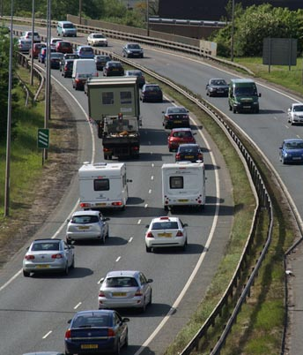
Good Candidates for a WZRSA
Proximity to another work zone
Project is considered “significant”
History of safety and mobility issues
Image: ATSSA
Notes:
Key Message: Define project characteristics that can exist that make a project a good candidate for a WZRSA.
Background Information:
A WZRSA can be beneficial to perform on a project when the following situations exist:
The project location is in proximity to another work zone, and either can have overlapping effects on the other;
Project is considered “significant” according the Work Zone Mobility Rule;
The project is high-profile in nature;
The proposed project location has a history of safety and mobility issues;
The project has a complex traffic control plan;
Multiple construction stages exist;
The contractor proposes changes to the traffic control plan; and/or
The active work zone has not met performance goals or is not performing as expected in safety, mobility, or visibility categories.
Interaction: Ask the group to name other project characteristics that would make a WZRSA a potential tool.
Notes:

Slide 37
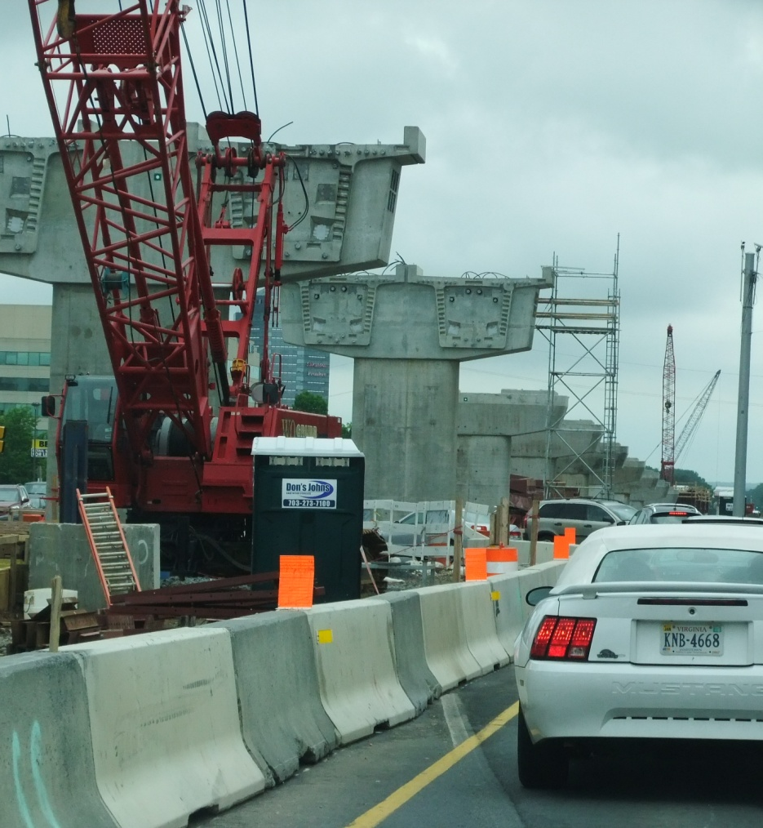
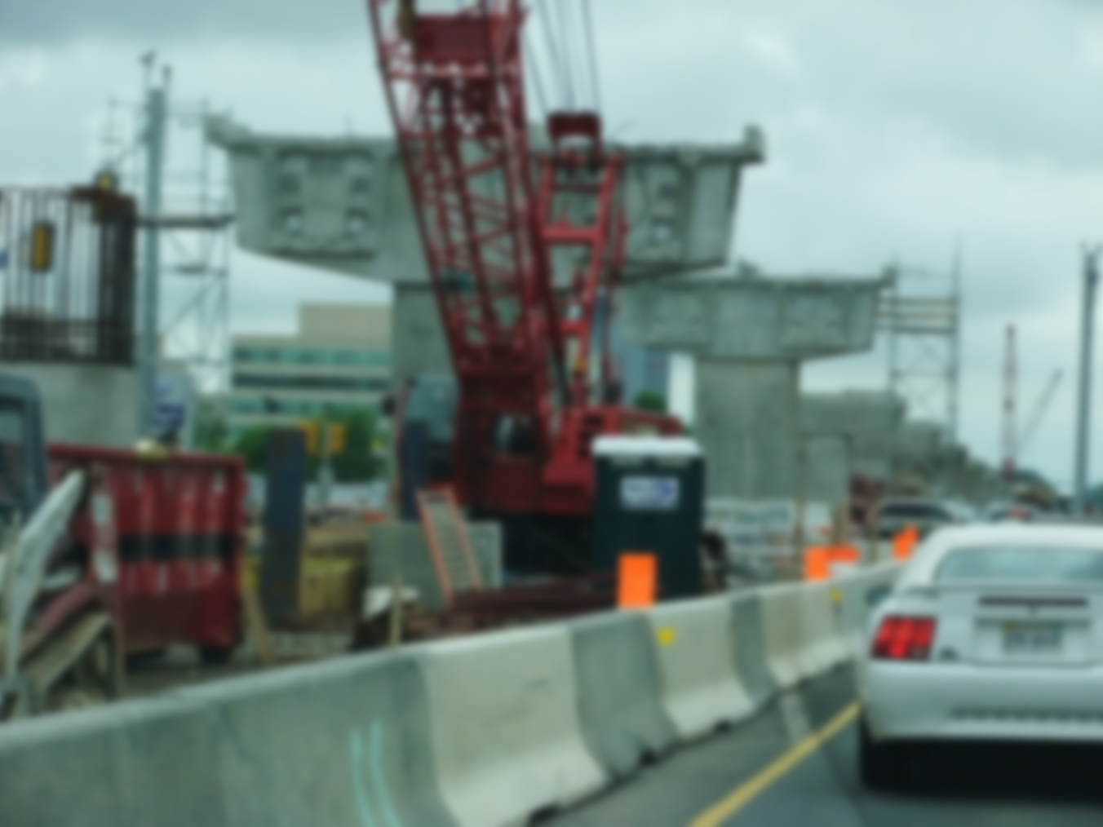
Good Candidates for a WZRSA
Complex traffic control plan
Multiple construction stages exist
Active work zone is not performing as expected
Image: ATSSA
Notes:
Key Message: Define project characteristics that can exist that make a project a good candidate for a WZRSA.
Background Information:
A WZRSA can be beneficial to perform on a project when the following situations exist:
The project location is in proximity to another work zone, and either can have overlapping effects on the other;
Project is considered “significant” according the Work Zone Mobility Rule;
The project is high-profile in nature;
The proposed project location has a history of safety and mobility issues;
The project has a complex traffic control plan;
Multiple construction stages exist;
The contractor proposes changes to the traffic control plan; and/or
The active work zone has not met performance goals or is not performing as expected in safety, mobility, or visibility categories.
Interaction: Ask the group to name other project characteristics that would make a WZRSA a potential tool.
Notes:

Slide 38
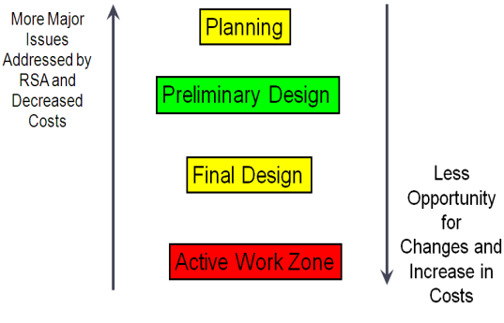
When to Conduct a WZRSA?
Early Phases
  Planning
  Preliminary design
  Final design
Active Work Zone
Image: FHWA
Notes:
Key Message: A WZRSA can be conducted anytime during planning, design, and active phases.
Background Information:
For large-scale projects, the planning and design of work zones occurs over a span of many years and involves a team comprised of diverse backgrounds and interests.
During the planning phase, work zones can be conceptual in nature and may only exist through discussions and considerations of those responsible for assigning a proposed budget and timeline to the project.
During design, there are usually several iterations of modifications to the work zone design to ensure the inclusion of various traffic control components, operational and safety considerations for each roadway user type, and strategies to mitigate potential negative impacts to operational safety and mobility. Throughout the project development process, the work zone exists only on paper and in the minds of those responsible for its design.
A WZRSA may also be conducted on active work zones. Active work zones can consist of installed TTCDs, safety and mobility strategies that have been deployed, and the presence of construction equipment and workers.
While greater opportunities for change and project savings can occur during project planning and design, safety improvements can still be realized during active work zones.
In summary, a WZRSA can be conducted at any stage of the work zone development process.
The earlier an WZRSA is conducted, the more potential it has to identify potential safety issues before they cause collisions.
The longer you wait, the more resistance you’re likely to encounter.
Interaction:
Notes:

Slide 39
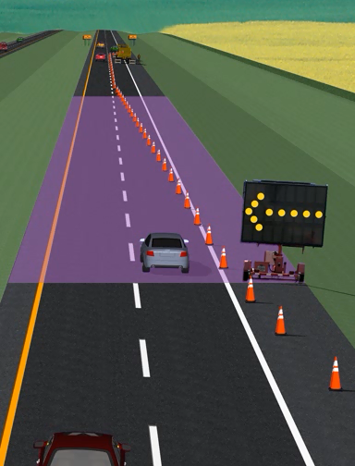
Planning and Design WZRSAs
Geometric design
Staging
Construction techniques
Duration
Impacts on all road users
Temporary traffic control
Project costs
Public involvement
Image: ATSSA
Notes:
Key Message: Share appropriate phase-specific considerations during the planning and design of work zones.
Background Information:
During these phases, specific considerations should be given to:
Whether work zone safety and mobility goals are complementary;
Geometric design of the work zone;
Work zone staging;
Construction techniques;
Construction duration;
The impacts the work zone will have on roadway users, workers, transit, railroads, schools, businesses, parking, detours, pedestrians, emergency response, special events, seasonal travel, and surrounding communities;
Identification of the type and placement of temporary traffic control and safety devices;
Identification of transportation management strategies;
Project costs;
Involving the public and other stakeholders; and
Communication channels for use during the active work zone phase.
Interaction:
Notes:

Slide 40
Active Work Zone RSA
Ensure safety and mobility goals are being met
Verify that the TMP is working effectively
Notes:
Key Message: Construction, utility, operations, and maintenance activities in an active work zone can have a definite and immediate impact on roadway users.
Background Information:
Active work zones can include work being performed during a short- or long-term duration, in addition to a moving operation. Active work zones can consist of installed TTCDs, safety and mobility strategies that have been deployed, and the presence of construction equipment and workers. Chronological phases of a work zone include set-up, active work zone, non-active work zone (e.g., overnight in between working days), and take-down/removal.
During the active work zone phase, specific considerations should be given to:
Whether safety and mobility performance goals are being met in the work zone; and
If the transportation management plan is performing as needed.
Interaction:
Notes: Photo sources:
http://www.dbiservices.com/asset-maintenance-toll-roads-public-private-partnerships
http://www.justdrivepa.org/Traffic-Safety-Information-Center/Work-Zone/
http://ntl.bts.gov/lib/38000/38500/38510/ch10.htm

Slide 41
Work Zone Safety: Think GORE
G
Geometry
O
Operations
R
Road Users
E
Environment
Image: FHWA
Notes:
Key Message: There are four main components of work zone safety: geometry, operations, road users, and the environment.
Background Information: Each of these contribute to work zone safety on their own and can also interact to affect work zone safety.
Ask: how might the road safety basics (geometry, operations, road users, and environment) differ in the different phases of the a WZRSAs?
Also, how do these basic considerations change with respect to traditional road safety assessments?
Interaction: BRAINSTORM! (This will be a very interactive section. Allow several minutes per slide in this section on GORE.)
Notes:

Slide 42
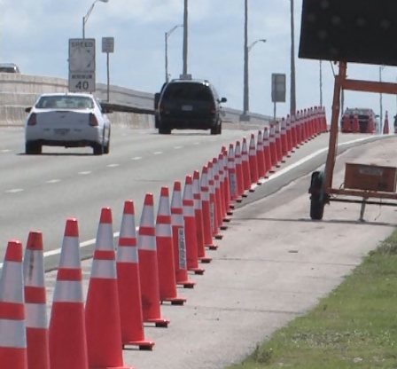
G
Geometry
Curve
Gradient
Cross section
Clearance
Sight distance
Clear zone
Image: ATSSA
Notes:
Key Message: Define the aspects of work zone geometry.
Background Information:
Brainstorm situations where work zones might change the way you typically assess the geometrical aspects of road safety? (i.e., you might have to consider new roadside hazards (such as construction equipment) that aren’t typically there)
Interaction: Ask audience for suggestions before showing considerations.
Notes:

Slide 43
O
Operations
Congestion
Signing
Signal operation
Speeding
Queuing
Turning movements
Frequent stops
Unintended consequences
Notes:
Key Message: Define the aspects of work zone operations.
Background Information:
How do your assessment methods change when you have to consider operations in a work zone?
Interaction: Ask audience for suggestions before showing considerations. Then, ask the class to cite an example of an unintended consequence: Example of an intended consequence is overloading other routes when drivers avoid a work zone.
Notes:

Slide 44
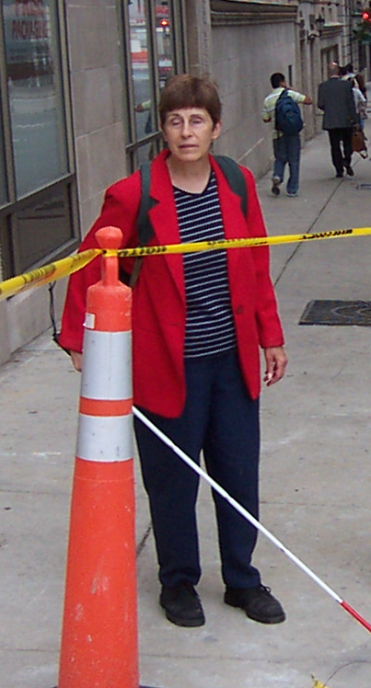
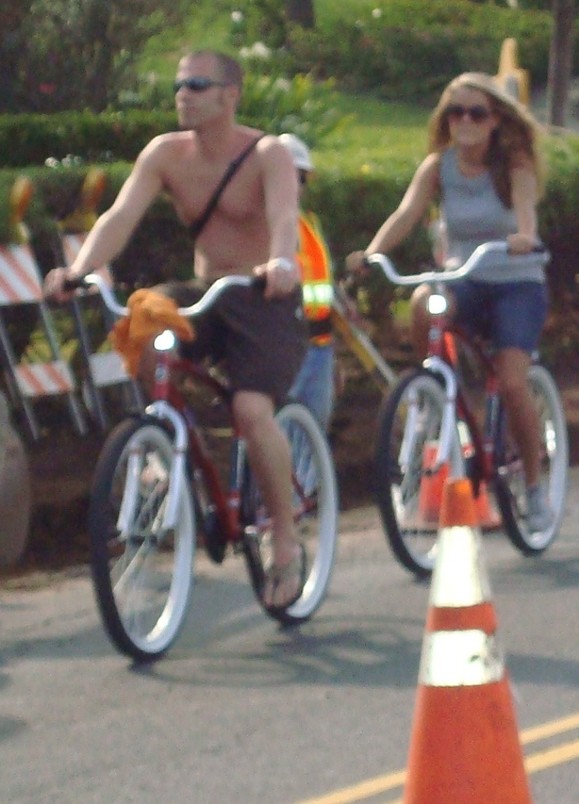

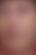
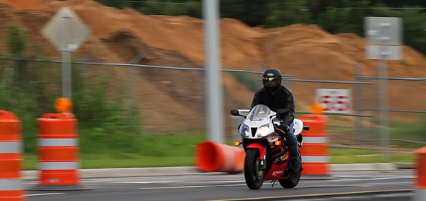
R
Road Users/Human Factors
Driver expectation
Motorcyclists
Bicyclists
Pedestrians
Special needs
Images: ATSSA
Notes:
Key Message: Define the aspects of human factors in work zones.
Background Information:
Examples of special needs could be impaired drivers, older drivers, Amish, etc.
How do your assessment methods change when you have to consider road users and other human factors in a work zone?
Interaction: Ask audience for suggestions before showing considerations.
Notes:

Slide 45
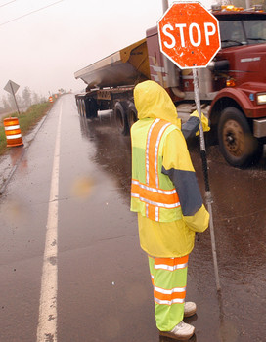

E
Environment
Weather
Lighting conditions
Topography
Glare
Night work
Images: ATSSA
Notes:
Key Message: Define the aspects of environmental factors in work zones.
Background Information:
Examples of topography can include sand, dust, wind, etc.
How do your assessment methods change when you have to consider environmental conditions in a work zone?
Interaction: Ask audience for suggestions before showing considerations.
Notes:

Slide 46
Common Issues and Challenges
1. Responsibilities
2. Programming & Scheduling
3. Effect on Project Cost
4. Risk Management
Notes:
Key Message: Public agencies sometimes resist a RSA program because they perceive that it will increase project costs, delay implementation of a project, tie up staff, or increase their liability.
Background Information:
We will address these challenges in this section, starting with responsibilities of all the parties, including the road agency, in the RSA process.
Interaction:
Notes:

Slide 47
1. WZRSA Responsibilities:
Highway Agency / Road Owner
Commit to the WZRSA process
Commit resources (time, funding, and staff)
Select WZRSA team
Provide required information
Attend WZRSA meetings
Describe issues, challenges, and constraints
Prepare response letter
D
O
T
Notes:
Key Message: The road owner has several responsibilities in order to have a successful WZRSA performed.
Background Information: These responsibilities reflect the 3-step audit process discussed earlier. Typically, support from senior management in the road agency is vital to the success of a WZRSA and the RSA program as a whole.
Commitment of resources is critical, including: time within the project schedule for conducting the WZRSA; incorporating any improvements resulting from the WZRSA; funds to perform the WZRSA ; staff to represent the road agency in the WZRSA process.
The road agency usually selects the audit team, which can be composed of road agency staff, consultants, or a mix of the two.
Prior to the start of the audit, road agency staff should provide required information such as traffic volumes and collision records. For design stage audits, view the design drawings and reports.
The road agency should attend the WZRSA start-up and wrap-up meeting. At the start-up meeting, road agency staff should be prepared to describe issues, challenges, and constraints. At the wrap-up meeting, the road agency is invited to consider any suggested mitigation measures identified by the audit team, but can suggest alternative measures or adopt no measures.
The road agency summarizes its responses and intended actions in a response letter.
In the case of a Design-stage WZRSA, the designer should also attend the start-up and wrap-up meetings to provide input.
It is important to note that a well-run WZRSA is not a critical review of the designer’s work, but rather a review of the design with a focus on how safety can be incorporated into it.
RSAs in which the designer and audit team work together in a spirit of cooperation are generally the most productive in terms of ensuring that the audit team fully understands design issues and challenges, with the result that suggested mitigation measures to address safety issues are practical and reasonable.
Interaction:
Notes:

Slide 48
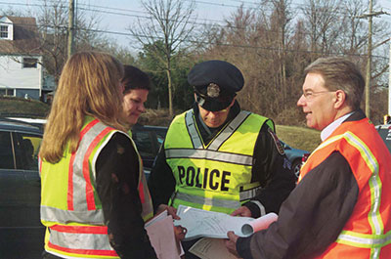

1. WZRSA Responsibilities:
WZRSA Team
Attend pre-review meeting
Acquire an understanding of:
  Project
  Challenges
  Constraints
Review available information
Image: FHWA
Notes:
Key Message: The WZRSA team has several responsibilities that contribute to a successful WZRSA.
Background Information:
The audit team attends the pre-audit meeting with the road owner and project team to understand the project, its purpose, its background, and the constraints that have influenced the design.
The audit team reviews drawings and other information to identify safety issues.
The audit team conducts a field review to understand the context of the road and to identify safety issues.
Practical suggestions for mitigating all safety issues need to be identified. For design phase audits, these suggestions must be able to be incorporated in the design plans. Mitigation measures can be finalized with input from the road agency (and designer, if applicable).
At the post-audit meeting, the audit team presents a summary of safety issues and potential mitigation to address them.
Interaction:
Notes:

Slide 49
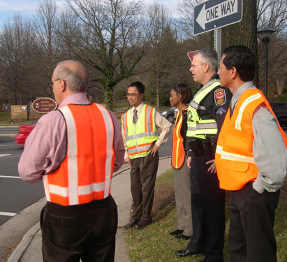
1. WZRSA Responsibilities:
WZRSA Team
Conduct field review
Identify safety issues
Identify feasible suggestions for mitigation
Write WZRSA report
Present preliminary findings at post-review meeting
http://safety.fhwa.dot.gov/rsa/benefits/images/photo006.jpg
Notes:
Key Message: The WZRSA team has several responsibilities that contribute to a successful WZRSA.
Background Information:
The audit team attends the pre-audit meeting with the road owner and project team to understand the project, its purpose, its background, and the constraints that have influenced the design.
The audit team reviews drawings and other information to identify safety issues.
The audit team conducts a field review to understand the context of the road and to identify safety issues.
Practical suggestions for mitigating all safety issues need to be identified. For design phase audits, these suggestions must be able to be incorporated in the design plans. Mitigation measures can be finalized with input from the road agency (and designer, if applicable).
At the post-audit meeting, the audit team presents a summary of safety issues and potential mitigation to address them.
Interaction:
Notes:

Slide 50
2. Programming & Scheduling
  Pre-Construction WZRSA
  Can occur concurrently with the agency’s review of planning documents and design drawings
  Active WZRSA
  Occur while work is going on, with recommendations designed to be implemented without affecting schedule
Notes:
Key Message: There are several questions that confront us concerning the WZRSA – the most significant of which revolves around TIME. Fortunately, a WZRSAs require a relatively low investment of time and the benefits can be high.
Background Information:
Will the WZRSA delay the project? (This concern is usually expressed with reference to planning/design audits.)
Pre-construction audits typically require little time to complete once materials have been made available to the audit team.
An early-stage WZRSA can occur concurrently with the agency’s review of planning documents and design drawings.
Medium- or large-size projects usually require 2 to 3 weeks to complete the WZRSA (from start-up meeting to submission of WZRSA report);
smaller projects require less time, though usually not less than a week.
A further investment of time is then required for the road agency to consider the items in the WZRSA report and formulate a response to them.
Active work zone: Will a WZRSA affect the project schedule?
Active WZRSA occur while work is going on, with recommendations designed to be implemented without affecting schedule.
Interaction: Ask participants to describe which projects might be good candidates for WZRSAs.
Notes:

Slide 51
3. Effect on Project Cost
The WZRSA Team provides suggestions only
The road owner remains responsible for final decisions
Will a Work Zone RSA drive up costs?
Notes:
Key Message: For both pre- and post-construction audits, many road agencies are concerned that the WZRSA will drive up costs by generating an extensive list of safety issues for which potentially costly solutions will be identified, which must be funded using limited financial resources.
Background Information:
The road agency reviews all audit suggestions and accepts or declines them on the basis of a variety of reasons.
The road owner remains responsible for design decisions.
Mitigate Problems: In audits completed for the FHWA pilot RSA series in 2004/5, the audit team frequently focused on low-cost safety improvements such as signing, pavement markings, delineation, access consolidation, enhanced signal displays, and pedestrian improvements.
The WZRSA should involve the ongoing participation and involvement of the road agency, who can pre-screen potential mitigation measures to advise on whether they are considered technically and financially feasible. There is generally no reason to include infeasible mitigation measures in the formal audit report, since they have already been identified as unlikely to be implemented. However, even if no feasible mitigation measures can be suggested, each safety issue identified by the audit team should be included in the audit report. The audit team can issue the WZRSA report (with findings and recommendations) in draft form to the road agency for their comments and any further input.
For early stage audits, the audit team should ensure that all suggestions are consistent with the stage of the audit.
Interaction:
Notes:

Slide 52
3. Effect on Project Cost
Mitigate problems:
  Focus on low-cost safety improvements
  Suggestions can be pre-screened with the road owner
  Suggestions must be consistent with the project stage
Notes:
Key Message: For both pre- and post-construction audits, many road agencies are concerned that the WZRSA will drive up costs by generating an extensive list of safety issues for which potentially costly solutions will be identified, which must be funded using limited financial resources.
Background Information:
The road agency reviews all audit suggestions and accepts or declines them on the basis of a variety of reasons.
The road owner remains responsible for design decisions.
Mitigate Problems: In audits completed for the FHWA pilot RSA series in 2004/5, the audit team frequently focused on low-cost safety improvements such as signing, pavement markings, delineation, access consolidation, enhanced signal displays, and pedestrian improvements.
The WZRSA should involve the ongoing participation and involvement of the road agency, who can pre-screen potential mitigation measures to advise on whether they are considered technically and financially feasible. There is generally no reason to include infeasible mitigation measures in the formal audit report, since they have already been identified as unlikely to be implemented. However, even if no feasible mitigation measures can be suggested, each safety issue identified by the audit team should be included in the audit report. The audit team can issue the WZRSA report (with findings and recommendations) in draft form to the road agency for their comments and any further input.
For early stage audits, the audit team should ensure that all suggestions are consistent with the stage of the audit.
Interaction: Will a WZRSA drive up costs?
Notes:

Slide 53
4. Risk Management
What if we identify issues/problems in the WZRSA, but the agency doesn’t address them?
  Agencies should seek legal advice
  Agencies can be taken to court with or
  without a RSA
Notes:
Key Message: With all of the road work that is performed, there are risk issues, but with the proper planning, strong policies, and good decisions, we can minimize the risks.
Background Information:
There are legal considerations and implications that pertain to road safety audits. Staff should consult the road agency’s attorney on the legalities specific to their jurisdiction.
Road agencies can be taken to court with or without a road safety audit. What matters is taking proactive steps that contribute to the defense of the lawsuit.
A RSA IS proactive and demonstrate that an agency is taking extra steps to ensure that the safety of a project is of paramount consideration.
The road safety audit (the RSA report and the agency’s response letter) can constitute part of a risk management system that shows that the road agency is exercising good faith in managing its risks.
Interaction:
Notes:

Slide 54
4. Risk Management
Does a RSA expose agencies to more risk?
  RSA can be part of a comprehensive safety management system
Notes:
Key Message: With all of the road work that is performed, there are risk issues, but with the proper planning, strong policies, and good decisions, we can minimize the risks.
Background Information:
There are legal considerations and implications that pertain to road safety audits. Staff should consult the road agency’s attorney on the legalities specific to their jurisdiction.
Road agencies can be taken to court with or without a road safety audit. What matters is taking proactive steps that contribute to the defense of the lawsuit.
A RSA IS proactive and demonstrate that an agency is taking extra steps to ensure that the safety of a project is of paramount consideration.
The road safety audit (the RSA report and the agency’s response letter) can constitute part of a risk management system that shows that the road agency is exercising good faith in managing its risks.
Interaction:
Notes:

Slide 55
NCHRP RSA Questionnaire Responses
“[RSAs] demonstrate a proactive approach to identifying and mitigating safety concerns.”
“Our attorneys say that once safety issues
are identified, and if we have financial
limitations on how much and how fast we can correct the issues, then the audit will help us in defense.”
Notes:
Key Message: In a 2004 Report on Road Safety Audits (NCHRP Synthesis 336) conducted by Eugene Wilson and Martin Lipinski for National Cooperative Highway Research Program, Transportation Research Board, there were a number of comments regarding risk and liability.
Background Information:
Here are two views expressed agencies responding to a questionnaire regarding their experiences with RSAs.
Another respondent noted that, “[w]hen findings cannot be implemented, an exception report is developed to address liability and mitigating measures.”
It is doubtful that we will every live in a Utopian society free of law suits, but we do know that with proper management, we can minimize our risk.
And this is a good segway into our next topic, WZRSA Procedures.
Interaction:
Notes: Reported in Road Safety Audits (NCHRP Synthesis 336) (Eugene Wilson and Martin Lipinski for National Cooperative Highway Research Program, Transportation Research Board, 2004)

Slide 56
Module 1 Recap
Describe why work zone crashes occur
Differentiate among WZRSA, WZ Inspection, WZ Process Review
Identify challenges in conducting a WZRSA
Notes:
Key Message: Review the objectives for Module 1
Background Information:
Describe why work zone crashes occur
Differentiate between WZRSA, WZ Inspection, WZ Process Review
Identify challenges in conducting a WZRSA
Interaction:
Notes: (Photo: http://www.iowadot.gov/workzone/images/work_zone_safety_header.jpg)

Slide 57
Work Zone Road Safety Audits
Module 2:
The Eight-Step Work Zone RSA Process
Images: FHWA
Notes:
Key Message: Introduce Module 2
Background Information:
Interaction:
Notes:

Slide 58
Module 2 Objectives
Describe how/when to conduct the WZRSA
Explain the WZRSA Eight-step process
Present case studies from Florida
Discuss lessons learned
Discuss key factors for success
Notes:
Key Message: Define the objectives for Module 2
Background Information:
STEP 5: Conduct Audit Analysis and Prepare Report of Findings
Describe how to conduct the WZRSA
Explain how to identify and prioritize safety issues
Outline the basic components of a WZRSA report
STEP 6: Present Audit Findings to Road Owner
Explain what to present to the road owner at the conclusion of the WZRSA
Describe what to include in the formal report
STEP 7: Road Owner Prepares Formal Response
Understand how to appropriately respond to the WZRSA report
STEP 8: Incorporate Findings into the Project and Evaluate Results
Identify the steps for implementing the suggested improvements
Interaction:
Notes: (Photo: http://www.iowadot.gov/workzone/images/work_zone_safety_header.jpg)

Slide 59
The WZRSA Eight-Step Process
6
Present
Findings to
Road
Owner
1
Identify
Project
5
Analysis &
Prepare
Report
7
Prepare
Formal
Response
2
Select RSA
Team
4
Perform
Data & Field
Reviews
8
Incorporate
Findings
& Evaluate
Results
3
Conduct
Pre-audit
Meeting
Responsibilities
Image: FHWA
RSA Team
Road Owner
Notes:
Key Message: Introduce the WZRSA Eight-Step Procedure
Background Information: Follows the same process as other RSAs with a focus on work zones.
Interaction:
Notes:

Slide 60
Step 1. Identify the Project
1
Identify the
Project
6
Present
Findings to
Road
Owner
1
Identify
Project
5
Analysis &
Prepare
Report of
Findings
7
Prepare
Formal
Response
2
Select RSA
Team
4
Perform
Data & Field
Reviews
8
Incorporate
Findings
& Evaluate
Results
3
Conduct
Pre-audit
Meeting
Image: FHWA
Notes:
Key Message: Introduce Step 1.
Background Information: Let’s take a look at our first step in the process: Identify the Project.
Interaction:
Notes:

Slide 61
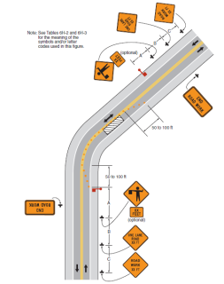
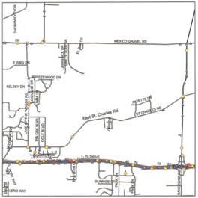
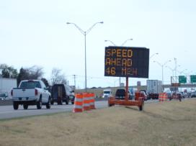
Identify the Project
Step
1
Active Work Zone
Planning Phase
Design Phase
Images: FHWA
Notes:
Key Message: A WZRSA can be conducted during the project planning, design, and active work zone phases.
Background Information:
The primary WZRSA tasks should include:
Checking the work zone activity area configuration, examining the implementation of TTCDs, and assessing driver behavior, and
Reviewing project design and TMP.
A WZRSA can be beneficial on a project when the following situations exist:
The project location is in proximity to another work zone, and either can have overlapping effects on the other
The project is high-profile in nature
The proposed project location has a history of safety and mobility issues
The project has a complex traffic control plan
Multiple construction stages exist
The contractor proposes changes to the traffic control plan
The active work zone has not met performance goals or is not performing as expected in safety, mobility, or visibility categories
Interaction: Solicit input from class on other considerations that make a project a good candidate for WZRSA.
Notes:

Slide 62
Identify the Project
Step
1
Make structural changes on paper instead of in concrete
Optimize crash and conflict prevention
Notes:
Key Message: WZRSA can have several positive effects when performed during planning, design, and even active work zone phases.
Background Information:
A WZRSA can lead to the selection of more effective traffic control strategies during the planning and design phases.
A WZRSA can also modify construction or work zone staging efforts before or during an active work zone, which gives the potential for project cost savings while being less intrusive to motorists.
These tangible results show how recommendations from a WZRSA could translate into project time and cost savings and provide for enhanced safety and mobility aspects within the work zone.
Interaction: Ask participants to give an example of when cost savings and positive safety/mobility impacts might occur as a result of modifications to construction or work zone staging efforts.
Notes:

Slide 63
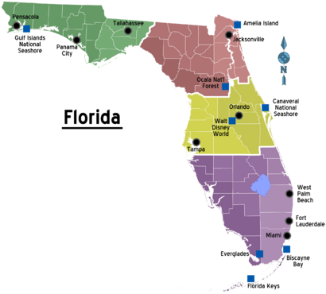
Example: Florida DOT WZRSAs
Example
Image: FHWA
Notes:
Key Message: A WZRSA pilot was conducted to test the guidelines and prompt lists. The pilot took place January 28 – February 1, 2013 in Tampa, FL.
Background Information:
The team tested the process in an Active Work Zone and on a project in the Design Phase.
The ATSSA team held pre-coordination meetings and exchanged emails in the month leading to the pilot event with Florida Department of Transportation (DOT) in advance of the pilot event to identify projects, choose members of the WZRSA team, collect project data, and coordinate logistics.
During the pre-coordination meetings and once on site, the WZRSA teams followed the process as outlined in the pre-final draft of the Work Zone Road Safety Audit Guidelines & Prompt Lists.
Interaction:
Notes:

Slide 64
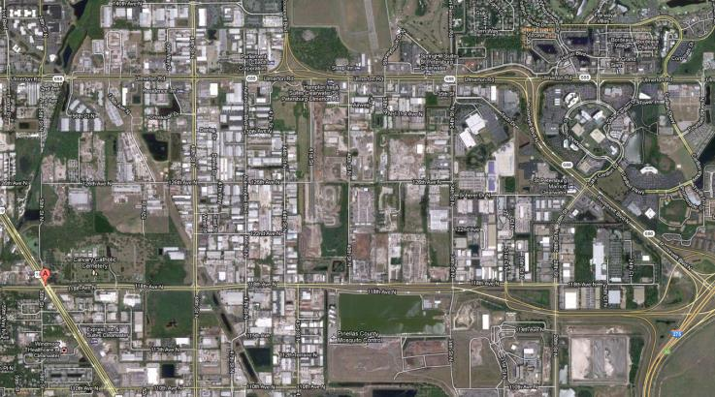
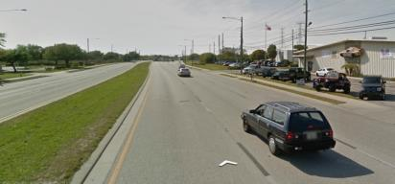
Design Phase WZRSA Example
Example
Airport
118th Avenue
EMS
Images: Google Maps
Notes:
Key Message: Describe the 118th Avenue project.
Background Information: Design Phase
The ATSSA team and Florida DOT chose a design project on 118th Ave. at the 60 percent completion level for the design phase WZRSA.
The existing 118th Ave. is a six-lane urban divided highway with major intersections at US 19 and 49th Street.
The facility has a posted speed of 45mph and is classified as a minor arterial.
The proposed roadway will be an urban principal arterial; it consists of a multi-lane elevated roadway with frontage roads.
The design speed is 60 mph for the new mainline express lanes, 40 mph for flyover ramps, and 45 mph for frontage roads and mainline ramps.
During the active work zone phase, the design team plans to utilize several local roads as detour routes.
Special work zone staging and construction techniques were considered due to the proximity of a nearby small airport.
This project was chosen due to its significant construction and traffic control staging, impact on multiple road users (including transit, pedestrians, and bicyclists), effect on local businesses and emergency service providers, and proximity to an airport. Since the project’s design was approximately 60 percent complete at the time of the WZRSA, semi-significant recommendations could be made during the WZRSA and incorporated as a result.
Interaction:
Notes:

Slide 65
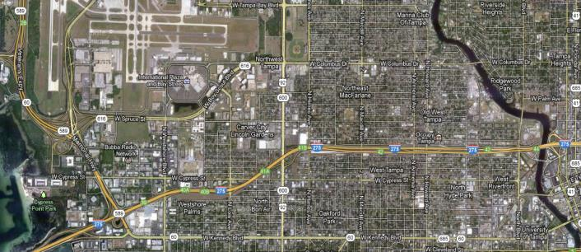
Active WZRSA
Example
Image: Google Maps
Memorial Highway to Hillsborough River
  Armenia/Howard
  Interchanges
  Ashley/Kay
  Interchange
Interstate 275
Notes:
Key Message: Describe the I-275 project.
Background Information:
Active Work Zone Phase – The ATSSA team and Florida DOT chose a construction project on Interstate 275 (I-275) for the active WZRSA.
I-275 is an urban freeway/expressway with a speed limit of 65 mph.
The design speed is 60 mph from SR 60 to Himes Ave., 65 mph from Himes Ave. to Willow Ave.,
and 50 mph from Willow Ave. to the Hillsborough River.
This project is a complete reconstruction of I-275 from SR 60 (Memorial Highway) to the Hillsborough River, which is approximately 4 miles in length.
The project will replace 13 bridges, widen three bridges, and construct three new bridges.
It also involves constructing mechanically stabilized earth walls, earthwork fills, drainage, concrete and asphalt pavements, lighting, signing, intelligent transportation systems (ITS), landscaping, and architectural treatments.
The active work zone spans several construction seasons, shifts traffic to newly constructed lanes over several segments, and replaces two former right-hand exits with temporary left-hand exits from the freeway.
During the WZRSA, the team focused its review on two specific locations at the request of the project manager: the Armenia/Howard interchange and Ashley/Kay interchange.
Interaction:
Notes:

Slide 66
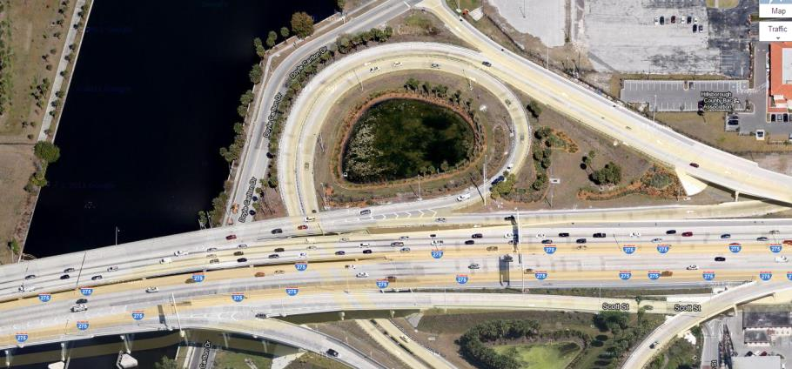
Active WZRSA
Example
  Ashley/Kay merge
  Work zone begins
  Ashley/Kay Interchange
Image: Google Maps
  Concrete traffic barrier lane shift/merge
Notes:
Key Message: Describe the I-275 project.
Background Information:
During the WZRSA, the team focused its review on two specific locations at the request of the project manager: the Armenia/Howard interchange and Ashley/Kay interchange.
The Ashley/Kay interchange was technically outside of the work zone limits, but traffic merging onto I-275 from the interchange immediately entered the work zone. The Ashley Street ramp merges with the Kay Street ramp before merging with I-275 approximately 200 feet later.
Interaction:
Notes:

Slide 67
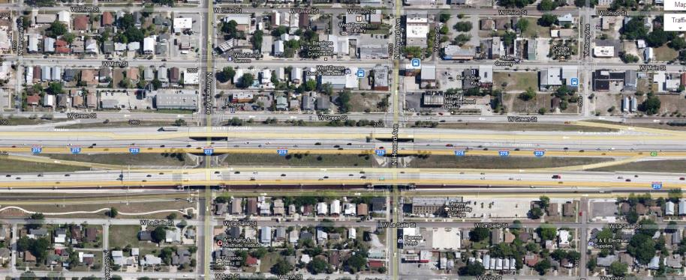
Active WZRSA
Example
  Armenia/Howard Interchanges
Signalized intersections
Image: Google Maps
Notes:
Key Message: Describe the I-275 project.
Background Information:
During the WZRSA, the team focused its review on two specific locations at the request of the project manager: the Armenia/Howard interchange and Ashley/Kay interchange.
The Armenia/Howard interchanges were typical right hand exits prior to construction. During the active work zone, however, both exits were converted to left hand exits. Traffic was led to either Armenia Avenue or Howard Avenue, depending on the direction traveled. Both exits at Armenia and Howard Avenues were signalized intersections, along with successive signals along each corridor with approximately 300-400’ temporary signal spacing.
Interaction:
Notes:

Slide 68
Step 2. Select WZRSA Team
6
Present
Findings to
Road
Owner
1
Identify
Project
5
Analysis &
Prepare
Report of
Findings
7
Prepare
Formal
Response
2
Select WZRSA
Team
2
Select RSA
Team
4
Perform
Data & Field
Reviews
8
Incorporate
Findings
& Evaluate
Results
3
Conduct
Pre-audit
Meeting
Responsibilities
RSA Team
Image: FHWA
Road Owner
Notes:
Key Message: Introduce Step 2.
Background Information:
The second step in the process is to select a WZRSA team.
Interaction:
Notes:

Slide 69
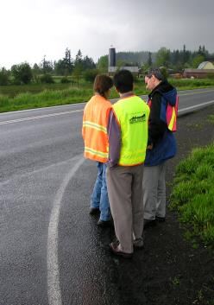
Step 2. Select WZRSA Team
Step
2
Independent
Experienced
Multi-disciplinary
Choose WZRSA Team Leader with experience in the WZRSA process
Image: FHWA
Notes:
Key Message: Selecting an appropriate WZRSA team and team leader can affect the quality and thoroughness of considerations during the WZRSA.
Background Information:
The Objective of the WZRSA Team:
The objective of selecting an audit team is to choose an independent, qualified, and multidisciplinary group of experts who can successfully conduct a WZRSA.
It is important to assemble an WZRSA team that has sufficient competency to contribute to the objective of the WZRSA, while still providing a “birds-eye” view and fresh perspective.
By building a team that spans many disciplinary fields and extends past engineering lines, well-rounded insights can contribute to out-of-the-box solutions.
Team members are encouraged to share insights on all aspects of the safety examination as they are not only safety professionals, but road users as well.
Previous RSA experience is not required; specific subject matter expertise should be the most important factor for team selection.
Selecting the Team Leader:
The road owner is responsible for selecting the WZRSA team leader.
The team leader should have a thorough understanding of the RSA process and possess excellent communications and leadership skills.
The team leader will have the ultimate say on the WZRSA final report and will serve as the primary point of contact between the road owner, the design team, and the audit team.
The road owner and the WZRSA team leader should select a set of qualified individuals from a variety of organizations – within the agency, from another public agency, or from other outside sources.
Interaction:
Notes:

Slide 70
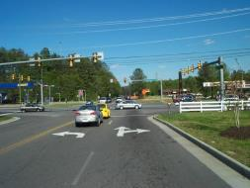
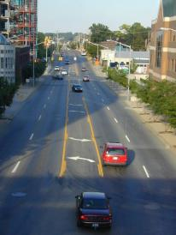
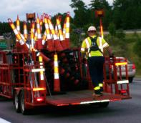
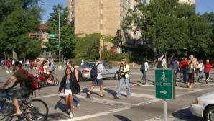
Step 2. Select WZRSA Team
Step
2
Traffic Operations
Geometric Design
Temporary Traffic
Control
Road Users/ Human Factors
Images: ATSSA
Notes:
Key Message: Discuss the needed skills, expertise, and qualities of the WZRSA team.
Background Information:
Needed Skills of the WZRSA Team.
Must be impartial and must not have been involved in the project development process.
The freedom, ability, and comfort of auditors to comment frankly on potentially controversial safety issues are crucial to the success of the WZRSA.
Individuals with no prior input or participation in the project can also be able to provide a fresh viewpoint from a perspective
The audit team should represent a group of individuals that possess skills that will ensure the most critical aspects of the project are addressed.
Generally, WZRSA teams have five to eight members, but can be larger on complex projects
Team Composition. Depending on the nature of the project and the phase in which the WZRSA is to be conducted, those to consider serving on an WZRSA team can include a variety of people.
It can also prove beneficial to include a member of the community in which the work zone will be or is taking place. Community members can have insights that contribute to a more robust review. Their participation on the team can also assist in gaining public support for the project or work zone.
In addition to those listed above, WZRSA team members should be added and considered based on specific phases of a project being assessed.
Areas of specialty that would further supplement the core skills will vary depending on the WZRSA phase (planning, design, or active work zone).
Core team members should include DOT staff versed in work zone and safety concepts and law enforcement, at a minimum.
It is beneficial to have team members who are good communicators, both oral and written, and who work well in group exercises.
Interaction: What other general attributes can be good for team members to possess?
Notes:

Slide 71
Step
2
Select WZRSA Team:
Planning Phase
High-level concepts discussed
Preferred: team members that are familiar with the local roads and communities
Notes:
Key Message: Selecting a WZRSA team varies, in part, by the project phase in which the WZRSA is to be conducted.
Background Information:
In the planning phase, the WZRSA team discusses high-level concepts and can not rely on drawings or formalized plans.
In addition to the WZRSA team members listed previously, additional members should include a representative who is familiar with the local road network and affected communities, and someone who is familiar with other planned projects in the vicinity of the work zone being examined.
Interaction: How would your team change if you were conducting a WZRSA during the planning phase, preliminary design phase, final design stage, or active work zone phase?
Notes:

Slide 72
Step
2
Select WZRSA Team:
Preliminary Design Phase
Reliance on drawings and traffic flow projections
Road design engineers are helpful during this phase
Notes:
Key Message: Selecting a WZRSA team varies, in part, by the project phase in which the WZRSA is to be conducted.
Background Information:
In the preliminary design phase, members of the WZRSA team must rely on drawings to determine what the project will include and how traffic flow, accessibility, and safety will be maintained during the project. They need to be able to visualize the road in three dimensions with all its appurtenances. A field investigation of the site of a proposed road will help in visualizing the design and will assist the audit team in better understanding how the new project will transition into existing roads. In addition to the WZRSA team members listed above, a preliminary design phase WZRSA should have a road design engineer skilled in horizontal and vertical road alignment, road cross-section elements, and intersection layout.
Interaction:
Notes:

Slide 73
Step
2
Select WZRSA Team:
Final Design Phase
Traffic safety/ operations engineer
Road design engineer
Road maintenance
Enforcement
First responders
Schools
Highway-rail grade crossings
Notes:
Key Message: Selecting a WZRSA team varies, in part, by the project phase in which the WZRSA is to be conducted.
Background Information:
A final design phase WZRSA team should have a traffic operations engineer skilled in traffic signal control; traffic signs; delineation; pavement markings; pedestrian, bicycle, and transit facilities; and a road design engineer skilled in roadside protection and work zone TTC. Consideration should also be given to individuals with experience in road maintenance, enforcement, first response, schools, highway-rail grade crossings, and other areas.
Interaction:
Notes:

Slide 74
Step
2
Select WZRSA Team:
Active Work Zone
Any of the previously mentioned team members plus:
  Human factors
  Positive guidance
  Maintenance
  Law enforcement
Notes:
Key Message: Selecting a WZRSA team varies, in part, by the project phase in which the WZRSA is to be conducted.
Background Information:
In the active work zone phase RSA, the WZRSA team should also include experts in human factors/positive guidance, maintenance, and law enforcement, in addition to the WZRSA team members listed above. During this phase, the team should have sufficient expertise to also consider ingress and egress to/from the work zone, work space and activity area issues, and work zone TTCD setup and removal.
Interaction:
Notes:

Slide 75
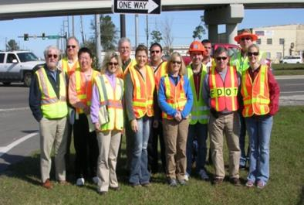
Disciplines included in Florida’s WZRSA
Example
Safety
Work zones
Traffic and traffic operations
RSA process
Maintenance of traffic
Construction
Design
Image: FHWA
Notes:
Key Message: The WZRSA team for the Florida Pilot WZRSA was chosen to encompass a variety of disciplines.
Background Information: Discuss team composition
The independent, multi-disciplinary WZRSA team was selected by Florida DOT and the ATSSA team
The same team conducted a WZRSA for both projects.
Interaction: Ask: What other disciplines could have been represented for the design phase WZRSA? What about for the Active WZRSA?
Notes:

Slide 76
Step 3. Conduct a Pre-Audit Meeting
6
Present
Findings to
Road
Owner
1
Identify
Project
5
Analysis &
Prepare
Report of
Findings
7
Prepare
Formal
Response
3
Conduct a
Pre-Audit
Meeting
2
Select RSA
Team
4
Perform
Data & Field
Reviews
8
Incorporate
Findings
& Evaluate
Results
3
Conduct
Pre-audit
Meeting
Responsibilities
RSA Team
Image: FHWA
Road Owner
Notes:
Key Message: Introduce Step 3.
Background Information:
Step 3: Conduct a Pre Audit Meeting:
The pre-audit meeting is comprised of two parts: the project overview meeting with the road owner and the review of project information.
Interaction:
Notes:

Slide 77
Pre-Audit Meeting: Road
Owner Responsibilities:
Step
3
Communicates basic project information
Reviews
  Project schedule
  Duration
Discusses
  Constraints
  Limitations
Notes:
Key Message: The project overview meeting is an opportunity for the road owner to formally meet the WZRSA team and kick off the WZRSA.
Background Information:
The road owner should introduce the WZRSA team leader and give details related to the following topics:
Specific goals and objectives for the WZRSA;
Concerns with the roadway section where the work zone will take place;
Safety concerns with similar projects;
Work zone schedule and duration;
State laws and agency policies related to work zone activities (e.g., no texting and driving, how speed limits are established);
Constraints and limitations associated with the project, including guidelines by which the WZRSA will be conducted and the types and extent of recommendations that can be made by the team; and
Guidance on the level of risk associated with the various safety issues identified (e.g., low, medium, or high).
Once introduced to the team, the WZRSA team leader should be prepared to discuss the following:
Identification of individual team members’ roles;
Reviewing the WZRSA process; and
Summarizing the contact information of the road owner, all relevant project contacts, and all team members.
Interaction:
Notes:

Slide 78
Step
3
Pre-Audit Meeting: Road
Owner Responsibilities
Identifies individual roles
Reviews WZRSA process
Notes:
Key Message: The project overview meeting is an opportunity for the road owner to formally meet the WZRSA team and kick off the WZRSA.
Background Information:
The road owner should introduce the WZRSA team leader and give details related to the following topics:
Specific goals and objectives for the WZRSA;
Concerns with the roadway section where the work zone will take place;
Safety concerns with similar projects;
Work zone schedule and duration;
State laws and agency policies related to work zone activities (e.g., no texting and driving, how speed limits are established);
Constraints and limitations associated with the project, including guidelines by which the WZRSA will be conducted and the types and extent of recommendations that can be made by the team; and
Guidance on the level of risk associated with the various safety issues identified (e.g., low, medium, or high).
Once introduced to the team, the WZRSA team leader should be prepared to discuss the following:
Identification of individual team members’ roles;
Reviewing the WZRSA process; and
Summarizing the contact information of the road owner, all relevant project contacts, and all team members.
Interaction:
Notes:

Slide 79
Review Project Information
Step
3
Project description
Type of work
Geographical information
TTC Plans and TMPs
Roadway classification
Speed limit and design speed
Potential impacts to EMS
Crash history
Traffic data
Notes:
Key Message: During the project overview meeting, the road owner provides pertinent basic information related to the location and design criteria of the work zone.
Background Information:
Based on the project phase, the road owner should be prepared to summarize:
Project description and type of work to be conducted;
Geographical area information and maps;
Roadway classification, speed limit and design speed;
Availability of adjacent road networks;
Potential impacts to and from emergency service provider locations;
Historical crash and volume data near the planned work zone, including variations by days of the week and seasonally;
Statewide work zone crash data trends;
Findings from previous corridor studies conducted within the area of the planned work zone;
How the limits of the work zone were decided;
The number and types of road users within the work zone;
Number, severity, and cause of crashes that have occurred within the active work zone; and
Hours/days of work zone operation.
Interaction:
Notes:

Slide 80
Other Project Information
Step
3
Based on the project phase, what other types of information may the team want the road owner to share?
What else does the WZRSA Team need to assess the safety aspects of this work zone?
Notes:
Key Message: Other project information can prove beneficial for the WZRSA team to review.
Background Information:
Interaction: BRAINSTORM!
Speaker notes: Spend 2-3 minutes soliciting feedback from the group based on planning, design, and active work zone phases.
Examples
Planning phase: the project’s significance, according to the Work Zone Mobility Rule
Design phase: if other work zones are being planned or designed in proximity of the project, to become active at the same time.
Active work zone phase: the number of type of motorists complaints regarding the active work zone
Notes:

Slide 81
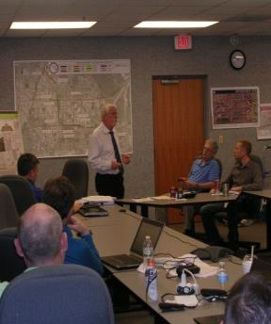
Example
Review Project Information
Road owner presentation
Reviewed project information
Provided a summary of the crash history
Provided specific safety concerns about the location
Answered questions posed by the team
Image: FHWA
Notes:
Key Message: The road owner(s) conducted a pre-audit meeting with the WZRSA team to convey important project information.
Background Information:
Each road owner presented project information of their respective project, which included:
Geographic information about the project
A summary of the crash history
Specific safety concerns about the location
Answered questions posed by the team
Interaction:
Notes:

Slide 82
Example
Additional Information Provided:
Florida WZRSA Example
  Project description
  Type of work
  Schedule of work zone operation
  Geographical area information and maps
  Roadway classification
  Speeds
Image: FHWA
Notes:
Key Message: Describe other project information that the road owner should share during the pre-audit meeting.
Background Information:
Other information that was presented by each road owner included the following:
Project description and type of work being conducted, Hours/days of work zone operation;
Geographical area information and maps;
Roadway classification, speed limit and design speed;
Availability of adjacent road networks;
Impacts to and from emergency service provider locations;
Historical crash and volume data near the work zone, including variations by days of the week and seasonally;
Statewide work zone crash data trends;
Number, severity, and cause of crashes that have occurred within the active work zone; and
The number and types of road users present within the limits of the work zone and how they are being accommodated.
Interaction:
Notes:

Slide 83
Example
Additional Information Provided:
Florida WZRSA Example
  Availability of adjacent road networks
  Impacts to and from emergency service provider locations
  Historical crash data
  Volume data
  Other road user considerations
Image: FHWA
Notes:
Key Message: Describe other project information that the road owner should share during the pre-audit meeting.
Background Information:
Other information that was presented by each road owner included the following:
Project description and type of work being conducted, Hours/days of work zone operation;
Geographical area information and maps;
Roadway classification, speed limit and design speed;
Availability of adjacent road networks;
Impacts to and from emergency service provider locations;
Historical crash and volume data near the work zone, including variations by days of the week and seasonally;
Statewide work zone crash data trends;
Number, severity, and cause of crashes that have occurred within the active work zone; and
The number and types of road users present within the limits of the work zone and how they are being accommodated.
Interaction:
Notes: Number, severity, and cause of crashes in the active work zone

Slide 84
Step 4. Perform Data and Field Reviews
6
Present
Findings to
Road
Owner
1
Identify
Project
5
Analysis &
Prepare
Report of
Findings
7
Prepare
Formal
Response
4
Perform Data
and Field
Reviews
2
Select RSA
Team
4
Perform
Data & Field
Reviews
8
Incorporate
Findings
& Evaluate
Results
3
Conduct
Pre-audit
Meeting
Responsibilities
RSA Team
Image: FHWA
Road Owner
Notes:
Key Message: Introduce Step 4.
Background Information:
In Step 4, the WZRSA team begins to review project-specific documentation and drawings and visits the site where the work zone is planned or active. The team will use prompt lists to identify work zone safety considerations that are relevant to the phase in which the WZRSA is conducted. The prompt lists can help the team to consider certain elements of the work zone that might be otherwise overlooked.
Interaction:
Notes:

Slide 85
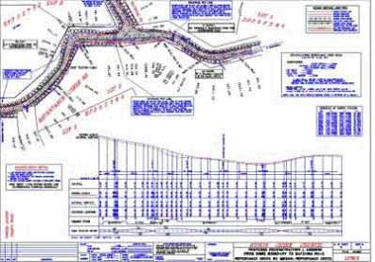
Review Project Data:
Team Reviews Plans:
Step
4
  As a group, individually or both
  With all road users in mind
  Systematically
Image: FHWA
The Team may refer to Prompt Lists for relevant aspects of the WZRSA
Notes:
Key Message: The team’s review of design drawings will be crucial to understanding the interaction between the proposed work zone and its environment.
Background Information:
Team should review the plans as a group
The WZRSA team should examine the design drawings in detail, imagining how the road would appear from the perspective of road users (including drivers of different vehicle types and older drivers) and, if applicable, cyclists and pedestrians (including pedestrians of different age groups and abilities).
A useful approach is to review the design drawings systematically in one direction at a time for each road section and to review each movement individually at freeway interchanges and at-grade intersections.
Simulation models can also be a helpful tool for visualizing how the work zone will appear to roadway users.
The WZRSA team members may use prompt lists as a reminder of relevant aspects of the WZRSA – Prompt lists will be discussed in further detail later in the presentation.
During the field review, it may be possible to verify identified issues and discover additional safety issues that might not be evident from the design drawings and other project data.
Interaction:
Notes:

Slide 86
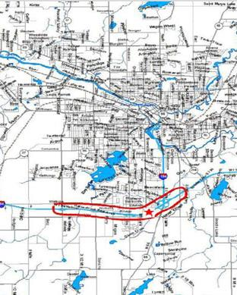
Review Project Data:
Planning Phase
Step
4
  Project significance according to the Rule
  Planned adjacent projects and work zones
  Alternate road networks
  Geometric and sight distance
  Impacts to businesses and communities
Image: FHWA
Notes:
Key Message: During this early phase in the project’s life, there are several considerations that can affect future safety and mobility outcomes during the active work zone phase.
Background Information:
While no formal plans can exist, the planning phase is ideal for reviewing:
Project significance, according to the Final Rule on Work Zone Safety and Mobility (§ 630.1010) and State or local policy (which leads to developing a TMP and its components);
Consideration of planned adjacent projects and work zones;
The availability of alternate road networks;
Geometric and sight distance considerations at the work zone location; and
Impacts to businesses and communities in the vicinity.
Other considerations within this step of the WZRSA process should include a review of project timing with respect to seasonal travel volumes, the presence of school and bus routes, tourism events, and local impacts to schools, businesses, military posts, and local festivals and events.
Interaction:
Notes: (Photo: http://ops.fhwa.dot.gov/wz/resources/final_rule/tmp_examples/sample_tmps/sec_f.htm)

Slide 87

Review Project Data:
Preliminary Design Phase
Step
4
  Consider all users
  Safety vs. mobility goals
  Alternative designs
  Seasonal traffic
  Environmental documents
  Adjacent projects
Image: ATSSA
Notes:
Key Message: During preliminary design, it is common to produce basic plans that indicate horizontal and vertical alignments, general limits of the work zone, and possibly a determination of how to stage the work.
Background Information:
In addition to reviewing the planning phase information, the team can also review:
How work zone activities affect all roadway users, such as pedestrians, bicyclists, motorcyclists, older and teen drivers, motor carriers, and Americans with Disabilities Act (ADA) considerations
Impacts to work zone safety and mobility goals, including tradeoffs between the two
Assessments made during considerations for alternate design concepts, construction staging, and construction techniques
Environmental documents and design commitments
Impacts contributed by adjacent projects and work zones
Impacts from seasonal travel
Interaction:
Notes: (Photo: http://www.dedham-ma.gov/index.cfm?pid=12646)

Slide 88
Review Project Data:
Final Design Phase
Step
4
  TMP correlates with safety vs. mobility goals
  Impacts mitigated
  Adjacent work zones
  Geometric design
  Intermodal transportation accommodated
Notes:
Key Message: In the final design phase, activities include the development of temporary traffic control plans (TTCP), construction staging plans, a work zone impacts assessment, a TMP, and a detailed set of project plans that address the remainder of design considerations before being bid upon by contractors.
Background Information:
In addition to reviewing the planning and preliminary design phase information, the team can also review:
Strategies appearing in the TMP that correlate with defined safety and mobility goals
Available ITS, interactive communications, and safety devices that are incorporated into the TMP and TTCP
The impact of construction staging, phasing, and methods on safety and mobility have been mitigated
Projects across a corridor have been coordinated
Roadway geometry and characteristics within the work zone limits provide for optimal safety and mobility
TTC does not conflict with itself or with existing traffic control
TTC does not adversely affect specific roadway users, or if it does, those impacts are mitigated (e.g., motorcycles and transverse rumble strips)
The interaction between work zone activities and other transit modes provides for optimal safety and mobility for all, including interaction with bus routes/stops, light rail, and other occurrences
Interaction:
Notes: (Photo: http://www.dedham-ma.gov/index.cfm?pid=12646)

Slide 89
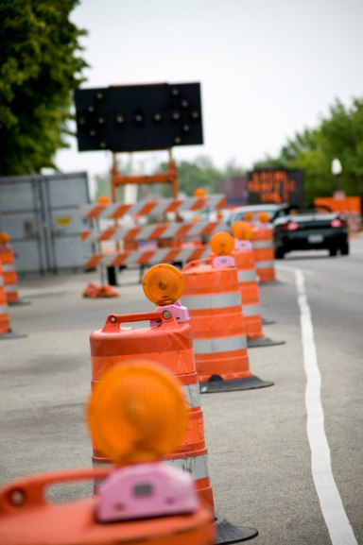
Review Project Data:
Active Work Zone Phase
Step
4
  User expectations
  TTC design
  Guidance for road users
  Roadway and geometric conditions
  Intermodal transportation
  Accommodations for EMS and law enforcement
  Access
Image: ATSSA
Notes:
Key Message: In this phase, work zone activities are in full-effect. Transportation management strategies and TTCDs are deployed and monitored for effectiveness based on measurements against safety and mobility goals determined during the design phase. The active work zone phase provides a real-time opportunity to ensure that plans are executed and achieving favorable results.
Background Information:
In addition to reviewing the planning and design phase information, the team can also review:
Road user expectations are aligned with proper deployment and use of transportation management strategies and TTCDs (e.g., drivers have been informed of upcoming back of queue, flagger ahead, or a change in speeds);
The transportation management strategies, TTC, and speed limit are appropriate for field conditions;
The work zone provides road users with the appropriate amount and type of guidance;
Roadway and geometric conditions meet driver expectations;
Roadway and geometric conditions support work zone safety and mobility goals;
Interaction with other transit modes exists (e.g., rail, light rail, transit);
Enforcement and EMS are properly accommodated;
Access for road workers and construction equipment; and
All road users are accommodated within the work zone.
Interaction:
Notes: (Photo: http://www.nationlaw.com/accidents-injuries/work-zone-accidents/)

Slide 90
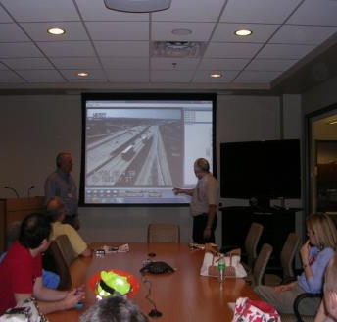
Review Project Data:
Florida WZRSA Example
Example
  TMP
    TTC Plan
  Construction staging
  Historical crash data
  Work zone crashes/ causes
  Visited the TMC
    Live video feed of project area
Image: FHWA
Notes:
Key Message: The team reviewed the project data, drawings, and available crash data, and asked follow up questions of the road owner.
Background Information:
For the I-275 WZRSA, the team reviewed temporary traffic control plans (TTCP), the transportation management plan (TMP), and the construction staging.
The team also asked about historical crashes that occurred prior to the work zone and those that had happened during the active work zone within the four mile segment. The contractor supplied detailed crash information pertaining to type and causation.
The team visited the Transportation Management Center (TMC) to observe traffic in the work zone using live feed from cameras in the field. This was a valuable experience that allowed the team to become oriented to the project and observe traffic patterns and driver behavior.
Interaction:
Notes:

Slide 91
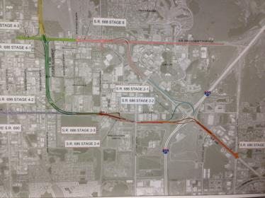
Review Project Data:
118th Avenue
Example
  Design plans
  TTCP, TMP
  Construction staging
  Pedestrian accommodations
  Impact of vertical flyovers on nearby airport
  Used web-mapping to “drive through”
Image: FHWA
Notes:
Key Message: The team reviewed the project data, drawings, and available crash data, and asked follow up questions of the road owner.
Background Information:
The team reviewed the project plans at 60% completion level, including the temporary traffic control plan (TTCP), the transportation management plan (TMP), and discussed construction staging.
The corridor has existing sidewalks so the team reviewed how the TTCP impacted pedestrian traffic and accommodations.
A small airport (in the red circle) is situated near the future work zone. Since the project entails constructing flyovers with overhead cranes, the team looked at potential conflicts with air traffic.
The road owner oriented the team to the project location by using a web-based mapping system to “drive through” the project and answer any questions that arose.
Interaction:
Notes:

Slide 92
Field Review: Team Preparation
Step
4
  Transportation
  Equipment
  Note-taker
  Photographer
  Team safety
    PPE
    Class 2 or 3 vests
    Water
Notes:
Key Message: Before the field review, the team should prepare for their trip by taking several steps.
Background Information:
As the team moves into the Field Review, they should take these steps:
Trip Preparation
Arrange transportation and equipment - it’s best if all WZRSA team members can ride through the work zone together in one vehicle.
Designate note-taker and photographer
Ensure safety of the WZRSA team
For team members who are not accustomed to working in traffic or around work zone activities, the team leader can consider conducting basic safety and awareness training prior to visiting the work zone site.
Interaction:
Notes:

Slide 93
Field Review: Team Equipment
Step
4
Drawings
Aerial photos
Cameras (still and video)
Measuring tape
Note pad
Binoculars
Prompt list
Notes:
Key Message: Before the field review, the team should gather the equipment they will need during the review.
Background Information: As the team moves into the Field Review, they should take these steps:
Gather Equipment
Drawings and/or aerial photos of site
Camera (still and video)
Photographs and video should be an integral part of capturing elements during the field review.
They can also be used to communicate actual field conditions during the presentation of findings to the road owner.
During the field review, the team should take photographs and video footage of anything that may need to be reviewed or revisited while writing the WZRSA final report or while presenting the findings to the road owner.
High-visibility vests
Members shall use proper safety equipment and traffic control at all times, and the potential for adverse impacts on road traffic and audit team safety must be managed during the field review.
Prompt list (optional)
Interaction:
Notes:

Slide 94
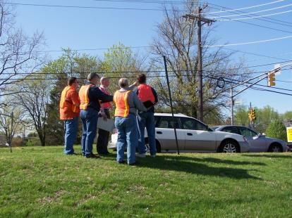
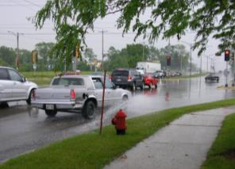
Field Review:
Drive and Walk the Site!
Step
4
Images: FHWA
Notes:
Key Message: Driving and walking the site allows the team to see the work zone from each road users’ perspective and to see the traffic control elements as each road user sees them.
Background Information:
As the team is driving through, it is important to keep in mind that a driver’s perspective will vary depending on the type of vehicle being driven. Photos or video taken from other road user perspectives can help document key items for later reference.
For example, a commercial motor vehicle driver will view the work zone differently than a motorcyclist traveling through the same work zone.
Interaction:
Notes:

Slide 95
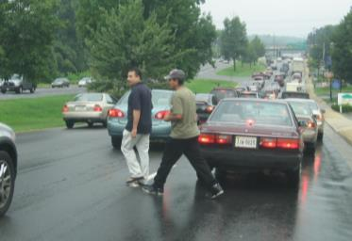

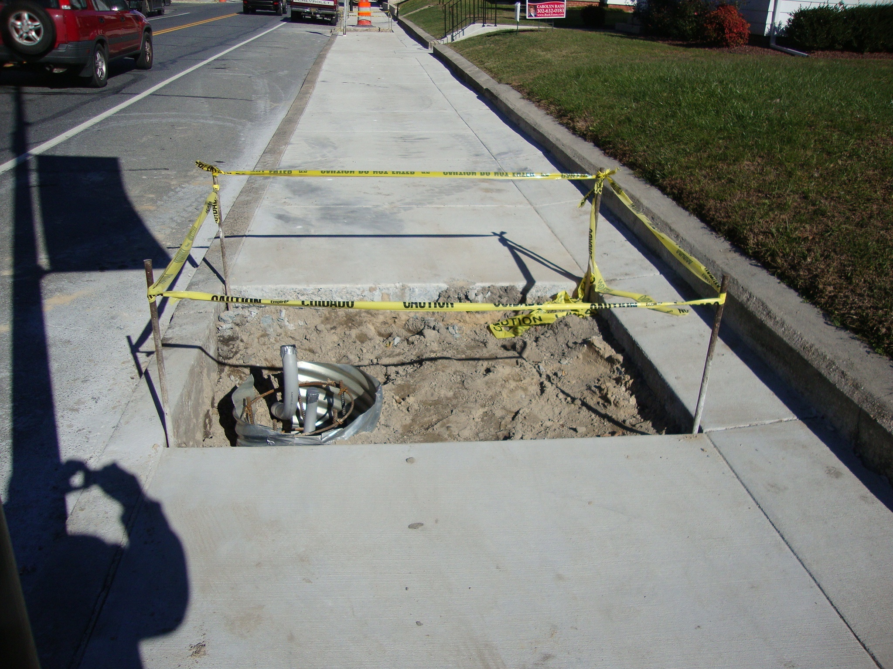
Field Review: Observations
95
Step
4
  Road user types
  Erratic maneuvers
  Driver behavior
  Contractor operations
  Flagger control
  Worker protection
  Positive protection
Images: ATSSA
Notes:
Key Message: During the field review, the team should make careful observations with respect to road users, driver behavior, and other considerations.
Background Information:
Observe road user characteristics:
What are typical speeds?
What is the typical traffic mix, including heavy vehicles, farm equipment, cyclists?
Does traffic tend to queue at certain times of the day or in certain lanes?
Observe driver behavior:
How are road users (motorists, pedestrians, etc.) navigating through the project limits?
Did you witness any unlawful maneuvers?
Do any users seemed confused by the geometry or traffic control devices?
Observe whether queuing exists:
How long is the queue?
Where in the work zone does queuing occur?
Observe surrounding land uses:
What are the existing developments contributing traffic to the audit site?
Are there any driveways that might affect the planned roadway?
What are the typical traffic patterns associated with the adjacent land uses (for example, weekend traffic near a sports field)?
Observe link points to the adjacent transportation network:
Are there at-grade railway crossings in the vicinity of the audit site that could delay traffic?
Are interchange ramps close to the site?
Interaction:
Notes:

Slide 96
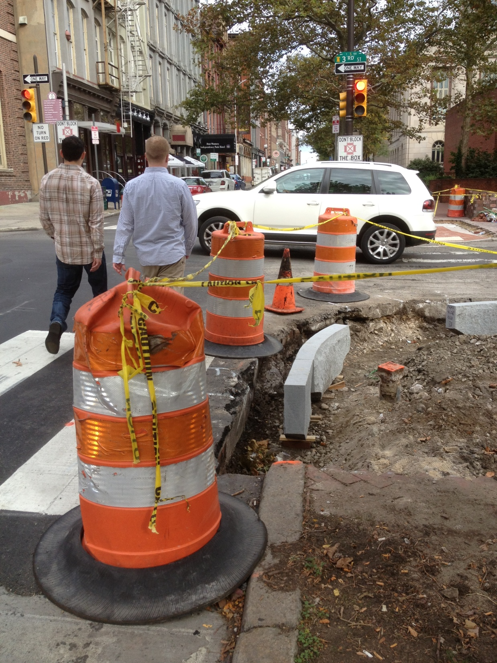
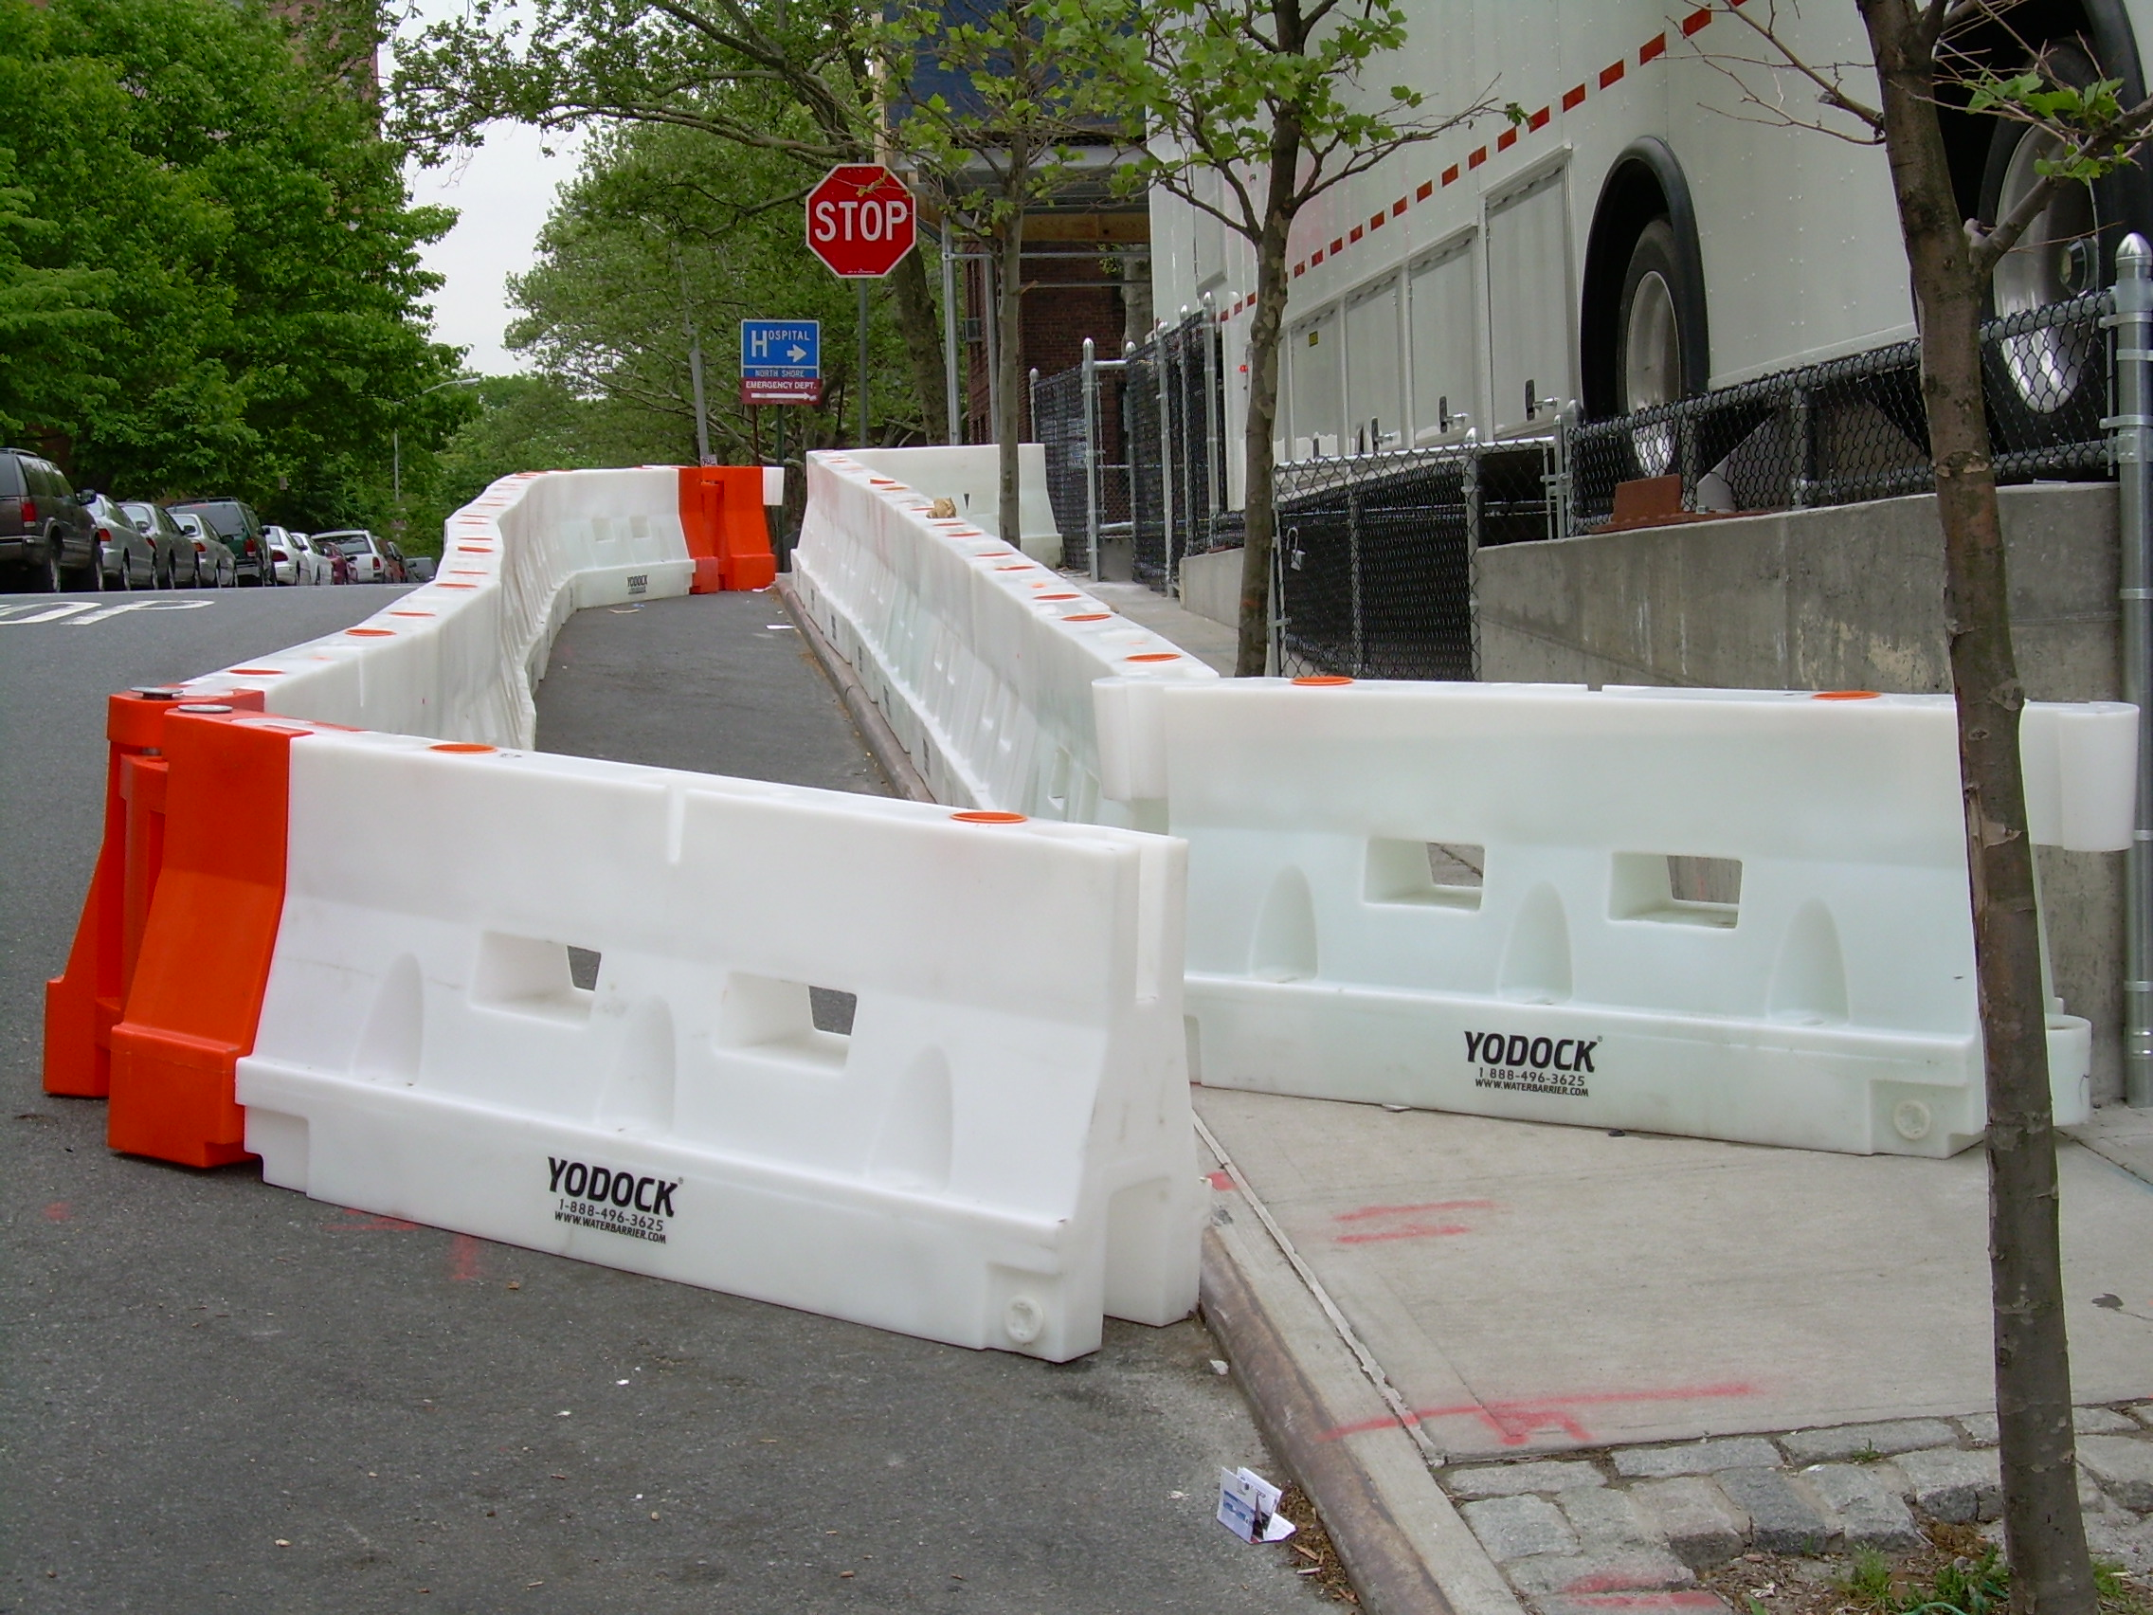
Field Review: Common Items
Step
4
Pedestrian and cyclist considerations
Accommodations for all road users
  ADA
Visual clutter
Lack of positive guidance
Images: ATSSA
Notes:
Key Message: There are common items that are frequently found in work zones that the team should observe during the field review.
Background Information:
The team should:
review each approach throughout the work zone to determine if sight distance obstructions exist
investigate pedestrian and bicyclist facilities, particularly at points where they come into conflict with vehicular traffic
review locations with pedestrian traffic - if the work zone is on a route with sidewalks and/or a bike path, the team will want to consider the perspectives of these users and how the work zone impacts their ability to travel.
Interaction:
Notes:

Slide 97


Field Review: Common Items
Step
4
Visibility of advance warning signs
Clutter
Images: ATSSA
Notes:
Key Message: There are common items that are frequently found in work zones that the team should observe during the field review.
Background Information:
The team should:
Explain the issues associated with the photos.
Emphasize that these setups MEET TTC standards but may not be safe.
Interaction: What is wrong with this? Is it safe? Would this warrant a recommendation? Which recommendation would you make?
Notes: Try to generate discussion.

Slide 98



Field Review: Common Items
Step
4
Steel plates
Clear zone issues
Bumps
Drop-offs
Grooved pavements
Images: ATSSA
Notes:
Key Message: There are common items that are frequently found in work zones that the team should observe during the field review.
Background Information:
The team should:
review each approach throughout the work zone to determine if sight distance obstructions exist
investigate pedestrian and bicyclist facilities, particularly at points where they come into conflict with vehicular traffic
review locations with pedestrian traffic - if the work zone is on a route with sidewalks and/or a bike path, the team will want to consider the perspectives of these users and how the work zone impacts their ability to travel.
Interaction:
Notes:

Slide 99


Field Review: Common Items
Step
4
Blocked sidewalks
Utility operations
End-of-queue issues
Turning lanes blocked
Lack of advance warning
Images: ATSSA
Notes:
Key Message: There are common items that are frequently found in work zones that the team should observe during the field review.
Background Information:
The team should:
review each approach throughout the work zone to determine if sight distance obstructions exist
investigate pedestrian and bicyclist facilities, particularly at points where they come into conflict with vehicular traffic
review locations with pedestrian traffic - if the work zone is on a route with sidewalks and/or a bike path, the team will want to consider the perspectives of these users and how the work zone impacts their ability to travel.
Interaction:
Notes:

Slide 100


Field Review: Common Items
Step
4
Conflicts with pedestrians
Constructability issues
Images: ATSSA
Notes:
Key Message: There are common items that are frequently found in work zones that the team should observe during the field review.
Background Information:
The team should:
Explain the issues associated with the photos.
Emphasize that these setups MAY MEET TTC standards but may not be safe.
Interaction: What is wrong with this? Is it safe? Would this warrant a recommendation? Which recommendation would you make?
Notes: Try to generate discussion.

Slide 101

Field Review: Common Items
Step
4
Transit stop issues
Image: ATSSA
Notes:
Key Message: There are common items that are frequently found in work zones that the team should observe during the field review.
Background Information:
The team should:
Explain the issues associated with the photos.
Emphasize that these setups MEET TTC standards but may not be safe.
Interaction: What is wrong with this? Is it safe? Would this warrant a recommendation? Which recommendation would you make?
Notes: Try to generate discussion.

Slide 102

Field Review: Common Items
Step
4
Sight distance obstructions
Image: ATSSA
Notes:
Key Message: There are common items that are frequently found in work zones that the team should observe during the field review.
Background Information:
The team should:
Explain the issues associated with the photos.
Emphasize that these setups MEET TTC standards but may not be safe.
Interaction: What is wrong with this? Is it safe? Would this warrant a recommendation? Which recommendation would you make?
Notes: Try to generate discussion.

Slide 103

Step
4
Field Reviews:
Variable Conditions to Observe
Peak and off-peak traffic periods
Dry and wet weather conditions
Day and night conditions
  Glare
  Illumination
Image: FHWA
Notes:
Key Message: During the field review, the team should plan to observe the work zone under variable traffic flow and environmental conditions.
Background Information:
A WZRSA planned or located in urban areas should be scheduled for peak periods so the audit team can observe the work zone under heavy traffic conditions.
Afternoon observations can facilitate remaining onsite into the evening so the audit team can observe lower volume conditions and issues relating to inadequate lighting and visibility of roadway delineation.
Whenever possible, the WZRSA team should conduct a nighttime visit to identify any issues under dark conditions and should consider reviewing the site both on foot and in-vehicle.
The WZRSA team can also take advantage of reviewing the site during periods of inclement weather, if possible.
Interaction:
Notes:

Slide 104

Field Review: Prompt Lists
Step
4
Provide structure to the site visit
Reminds the team what to look for
Ensure that nothing is overlooked
Image: FHWA
Notes:
Key Message: The purpose of the WZRSA prompt lists is to help the WZRSA team identify potential safety issues and to ensure that they do not overlook something important.
Background Information:
The prompt lists may also be used by planners and designers to help them identify potential safety issues proactively as the design progresses.
WZRSA prompt lists, even the most detailed ones, should be viewed as a prompt only.
The lists are not a substitute for knowledge and experience; rather, they are an aid in the application of knowledge and experience.
The WZRSA high-level prompt lists found in the guidelines are not all-inclusive, nor will they cover all potential issues and circumstances, but they are a good foundation and tool for conducting the WZRSA.
Interaction:
Notes:

Slide 105

When to Use a Prompt List
Reviewing project data
Conducting site visits
Conducting the WZRSA analysis
Writing the WZRSA report
Image: FHWA
Notes:
Key Message: Prompt lists can be used by the WZRSA team to ensure key components are not overlooked during several steps of the WZRSA.
Background Information:
During project data and plan review, prompt lists can assist the WZRSA team in identifying missing information relevant to the scope of the WZRSA.
During the WZRSA site visits in the planning and design phases, a review of prompt lists can assist the WZRSA team in visualizing and assessing how the proposed work zone will function.
During the WZRSA site visits in the active work zone phase, the prompt lists provide a means of ensuring that no safety-related elements are overlooked.
When filled out during project data and plan review, and during the field visits, the team can use the information contained in the comment fields of the prompt lists to facilitate writing the audit report more rapidly and accurately.
The team should not amend prompt lists to conform to the WZRSA report.
The written WZRSA report should contain a sufficient explanation of the identified safety issues, the extent of safety concern, and the resulting suggestions, without any need to refer to notes or prompt lists.
Interaction:
Notes:

Slide 106

How to Use a Prompt List
Individually or as a group
Use as a guide
Think about broad issues
Take note of unaddressed safety concerns
Image: FHWA
Notes:
Key Message: Prompt lists can be used by the WZRSA team to ensure key components are of the WZRSA are not overlooked and can be used in several manners.
Background Information:
Individually or as a group -
Photocopy the prompt lists for each team member
Prompt lists should be applied in a way that best meets each WZRSA team member's needs
The prompt lists are structured to support the WZRSA team regardless of how they choose to undertake their work.
Use as a guide –
Tailor the prompt lists to meet your needs
Even the most detailed prompt lists cover only the more common elements of work zone design and practice; they are not exhaustive
WZRSA team members should use their own experience, skills, and judgment about the safety of any feature. If a listed topic is not apparently relevant to the project being audited, the team should take a broad view of the topic to see if it prompts a relevant question
For example: sight lines can be obstructed by features not listed in the prompt lists, but only at particular times of day or during a particular season of the year.
An understanding of the general environment around the project will help auditors make the best use of prompt lists.
Think about broad issues: consider smaller issues after the big issues are resolved
Take note of unaddressed safety concerns: document concerns with photographs, by writing on the plans, or by taking notes
Interaction:
Notes:

Slide 107

Field Review: I-275 Example
Example
  Drove the entire work zone
  Walked the area of the two interchanges
  Observed driver and pedestrian behavior
Image: FHWA
Notes:
Key Message: After reviewing the project data, drawings, and available crash data, the WZRSA team performed a field review of each project.
Background Information:
After the team visited the TMC, they divided into two Florida DOT vans to drive through the entire active work zone in both directions.
The team stopped to walk the areas of the Howard/Armenia interchange and Ashley/Kay interchange.
The team visually observed driver and pedestrian behaviors, noting how each interacted with TTC and the work zone.
Interaction:
Notes:

Slide 108
Field Review: 118th Avenue
Example
  Drove through the proposed WZ
  Viewed detour routes
  Visited firehouse affected by the construction
  Received valuable input from first responders
Notes:
Key Message: After reviewing the project data, drawings, and available crash data, the WZRSA team performed a field review of each project.
Background Information:
During the 118th Avenue field review, the team drove through the proposed work zone and the detour routes that have been identified in the design plans.
There were approximately 10 different detour routes, all of which were local roads with narrow widths and on-street parking, non-compliant with MUTCD signing/striping/pavement marking standards. The roads had the capacity to carry very low volumes. Due to on-street parking, sight distance obstructions were present at nearly every 4-way Stop controlled intersection.
While in the field, the team visited a fire station that will be impacted by the project. Florida DOT held public meetings to garner input earlier in the project and took this opportunity to bring fire house staff up to date on the project.
Team members documented input provided by firefighters on considerations that need to be made to accommodate emergency responders during construction activities. The first responders indicated that due to the future work zone detours and access issues, their average response times would rise from 2 minutes to 10 minutes.
Interaction:
Notes:

Slide 109
Step 5. Conduct Analysis & Prepare WZRSA Report
5
Conduct Analysis
& Prepare
Report
6
Present
Findings to
Road
Owner
1
Identify
Project
5
Analysis &
Prepare
Report of
Findings
7
Prepare
Formal
Response
2
Select RSA
Team
4
Perform
Data & Field
Reviews
8
Incorporate
Findings
& Evaluate
Results
3
Conduct
Pre-audit
Meeting
Responsibilities
Image: FHWA
RSA Team
Road Owner
Notes:
Key Message: Introduce Step 5.
Background Information:
In Step 5, the WZRSA team reviews the findings and establishes consensus on the improvements that should be recommended to mitigate safety concerns, then develops a report of their findings and recommendations.
Interaction:
Notes:

Slide 110
Conduct Audit Analysis
Step
5
Identify and prioritize safety concerns
Develop preliminary suggestions
Compose presentation of early findings
Notes:
Key Message: The objective of conducting an WZRSA analysis and preparing the WZRSA report is to succinctly report the findings of the audit team through identification and prioritization of safety issues.
Background Information:
Identify and Prioritize: Each audit team should establish how they wish to evaluate risk and prioritize safety concerns.
Develop Suggestions: When considering WZRSA recommendations, the WZRSA team may want to give road owner guidance on the level of risk associated with the various safety issues identified (e.g., low, medium or high).
Report findings to the road owner immediately if the WZRSA was conducted during an active work zone and safety concerns are a high priority.
Interaction:
Notes:

Slide 111







Step
5
Resources & References
Images: FHWA
Notes:
Key Message: Several resources can be used to help identify and substantiate safety recommendations.
Background Information:
Federal and State guidance related to:
Traffic control
Work zones
Pedestrian and ADA issues
Motorcycle and bicycle users
Worker safety
Interaction:
Notes:

Slide 112
Conduct Audit Analysis:
Mitigate Safety Concerns
Step
5
Low Cost | Medium Cost | High Cost
Enhance sign sheeting | Use enforcement | Use portable concrete barrier
Short Term | Long Term
Reduce work zone speed limits | Day work v. night work
Signing & pavement markings | Lane closures
Notes:
Key Message: During the WZRSA analysis, the WZRSA team reviews the findings and establishes consensus on the improvements that should be recommended to mitigate safety concerns.
Background Information:
In order to mitigate safety concerns, the recommendations can be categorized by cost or amount of time to implement (immediate, short-term, mid-term, or long-term). Examples:
Low Cost: Enhance sign sheeting
Medium Cost: Use enforcement patrols
High Cost: Use concrete traffic barriers for positive protection
Short Term Solutions: Reduce Work Zone Speed Limits and Signing & Pavement Markings
Long Term Solutions: Day Work versus Night Work and Lane Closures
Suggestions should then be made for reducing the degree of risk
Based on the stage that the WZRSA is conducted, the changes may be more equitable to implement.
In Planning Stage, there is significant flexibility to make changes to the design, scope, and purpose of the project.
In Early Design, major changes may be appropriate.
In Later Design stages, it will be more difficult to make major changes. Focus on lower-impact treatments.
In Active Work Zones, low-cost solutions are often the most appropriate.
Interaction: Ask participants to give examples of solutions with varying costs and time to implement.
Notes:

Slide 113
Using Relative Risk to Prioritize Safety Issues
113
Step
5
RISK CATEGORY |  | SEVERITY
 |  | Neg-ligible | Low | Med | High
Crash Frequency Category | Frequent | C | D | E | F
 | Occasional | B | C | D | E
 | Infrequent | A | B | C | D
 | Rare | A | A | B | C
Notes:
Key Message: Safety issues identified by the team can be prioritized relative to one another.
Background Information:
The Frequency and Severity ratings can be combined in this matrix to estimate the overall ranking ranging from “A” (minimal risk level) to “F” (extreme risk level).
A low overall rating of “A” corresponds with (for example) a safety issue that the WZRSA team expects to generate very few (“rare”) collisions, each having a “low” severity.
At the high end of the overall ranking, an high rating of “F” corresponds with (for example) a safety issue that the WZRSA team expects to generate “frequent” collisions, each having a potentially fatal (“extreme”) outcome.
Interaction:
Notes:

Slide 114
WZRSA Report Outline
Step
5
  1.0 Introduction
    Scope/purpose, project stage, items reviewed
  2.0 Background
    Audit team, general site visit observations
  3.0 Findings and Recommendations
    Description of each issue, evaluation of work zone safety risk, and suggestions
Notes:
Key Message: The next step the team will conduct is writing the WZRSA report. The WZRSA report can be organized in such a manner than the work zone information is presented, a list of reviewed items is mentioned, the audit team is introduced, and the team’s findings and recommendations are presented.
Background Information:
Upon completion of the WZRSA analysis, the audit team leader is ready to write the WZRSA report.
Alternatively, team members can be assigned sections of the report to write.
In some instances, the WZRSA report will need to be written immediately after completion of the site visit, such as in an WZRSA performed during an active work zone.
Other WZRSA reports are typically completed within a relatively short timeframe (two weeks).
To aid the team in reporting its findings, a sample outline has been prepared.
It covers three main headings:
Introduction: Scope and purpose of WZRSA; Identification of project stage, items reviewed; Work zone limits
Background: Audit team, affiliation, and qualifications; Commentary on data received; General site visit observations
Findings and Recommendations: Description of each issue; Evaluation of work zone safety risk; Suggestions for each identified safety risk
The report should be concise.
Include photos and diagrams to further illustrate points made.
Number each safety issue identified and, as appropriate, provide a map indicating its location.
Reference other reports, standards, policies or published research on road safety as needed
Use this outline to draft the first version of the report for use at the Presentation Phase
Interaction:
Notes:

Slide 115
WZRSA Report: For Each Item:
Step
5
Safety concern
Description
Prioritization (optional)
Suggestions (optional)
Image: FHWA
Notes:
Key Message: Describe the structure of the WZRSA report.
Background Information:
This slide presents a suggestion format for use by the team under outline section 3.0.
It is broken down into four parts:
Safety Concern
Description
Prioritization
Suggestions
Interaction:
Notes:

Slide 116
Step
5
WZRSA Report Writing Guide
Avoid broad descriptions of safety issues
Describe issues in detail
Suggest realistic improvements
Your turn!
Notes:
Key Message: Safety issues identified in the report should be described in a non-threatening manner with sufficient detail for the road owner to understand its meaning.
Background Information:
The report should specifically identify each safety issue with a brief description of why it poses a risk. Broad descriptions should be avoided. An inappropriate example is: “Temporary traffic control elements at many locations along Route 126 are not acceptable and can cause crashes to occur.”
Terms such as “unsafe,” “sub-standard,” “unacceptable,” “dangerous,” and “deficient” should be avoided and replaced with detailed descriptions of the concerns.
Suggestions for improvement should be constructive and realistic and should recognize that the project owner may have several different options to achieve the desired result.
The audit team leader should not demand specific corrective measures.
It will be up to the project owner and project development team to review the safety issue and determine how best to implement the suggestion.
WZRSA suggestions should be appropriate to the work zone phase and the elements being examined.
For example, in an WZRSA in the active work zone phase, it would not be appropriate to suggest making modifications to the season in which the work zone is active due to high traffic volumes.
More appropriate suggestions may be to use a detour or employ contingency TMP strategies.
Conversely, an WZRSA conducted during the planning phase should not cite specific safety or mobility strategies to be used before modeling or analysis of the work zone occurs.
It would be appropriate to suggest strategy considerations for further review.
After the main body of the report, the audit team leader may suggest that another WZRSA be conducted at a later point in the project or on subsequent changes to the road design, if significant design alterations were suggested in the WZRSA report.
Interaction: Engage participants in rewording the following safety issue – “The work zone was cluttered, full of trash, and the signing looked terrible.”
Notes:

Slide 117
Conduct Audit Analysis and Prepare Report of Findings: I-275 EXAMPLE
Example
  Reconvened at Florida DOT District Office
  Discussed the team’s observations
    Good findings
    Potential safety issues
Notes:
Key Message: After each field review, the team reconvened at the Florida DOT District 7 office to discuss the group’s observations, develop recommendations, and write the report.
Background Information:
Interaction:
Notes:

Slide 118


Conduct Audit Analysis and Prepare Report of Findings: I-275 Example
Example
Left hand merge at Ashley/Kay ramps
Sign placement is high
Images: FHWA
Notes:
Key Message: After each field review, the team reconvened at the Florida DOT District 7 office to discuss the group’s observations, develop recommendations, and write the report.
Background Information:
The team observed several vehicular conflicts during the off peak at the merge where the thru movement at Kay Street did not yield to the ramp traffic from Ashley Drive. Drivers from Ashley were observed stopping to yield for the Kay ramp. The geometry of the merge/yield is such that drivers on the right expect to yield, as with any other loop ramp. During the peak times, the yield condition was observed to operate as a merge with vehicles alternating.
The yield signs at the merge between Kay Street and Ashley Drive for the Kay Street approach seem too high. Also, the white yield pavement marking on Kay Street seem to blend with the concrete pavement.
Interaction:
Notes:

Slide 119


Conduct Audit Analysis and Prepare Report of Findings: I-275 Example
Example
Ashley/Kay ramps merge with I-275
Pedestrian crosswalk
Images: FHWA
Notes:
Key Message: After each field review, the team reconvened at the Florida DOT District 7 office to discuss the group’s observations, develop recommendations, and write the report.
Background Information:
The team observed that the merge area, beyond the Kay/Ashley yield, for the ramp merging with I275 seems somewhat short.
Vehicles were observed encroaching into the crosswalks in a few locations.
Interaction:
Notes:

Slide 120


Conduct Audit Analysis and Prepare Report of Findings: I-275 Example
Example
Successive signalized intersections on Howard and Armenia Avenues
Image: FHWA
Notes:
Key Message: After each field review, the team reconvened at the Florida DOT District 7 office to discuss the group’s observations, develop recommendations, and write the report.
Background Information:
Successive signalized intersections have inconsistent alignment and placement of signal heads (both horizontal and vertical).
Interaction:
Notes:

Slide 121
Use Relative Risk to Prioritize
Safety Issues: I-275 Example
Example
RISK CATEGORY |  | SEVERITY
 |  | Neg-ligible | Low | Med | High
Crash Frequency Category | Frequent | C | D | E | F
 | Occasional | B | C | D | E
 | Infrequent | A | B | C | D
 | Rare | A | A | B | C
Notes:
Key Message: Use the relative risk chart to prioritize the safety issues associated with I-275.
Background Information:
1. The team observed several vehicular conflicts during the off peak at the merge where the thru movement at Kay Street did not yield to the ramp traffic from Ashley Drive. Drivers from Ashley were observed stopping to yield for the Kay ramp. The geometry of the merge/yield is such that drivers on the right expect to yield, as with any other loop ramp. During the peak times, the yield condition was observed to operate as a merge with vehicles alternating.
2. The yield signs at the merge between Kay Street and Ashley Drive for the Kay Street approach seemed too high. Also, the white yield pavement marking on Kay Street seemed to blend with the concrete pavement.
3. The team observed that the merge area, beyond the Kay/Ashley yield, for the ramp merging with I-275 seemed somewhat short.
4. Vehicles were observed encroaching into the crosswalks in a few locations.
Successive signalized intersections have inconsistent alignment and placement of signal heads (both horizontal and vertical).
Interaction: Ask participants to prioritize the safety issues associated with I-275.
Notes:

Slide 122

Observations:
118th Ave Example
Example
Detour Routes
  Inadequate capacity
  Signing/striping issues
  Limited sight distance due to on street parking
  Signal phasing
Image: FHWA
Notes:
Key Message: After each field review, the team reconvened at the Florida DOT District 7 office to discuss the group’s observations, develop recommendations, and write the report.
Background Information:
The team observed the following safety issues with the detour routes:
Inadequate capacity
Signing/striping issues
Limited sight distance due to on street parking
Inadequate signal phasing to accommodate additional traffic volumes
Interaction:
Notes:

Slide 123
Step 6. Present WZRSA
Findings to Road Owner
6
Present WZRSA
Findings to Road
Owner
6
Present
Findings to
Road
Owner
1
Identify
Project
5
Analysis &
Prepare
Report of
Findings
7
Prepare
Formal
Response
2
Select RSA
Team
4
Perform
Data & Field
Reviews
8
Incorporate
Findings
& Evaluate
Results
3
Conduct
Pre-audit
Meeting
Responsibilities
RSA Team
Road Owner
Image: FHWA
Notes:
Key Message: Introduce Step 6.
Background Information:
In Step 6, the WZRSA team presents audit findings to the road owner as they appear the audit report.
Interaction:
Notes:

Slide 124
Present Audit Findings
Step
6
Introduction
  Say thanks!
Cite good aspects
Discuss safety concerns
Present findings and suggestions
Assist road owner in making best choices
Notes:
Key Message: The objective of presenting audit findings to the road owner is to orally report the key findings of the audit as presented in the audit report.
Background Information:
The WZRSA team should begin by thanking the agency for their cooperation and assistance.
Next, the team may want to discuss instances of successful practices seen in the field or in plans followed by reviewing the scope of the audit.
They may also preface the meeting with a reminder that the intent of an WZRSA is to identify opportunities to improve safety, rather than critique the work of the design team.
If safety concerns are identified, comments should be as specific as possible.
The report should describe the issues identified in terms of where they are located and how they represent a safety risk.
The team may elect to show pictures or video footage to the road owner to further illustrate the issue.
This presentation opportunity allows for:
Informal feedback from the road owner
Clarification of WZRSA findings and suggestions
Ensure findings are within the scope of the WZRSA
Assisting road owner in making best choices
Interaction:
Notes:

Slide 125
Step
6
Present Audit Findings:
Factor-in Feedback
Review and revise
  Findings
  Feedback
Initiate formal report
Notes:
Key Message: After the presentation of findings to the road owner, the WZRSA team may wish to clarify issues found in the report before finalizing and delivering the final report.
Background Information:
This presentation opportunity allows for:
informal feedback from the project owner
the WZRSA team to clarify its findings and suggestions
to ensure that findings are within the scope of the WZRSA.
Interaction:
Notes:

Slide 126
Present Audit Findings:
Example
Example
  Reconvened at Florida DOT district office
  Discussed the teams' observations
  Developed recommendations
  Drafted the report
  Debrief meeting
Notes:
Key Message: After each field review, the team reconvened at the Florida DOT District 7 office to discuss the group’s observations, develop recommendations, and write the report.
Background Information:
The team presented its findings for both WZRSAs to the road owners and District 7 management in a debrief meeting on the final day.
The debrief meeting was led by the WZRSA team leaders and began with positive findings from both WZRSAs.
For the active WZRSA, the team conveyed their opinion that the road owner should act swiftly to address higher priority issues.
Interaction:
Notes:

Slide 127

Present Audit Findings:
I-275 Positive Comments
Example
Good signal visibility
Raised Pavement Markers work well
Images: FHWA
Notes:
Key Message: After each field review, the team reconvened at the Florida DOT District 7 office to discuss the group’s observations, develop recommendations, and write the report.
Background Information:
Start with positive comments:
The team observed and appreciated the signal back plates with retroreflective material on them. The signal head stand out against the busy background.
The raised pavement markers placed at five foot spacing on the lane lines show up very well at night. Overall, the project has very good delineation and signage.
Interaction:
Notes: RPMs = raised pavement markers

Slide 128
Sample Findings:
I-275 Example
Example
WZRSA Team Observation/ | Recommendation
Speeding on the corridor increases at night as congestion decreases | Increase enforcement during non-peak hours
Pedestrian crosswalks at Howard and Armenia are parallel bars and vehicles stop within crosswalk | Provide special emphasis crosswalks
Notes:
Key Message: Review the types of recommendations that came from the Active WZRSA.
Background Information:
Review observations/recommendation from I-275 Active WZRSA. The 4th and 5th observations/recommendations are to be decided upon by the agency – both should/could not be implemented.
Interaction: Ask the group to prioritize the recommendations based on cost, then based on time to implement.
Notes:

Slide 129
Sample Findings:
I-275 Example
Example
WZRSA Team Observation | Recommendation
Successive signalized intersections have inconsistent alignment of signal heads | Realign signals heads at either lane line or travel line and provide optically limited heads
Yield signs on the Kay Street approach appear high with faded yield pavement markings | Lower yield signs and improve pavement markings
Notes:
Key Message: Review the types of recommendations that came from the Active WZRSA.
Background Information:
Review observations/recommendation from I-275 Active WZRSA. The 4th and 5th observations/recommendations are to be decided upon by the agency – both should/could not be implemented.
Interaction: Ask the group to prioritize the recommendations based on cost, then based on time to implement.
Notes:

Slide 130
Sample Findings:
I-275 Example
Example
WZRSA Team Observation | Recommendation
Yielding the left-hand traffic at the Ashley/ Kay merge goes against driver expectations | Reverse the yield condition
Ashley/Kay Street merge onto the mainline feels quick | Extend the merge area at Ashley/Kay Street by shifting the barriers
Notes:
Key Message: Review the types of recommendations that came from the Active WZRSA.
Background Information:
Review observations/recommendation from I-275 Active WZRSA. The 4th and 5th observations/recommendations are to be decided upon by the agency – both should/could not be implemented.
Interaction: Ask the group to prioritize the recommendations based on cost, then based on time to implement.
Notes:

Slide 131



Sample Audit Findings:
118th Ave: Positive Findings
Example
Design team has “thought of it all”
Local fire house is interested/informed about project and provided additional comments
Images: FHWA
Notes:
Key Message: After each field review, the team reconvened at the Florida DOT District 7 office to discuss the group’s observations, develop recommendations, and write the report.
Background Information:
Start with positive comments:
The design was comprehensive. It was evident that a lot of time and studying the location went into the design.
The first responders were happy to be engaged in the project through public meetings and discussion during the WZRSA.
Interaction:
Notes:

Slide 132
Sample Audit Findings:
118th Ave Example
Example
WZRSA Team Observation | Recommendation
Long construction duration | Potentially close 118th Ave. and move all traffic to detour routes
Detour routes have inadequate capacity, signing/striping issues, limited sight distance due to parking, signal phasing | Consolidate detour routes and make upgrades to observed items
Notes:
Key Message: Review the types of recommendations that came from the Final Design WZRSA.
Background Information:
Review observations/recommendation from 118th Avenue Final Design WZRSA.
Interaction: Ask the group to prioritize the recommendations based on cost, then based on time to implement.
Notes:

Slide 133
Step 7. Road Owner Prepares
Formal Response
6
Present
Findings to
Road
Owner
7
Road Owner
Prepares
Formal
Response
1
Identify
Project
5
Analysis &
Prepare
Report of
Findings
7
Prepare
Formal
Response
2
Select RSA
Team
4
Perform
Data & Field
Reviews
8
Incorporate
Findings
& Evaluate
Results
3
Conduct
Pre-audit
Meeting
Responsibilities
RSA Team
Image: FHWA
Road Owner
Notes:
Key Message: Introduce Step 7.
Background Information:
In Step 7, the road owner is responsible for documenting his response to the WZRSA in a formal document.
Interaction:
Notes:

Slide 134
Formal WZRSA Response
Step
7
Responses may include:
  What they plan to do
  Why they choose not to address a problem
How will the road owner address the concerns in the WZRSA?
Notes:
Key Message: After the road owner has had the opportunity to review the final WZRSA report, they are expected to develop their formal response to the safety recommendations.
Background Information:
The response should outline what actions the road owner will take related to each safety concern listed in the audit report.
The documentation of a formal response is especially beneficial if the road owner is not planning to address all of the safety issues outlined in the WZRSA report.
A letter report format signed by the road owner is a valid method of responding to the WZRSA report.
Interaction:
Notes:

Slide 135
Formal WZRSA Response:
Choosing the Response
Step
7
Address Concerns | Decline Suggestions
Within project scope? | Commit to a more cost-efficient option
Reduction in crashes? Reduction in severity? | Explain reasoning for declining a suggestion
Most cost efficient option?
Bonus: Also addresses other non-safety related problems
Notes:
Key Message: In responding to the WZRSA report, the road owner should consider the competing objectives involved in a project, some of which can be seen as conflicting with safety.
Background Information:
The road owner may consider the following in choosing whether or not to proceed with a suggestion:
Is the WZRSA report finding within the scope of the project?
Would the suggestions made in the WZRSA report address the safety issue, reducing the likelihood of crash occurrence?
Will the suggestion made in the WZRSA report lead to mobility, environmental, or other non-safety related problems?
What would be the cost associated with implementing the suggestion?
Are there more cost-effective alternatives that would also be effective?
Interaction:
Notes:

Slide 136
Step
7
Response Letter: Action Taken
Suggestion 1 | Action Taken
Consider total road closure instead of a complex multiple-phased active work zone | Planning Division will recommend a total road closure and appropriate detours be within the scope of this project when submitted to Design Division
Notes:
Key Message: Describe appropriate responses to WZRSA suggestions.
Background Information:
Based on the outcome, the project owner and/or design team may agree that a valid safety issue has been identified.
In this situation, they may either:
Agree with the suggestion described by the audit team and commit to its implementation, outlining a schedule for the completion of the suggestion.
Disagree with the suggestion described by the audit team and commit to an alternative, outlining a schedule for the completion of the alternative.
In doing so, the project owner and design team should provide a valid reason as to why they choose not to adopt the audit team's suggestion.
Choose not to implement any improvement at all due to project constraints.
In doing so, the project owner and design team should document the reasoning behind their decision.
Alternatively, the project owner and/or design team may disagree with the audit team regarding the safety issue, believing that there is no increased risk associated with the concern raised by the audit team.
In doing so, the project owner and/or design team should document the reasoning behind their decision.
Interaction: Ask the workshop participants to give examples of how they could respond differently to these two suggestions.
Notes:

Slide 137
Step
7
Response Letter:
Reason for Not Taking Action
Suggestion 2 | Action Taken
Consider total road closure instead of a complex multiple-phased active work zone | This is not feasible for the following reasons: Detouring traffic onto adjacent road networks will impact the road network adversely, adding to pre-existing congestion and safety issues
Notes:
Key Message: Describe appropriate responses to WZRSA suggestions.
Background Information:
Based on the outcome, the project owner and/or design team may agree that a valid safety issue has been identified.
In this situation, they may either:
Agree with the suggestion described by the audit team and commit to its implementation, outlining a schedule for the completion of the suggestion.
Disagree with the suggestion described by the audit team and commit to an alternative, outlining a schedule for the completion of the alternative.
In doing so, the project owner and design team should provide a valid reason as to why they choose not to adopt the audit team's suggestion.
Choose not to implement any improvement at all due to project constraints.
In doing so, the project owner and design team should document the reasoning behind their decision.
Alternatively, the project owner and/or design team may disagree with the audit team regarding the safety issue, believing that there is no increased risk associated with the concern raised by the audit team.
In doing so, the project owner and/or design team should document the reasoning behind their decision.
Interaction: Ask the workshop participants to give examples of how they could respond differently to these two suggestions.
Notes:

Slide 138
Step
7
Sample Inadequate Response
“We will not consider modifying lane closure times. We do not feel that it is needed.”
Notes:
Key Message: The road owner’s responses should be specific as to whether the suggestion was accepted and if not, why.
Background Information:
Responses require some thought and reasoning and should not be general statements.
This statement provides not substance for the decision.
Is it money?
Time?
Priority?
Etc.?
Interaction:
Notes: Photo sources: Transportation Research Board

Slide 139
Step
7
Sample Adequate Response
“While we understand how modifying lane closure times would reduce queuing, doing so would lengthen the duration of the project into another construction season. The additional staging and associated construction methods for this extended duration will cost approximately $1,800,000 representing about 15 percent of the total project cost.”
Notes:
Key Message: The road owner’s responses should be specific as to whether the suggestion was accepted and if not, why.
Background Information:
This response addresses the reasons for the denial in very succinct language.
The owner has successfully outlined the reasons for not proceeding with the suggestion.
Interaction:
Notes:

Slide 140
Step 8. Incorporate Findings
6
Present
Findings to
Road
Owner
1
Identify
Project
5
Analysis &
Prepare
Report of
Findings
7
Prepare
Formal
Response
8
Incorporate
Findings
2
Select RSA
Team
4
Perform
Data & Field
Reviews
8
Incorporate
Findings
& Evaluate
Results
3
Conduct
Pre-audit
Meeting
Responsibilities
RSA Team
Image: FHWA
Road Owner
Notes:
Key Message: Introduce Step 8.
Background Information:
In Step 8, the road owner applies the RSA-recommended strategies to planned or active work zones.
Interaction:
Notes:

Slide 141

Incorporate WZRSA Findings
Step
8
Measure
Document
Communicate the results of the selected strategy
Image: ATSSA
Notes:
Key Message: The road owner now incorporates the accepted recommendations into design plans or the active work zone and institutes a mechanism to learn about opportunities to improve future WZRSA.
Background Information:
Incorporating Findings into the WZ
As the road owner applies RSA-recommended strategies to work zones, the agency should develop a method to measure, document, and communicate the results of the changes made.
Identifying the effectiveness of strategies is an important aspect to continued progress in work zone safety and mobility.
Use the WZRSA as a learning opportunity
Having committed to the process of an WZRSA, the team should plan to learn from the WZRSA
Internally, the recipients of the WZRSA report should have gained a better understanding of road safety and principles of road design, operations, and human factors that either contribute to or take away from the elements of risk on their road network.
This knowledge can then be applied to future projects and, therefore, through repeated experiences, the road owner will ultimately be managing and designing safer work zones agency-wide.
The road owner should also review the WZRSA process to aid in refining future audits. Sample questions include:
Would it have been more effective to conduct the WZRSA at an earlier phase where the safety issues could have been addressed in a more cost-effective way?
Was the composition of the WZRSA team appropriate?
Was enough time allocated for the WZRSA?
Is there any evidence that safety has been improved at the study location?
Interaction:
Notes:

Slide 142

Use The WZRSA As a Learning Opportunity
Step
8
A holistic approach to
  WZ design
  Operations
  Human factors
  Safety
Apply new knowledge to future knowledge
Refine the WZRSA process and prompt lists to improve future WZRSA
Image: ATSSA
Notes:
Key Message: The road owner now incorporates the accepted recommendations into design plans or the active work zone and institutes a mechanism to learn about opportunities to improve future WZRSA.
Background Information:
Incorporating Findings into the WZ
As the road owner applies RSA-recommended strategies to work zones, the agency should develop a method to measure, document, and communicate the results of the changes made.
Identifying the effectiveness of strategies is an important aspect to continued progress in work zone safety and mobility.
Use the WZRSA as a learning opportunity
Having committed to the process of an WZRSA, the team should plan to learn from the WZRSA
Internally, the recipients of the WZRSA report should have gained a better understanding of road safety and principles of road design, operations, and human factors that either contribute to or take away from the elements of risk on their road network.
This knowledge can then be applied to future projects and, therefore, through repeated experiences, the road owner will ultimately be managing and designing safer work zones agency-wide.
The road owner should also review the WZRSA process to aid in refining future audits. Sample questions include:
Would it have been more effective to conduct the WZRSA at an earlier phase where the safety issues could have been addressed in a more cost-effective way?
Was the composition of the WZRSA team appropriate?
Was enough time allocated for the WZRSA?
Is there any evidence that safety has been improved at the study location?
Interaction:
Notes: Holistic: characterized by comprehension of the parts of something as intimately interconnected and explicable only by reference to the whole.

Slide 143
Step
8
Implementation of Improvements
May depend on:
  Policy
  Manpower
  Funding
Image: ATSSA
Notes:
Key Message: Describe factors leading to the implementation of WZRSA recommendations.
Background Information:
Once the response report is sent to the WZRSA team, the project owner and design team should ensure that the agreements described in the response report are completed as described and in the timeframe documented and assess what is feasible and what is not.
Interaction:
Notes:

Slide 144

Step
8
Implementation of Improvements
Planning phase WZRSA:
  Submit modified scope
Design phase WZRSA:
  Change design drawings
Active WZRSA:
  Incorporate improvements in active WZ
Image: ATSSA
Notes:
Key Message: The implementation of improvements will vary based on the project’s phase.
Background Information:
During the planning phase, implementation of improvements can result in a modified project scope.
In the design phase, project drawings can be modified to incorporate recommendations and project estimates can be updated to reflect the changes.
During an active work zone, the WZRSA suggestions may be able to be incorporated immediately.
Florida DOT uses a database to track the implementation and success of WZRSA recommendations.
Interaction:
Notes:

Slide 145
Step
8
Learn from the Process: Ask:
Was the WZRSA performed in the correct phase?
Were appropriate WZRSA parameters established?
Was the WZRSA Team the right composition/size?
Was there enough time to complete the WZRSA?
Has safety been improved?
Notes:
Key Message: Having committed to the process of an WZRSA, the project owner and design team should use the WZRSA as a learning opportunity.
Background Information:
Internally, the recipients of the WZRSA report should have gained a better understanding of road safety and principles of road design, operations, and human factors that either contribute to or take away from the elements of risk on their road network.
This knowledge may then be applied to future projects .
The project owner and design team should also review the WZRSA process to aid in refining future audits. Key questions they can ask themselves are:
Was the WZRSA performed in the correct phase?
Were appropriate WZRSA parameters established?
Was the WZRSA Team the right composition/size?
Was there enough time to complete the WZRSA?
Has safety been improved?
Was the WZRSA process appropriate?
Are modifications needed?
How can the findings affect future considerations?
Does the WZRSA have the support of the road owner & management?
How can the findings affect future considerations?
Interaction: Ask the group what else we could learn from conducting the WZRSA
Notes:

Slide 146
Step
8
Learn from the Process: Ask:
Was the WZRSA process appropriate?
Are modifications needed?
How can the findings affect future considerations?
Does the WZRSA have the support of the road owner & management?
Notes:
Key Message: Having committed to the process of an WZRSA, the project owner and design team should use the WZRSA as a learning opportunity.
Background Information:
Internally, the recipients of the WZRSA report should have gained a better understanding of road safety and principles of road design, operations, and human factors that either contribute to or take away from the elements of risk on their road network.
This knowledge may then be applied to future projects .
The project owner and design team should also review the WZRSA process to aid in refining future audits. Key questions they can ask themselves are:
Was the WZRSA performed in the correct phase?
Were appropriate WZRSA parameters established?
Was the WZRSA Team the right composition/size?
Was there enough time to complete the WZRSA?
Has safety been improved?
Was the WZRSA process appropriate?
Are modifications needed?
How can the findings affect future considerations?
Does the WZRSA have the support of the road owner & management?
How can the findings affect future considerations?
Interaction: Ask the group what else we could learn from conducting the WZRSA
Notes:

Slide 147
Summary:
The WZRSA Eight-Step Process
Identify project or active work zone to be reviewed
Select an independent, multi-disciplinary team
Conduct a start-up meeting to review project information and drawings
Perform field reviews in various conditions
Notes:
Key Message: Review the WZRSA Eight-Step process.
Background Information:
Interaction:
Notes:

Slide 148
Summary:
The WZRSA Eight-Step Process
Conduct the WZRSA analysis and prepare preliminary findings presentation
Present preliminary WZRSA findings to road owner and project team
Road owner prepares formal response
Incorporate findings into the project where appropriate
Notes:
Key Message: Review the WZRSA Eight-Step process.
Background Information:
Interaction:
Notes:

Slide 149
Open Discussion
Experiences?
Thoughts about the WZRSA process?
Notes:
Key Message: Discuss what participants have learned from the workshop, RSAs they have conducted, and what they can apply to a WZRSA in their agency.
Background Information:
Interaction: Ask participants to share their experiences. Let’s learn from one another.
Notes:

Slide 150
Five Key Factors for Success
Image: FHWA
Notes:
Key Message: There are critical factors that can be incorporated in the WZRSA process to help ensure a successful WZRSA.
Background Information:
Interaction:
Notes:

Slide 151
WZRSA suggestions should be consistent with the project phase
Key Factor for Success #1
Notes:
Key Message: Recommend appropriate safety considerations that are consistent with the project phase.
Background Information:
Interaction:
Notes:

Slide 152
Preliminary WZRSA results (findings and suggestions) have been presented to the Road Owner twice, both verbally and in draft form, before the final report is prepared
Key Factors for Success
Key Factor for Success #2
Notes:
Key Message: The WZRSA process inherently gives the road owner more than one opportunity to digest the safety recommendations.
Background Information:
Interaction:
Notes:

Slide 153
The WZRSA process has been used to help implement innovative road safety measures
Key Factors for Success
Key Factor for Success #3
Notes:
Key Message: The WZRSA process is tried and true!
Background Information:
Interaction:
Notes:

Slide 154
WZRSA Teams should be composed of a multi-disciplinary group of qualified professionals
Key Factors for Success
Key Factor for Success #4
Notes:
Key Message: A multi-disciplinary team provides more exposure to the varied elements found in work zones.
Background Information:
Interaction:
Notes:

Slide 155
WZRSA reports should be brief and succinct
Key Factors for Success
Key Factor for Success #5
Notes:
Key Message: Presenting the material briefly but descriptively helps the road owner better understand the recommendations without having to sort through unnecessary material.
Background Information:
Interaction:
Notes:

Slide 156
Lessons Learned
Image: FHWA
Notes:
Key Message: There are lessons learned that can be incorporated in the WZRSA process to help ensure a successful WZRSA.
Background Information:
Interaction:
Notes:

Slide 157
The WZRSA Team must acquire a clear understanding of the project background and constraints
Lesson Learned #1
Notes:
Key Message: This understanding comes from the introductory meeting, where the road owner lays out the project. Clearly define the scope of the WZRSA.
Background Information:
Interaction:
Notes:

Slide 158
The WZRSA Team and Road Owner must work cooperatively
Lesson Learned #2
Notes:
Key Message: It is imperative that the WZRSA team and road owner see eye to eye on all issues and processes associated with the WZRSA.
Background Information:
Interaction:
Notes:

Slide 159
A “Local Champion” can greatly help facilitate the establishment of WZRSA
Lessons Learned
Lesson Learned #3
Notes:
Key Message: A WZRSA can be used more often and in a more refined manner when a champion is identified.
Background Information:
Interaction:
Notes:

Slide 160
Module 2 Recap
Identify projects and phases to conduct a WZRSA
List reasons to consider conducting an WZRSA
Identify core skills for a WZRSA team
List some potential topics to discuss and review during the pre-audit meeting
Notes:
Key Message: Review Module 2 Objectives
Background Information:
STEP 1: Identify Project or Active Work Zone to be Audited
Identify potential projects and associated project phases to Conduct a WZRSA
List reasons to consider conducting a WZRSA
STEP 2: Select an WZRSA Team
Identify core skills to include on a WZRSA team
Identify potential WZRSA team members for various project phases
STEP 3: Conduct a Pre-audit Meeting to Review Project Information and Drawings
Identify personnel who should attend a pre-audit meeting
List potential topics to discuss and review during the pre-audit meeting
STEP 4: Conduct Review of Project Data and Field Review
Identify the types of data that should be reviewed at each project phase
List common problem items to look for in a WZRSA
Understand how prompt lists are used
Interaction:
Notes: (Photo: http://www.iowadot.gov/workzone/images/work_zone_safety_header.jpg)

Slide 161
Work Zone Road Safety Audits
Exam
Images: FHWA
Notes:
Key Message: Introduce Module 2
Background Information:
Interaction:
Notes:

Slide 162
WZRSA Exam
25 multiple choice questions @ 4 points each = 100 pts
Passing score: 80%
One hour time limit
Open book, open notes
Notes:
Key Message: Discuss the exam
Est. Presentation Time: 2 minute(s)
Explanation of Cues/Builds:
Suggested Comments: Self explanatory,
Suggested Questions: To get 80, how many questions can you miss and still pass? Eight.
Additional Information: None
Possible Problems: None

Slide 163
Work Zone Road Safety Audits
Module 3:
Conduct WZRSA
Images: FHWA
Notes:
Key Message: Introduce Module 2
Background Information:
Interaction:
Notes:

Slide 164
Module 3 Objectives
Conduct a real WZRSA
Explain logistics for tomorrow
Notes:
Key Message: Define Module 3 Objectives
Background Information:
Self explanatory
Interaction:
Notes:

Slide 165
Logistics for Tomorrow…
Meeting time
Transportation
Team safety
What to bring
Notes:
Key Message: Define Module 1 Objectives
Background Information:
Describe why work zone crashes occur
Differentiate among WZRSA, WZ Inspection, WZ Process Review
Identify challenges in conducting a WZRSA
Interaction:
Notes: (Photo: http://www.iowadot.gov/workzone/images/work_zone_safety_header.jpg)

Slide 166
Work Zone Road Safety Audits
Closing
Images: FHWA
Notes:
Key Message: Introduce Module 2
Background Information:
Interaction:
Notes:

Slide 167
Closing Module Objectives
Review course objectives
Review the “parking lot”
Complete course evaluations
Adjourn
Notes:
Key Message: Define Module Objectives
Background Information:
Interaction:
Notes:

Slide 168
Review of Workshop Objectives
Describe work zone road safety audits (WZRSA)
Summarize WZRSA basics
Describe work zone safety issues
Describe what a WZRSA - IS and IS NOT
Illustrate the 8-step WZRSA process
Evaluate a case study
Perform a WZRSA
Notes:
Key Message: Review of course objectives
Est. Presentation Time: 1-2 minute(s)
Explanation of Cues/Builds: None
Suggested Comments: These are the objectives we gave ourselves. [Review as needed]
Suggested Questions: Did we meet our objectives? Did we accomplish these things?
Additional Information: None
Possible Problems: Allow time for comments as needed. Seek suggestions for improvement.

Slide 169
The “Parking Lot”
Did we “park” any questions until later?
Have we answered all questions?
Any pending questions?
Notes:
Key Message: Explain the “parking lot”
Est. Presentation Time: Less than a minute.
Explanation of Cues/Builds: None
Suggested Comments: Let’s review the “parking lot” to make sure your questions and pending items were answered.
Suggested Questions: None
Additional Information: Remember this concept may have been used in the TCT course, so keep this brief.
Possible Problems: None

Slide 170
Course Evaluation Form
Please let us know how you feel about the course
  Positive or negative
How can we do better?
Please be specific
No name
Won’t affect your grade in any way
Notes:
Key Message: Completion of evaluation forms
Est. Presentation Time: 10 minutes
Explanation of Cues/Builds: None
Suggested Comments: Please complete the evaluation form using a pen or a thin felt tip There is no need to enter any personal information or information about the course (date, etc.). Simple X the box that best represents your views. Written comments are always welcomed. You may turn it in along with your exam and exam booklet.
Suggested Questions: None
Additional Information: None
Possible Problems: You may want to collect the forms here so they don’t get lost later. Avoid looking at the forms. Shuffle them as you collect them.

Slide 171
Course Evaluation Form
Mark with an ‘X” or shading
Notes:
Key Message: Completion of evaluation forms
Est. Presentation Time: 10 minutes
Explanation of Cues/Builds: None
Suggested Comments: Please complete the evaluation form using a pen or a thin felt tip There is no need to enter any personal information or information about the course (date, etc.). Simple X the box that best represents your views. Written comments (4.2) are always welcomed. You may turn it in along with your exam and exam booklet.
Suggested Questions: None
Additional Information: Form is not meant to be read. Specify that boxes towards the right are good!
Possible Problems: You may want to collect the forms here so they don’t get lost later. Avoid looking at the forms. Shuffle them as you collect them.

Slide 172
Work Zone Road Safety Audits
Thank you for choosing ATSSA for your training needs
Images: FHWA
Notes:
Key Message: Introduce Module 2
Background Information:
Interaction:
Notes:

